Slide 1


LhARA pre-CDR Prep: Infrastructure, Integration & Safety
Galen Aymar
11 December 2019

Slide 2
Outline
Status
Work needed for upcoming deadlines
31 Jan 2020
28 Feb 2020
Thoughts on R&D plan
Costing plan

Slide 3
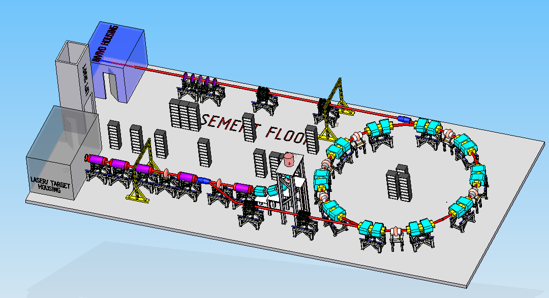
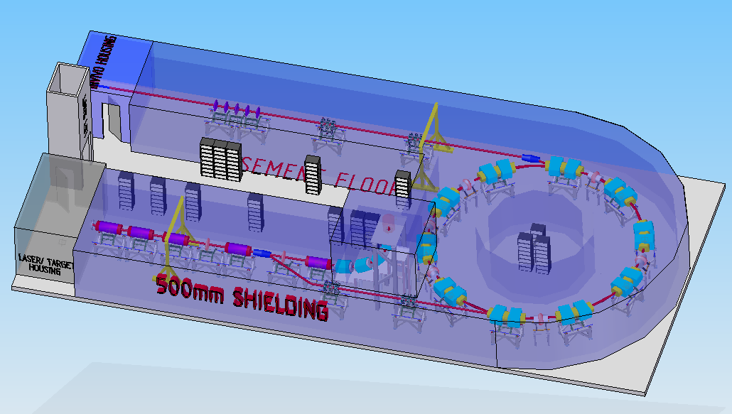
Status
Layout “v0” created using original estimates of machine configuration
Single laser room
In-vitro station above
In-vivo station on same floor
500 mm shielding placeholder
30 m x 14 m overall size

Slide 4
Work to complete for 31 Jan 2020
Facility layout with updates
Laser
Two laser rooms (source & target)
Beam Transport
Updated FFA layout w/ injection/extraction
Abort lines at 15 MeV and 127 MeV
Location of rebunching cavities and collimators
Power supplies for magnets
Power supplies/klystrons for RF cavities
Possible alternate layouts for solenoids?

Slide 5
Work to complete for 31 Jan 2020
Facility layout with updates
End Station
Insert first draft of in vitro end station
Potential second in vitro end station
Radiation Shielding
Updated shielding requirements throughout
Infrastructure
Space as required for vacuum, plant, air conditioning
Access for delivering equipment into and out of area

Slide 6
Work to complete for 28 Feb 2020
Write-up for Infrastructure and Integration
Discussion of power supply requirements
Discussion of wall plug requirements (substations, 3-phase, etc.)
Review of options for cabling (cable runs, false floor, trenches, etc.)
Discussion of controls, monitoring and instrumentation
Initial definition of requirements
Comparison to system in FETS (Front End Test Stand) at STFC

Slide 7
Work to complete for 28 Feb 2020
Write-up for Safety
Overview of STFC accelerator and laser safety codes to be used as reference (work with ISIS and CLF, respectively)
Demonstration of Risk Assessment methodology using the obvious risks for the laser and accelerator
Estimates of accelerator radiation based off of prior experience
Discussion of expected implementation of Construction Design Management (CDM) requirements

Slide 8
Thoughts on R&D Plan
No issues

Slide 9
Costing Plan
Combination of
Educated guess
Comparative (various STFC accelerator projects)
Parametric (£/m)
Quoted price estimates (lasers, end station equipment, etc.)
Concept stage budget estimates are typically +80%/-50%
Likely to focus on construction costs only, not operating costs

Slide 10
Thank you

