Slide 1
Welcome and introduction

Slide 2
Welcome!

Slide 3
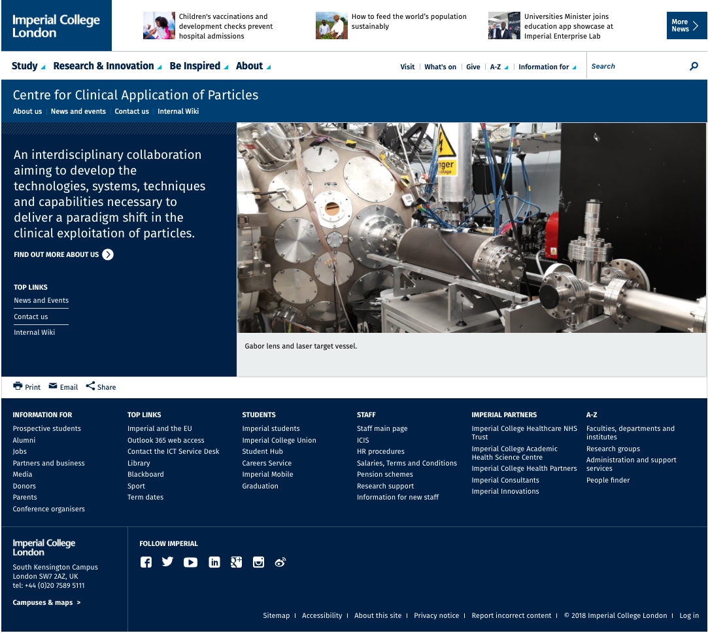
The Centre
Main page!
News, events …
… & …
.. wiki
https://www.imperial.ac.uk/clinical-application-of-particles/

Slide 4
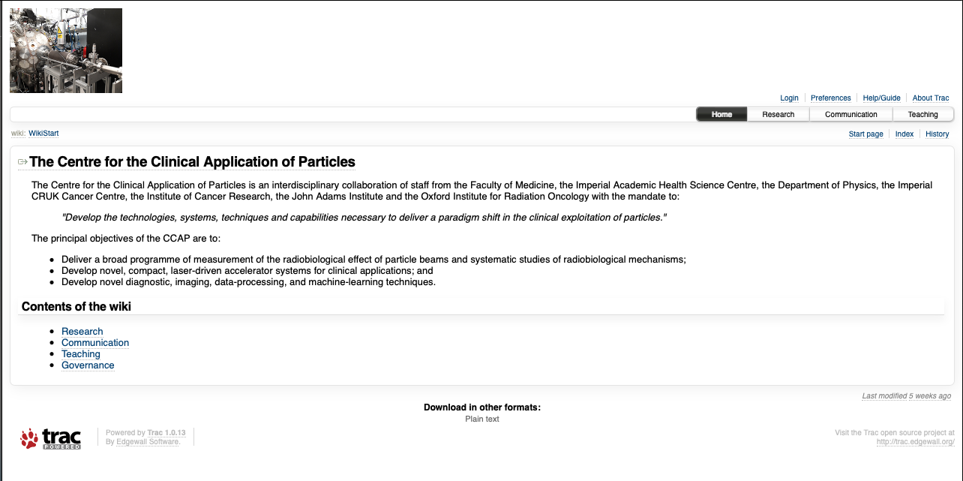
The Centre
https://ccap.hep.ph.ic.ac.uk/trac
as

Slide 5
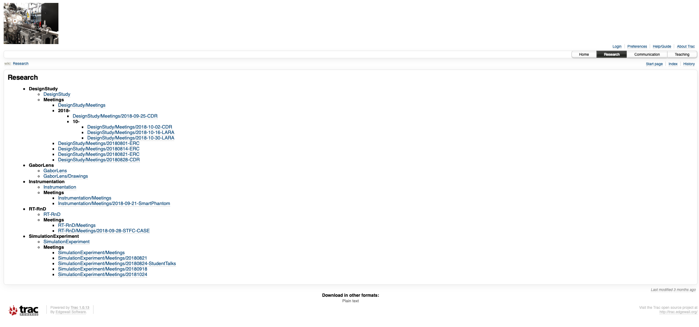
Research

Slide 6
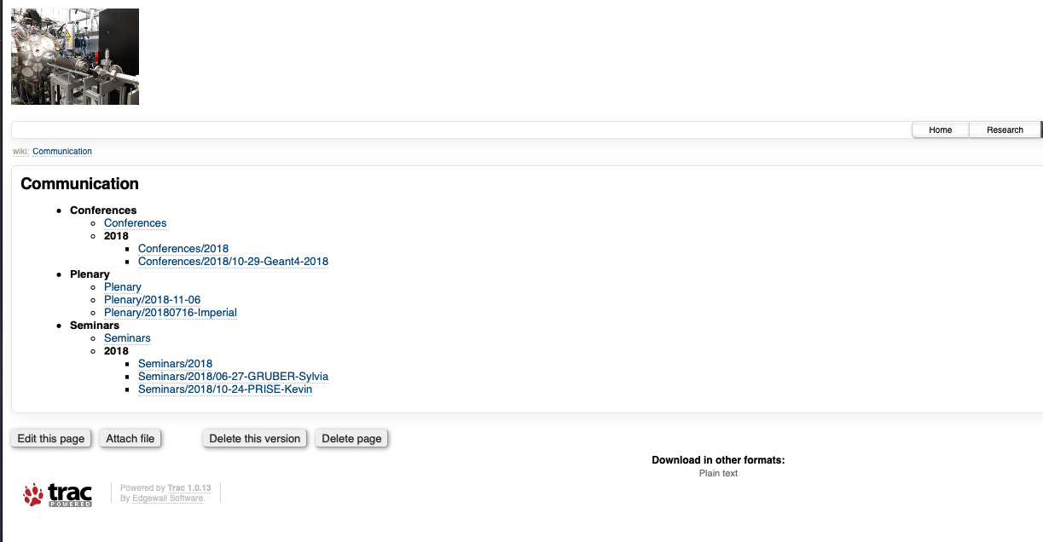
Seminars

Slide 7
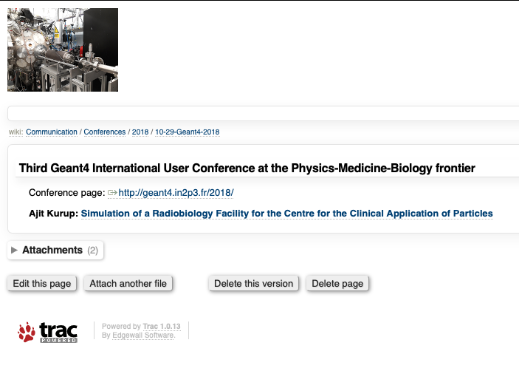
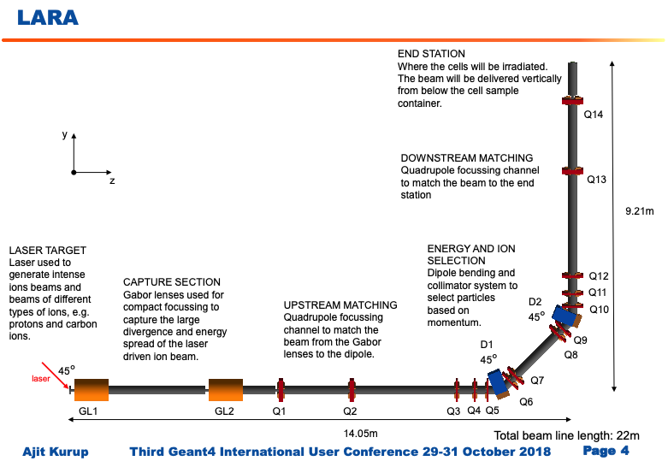
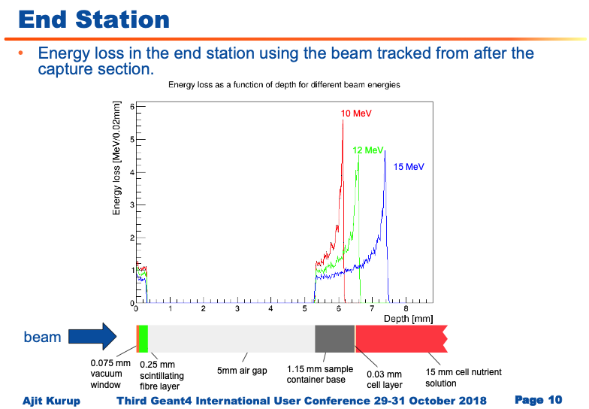
Conference presentations

Slide 8
This meeting
Welcome and introduction

Slide 9
