Slide 1

Simulating the nuSTORM Transfer Line with nuSIM
Marvin Pfaff

Slide 2
Motivation
To understand the time structure and beam characteristics at the proposed nuSTORM detector, it is important to properly propagate the beam structure from the SPS on target through the whole nuSTORM set-up
A simulation framework, that is simplified through effective parametrizations, has been developed to allow first event rate studies while detailed beam simulations with design of beam optics are caried out
A multi-stage/interface approach allows the inclusion of more detailed simulation data as these get available
The nuSIM transfer line class contains a first simple propagation of beam characteristics from target to injection
For this, the following steps were taken:
Pion distributions @ target generated
Momentum distribution
Transverse phase space distributions
Time distribution
Pion decay taken into account
Pions propagated to entrance of production straight

Slide 3
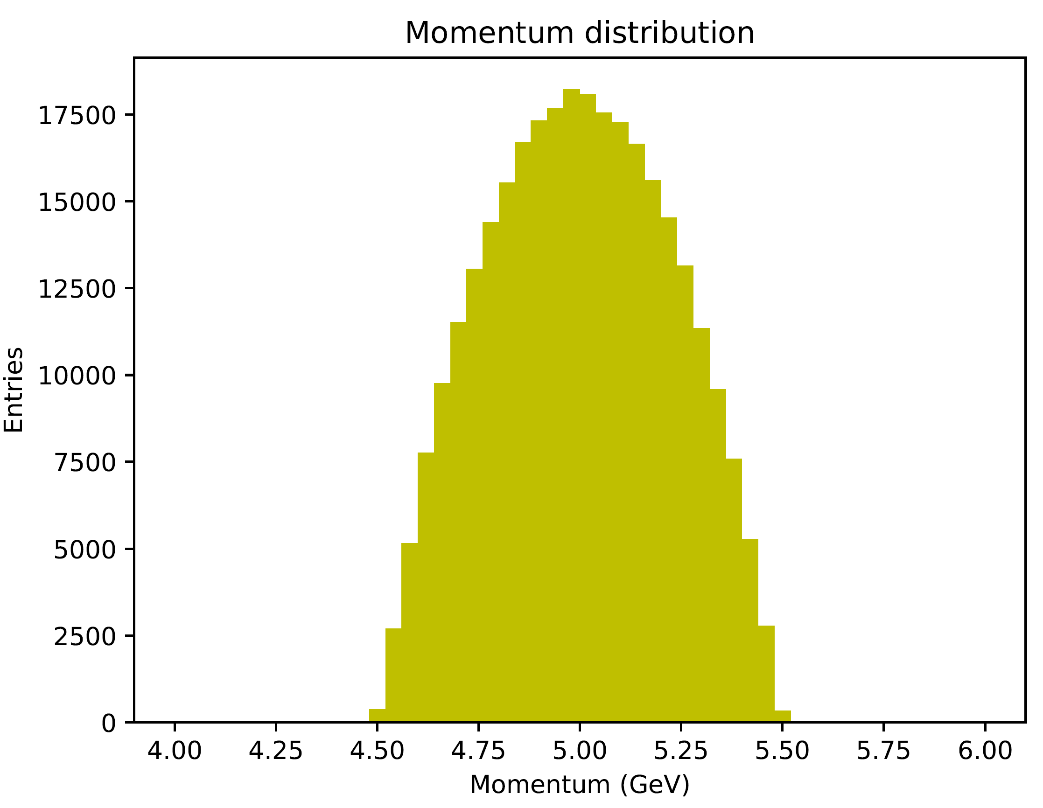
Momentum Distribution @ Target
Momentum distribution @ target (s = -50.0 m):
Parabolic distribution
5 GeV central momentum
10% momentum spread

Slide 4
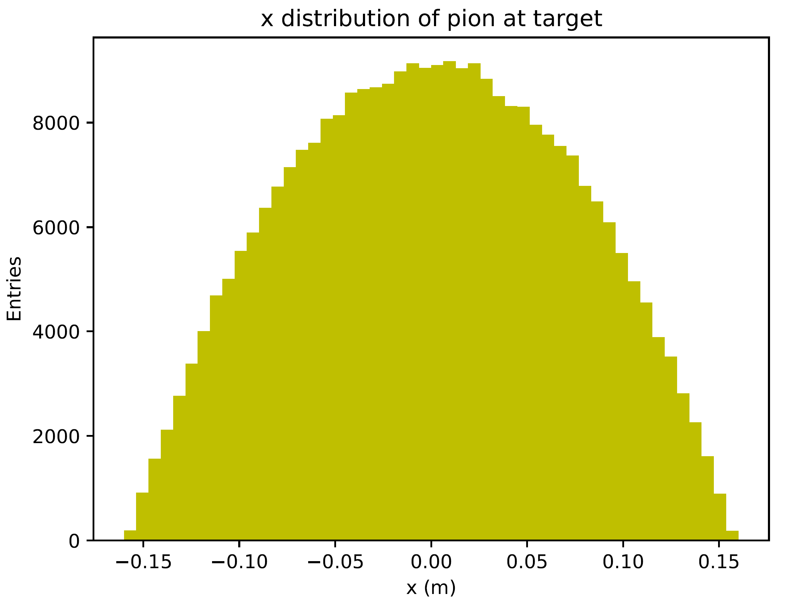
x Distribution @ Target
x distribution @ target (s = -50.0 m):
Parabolic distribution
Centered around 0 m
Transverse (2D) acceptance: 1 pi mm rad
Transverse beta function: 25,000 mm

Slide 5
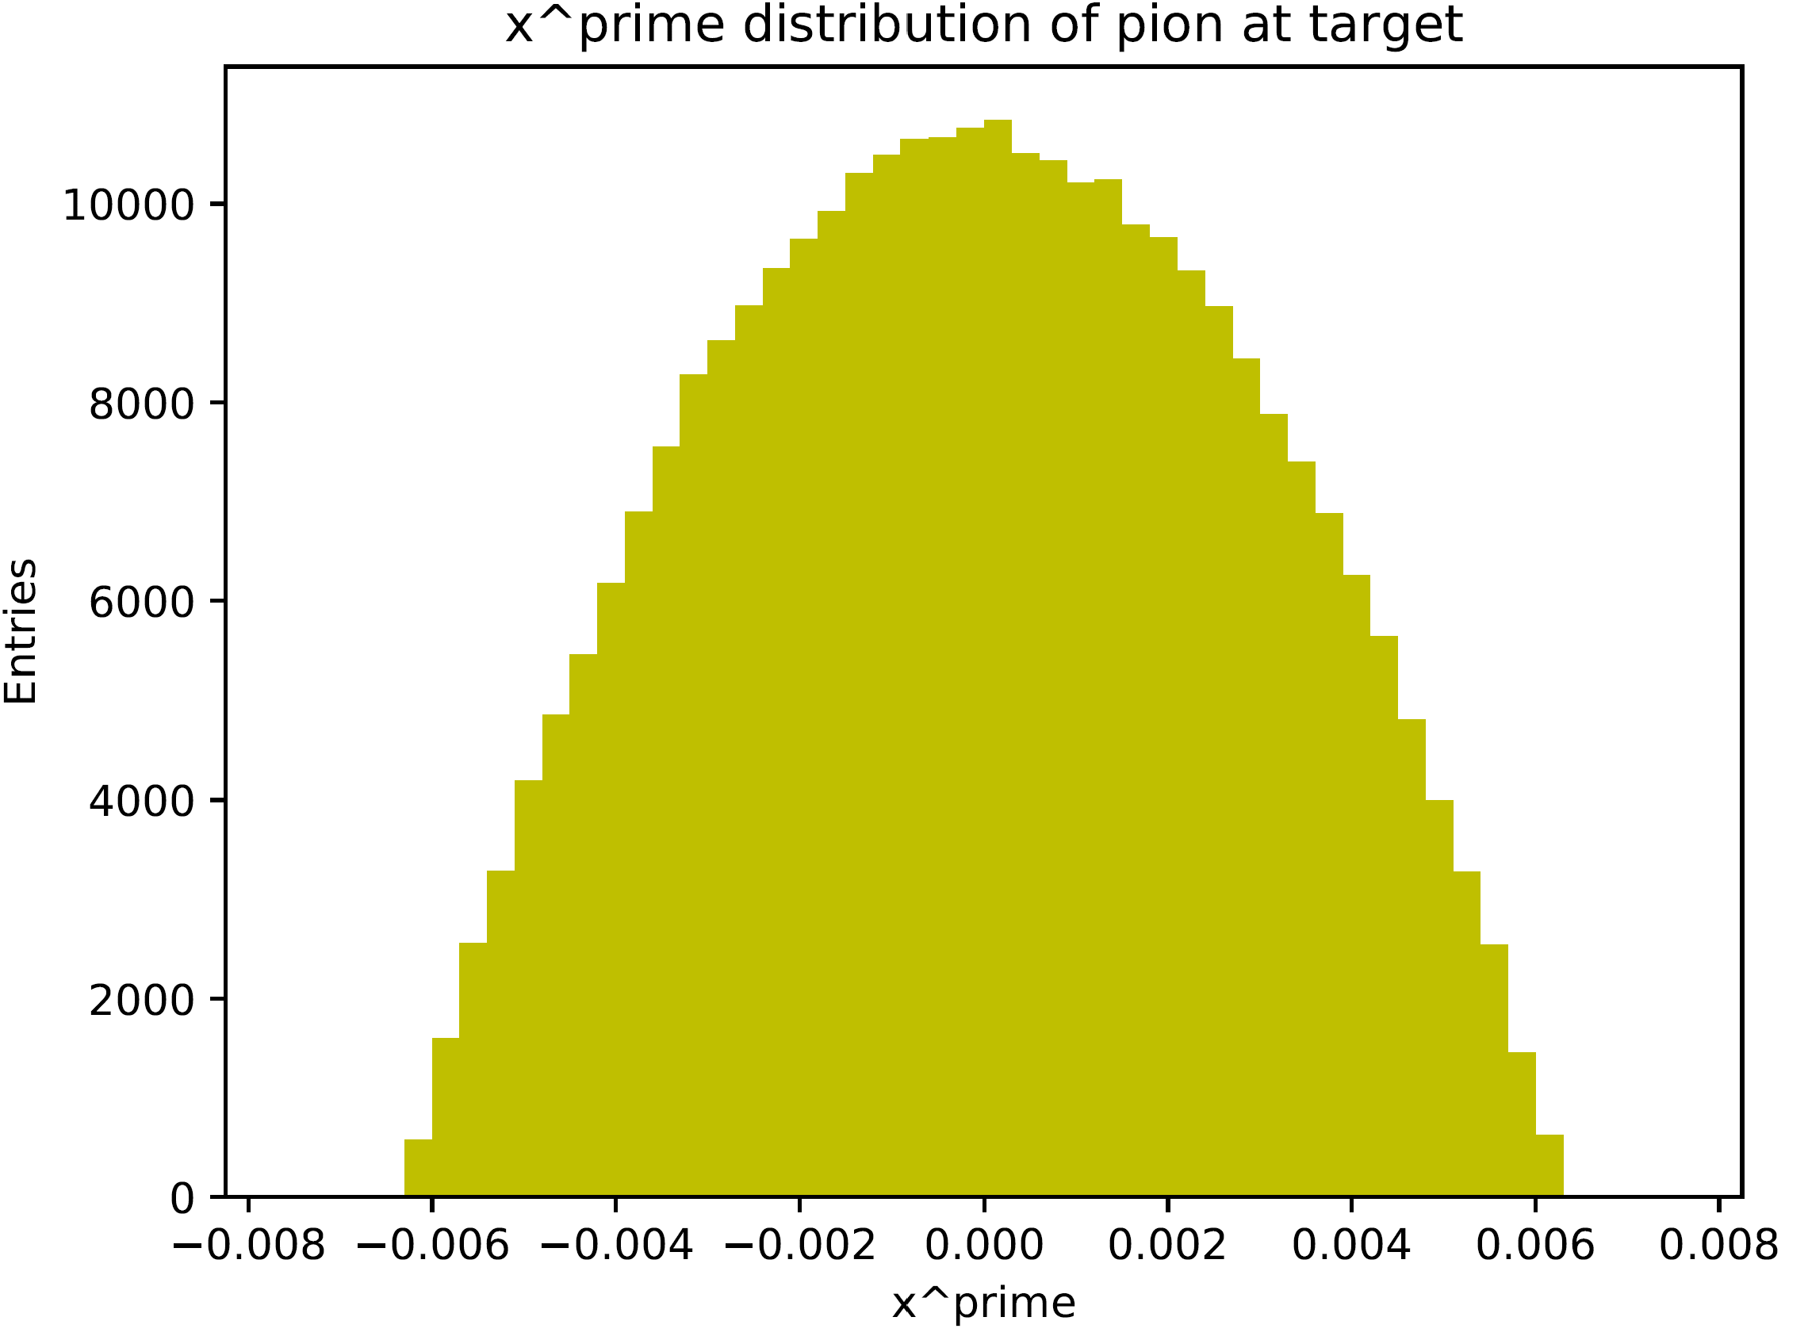
x‘ Distribution @ Target
x‘ distribution @ target (s = -50.0 m):
Parabolic distribution
Centered around 0 m
Transverse (2D) acceptance: 1 pi mm rad
Transverse beta function: 25,000 mm

Slide 6
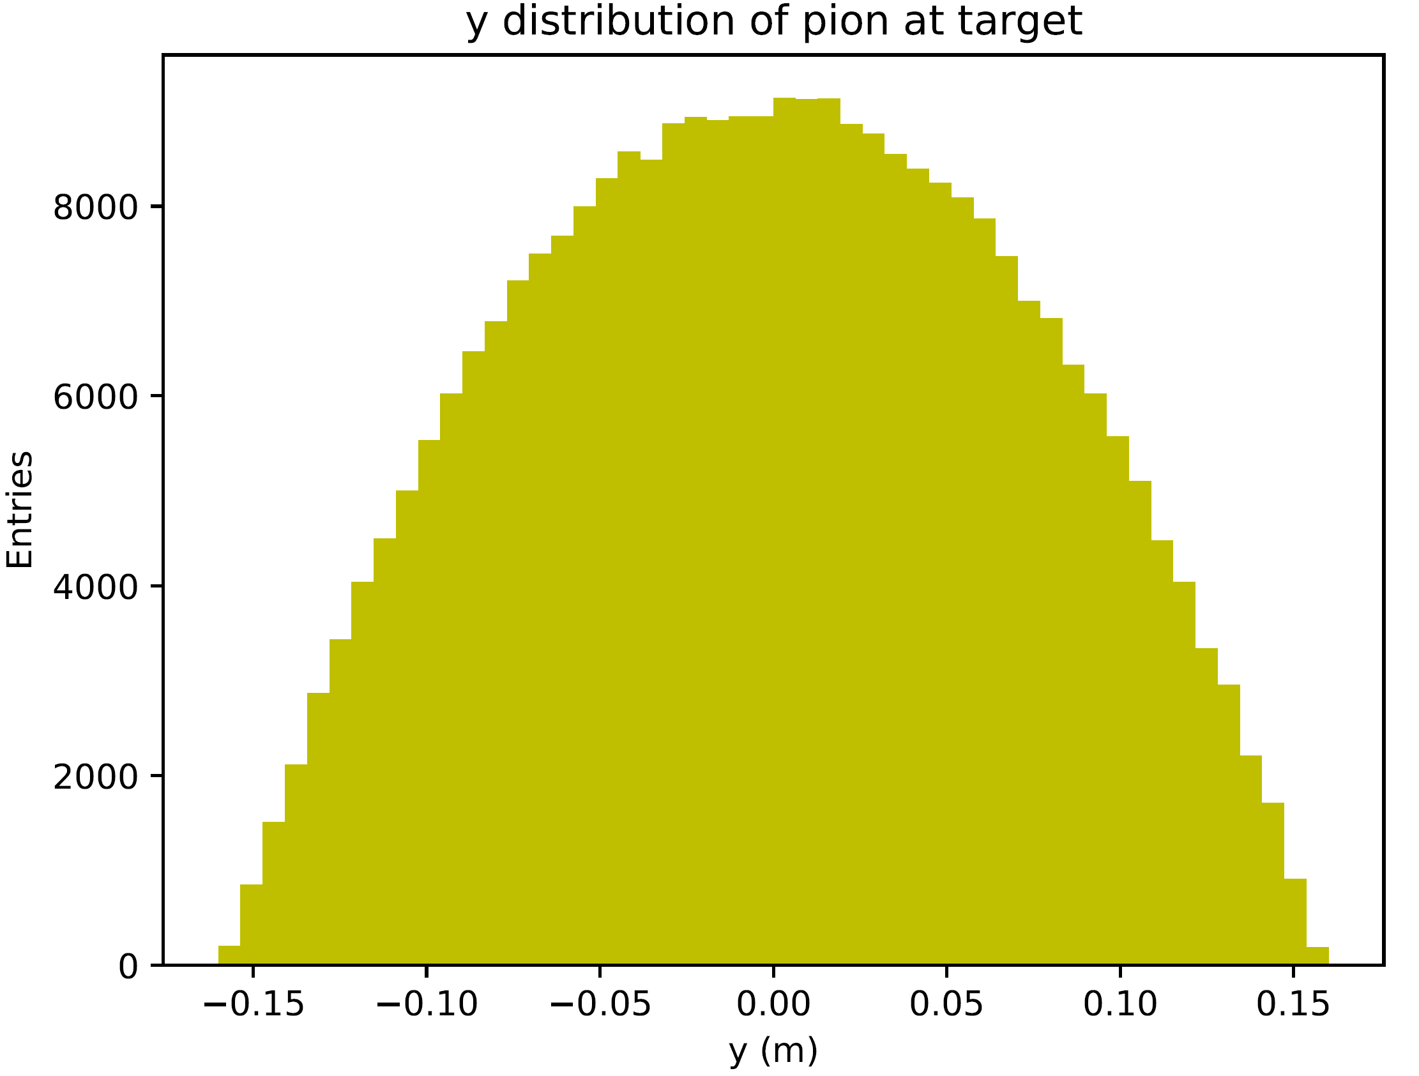

y & y‘ Distributions @ Target

Slide 7
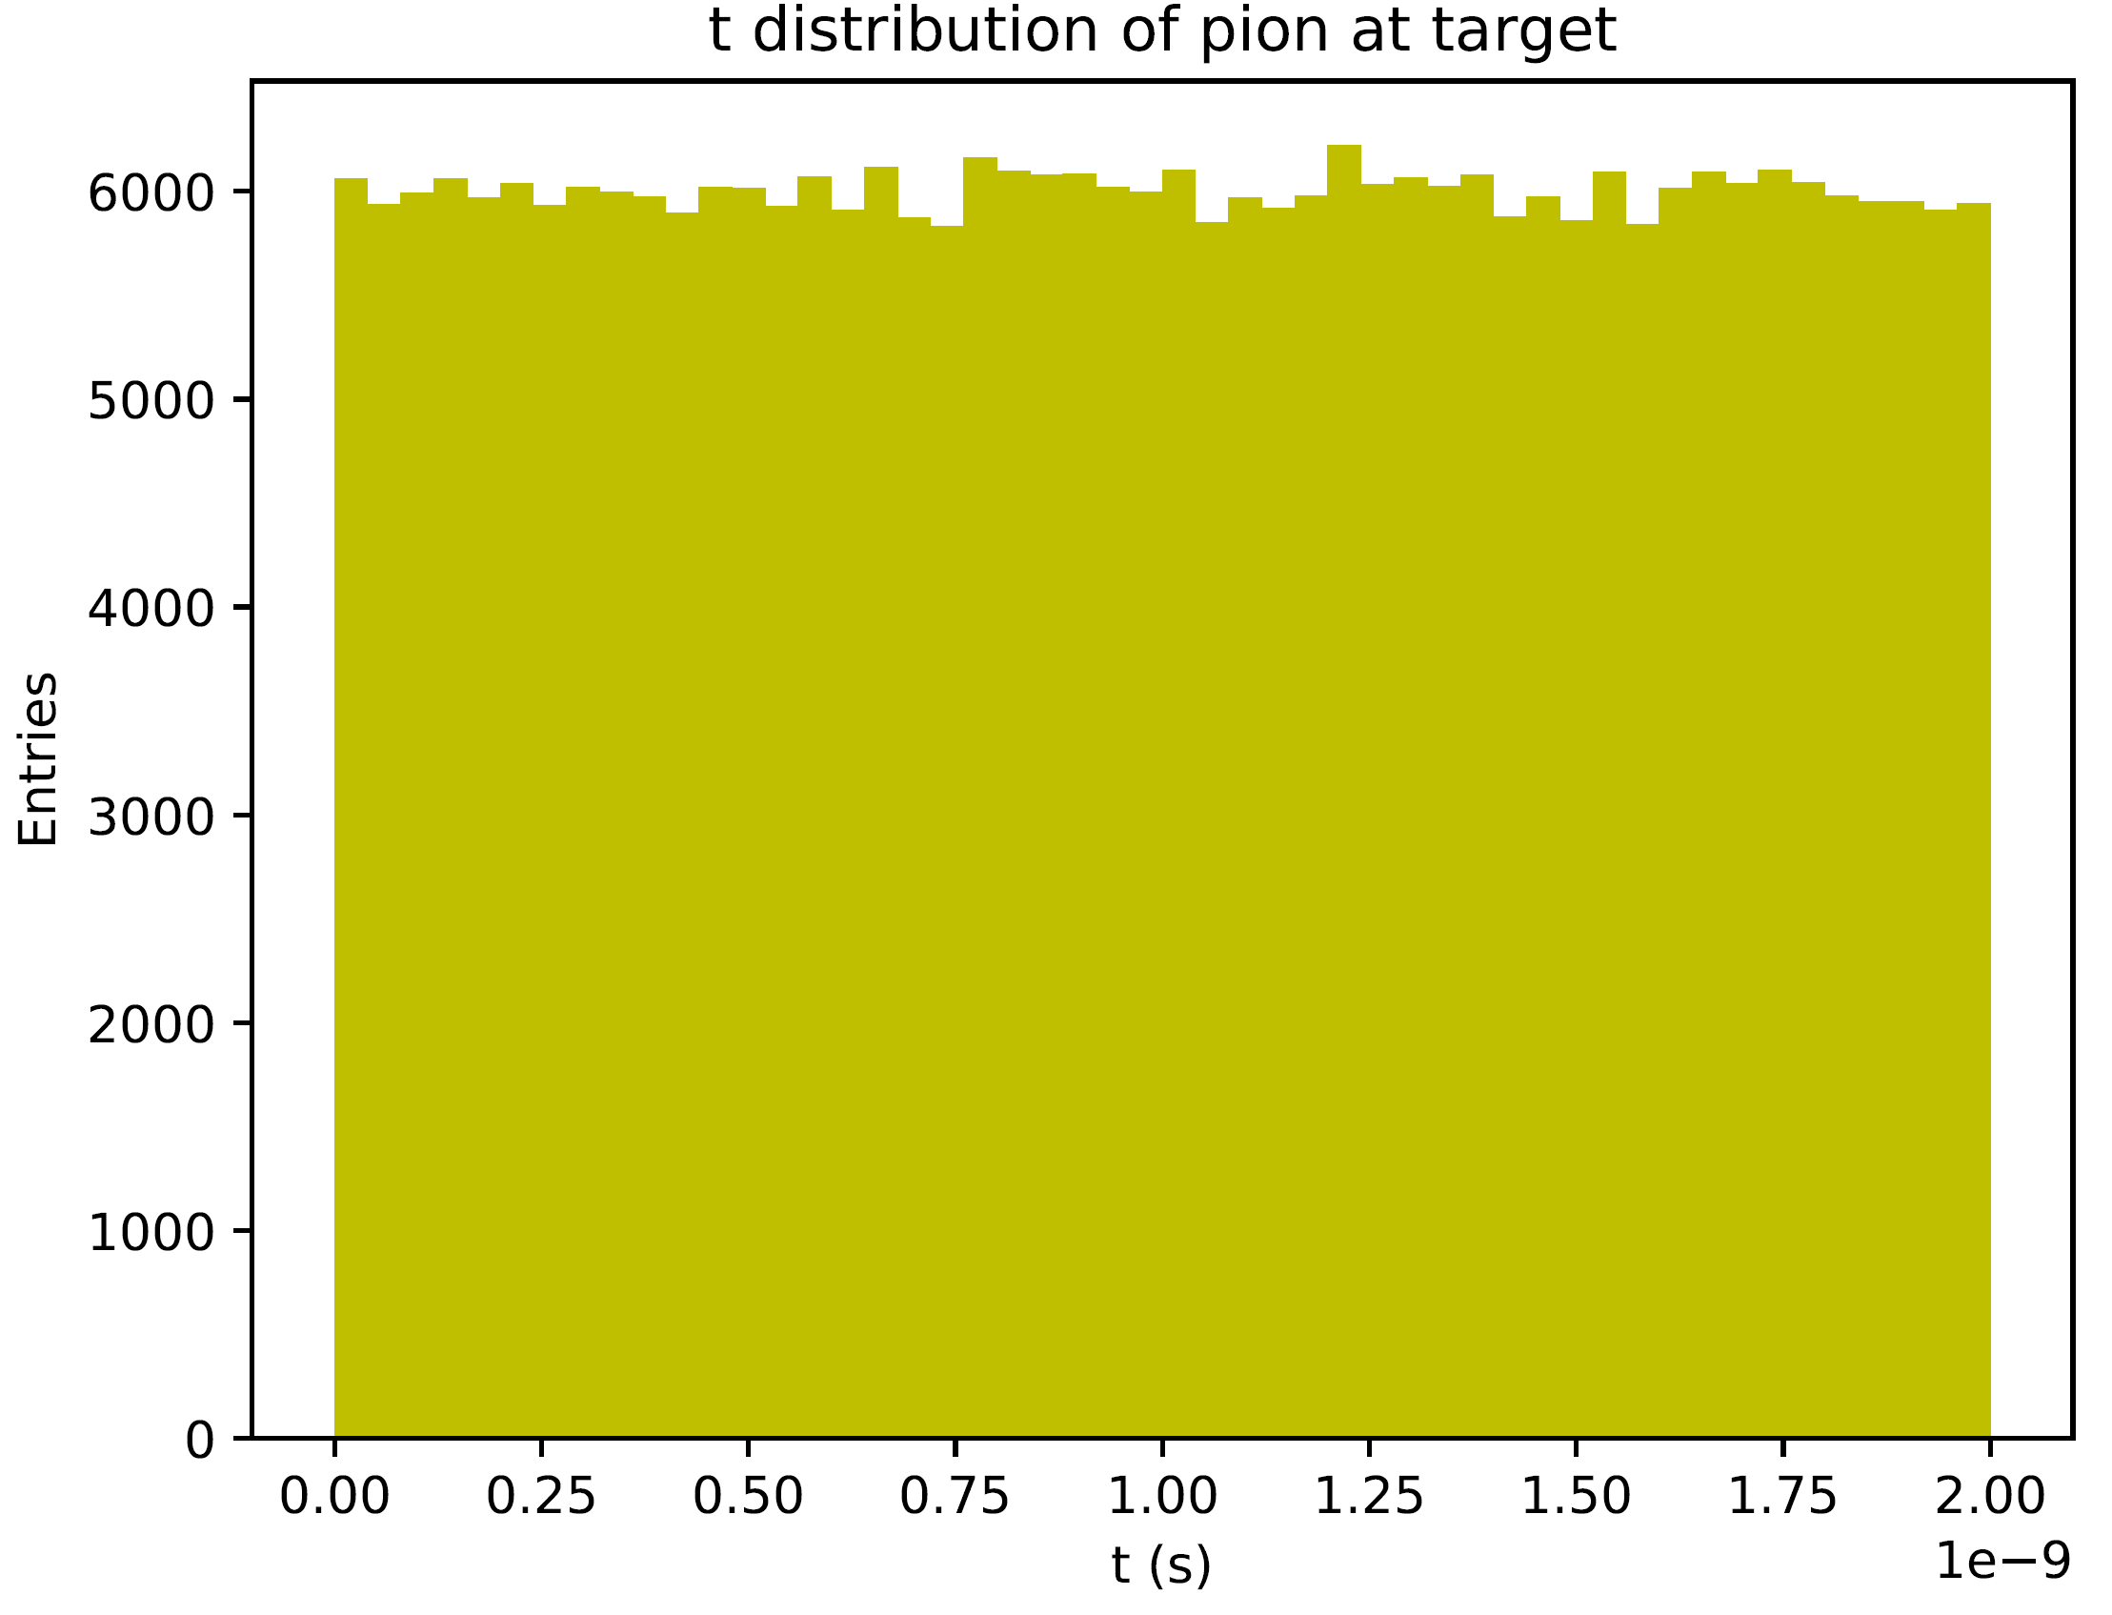
Time Distribution @ Target
Time distribution @ target (s = -50.0 m):
Uniform distribution
2 ns bunch length

Slide 8
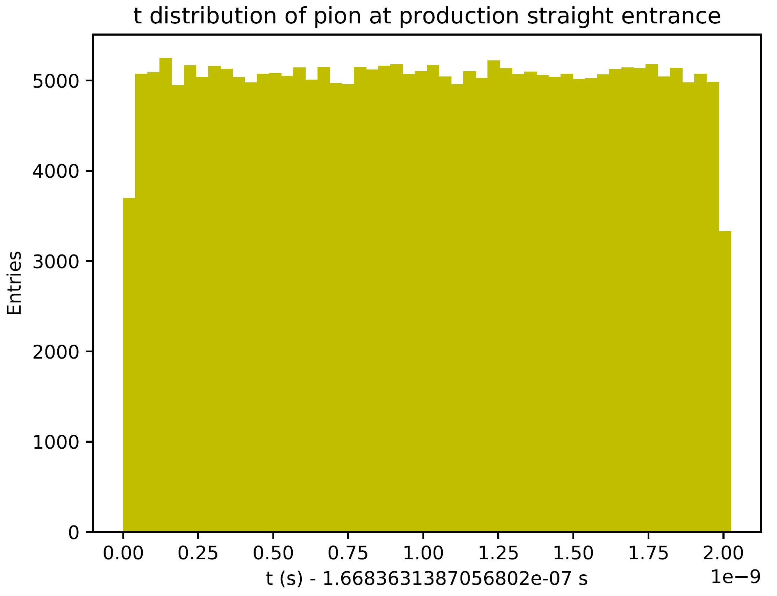
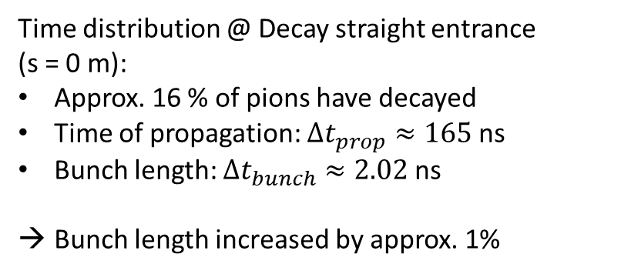
Time Distribution @ Decay Straight Entrance
Time distribution @ Decay straight entrance (s = 0 m):
Approx. 16 % of pions have decayed
Time of propagation: $∆t_{prop}≈165$ns
Bunch length: $∆t_{bunch}≈2.02$ns
Bunch length increased by approx. 1%

Slide 9
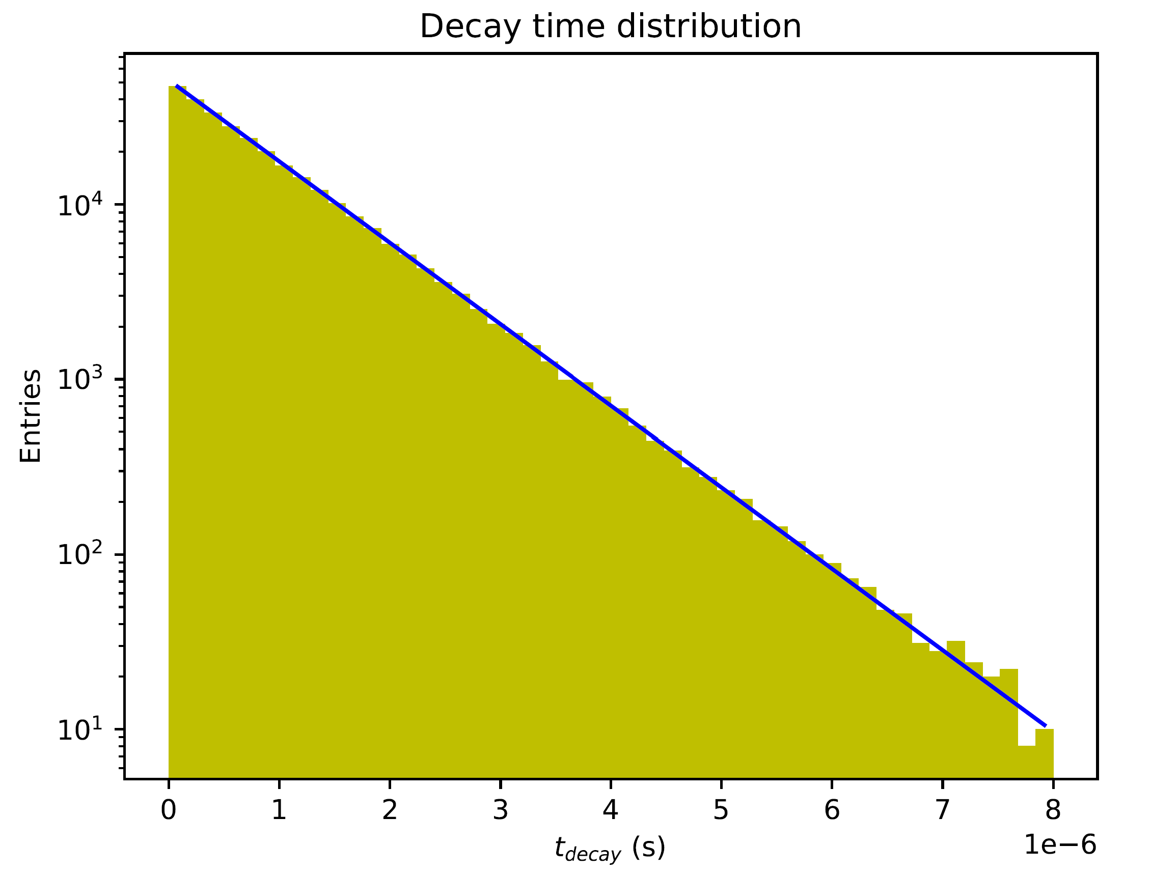
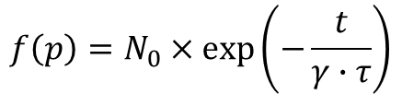
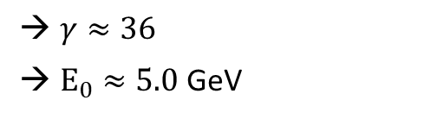
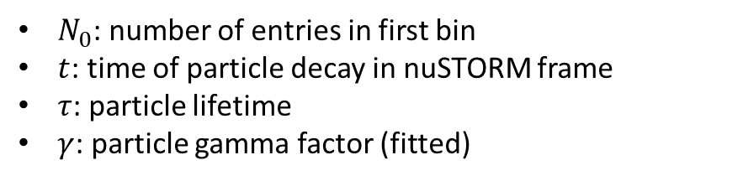
Pion Decay – Decay Times
PDF:
$$f\left(p\right)=N_{0}×\exp\left(−\frac{t}{γ∙τ}\right)$$
$N_{0}$: number of entries in first bin
$t$: time of particle decay in nuSTORM frame
$τ$: particle lifetime
$γ$: particle gamma factor (fitted)
$γ≈36$
$E_{0}≈5.0$ GeV

Slide 10
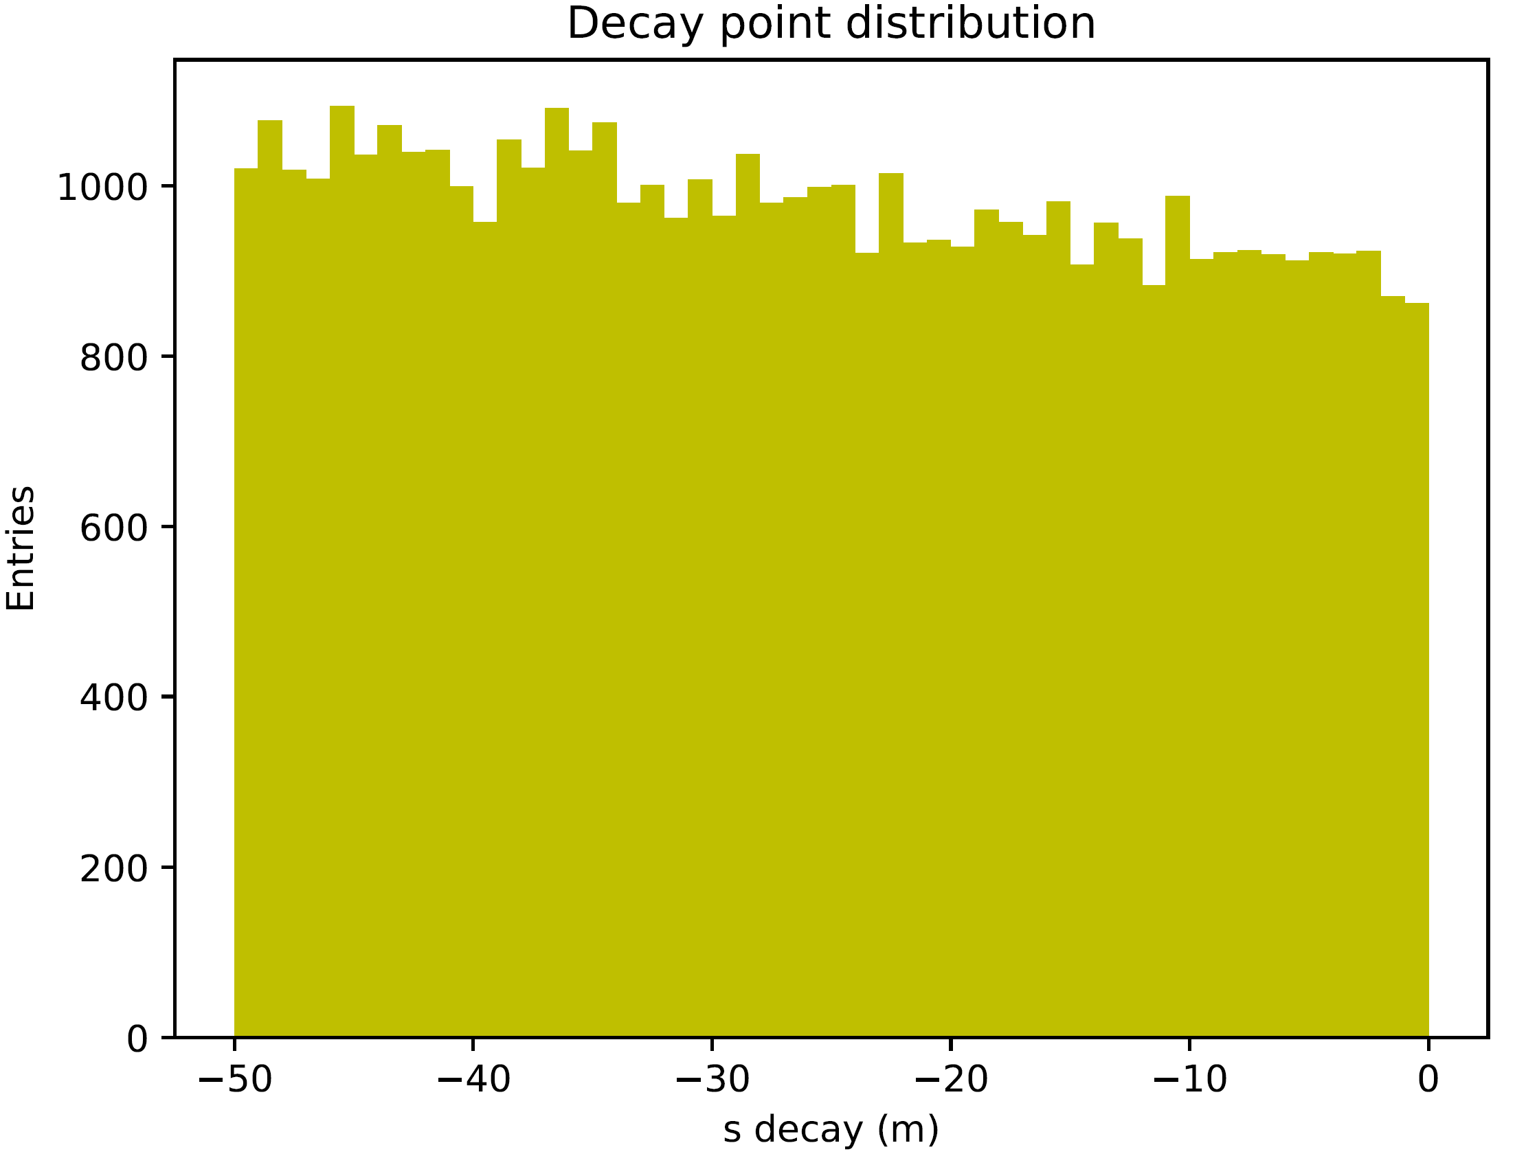

Pion Decay – Decay Point
Spatial distribution of pion decays in transfer line:
$$s_{i}=z_{i}=v_{i}⋅t_{dec,i}$$

Slide 11
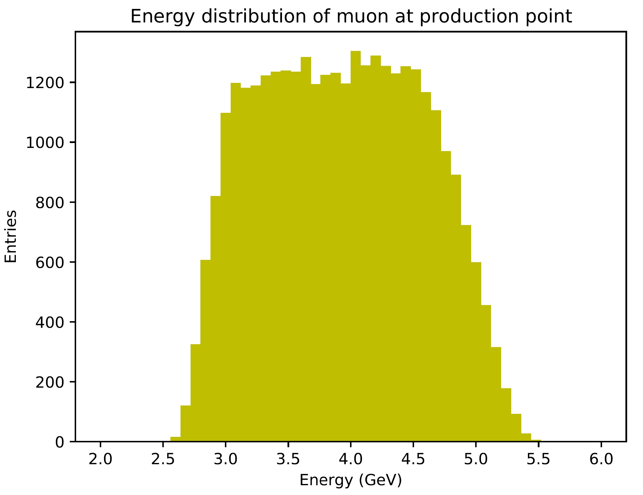
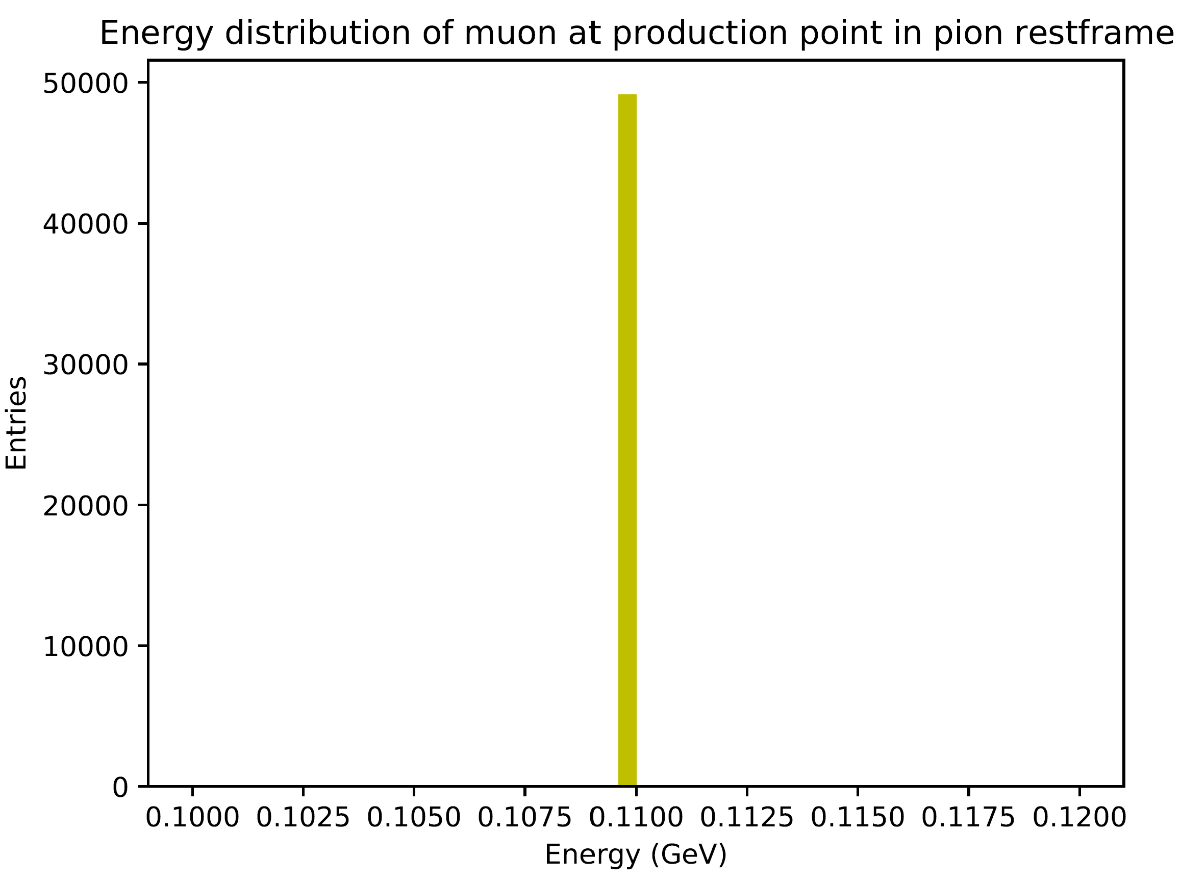
Pion Decay – Muon Energy
nuSTORM frame
pion rest frame

Slide 12
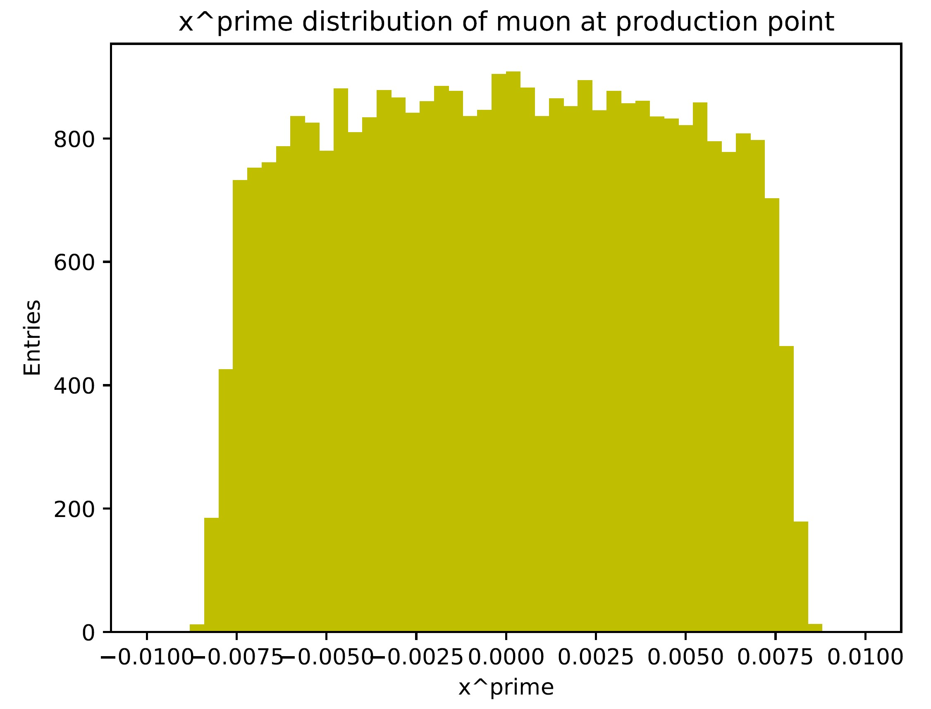
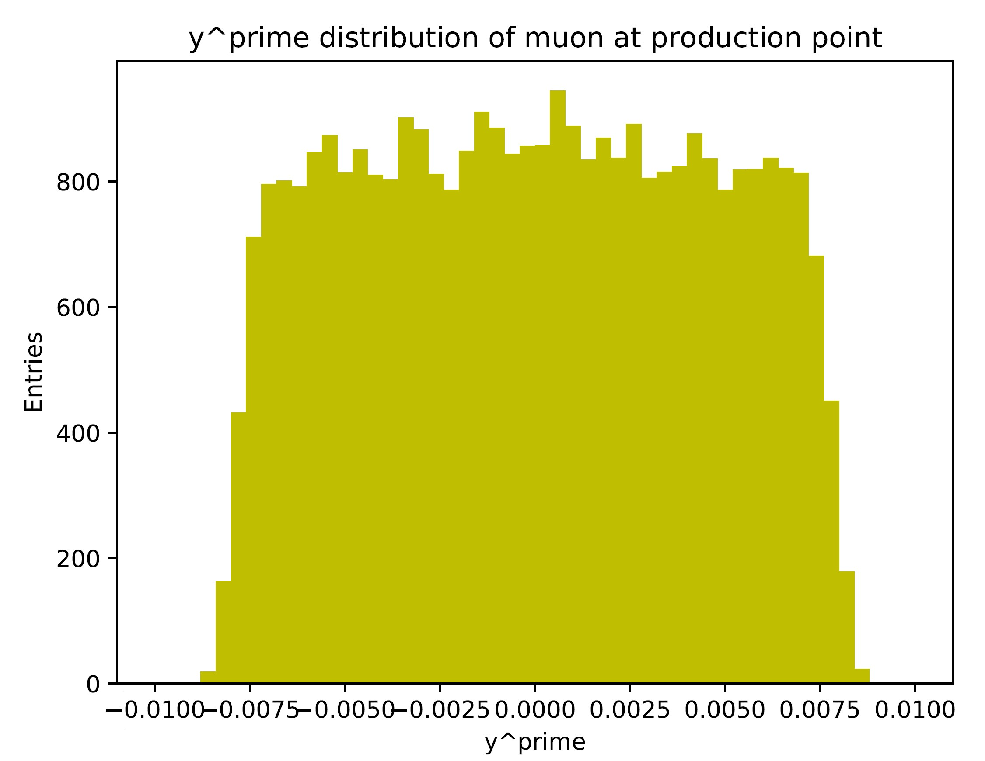
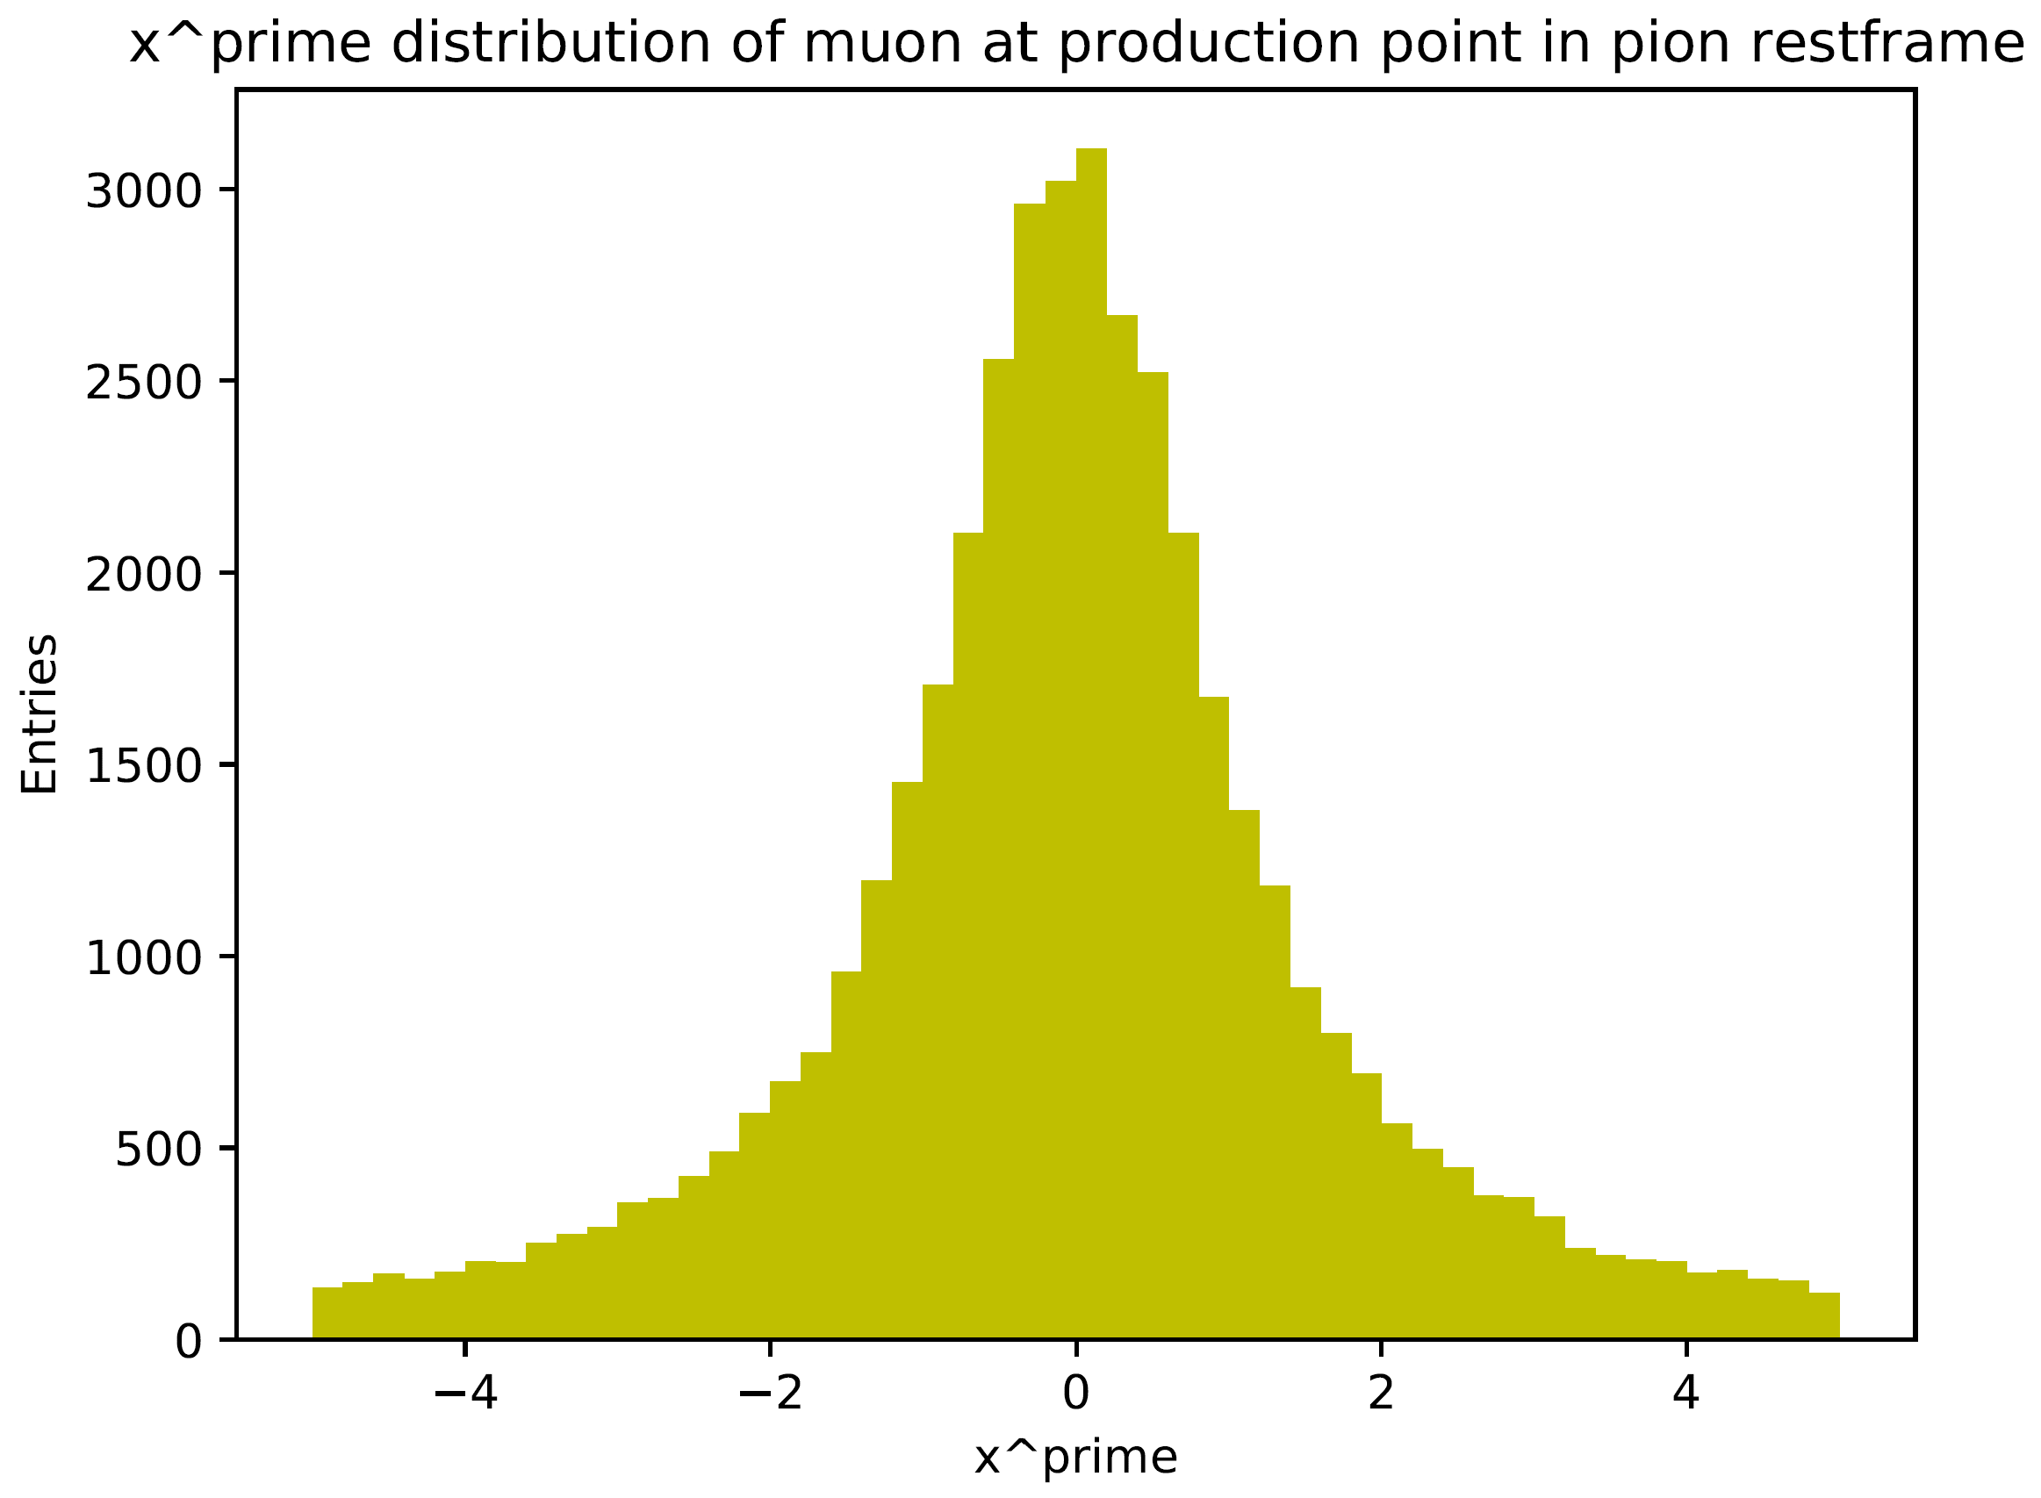

Pion Decay – Muon x‘ & y‘ Distributions
nuSTORM frame
pion rest frame

Slide 13
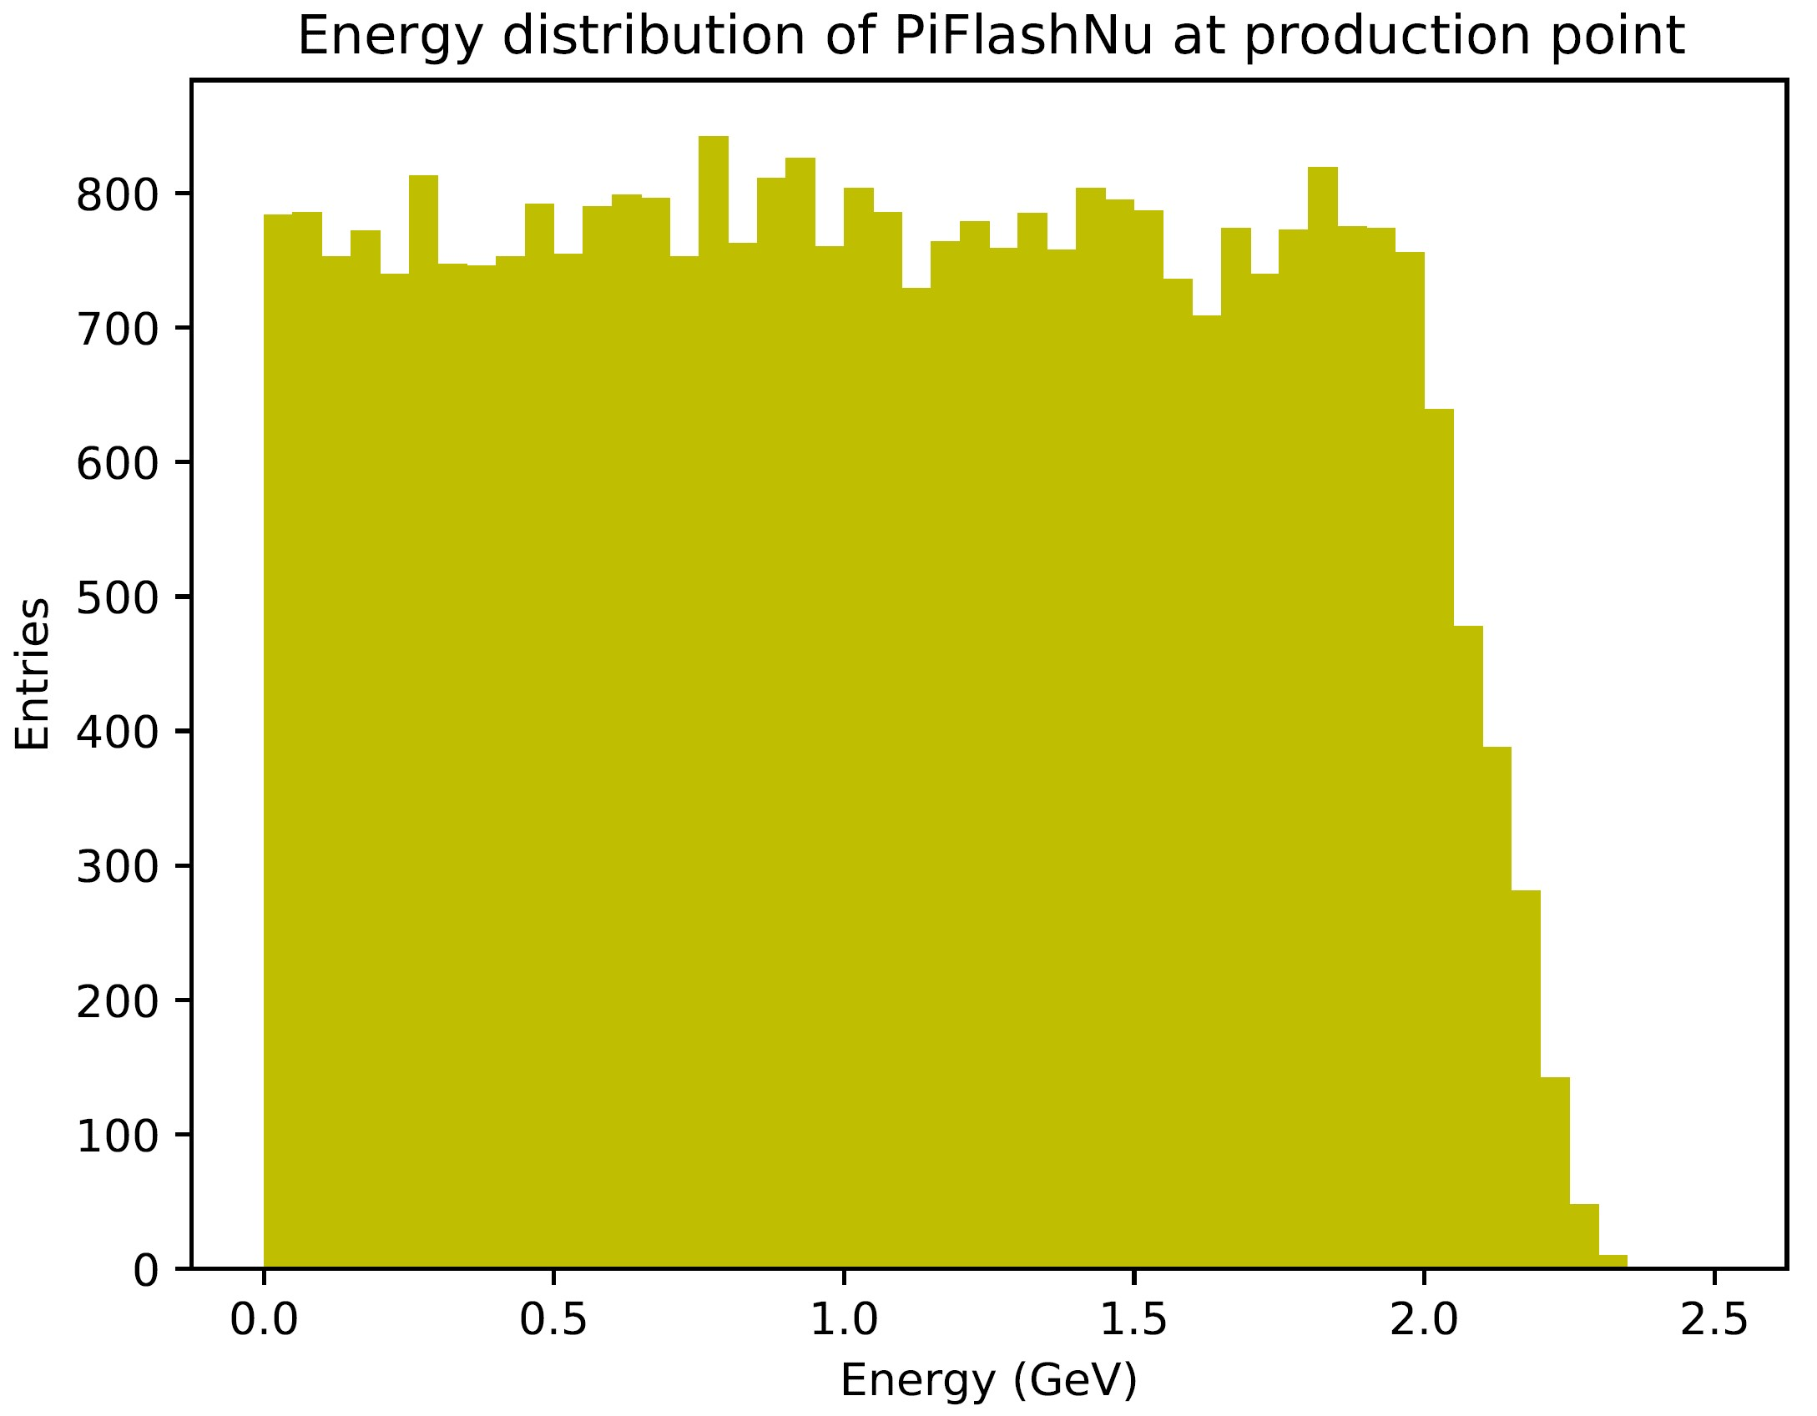
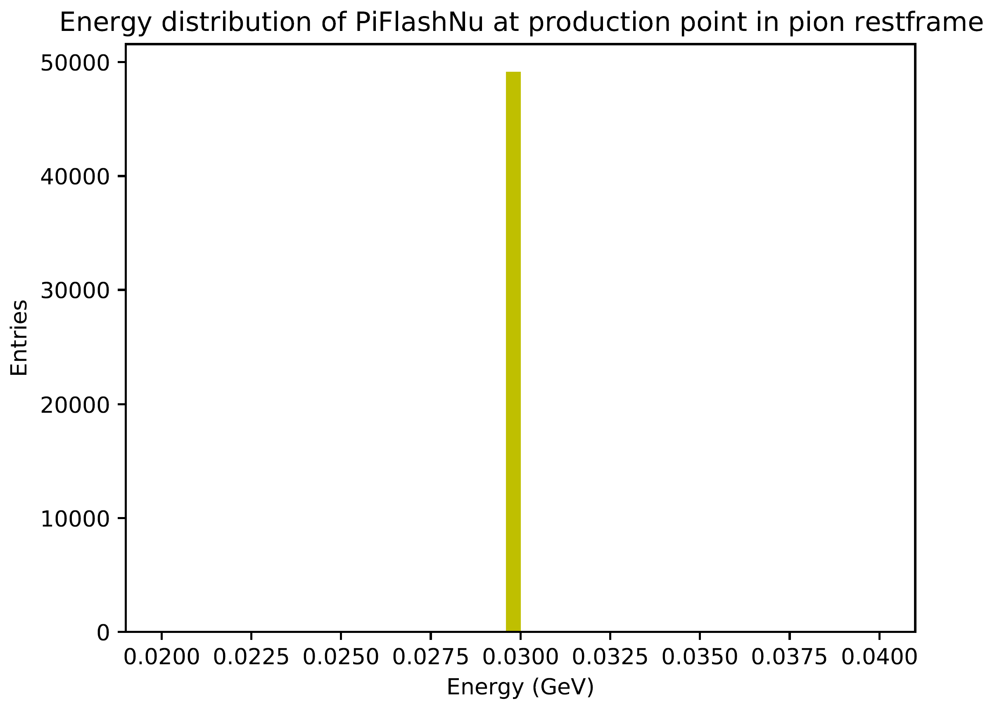
Pion Decay – Neutrino Energy
nuSTORM frame
pion rest frame

Slide 14
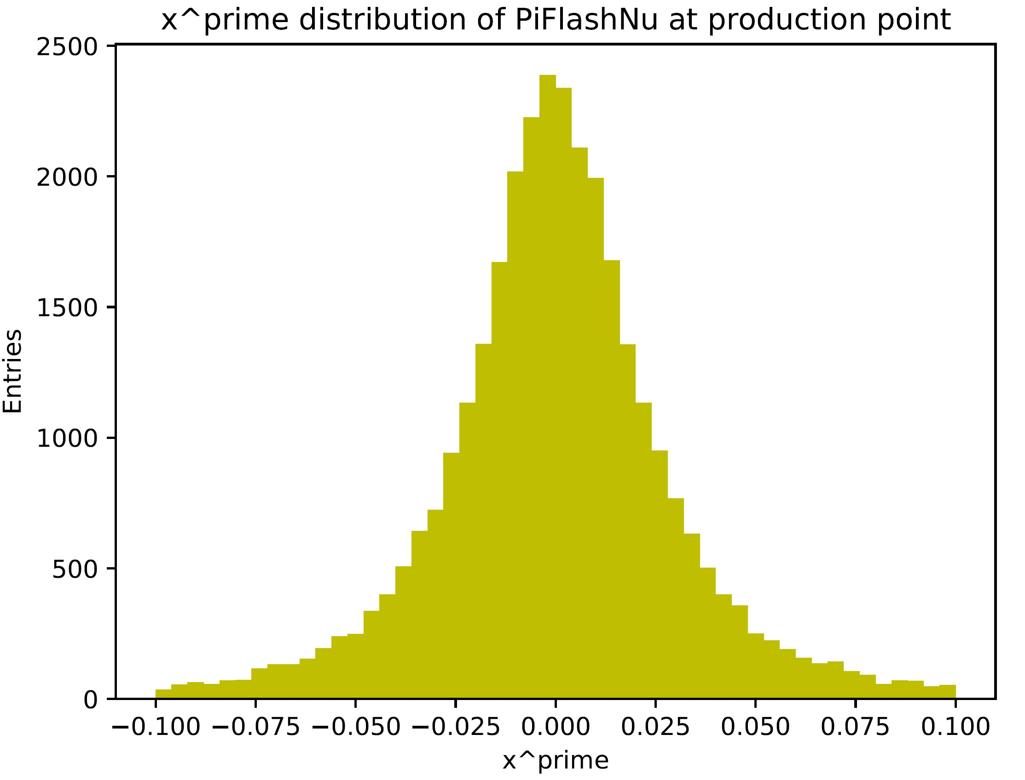
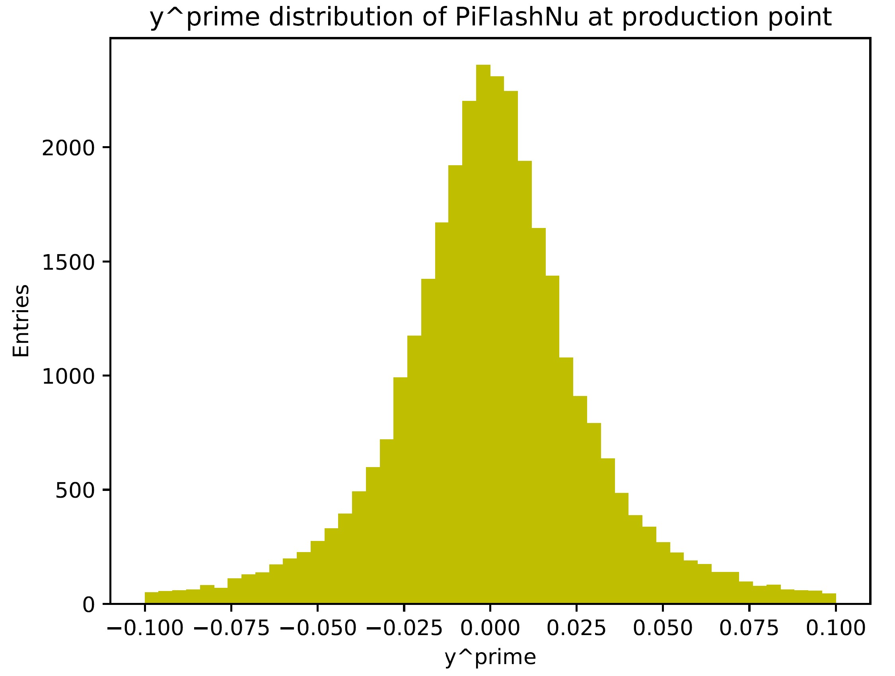
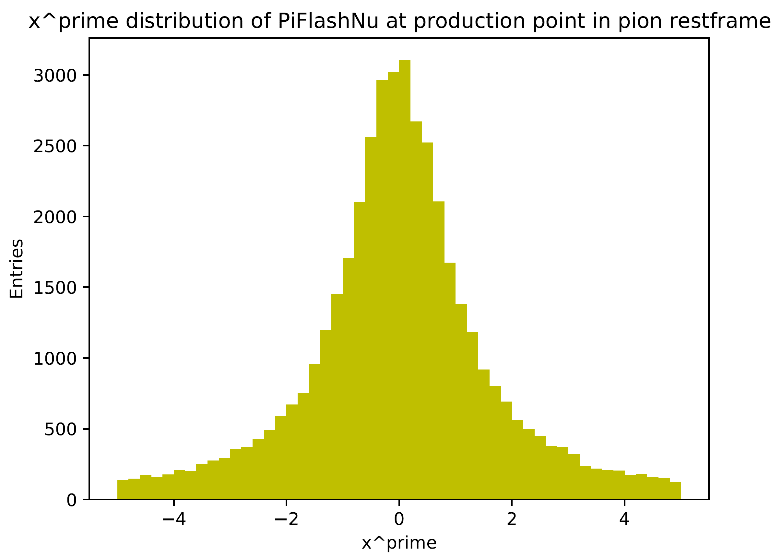
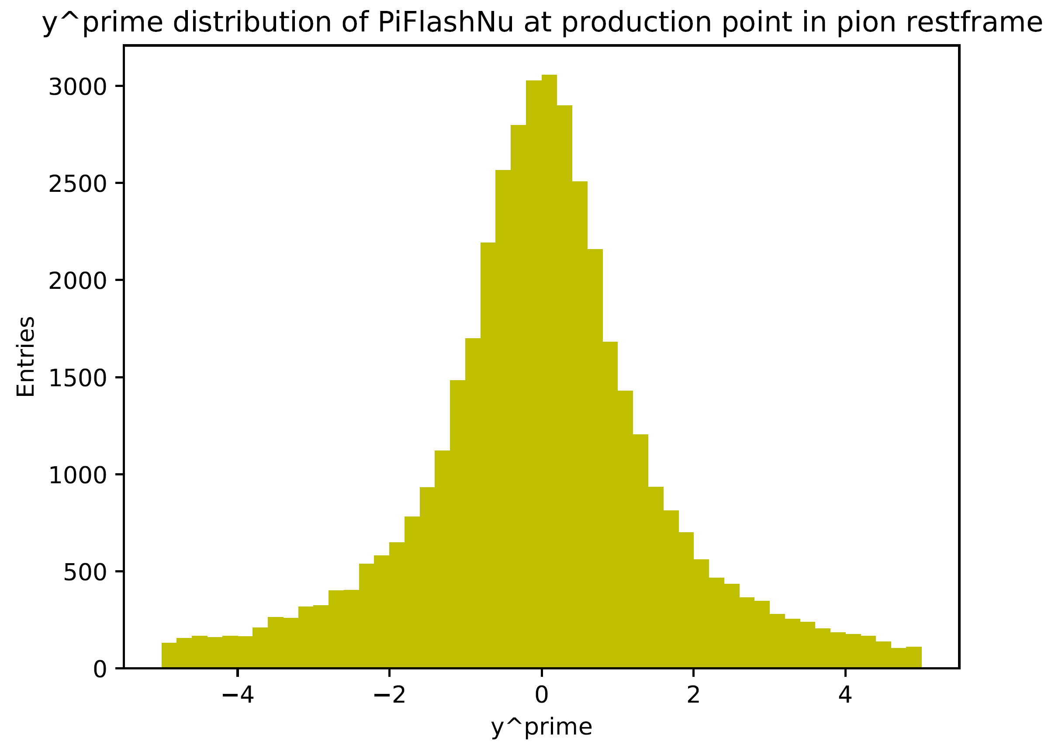
Pion Decay – Neutrino x‘ & y‘ Distributions
nuSTORM frame
pion rest frame

Slide 15
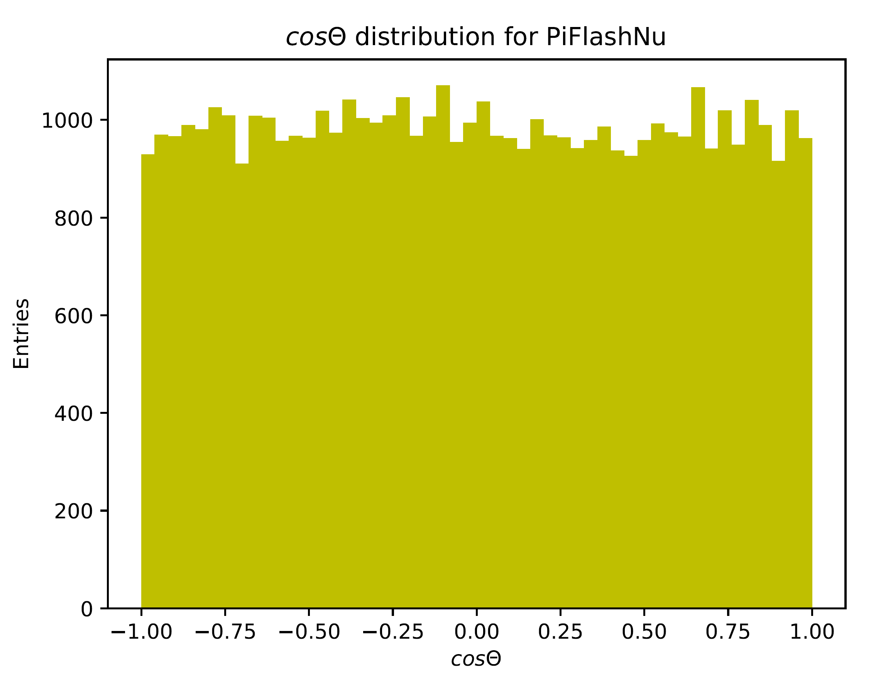
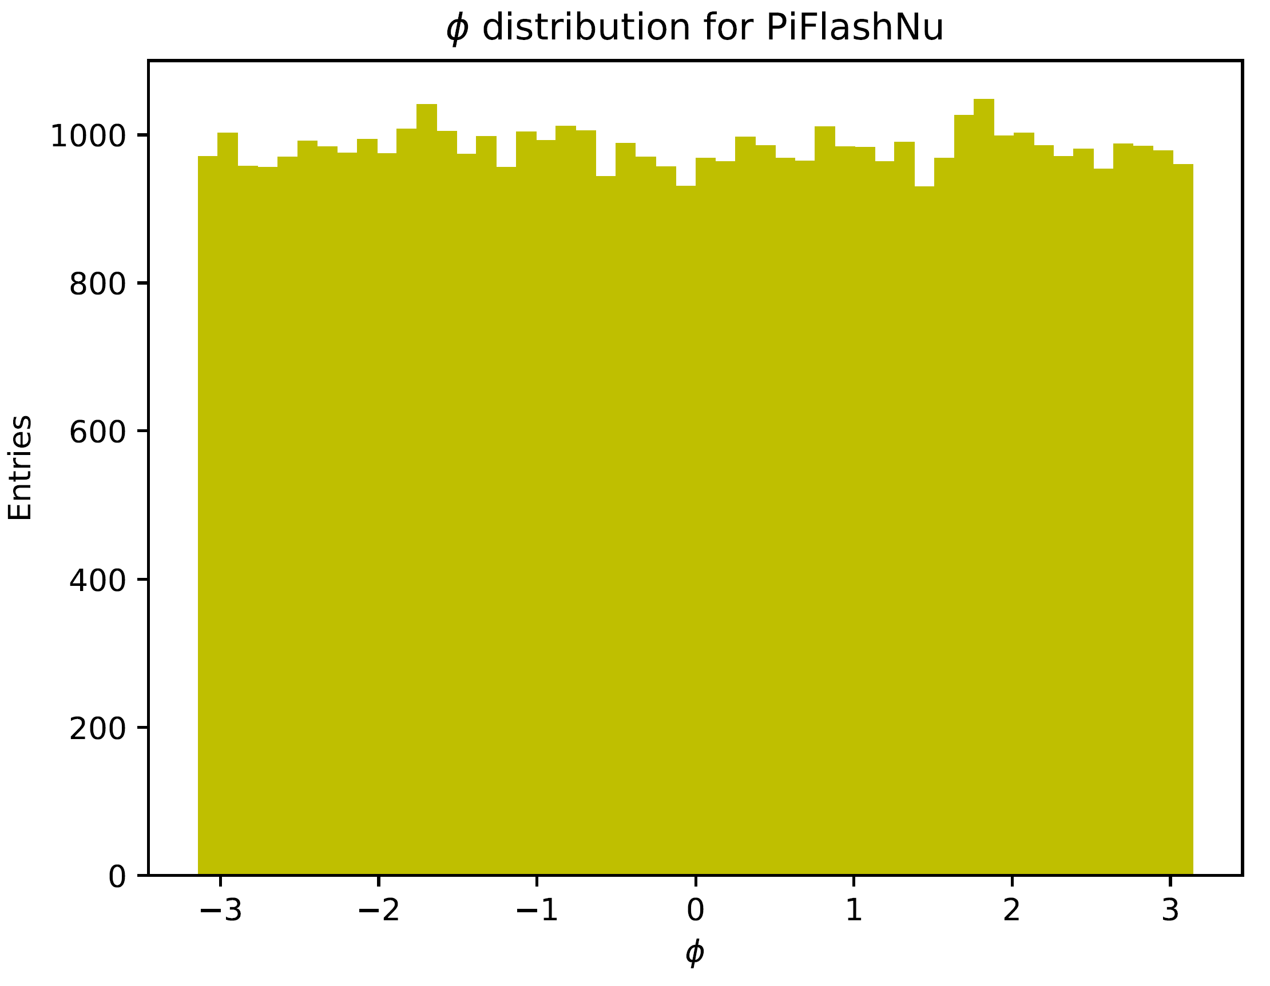
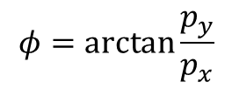
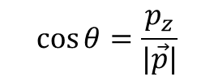
Pion Decay – Neutrino cosΘ & φ Distributions
$$\cos{θ}=\frac{p_{z}}{|\vec{p}|}$$
$$φ=\arctan{\frac{p_{y}}{p_{x}}}$$
→ Isotropic decay, as expected

Slide 16
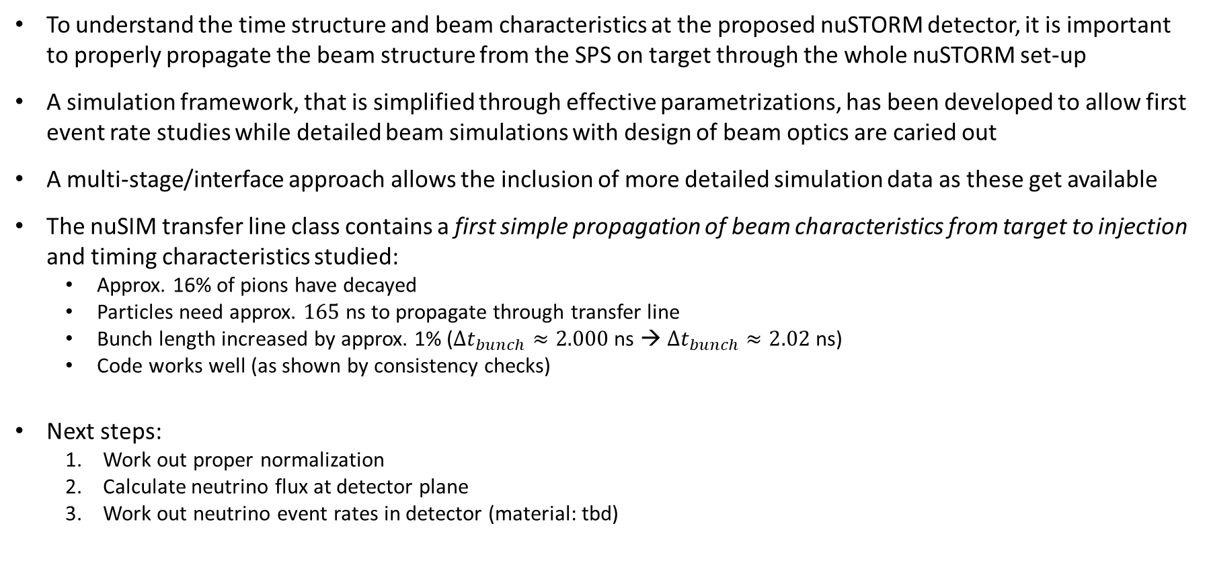
Summary & Outlook
To understand the time structure and beam characteristics at the proposed nuSTORM detector, it is important to properly propagate the beam structure from the SPS on target through the whole nuSTORM set-up
A simulation framework, that is simplified through effective parametrizations, has been developed to allow first event rate studies while detailed beam simulations with design of beam optics are caried out
A multi-stage/interface approach allows the inclusion of more detailed simulation data as these get available
The nuSIM transfer line class contains a first simple propagation of beam characteristics from target to injection and timing characteristics studied:
Approx. 16% of pions have decayed
Particles need approx. $165$ns to propagate through transfer line
Bunch length increased by approx. 1% ($∆t_{bunch}≈2.000$ns → $∆t_{bunch}≈2.02$ns)
Code works well (as shown by consistency checks)
Next steps:
Work out proper normalization
Calculate neutrino flux at detector plane
Work out neutrino event rates in detector (material: tbd)

