Slide 1
a transformational approach to precision, personalised particle-beam therapy

Slide 2
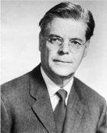
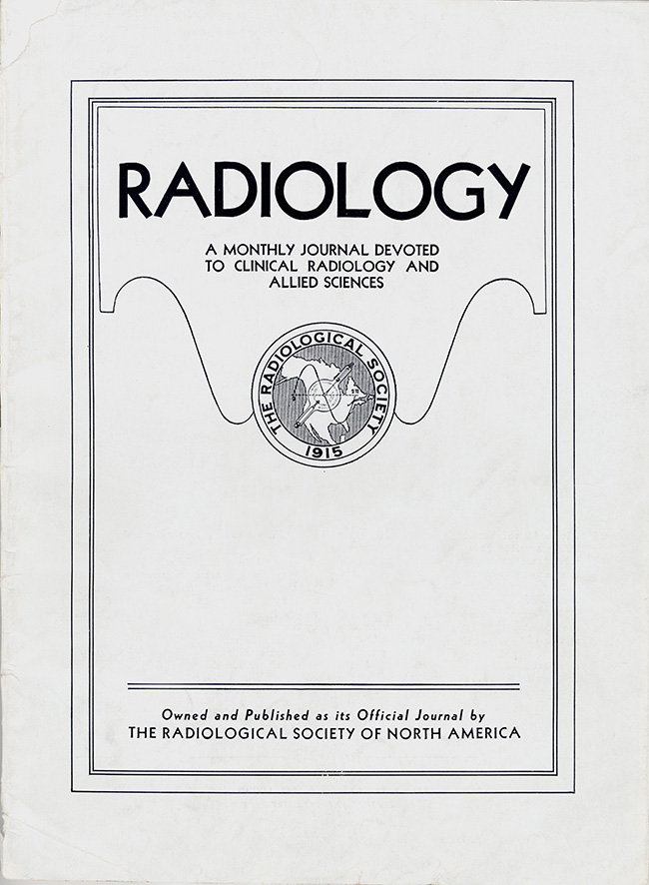
Hadron beams for radiation therapy
Radiology 47:487–91 (1946)
Robert R. Wilson
Wilson, then at Harvard designing 150 MeV cyclotron:
  Identified benefits and properties of proton beams for RT
  Pointed out potential of ions (carbon) and electrons

Slide 3
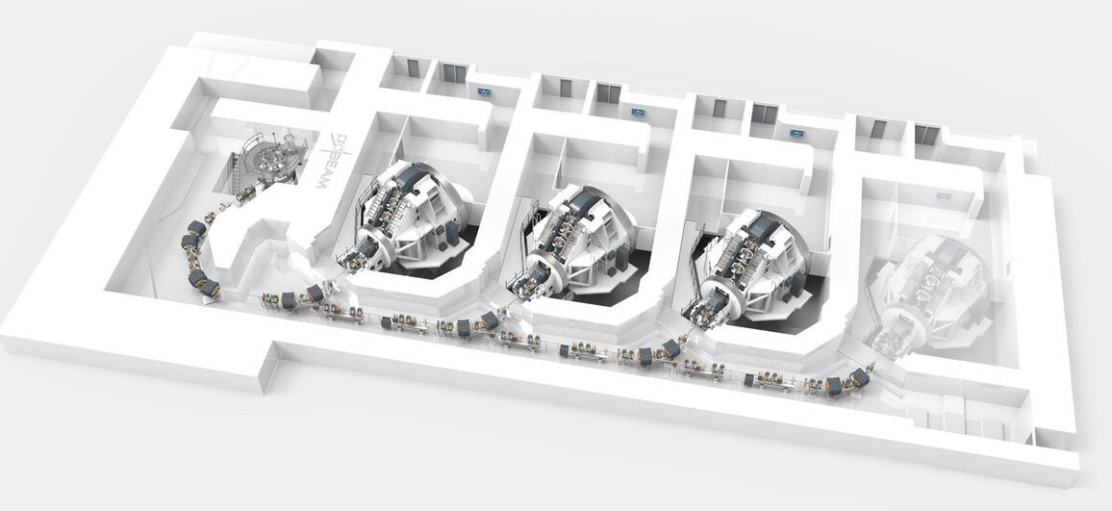
Particle beam therapy today
Cyclotron based
Synchrotron based
Christie Hospital Manchester
MedAustron
Austria

Slide 4
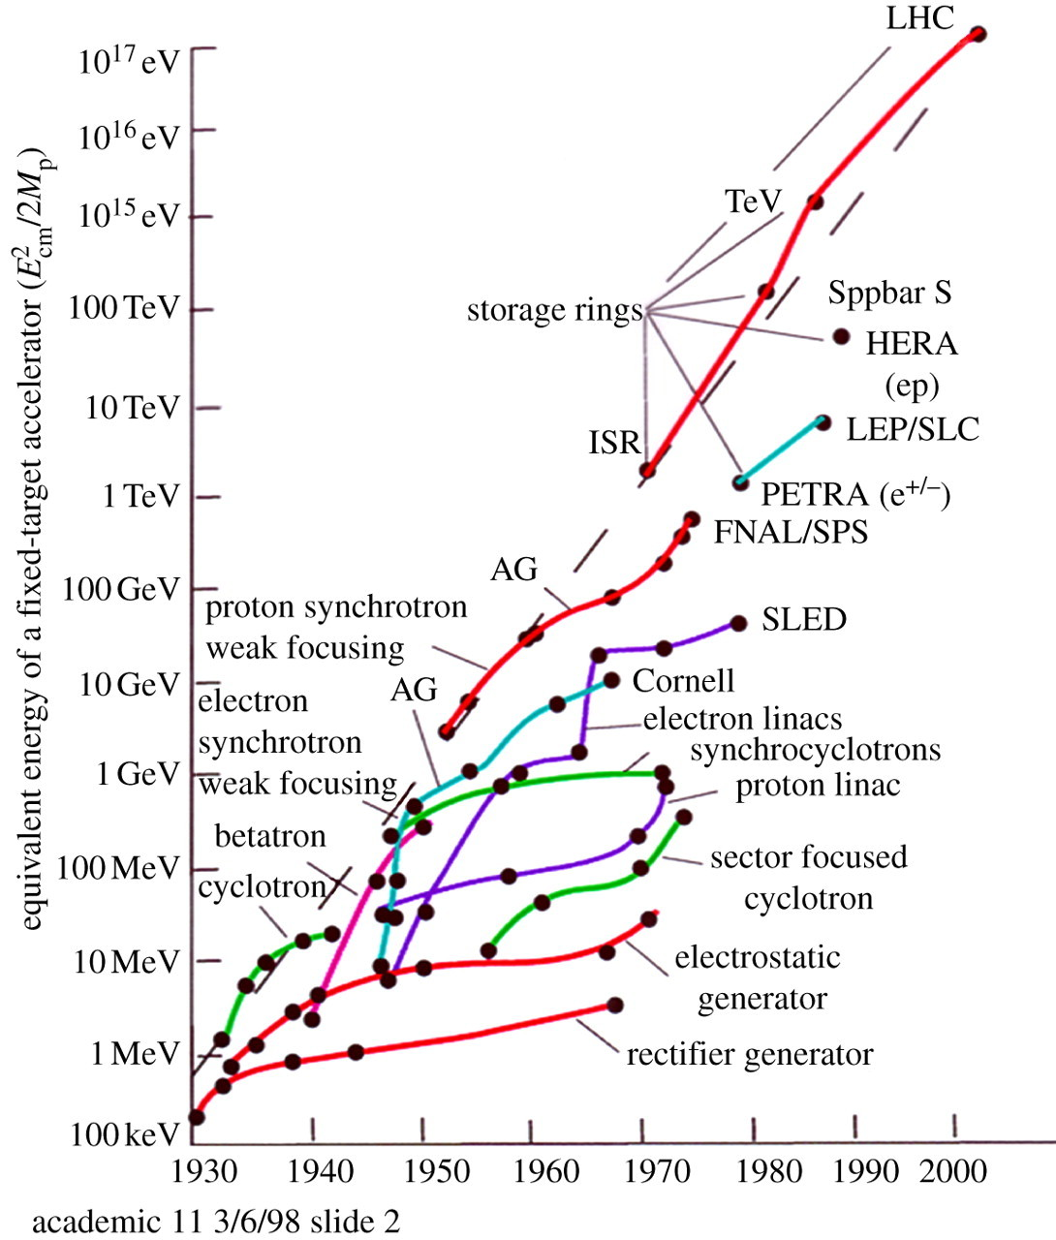
Evolving state of the art
Cancer therapy
(Mass Gen Hosp)
1974
Clinical studies (pituitary gland);
1954
Biological studies; 1948
Synchrotron
Goward, Barnes; 1946
Cyclotron
Laurence; 1932

Slide 5
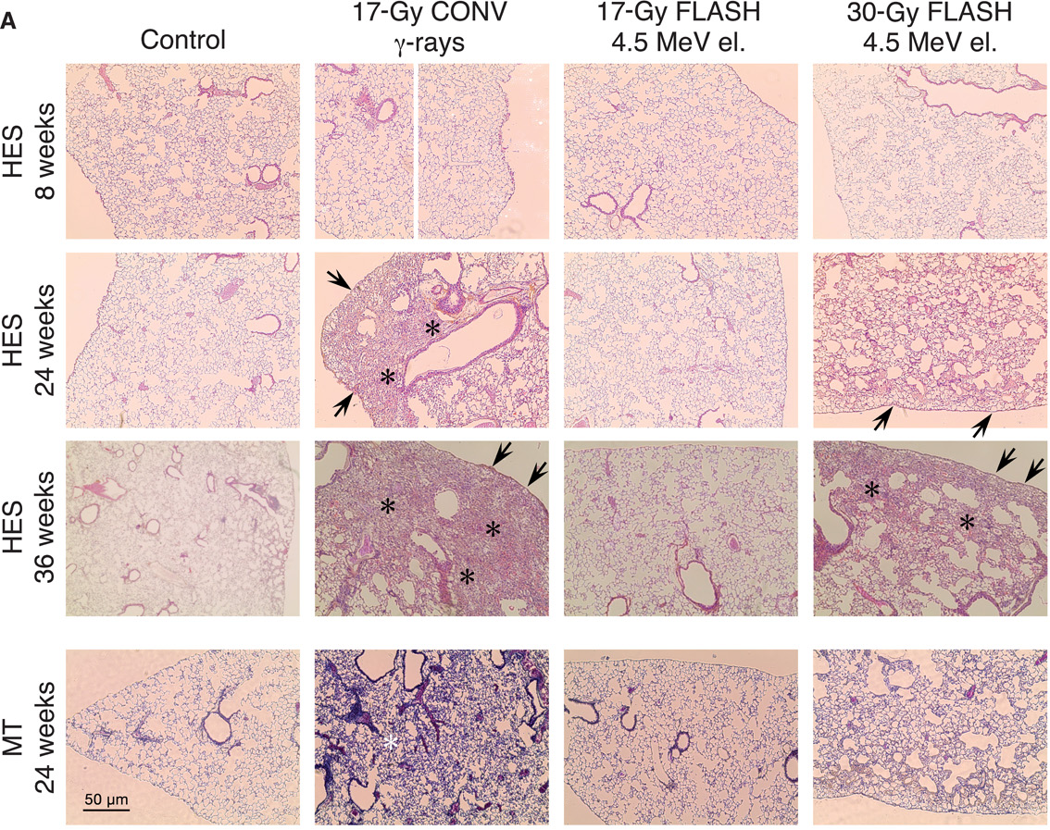
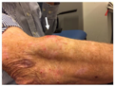
Potential benefit of new regimens
FLASH
Conventional regime : ~2 Gy/min
FLASH regime (p) : >40 Gy/s
Evidence of normal-tissue sparing while tumour-kill probability is maintained:
i.e. enhanced therapeutic window
Time line:
Reports: 2014 (e.g. Flauvadon et al, STM Jul 2014)
Confirmation in mini-pig & cat: 2018 (Clin. Cancer Research 2018)
First treatment 2019 (Bourhis et al, Rad.Onc. Oct 2019)

Slide 6
Potential benefit of new regimens
Worked example: micro beams
Conventional regime : > 1 cm diameter; homogeous
Microbeam regime : < 1 mm diameter; no dose between ‘doselets’
Remarkable increase of normal rat brain resistance.
[Dilmanian et al. 2006, Prezado et al., Rad. Research 2015]
Dose escalation in the tumour possible – larger tumor control probability

Slide 7
The challenge
Cancer: second most common cause of death globally
  Radiotherapy indicated in half of all cancer patients
Significant growth in global demand anticipated:
  14.1 million new cases in 2012 ⇢ 24.6 million by 2030
  8.2 million cancer deaths in 2012 ⇢ 13.0 million by 2030
Scale-up in provision essential:
  Projections above based on reported cases (i.e. high-income countries)
  Opportunity: save 26.9 million lives in low/middle income countries by 2035
Provision on this scale requires:
  Development of new and novel techniques … integrated in a
  Cost-effective system to allow a distributed network of RT facilities
Atun, Lancet Oncol. 2015 Sep;16(10):1153-86

Slide 8
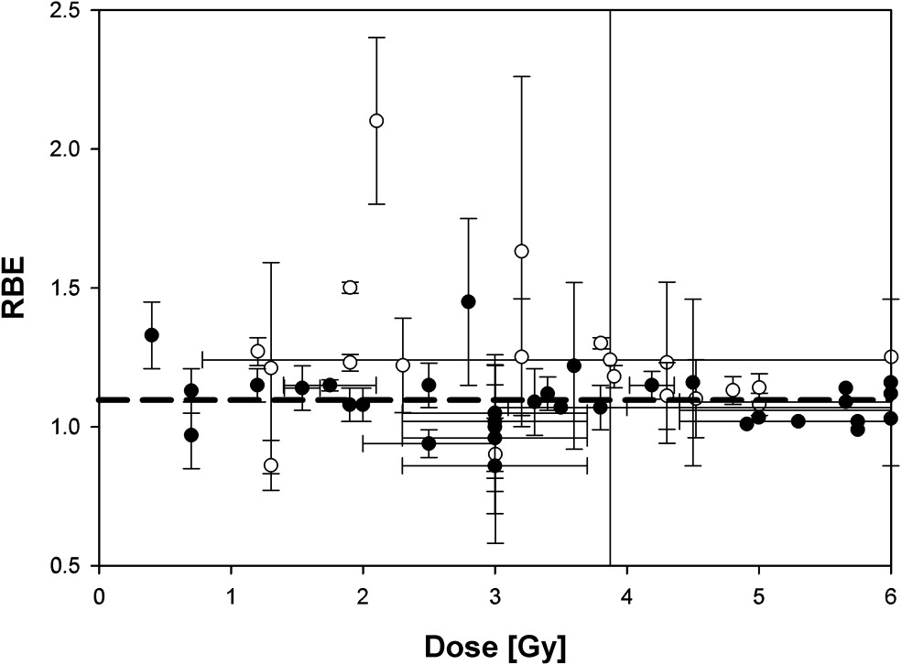
The case for radiobiology
Relative biological effectiveness:
  Defined relative to reference X-ray beam
  Known to depend on:
    Energy
    Ion species
    Dose
    Dose spatial distribution
    Dose rate
    Tissue type
    Biological endpoint
Yet:
  All p-treatment planning uses RBE = 1.1
  Effective values are used for C⁶⁺
Maximise the efficacy of PBT now & in future:
  Systematic programme needed to develop
  full understanding of radiobiology
Paganetti,
van Luijk
(2013)
SemRadOncol

Slide 9
Radiobiology in new regimens
Time
domain
Space
domain
The ideally
flexible beam facility
can deliver it all!
⇒ substantial
opportunity for a
step-change in
understanding!
Ion
species
Energy
Multidisciplinary approach essential
In combination
and with chemo/immuno Therapies

Slide 11
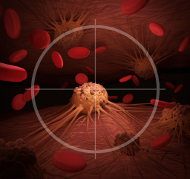
LhARA collaboration’s mission
Create a uniquely-flexible, novel system that will:
  Deliver a systematic and definitive
  radiobiology programme
  Prove the feasibility of the
  laser-hybrid approach
  Lay the foundations for
  transformative ion-beam therapy
    Highly automated,
    patient-specific
      Implies triggerable source,
      online imaging, integrated
      fast feedback and control

Slide 12
Laser-hybrid Accelerator for Radiobiological Applications
A novel, hybrid, approach:
Laser-driven, high-flux proton/ion source
  Overcome instantaneous dose-rate limitation
    Capture at >10 MeV
  Delivers protons or ions in very short pulses
    Bunches as short as 10—40 ns
  Triggerable; arbitrary pulse structure
Novel “electron-plasma-lens” capture & focusing
  Strong focusing (short focal length) without the use of high-field solenoid
Fast, flexible, fixed-field post acceleration
  Variable energy
    Protons: 15—127 MeV
    Ions: 5—34 MeV/u
Front. Phys., 29 September 2020; DOI: 10.3389/fphy.2020.567738

Slide 13
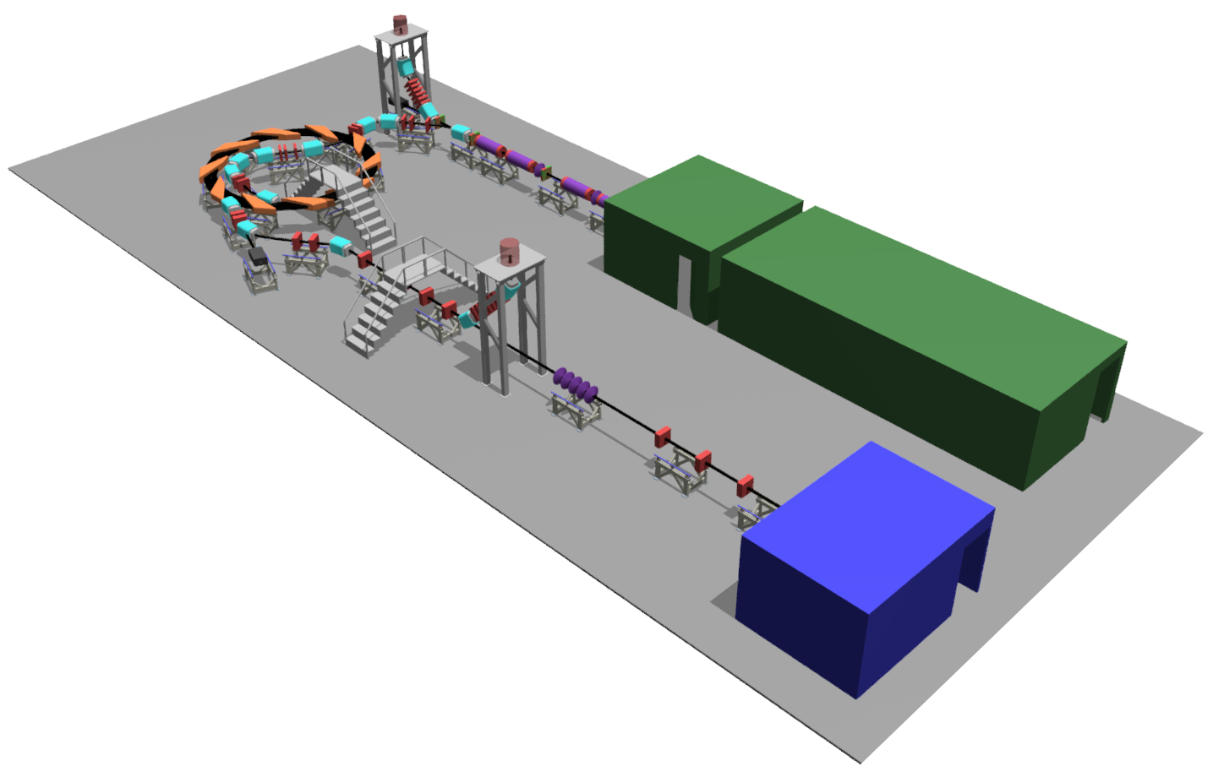

Front. Phys., 29 September 2020; DOI: 10.3389/fphy.2020.567738

Slide 14
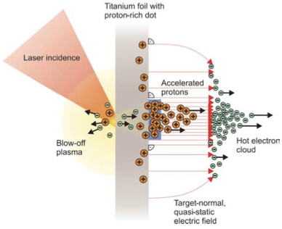
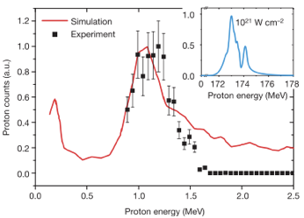
Sheath acceleration
Laser incident on foil target:
  Drives electrons from material
  Creates enormous electric field
Field accelerates protons/ions
  Dependent on nature of target
Active development:
  Laser: power and rep. rate
  Target material, transport
Schwoerer, H. et al., 2006; Nature, 439(7075).

Slide 15
Laser-driven beams for rbio: example 1
On Draco @ HZDR
DOI: 10.1038/s41598-020-65775-7
Draco:
  Petawatt laser
    E = 13 J, τ = 30 fs, 3 μm FWHM
Beam line:
  Target Normal Sheath Acceleration (TNSA)
  Pulsed solenoid focusing
    19.5T, 2 or 3 pulses/min.
    S1, S2: 40 mm bore
    Half angle acceptance 14º
  Measured transmission
  (18.6 MeV p)
    50.6% (dual solenoid)
    28.6% (single solenoid)

Slide 16
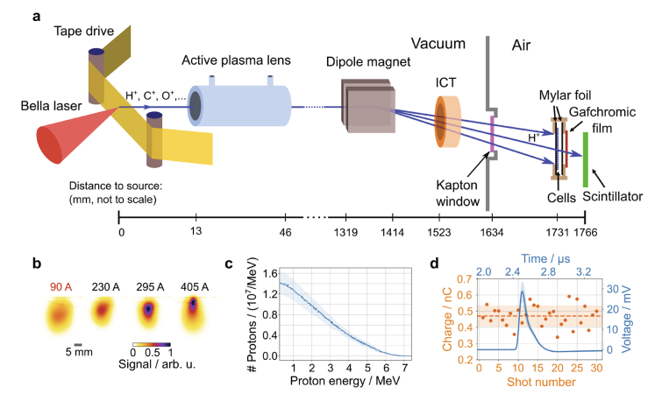
Laser-driven beams for rbio: example 2
On BELLA @ Berkeley
DOI 10.1038/s41598-022-05181-3
Berkeley Lab Laser Accelerator (BELLA):
  Petawatt laser
    E = 35 J, τ = 35 fs, 52 μm FWHM
Beam line:
  Target Normal Sheath Acceleration (TNSA)
  Active plasma lens focusing
    1 mm diameter Ar gas filled capillary
    33 mm length
    13 mm behind the tape drive target
    ~0.2% transport efficiency for protons with E > 1.5 MeV

Slide 17
Laser-driven proton/ion source
Commercial laser:
  Motivation: risk management
HT Lau
Thesis, 2022
Ti:Sapphire commercial system >150TW
Pulse ~35 fs at rep-rate of at least 10Hz
At least 500mJ laser energy - I_{L} ~ 10²⁰ Wcm⁻²

Slide 18
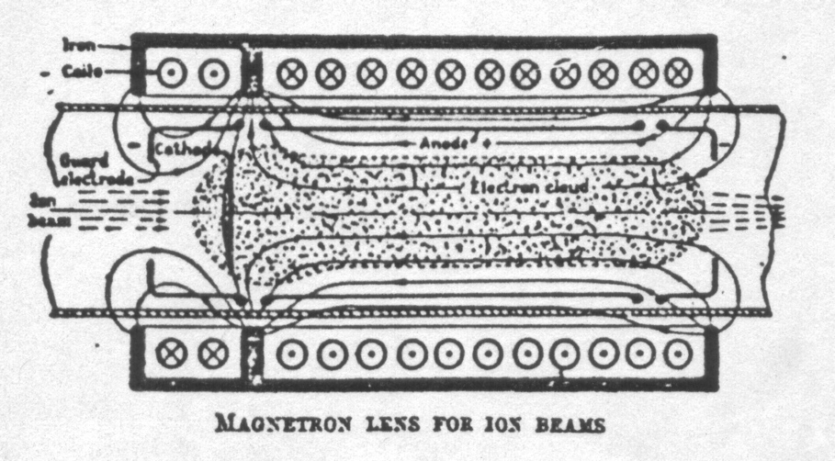
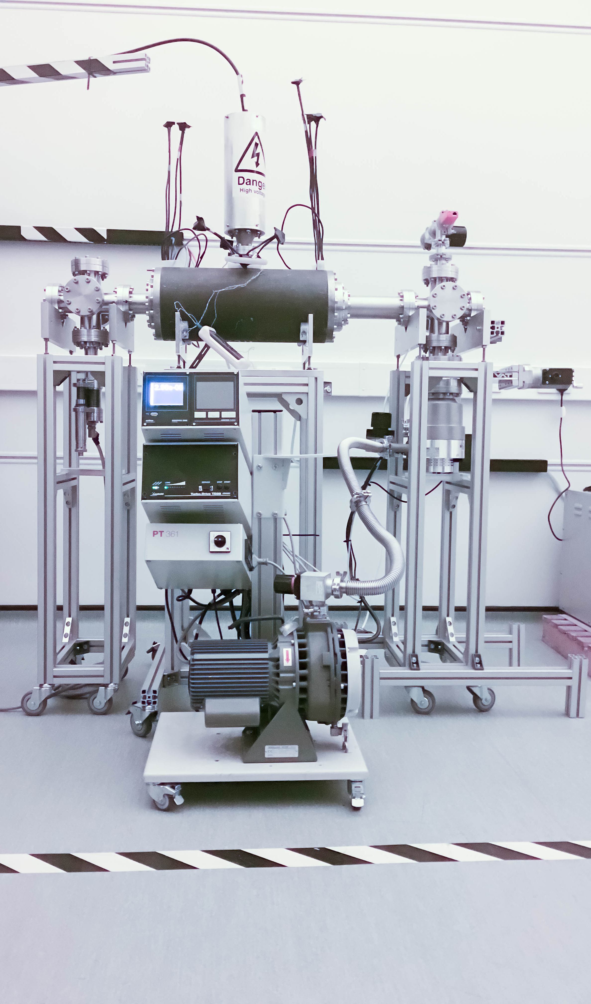
LhARA Capture
Posocco, Pozimski
“Electron-plasma” (Gabor) lens:
  Strong focusing exploiting electron
  gas in “Penning/Malmberg” trap
Gabor
1957
Front. Phys., 29 September 2020; DOI: 10.3389/fphy.2020.567738

Slide 19
VSIM/BDSIM:
evaluation of m = 1
diocotron mode
Dascalu

Slide 20
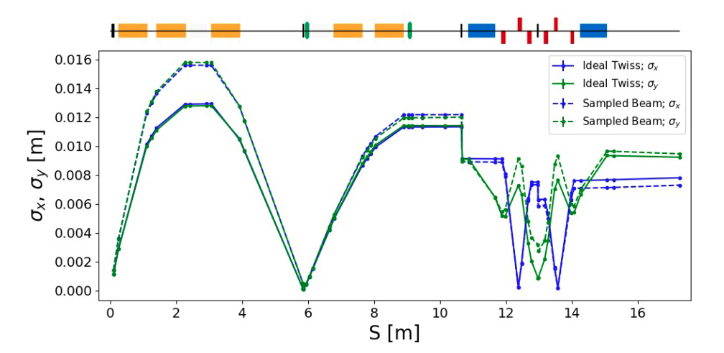
Beam envelopes Stage 1
HT Lau, IPAC 2021, WEPAB139
Propagation of “semi-realistic” source distribution:
  Generated using SMILEI
  Optimisation studies on going

Slide 21
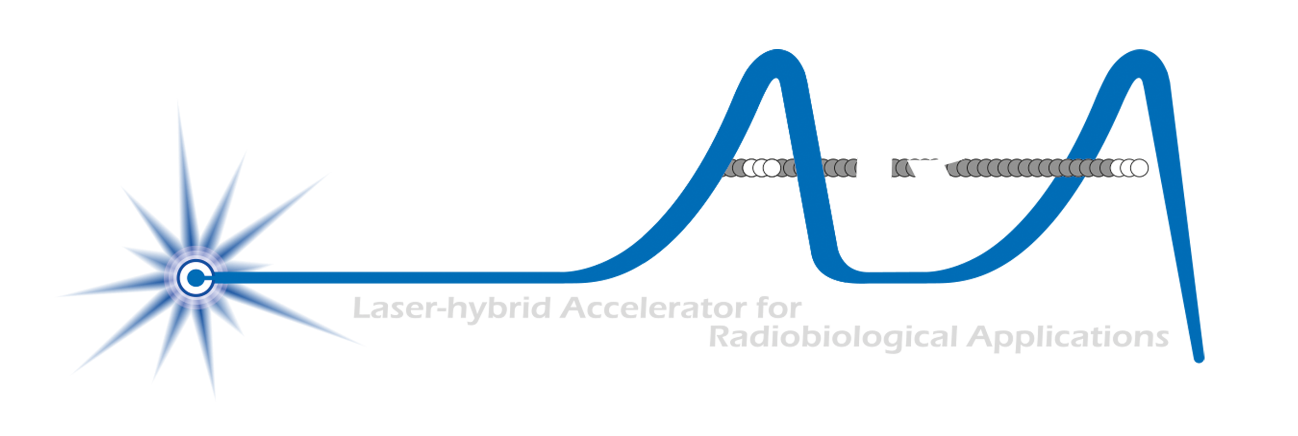
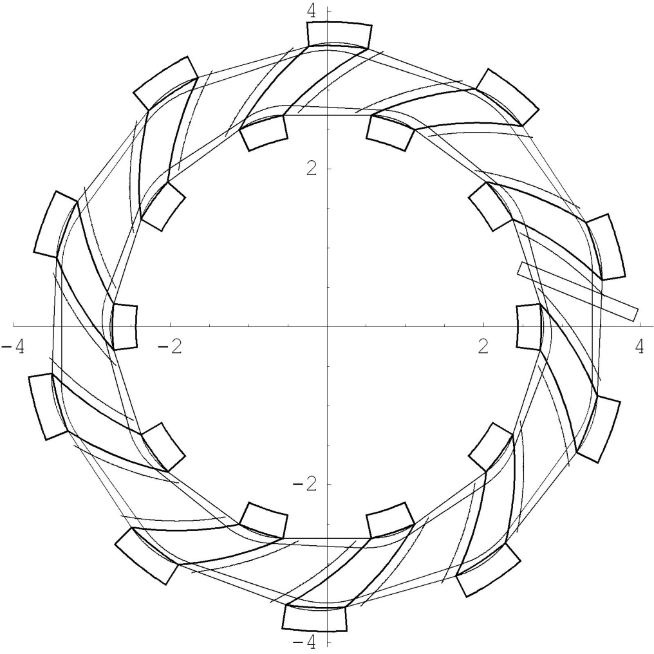
Rapid, flexible acceleration for stage 2
Dimensions in m
Evolution of
RACCAM design;
prototype magnet
demonstrated
Fixed-field alternating-gradient accelerator (FFA):
  Invented in 1950s
    Kolomensky, Okhawa, Symon
  Compact, flexible solution:
    Multiple ion species
    Variable energy extraction
    High repetition rate (rapid acceleration)
    Large acceptance
  Successfully demonstrated:
    Proof of principle at KEK
    Machines at KURNS
    Non-scaling PofP EMMA (DL)
LhARA FFA
10 cells
2 MA loaded
RF cavities
η
β_{v}
β_{h}
Front. Phys., 29 September 2020; DOI: 10.3389/fphy.2020.567738

Slide 22
LhARA @ the Ion Therapy Research Facility
N. Bliss (DL)
Draft
N. Bliss (DL)
Draft
Submitted to UKRI Infrastructure Advisory Committee
14 June 2021
N. Bliss (DL)
Draft

Slide 23
Detailed LhARA proposal in preparation

Slide 24
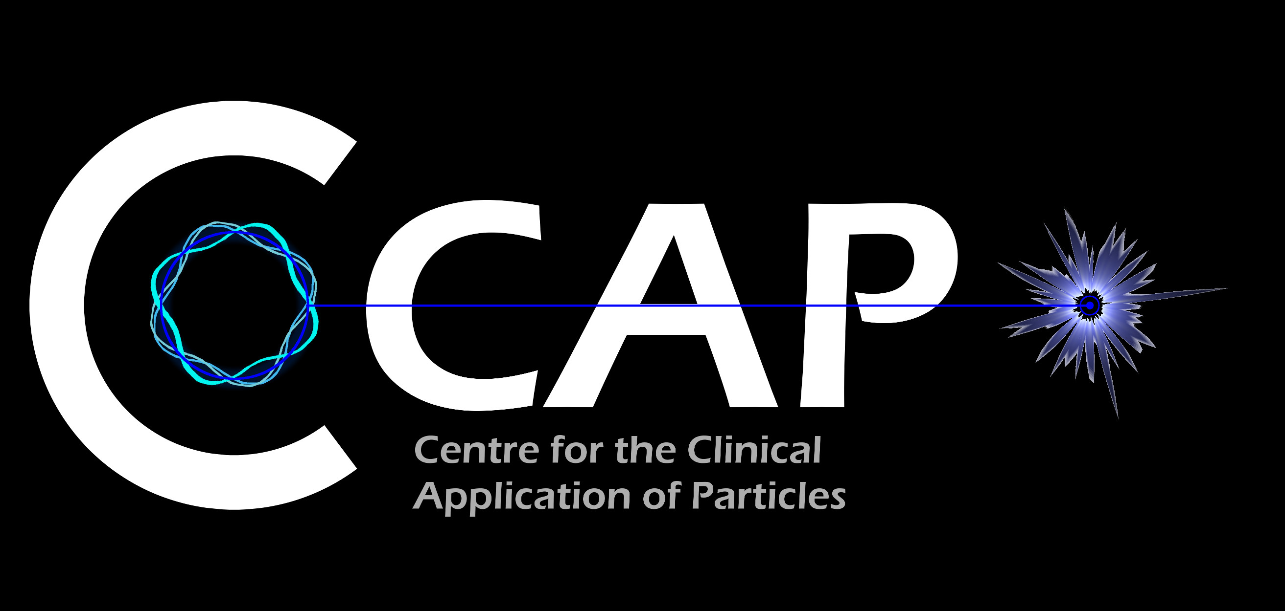
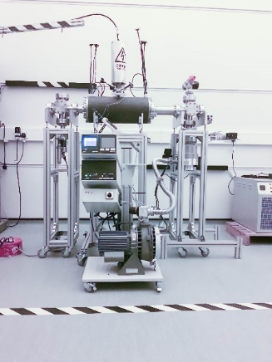
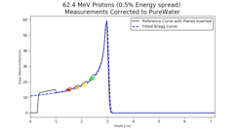

Novel accelerator techniques
System: image processing
fast feedback, control
Fundamental
Biology & biochemistry

Slide 25
Conclusions
Laser-driven sources are disruptive technologies …
  With the potential to drive a step-change in clinical capability
Laser-hybrid approach has potential to:
  Overcome dose-rate limitations of present PBT sources
  Deliver uniquely flexible facility:
    Range of: ion species; energy; dose; dose-rate; time; and spatial distribution
  Be used in automated, triggerable system → reduce requirement for large gantry
    Disruptive/transformative approach to “distributed PBT for 2050”
To serve the ITRF, the LhARA collaboration now seeks to:
  Prove the novel laser-hybrid systems in operation
  Contribute to the study of the biophysics of charged-particle beams
    Enhance treatment planning
  Create novel capabilities to ‘spin back in’ to science and innovation

Slide 26
Acknowledgements
ITRF team: N. Bliss, J. Clarke, M. Noro, H. Owen

Slide 28
Many initiatives in Americas, Europe, Asia
Applications in biological research, ambition to push toward clinical application …
  Phys Lett A. (2002) 299:240–7. doi: 10.1016/S0375-9601(02)00521-2
  Med Phys. (2003) 30:1660–70. doi: 10.1118/1.1586268
  Med Phys. (2004) 31:1587–92. doi: 10.1118/1.1747751
  Science. (2003) 300:1107–111
  New J Phys. (2010) 12:85003. doi: 10.1088/1367-2630/12/8/085003
  Phys Med Biol. (2011) 56:6969–82. doi: 10.1088/0031-9155/56/21/013
  Appl Phys Lett. (2011) 98:053701. doi: 10.1063/1.3551623
  Appl Phys Lett. (2012) 101:243701. doi: 10.1063/1.4769372
  AIP Adv. (2012) 2:011209. doi: 10.1063/1.3699063
  Appl Phys B. (2013) 110:437–44. doi: 10.1007/s00340-012-5275-3
  Appl Phys B. (2014) 117:41–52. doi: 10.1007/s00340-014-5796-z
  Radiat Res. (2014) 181:177–83. doi: 10.1667/RR13464.1
  Phys Rev Acceler Beams. (2017) 20:1–10. doi: 10.1103/PhysRevAccelBeams.20.032801
  J Instrum. (2017) 12:C03084. doi: 10.1088/1748-0221/12/03/C03084
  A-SAIL Project. (2020). Available online at: https://www.qub.ac.uk/research-centres/A-SAILProject/
  Vol. 8779. Prague: International Society for Optics and Photonics. SPIE (2013). p. 216–25.
  Vol. 11036. International Society for Optics and Photonics. SPIE (2019). p. 93–103.
  Nuovo Cim C. (2020) 43:15. doi: 10.1393/ncc/i2020-20015-6
  10th International Particle Accelerator Conference. Melbourne, VIC (2019). p. TUPTS005
  …
I will not attempt a review, choosing instead to focus on opportunity
A selection …

Slide 29
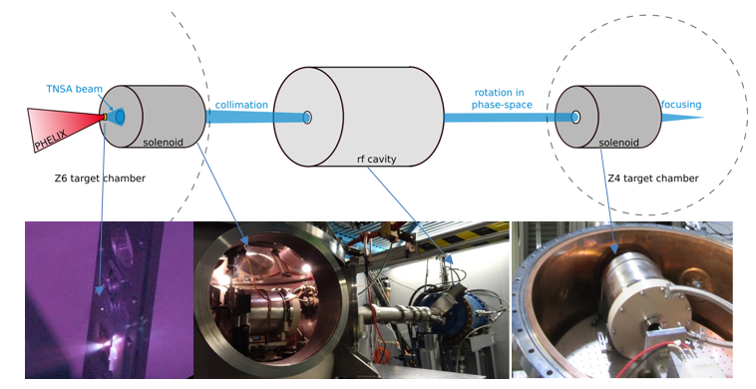
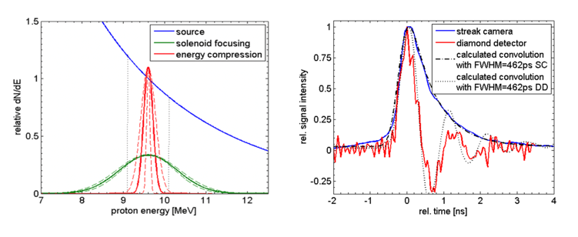
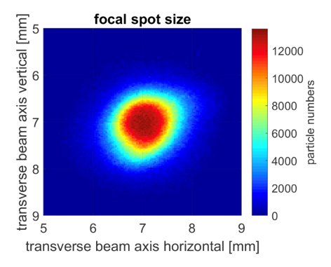
Capture
Variety of initiatives; some key examples
On PHELIX @ GSI
LIGHT – Laser Ion Generation, Handling and Transport
DOI: 10.1063/1.3299391
DOI: 10.1103/PhysRevSTAB.14.121301
DOI: 10.1103/PhysRevSTAB.16.101302
DOI: 10.1103/PhysRevSTAB.17.031302
NIMA 909 (2018) 173–176
PHELIX:
  Petawatt High-Energy Laser for Heavy Ion EXperiments
    E < 25 J, τ = 500 fs, I > 10¹⁹ J/cm2
LIGHT:
  Target Normal Sheath Acceleration (TNSA)
  Ion beam is collimated by a pulsed high-field solenoid
  Phase rotation in RF cavity
  Final focus with a second pulsed high-field solenoid
https://www.gsi.de/work/forschung/appamml/plasmaphysikphelix/experimente/light

Slide 30
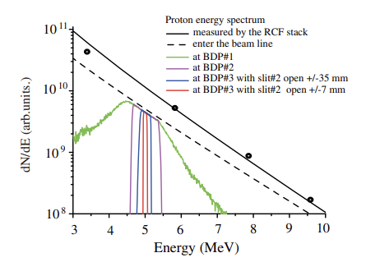
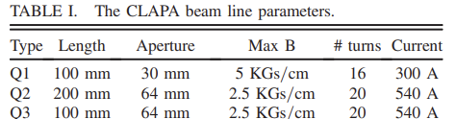
Capture
Variety of initiatives; some key examples
On CLAPA @ Peking University
DOI: 10.1103/PhysRevAccelBeams.22.061302
DOI: 10.1103/PhysRevAccelBeams.23.121304
Compact Laser Plasma Accelerator (CLAPA):
  Petawatt laser
    E = 1.3 J, τ = 30 fs, 5 μm FWHM
Beam line:
  Target Normal Sheath Acceleration (TNSA)
  Quadrupole triplet focusing
  Measured transmission:
    88% transmission through triplet
    ±50 mrad collection angle @ 5 MeV

Slide 31
ELIMAIA-ELIMED
Quantum Beam Sci. 2018, 2, 8; doi:10.3390/qubs2020008
Frontiers in Phys. Med. Phys. & Imag. – doi: 10.3389/fphy.2020.564907
Extreme Light Infrastructure, Prague, Czech Republic:
ELI Multidisciplinary Applications of laser-Ion Acceleration (ELIMAIA)
  ELI MEDical and multidisciplinary applications (ELIMED)
    ELIMAIA section dedicated to ion focusing, selection, characterization, and irradiation
  Proton energies from 5 to 250 MeV transported to in-air section

