Slide 1
Proton & ion beams for bio-medical application; the next generation
a step on the route to precision particle-beam therapy

Slide 2
opportunity
Proton & ion beams for bio-medical application; the next generation

Slide 3
Radiotherapy; the challenge
Cancer: second most common cause of death globally
Radiotherapy indicated in half of all cancer patients
Significant growth in global demand anticipated:
14.1 million new cases in 2012 ⇢ 24.6 million by 2030
8.2 million cancer deaths in 2012 ⇢ 13.0 million by 2030
Scale-up in provision essential:
Projections above based on reported cases (i.e. high-income countries)
Opportunity: save 26.9 million lives in low/middle income countries by 2035
Provision on this scale requires:
Development of new and novel techniques … integrated in a
Cost-effective system to allow a distributed network of RT facilities
Atun, Lancet Oncol. 2015 Sep;16(10):1153-86

Slide 4
The benefit of particles
Maximise therapeutic benefit by:
Maximising damage to tumour
Minimising damage to healthy tissue
X-ray therapy:
Modality used in most radiotherapy
Dose falls exponentially with depth
Proximity of sensitive organs limits dose to tumour

Slide 5
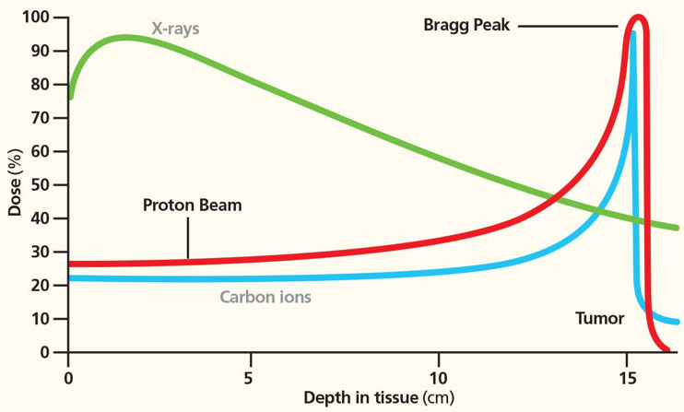
Particle-beam therapy
Proton and ion-beam therapy:
Bulk of dose deposited in Bragg peak
Significant normal-tissue sparing (entry)
Almost no dose beyond the Bragg peak

Slide 6
Disruptive technology
Proton & ion beams for bio-medical application; the next generation

Slide 7

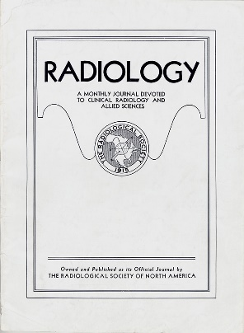
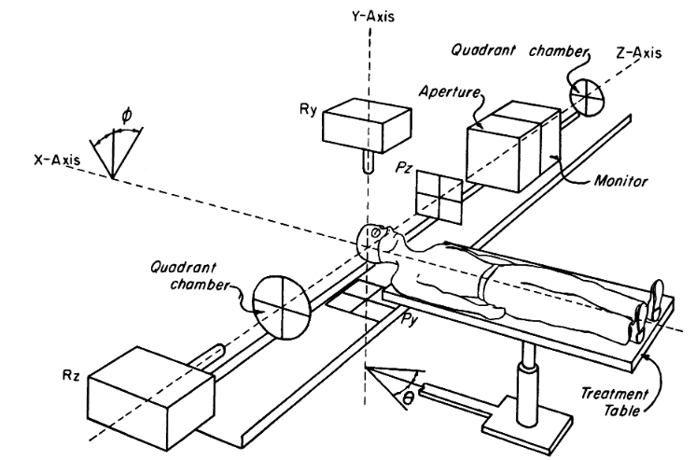
Protons for clinical use
First proposed by R. R. Wilson
“Radiological Use of Fast Protons” R.R. Wilson Radiology 47:487-491, 1946.
Treatment started in 1954 at LBNL
“Pituitary irradiation with high-energy proton beams: a preliminary report.” C. A. Tobias et al. Cancer Res. 18(2):121-34, 1958

Slide 8
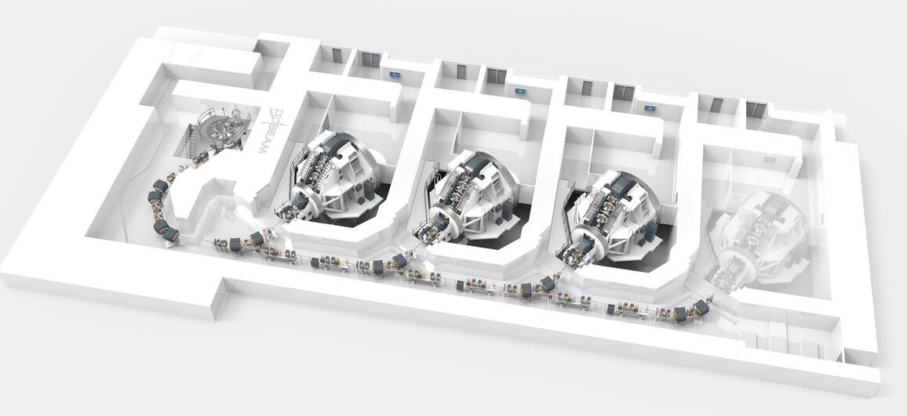
Particle beam therapy today
Cyclotron based
Synchrotron based
Christie Hospital Manchester
MedAustron Austria

Slide 9
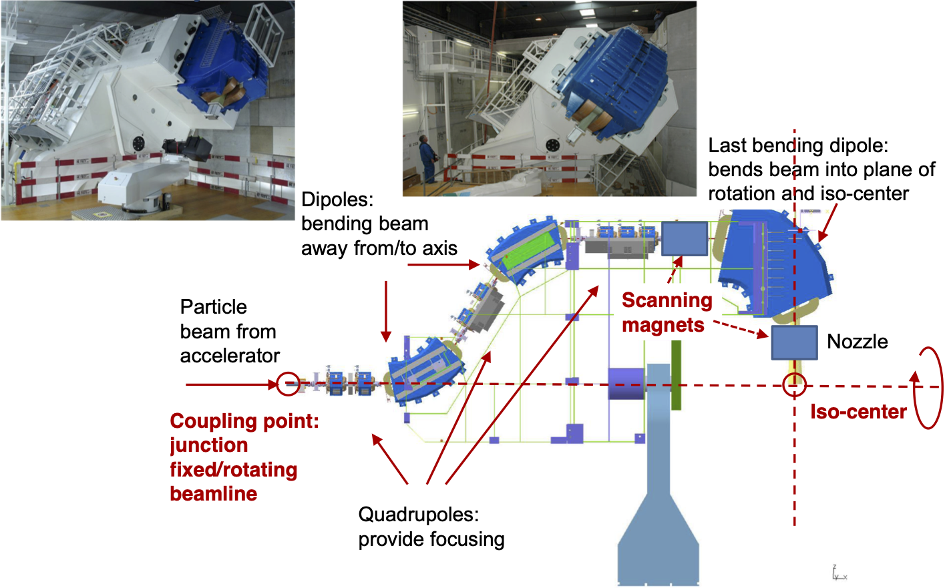
Beam delivery
PSI gantry
PSI gantry
Engineering tour de force!
360-degree irradiation
At a price: Size, complexity, maintenance
H. Owen

Slide 10
Particle source
S. Laurie
S. Laurie
Extraction energy:
Low
Instantaneous dose:
Limited at source

Slide 11
Radiobiology
Proton & ion beams for bio-medical application; the next generation

Slide 12
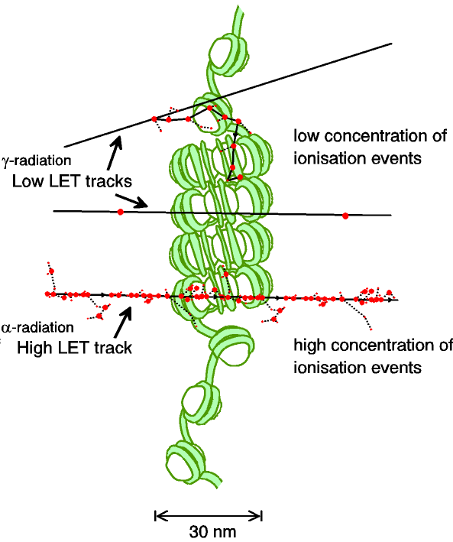
Biological impact ^{from the} physics of ionisation
Low-LET radiation:
Repairable single/double strand breaks
High-LET radiation:
Complex DNA lesions
Multiple DNA pathways
More difficult to repair
Enhances cell death
Programmatic approach:
Systematic studies of impact of radiation

Slide 13
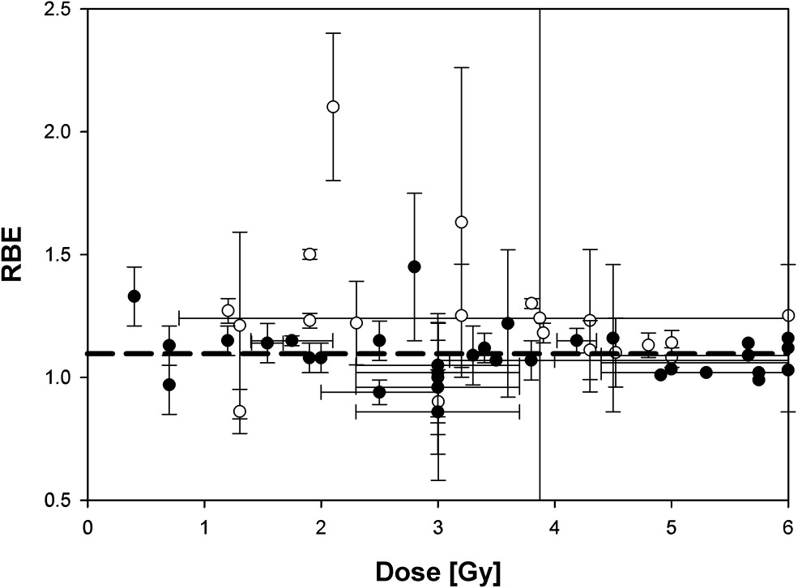
The case for fundamental radiobiology
Relative biological effectiveness:
Defined relative to reference X-ray beam
Known to depend on:
Energy, ion species
Dose & dose rate
Tissue type
Biological endpoint
Yet:
p-treatment planning uses 1.1
Effective values are used for C⁶⁺
Maximise the efficacy of PBT:
Require full understanding of radiobiology
Paganetti, van Luijk (2013)
SemRadOncol

Slide 14
Radiobiology in new regimens
Time
domain
Space
domain
The ideally flexible beam facility can deliver it all!
⇒ substantial opportunity for a step-change in understanding!
Ion
species
Energy
Multidisciplinary approach essential
In combination and with chemo/immuno Therapies

Slide 16
Disruptive technology
Proton & ion beams for bio-medical application; the next generation

Slide 17
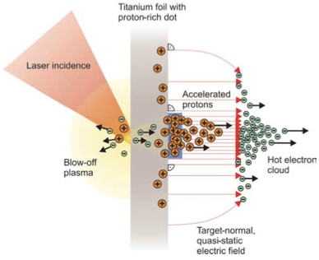
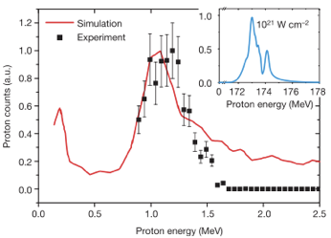
Sheath acceleration
Laser incident on foil target:
Drives electrons from material
Creates enormous electric field
Field accelerates protons/ions
Dependent on nature of target
Active development:
Laser: power and rep. rate
Target material, transport
Schwoerer, H. et al., 2006; Nature, 439(7075).

Slide 18

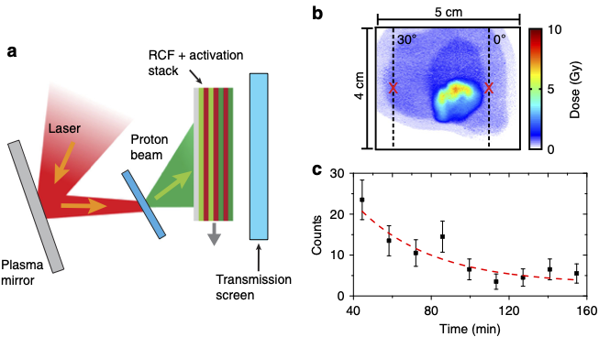
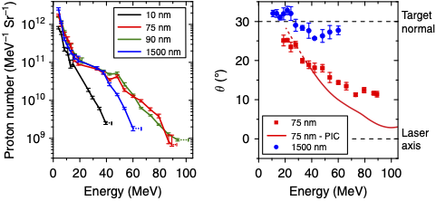
Advances
(2018)9:724 DOI: 10.1038/s41467-018-03063-9
Vulcan
Production: ⁶³Cu(p,n)⁶³Zn
⁶³Zn – β⁺decay
Ultrathin foil irradiated by "long", linearly-polarised laser pulse
Mechanism:
Radiation-pressure/target-normal sheath acceleration
High-energies confined to narrow angular range by radiation-induced transparency

Slide 19
Advantages
Protons (and ions) produced at “high energy”:
e.g. 15 MeV → 250 times energy of conventional proton source
High energy substantially reduced impact of space charge
Allows evasion of instantaneous dose-rate limitation of today’s sources
Pulsed operation “natural”:
Discharge sources are DC; accelerator imposes time structure
Pulsed operation determined by laser:
A triggerable, “on demand”, source
Critical issues:
Efficient capture of divergent, high-energy ion flux
Transformation of captured flux into useful beam

Slide 20
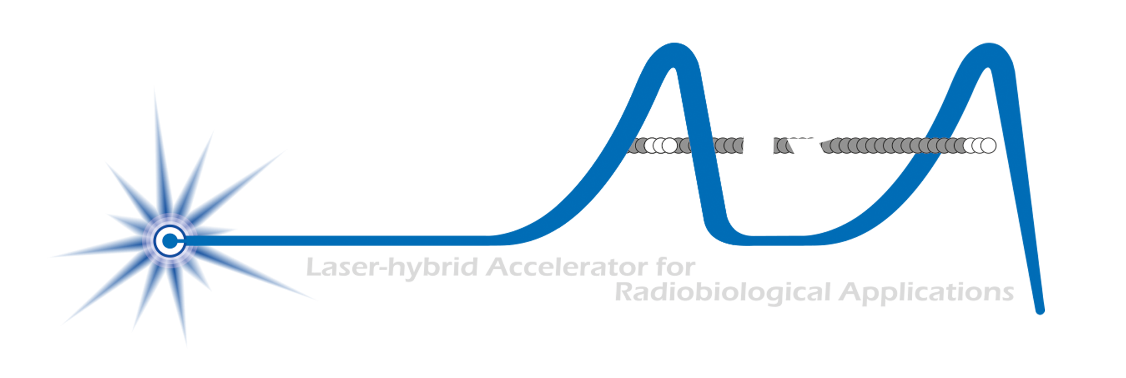
LhARA
Proton & ion beams for bio-medical application; the next generation

Slide 21
Laser-hybrid Accelerator for Radiobiological Applications
A novel, hybrid, approach:
Laser-driven, high-flux proton/ion source
Novel “electron-plasma-lens” capture & focusing
Fast, flexible, fixed-field post acceleration
Front. Phys., 29 September 2020; DOI: 10.3389/fphy.2020.567738

Slide 22
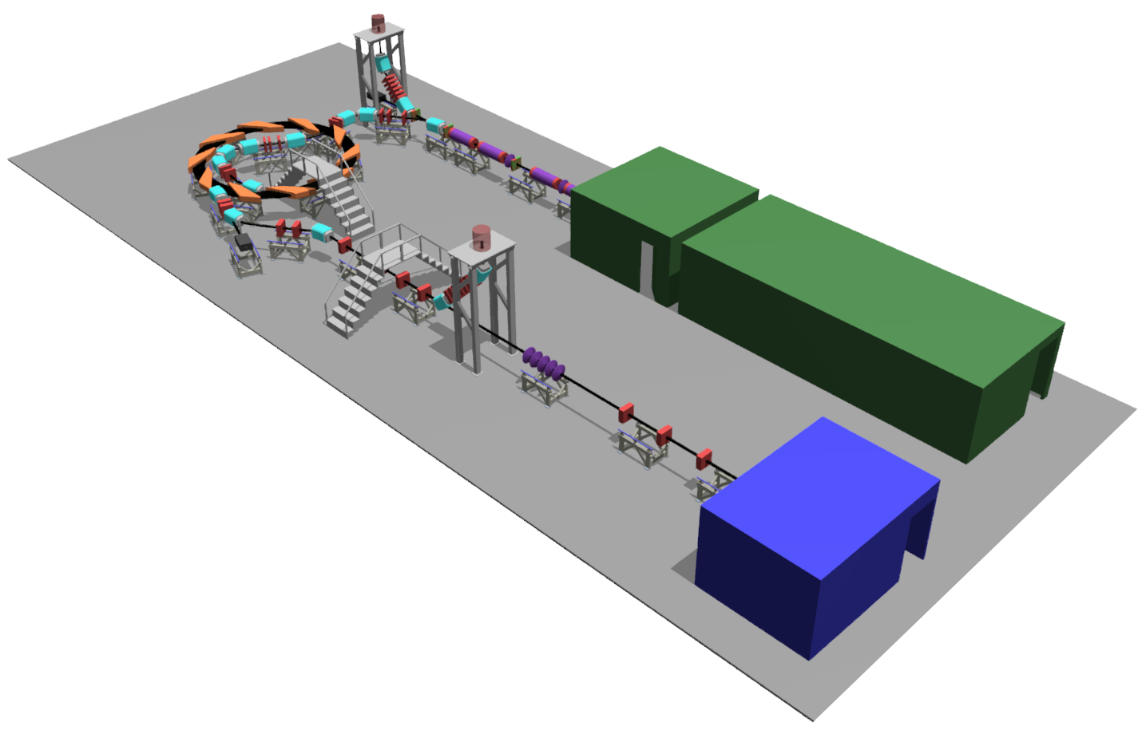
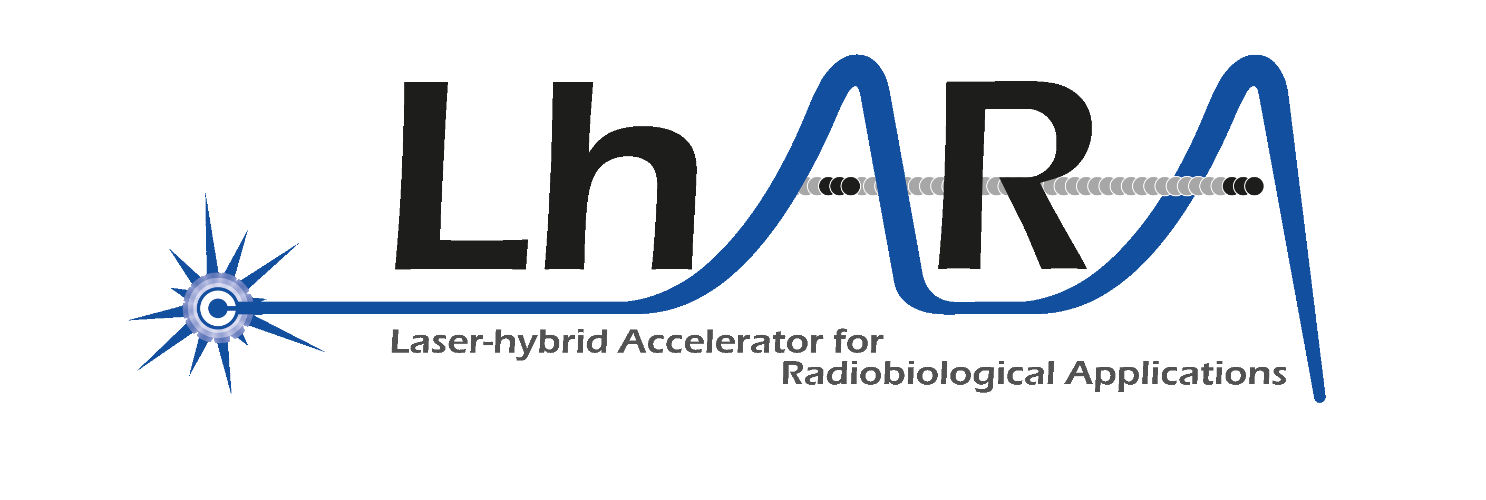
Front. Phys., 29 September 2020; DOI: 10.3389/fphy.2020.567738

Slide 23
Laser-driven proton/ion source
Advantage:
Enormous proton/ion flux at 10—15MeV in tiny (30 fs) pulse at 10 Hz
HT Lau
Ti:Sapphire commercial system >15TW
Pulse ~35fs at rep-rate of at least 10Hz
At least 500mJ laser energy - I_{L} ~ 1020 Wcm⁻²
Requirement:
Efficient capture, focusing, selection and manipulation of divergent ion beam

Slide 24
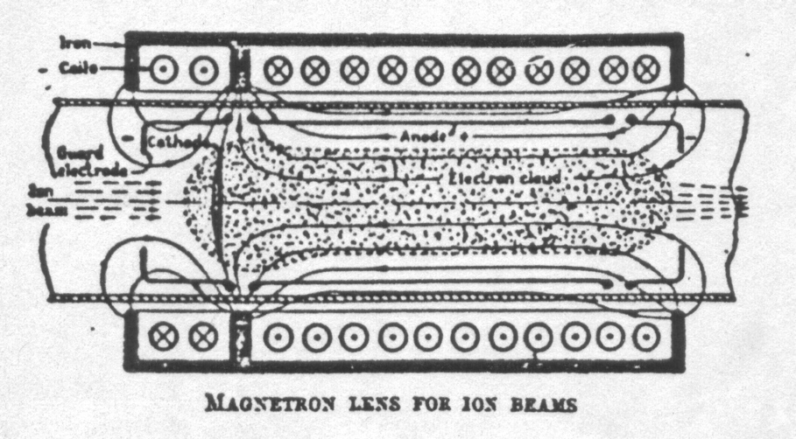
Beam capture/production principle
Posocco, Pozimski
“Electron-plasma” (Gabor) lens:
Strong focusing exploiting electron gas in “Penning/Malmberg” trap
Gabor
1957
Front. Phys., 29 September 2020; DOI: 10.3389/fphy.2020.567738

Slide 26
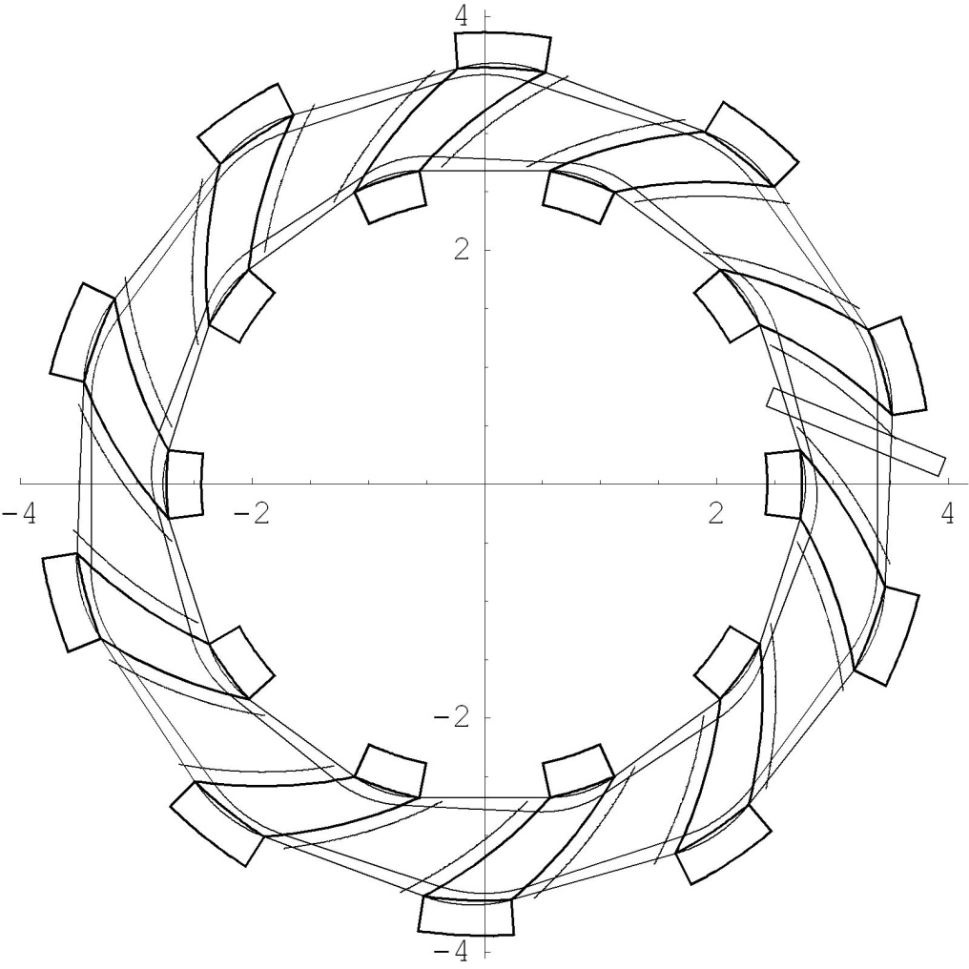
Rapid, flexible acceleration for stage 2
Dimensions in m
Evolution of RACCAM design; prototype magnet demonstrated
Fixed-field alternating-gradient accelerator (FFA):
Invented in 1950s
Kolomensky, Okhawa, Symon
Compact, flexible solution:
Multiple ion species
Variable energy extraction
High repetition rate (rapid acceleration)
Large acceptance
Successfully demonstrated:
Proof of principle at KEK
Machines at KURNS
Non-scaling pop, EMMA, at DL
LhARA FFA
10 cells
2 MA loaded RF cavities
η
β_{v}
β_{h}
Front. Phys., 29 September 2020; DOI: 10.3389/fphy.2020.567738

Slide 27
LhARA performance: doses and dose rates
Front. Phys., 29 September 2020; DOI: 10.3389/fphy.2020.567738

Slide 28
Conclusions
Proton & ion beams for bio-medical application; the next generation

Slide 29
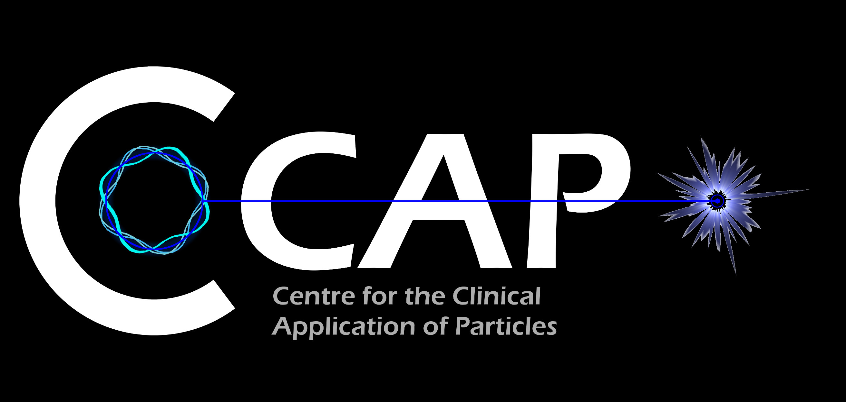
Conclusions
Laser-driven sources are disruptive technologies …
With the potential to drive a step-change in clinical capability
Laser-hybrid approach has potential to:
Overcome dose-rate limitations of present PBT sources
Deliver uniquely flexible facility:
Range of: ion species; energy; dose; dose-rate; time; and spatial distribution
Be used in automated, triggerable system → reduce requirement for large gantry
Disruptive/transformative approach to “distributed PBT for 2050”
The LhARA collaboration now seeks to:
Prove the novel laser-hybrid systems in operation
Contribute to the study of the biophysics of charged-particle beams
Enhance treatment planning
Create novel capabilities to ‘spin back in’ to science and innovation

