Slide 1


Medical applications of particle accelerator and detector technologies
Ajit Kurup
24th October 2019

Slide 2

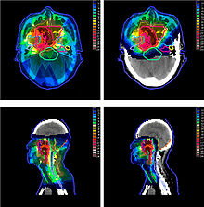

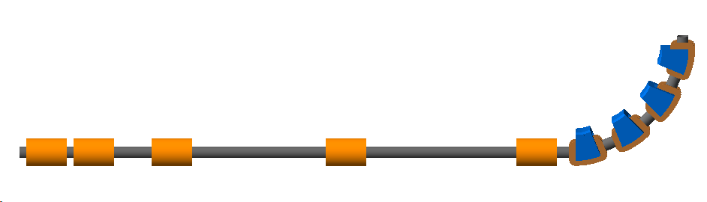

Introduction
Cancer is a major killer with 17 million new cases per year and this is set to rise to 27.5 million new cases per year by 2040.
Radiotherapy is an important treatment modality with 27% of patients receiving radiotherapy as part of their primary treatment.
Conventional radiotherapy uses x-rays which has an exponential dose profile.
Particle radiotherapy (commonly protons) makes use of the Bragg peak to localise deposited dose.
Challenges for conventional technologies for particle therapy.
Centre for the Clinical Application of Particles.
  Conceptual design for Laser-hybrid Accelerator for Radiobiological Applications (LhARA).
  Accelerator and detector development.
45$°$
laser

Slide 3
A Brief Introduction to Particle Therapy

Slide 4


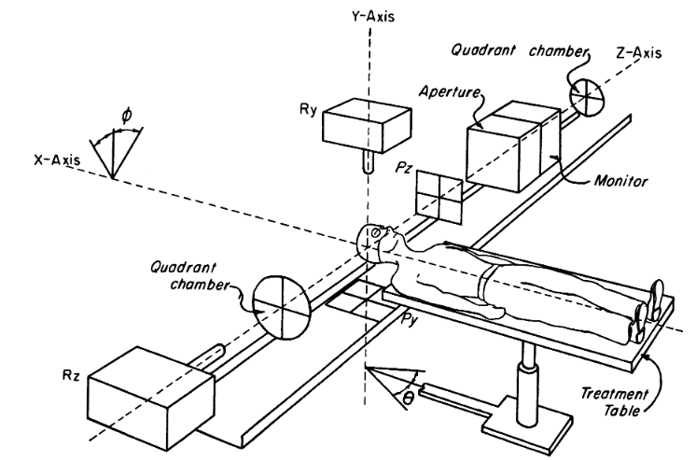
Protons for clinical use
First proposed by R. R. Wilson
  “Radiological Use of Fast Protons” R.R. Wilson
  Radiology 47:487-491, 1946.
First treatment of patients started in 1954 at LBNL.
  “Pituitary irradiation with high-energy proton beams: a preliminary report.” C. A. Tobias et al. Cancer Res. 18(2):121-34, 1958.
This was possible thanks to high-energy physicists!

Slide 5
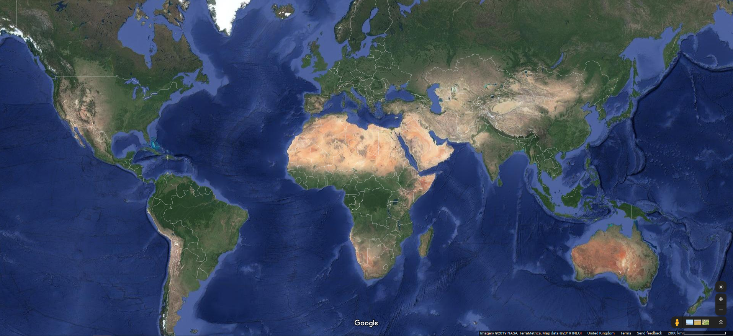
Protons for clinical use
Existing proton and carbon treatment facilities.
In contrast, X-ray machines are compact and cheaper.
  Can be installed in every hospital.
  State-of-the-art Volumetric Modulated Arc Therapy (VMAT) can deliver a treatment dose conformal to the tumour geometry (by continuously rotating the beam around the patient whilst modulating the beam) and minimises dose to surrounding tissues by using multiple treatment fields.
1
1
4
1
3
3
6
2
1
1
3
1
1
1
33
3
1
6
2
3
2
14
1
1
Proton beam facility
(83 in total)
1
Carbon ion facility
(13 in total)
Data from PTCOG updated Sept. 2019

Slide 6
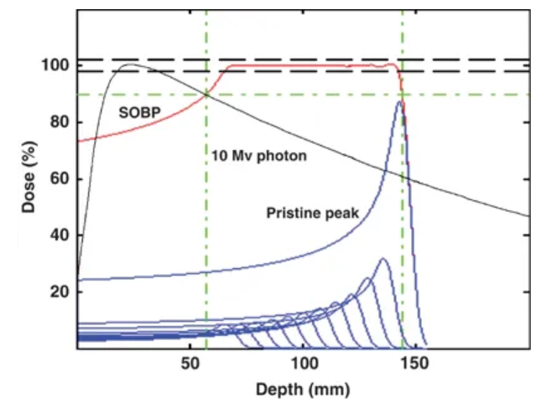
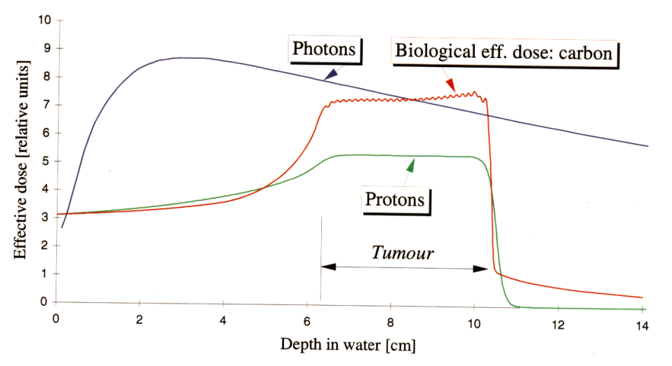
Photons vs ions
Photons have exponential dose deposition profile.
The Bragg peak for charged particles means dose is localised.
  Bragg peak depth is dependent on energy.
Clinical treatments use a Spread Out Bragg Peak (SOBP) to conform dose over the length of the tumour.
Carbon ions have a better dose profile in front of the tumour though fragmentation creates a distal tail.
SOBP
Pristine peak
Levin et al. “Proton beam therapy” British Journal of Cancer volume 93, pages 849–854 (2005).

Slide 7
Photons vs ions
Optimised treatment plans for a prostate cancer patient.
4 beam intensity modulated proton therapy plan.
X-ray based VMAT plan.
Marco Durante, Roberto Orecchia & Jay S. Loeffler
Nature Reviews Clinical Oncology volume 14, pages 483–495 (2017)

Slide 8

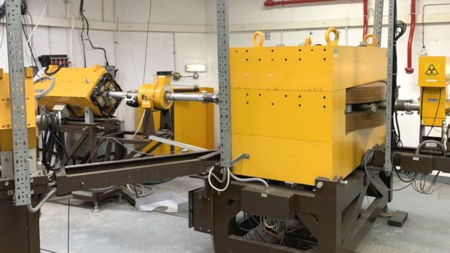
NHS Centres in the UK
Clatterbridge treating eye tumours (since 1989) with 60MeV protons.

Slide 9
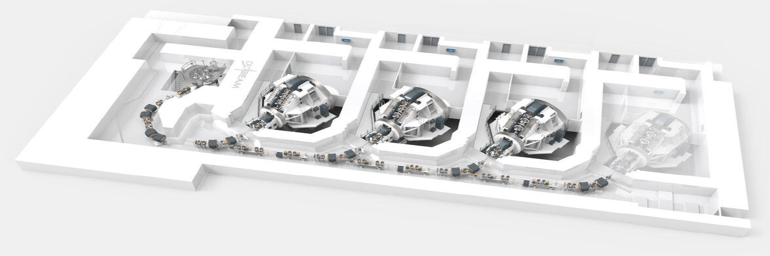

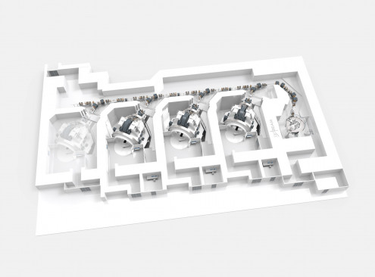

NHS Centres in the UK
Two new centres to treat up to 750 patients each.
  The Christie NHS Foundation Trust (Manchester) opened in 2018.
  University College London Hospital (UCLH) NHS Foundation Trust due to open in 2020.

Slide 10
Challenges

Slide 11
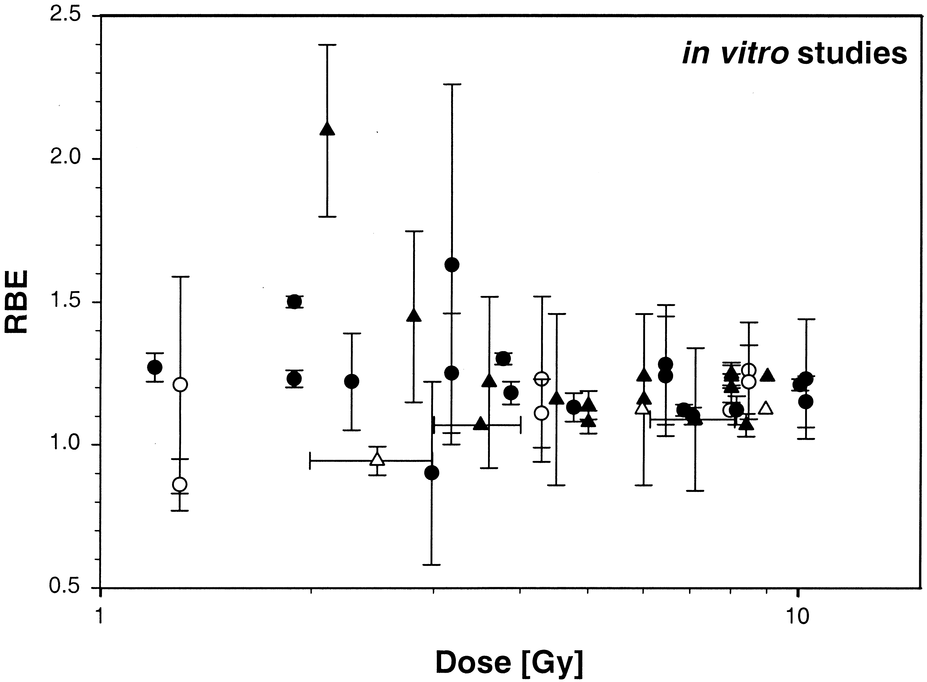
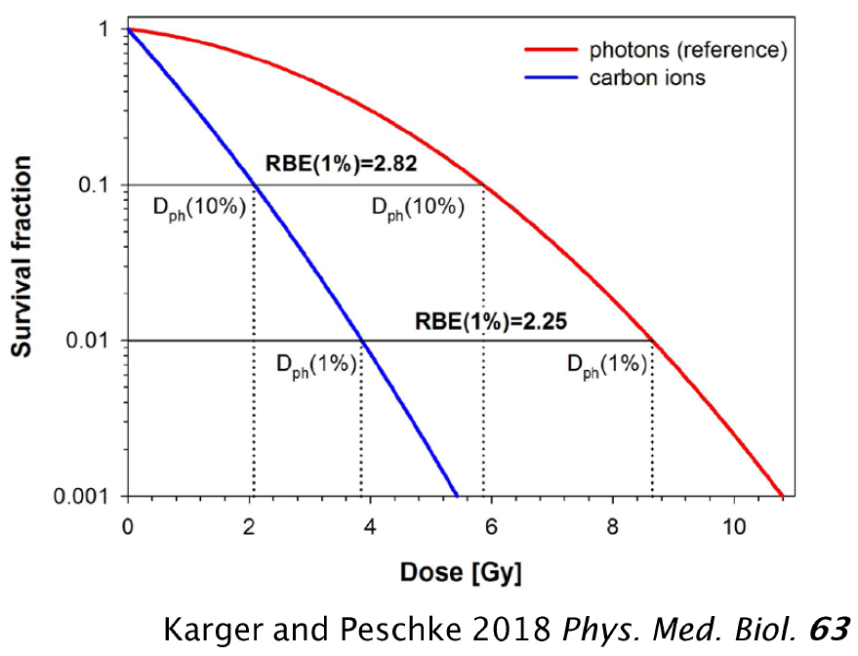
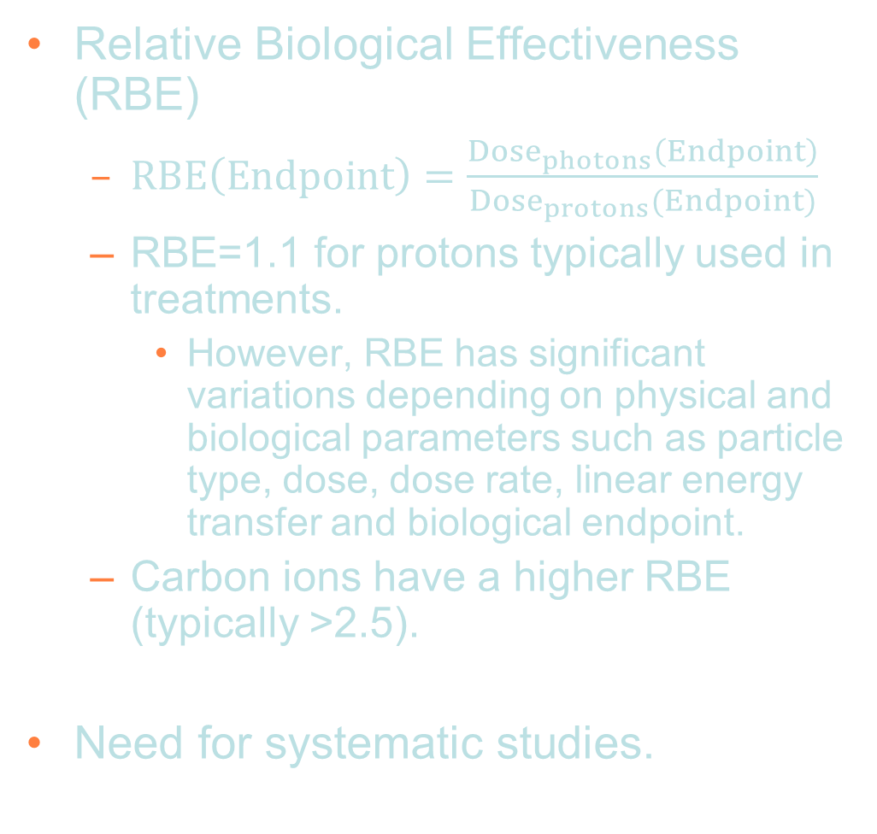
Challenges – Radiobiology
Relative Biological Effectiveness (RBE)
  $RBE\left(Endpoint\right)=\frac{Dose_{photons}\left(Endpoint\right)}{Dose_{protons}(Endpoint)}$
  RBE=1.1 for protons typically used in treatments.
    However, RBE has significant variations depending on physical and biological parameters such as particle type, dose, dose rate, linear energy transfer and biological endpoint.
  Carbon ions have a higher RBE (typically >2.5).
Need for systematic studies.
Experimental proton RBE values (relative to ⁶⁰Co).
Paganetti H et al. 2002 Relative biological effectiveness (RBE) values for proton beam therapy Int. J. Radiat. Oncol. Biol. Phys. 53 407–21

Slide 12
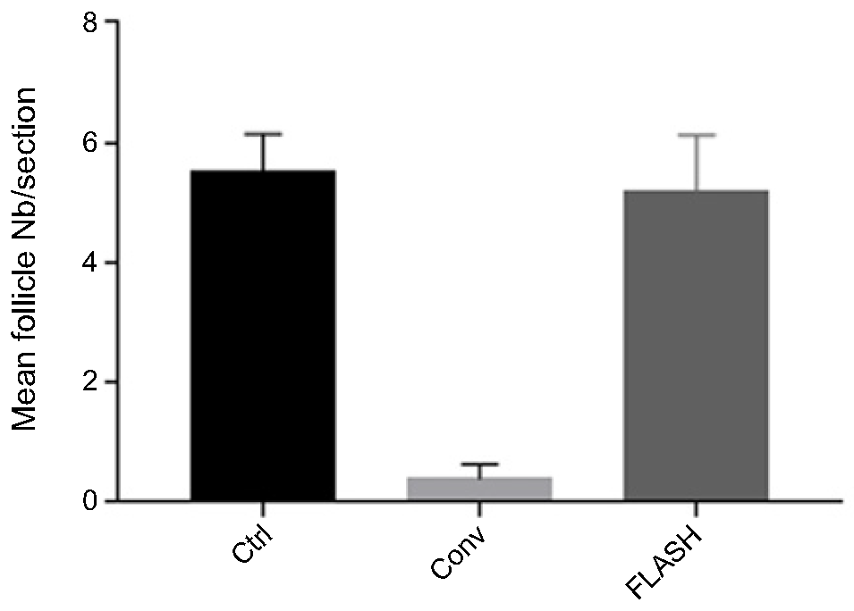
Challenges – Radiobiology
Ultra High Dose Rate/Flash treatment (>100Gy/s).
  Conventional dose rates are a few Gy/minute.
  Evidence to show improved normal tissue sparing.
    “The Advantage of FLASH Radiotherapy Confirmed in Mini-pig and Cat-cancer Patients.” Vozenin et al. Clin Cancer Res. 2019 Jan 1;25(1):35-42.
  Precise mechanism not known.
    In vivo and in vitro studies inconsistent.
  Potential to significantly improve outcomes.
Thirty-six weeks postradiotherapy, quantification of hair follicles per tissue sections has been performed on sections cut from 6-mm punch biopsies taken from nonirradiated, Conv-RT, and FLASH-RT patches (data are presented as number of hair follicle per tissue sections + SE)

Slide 13
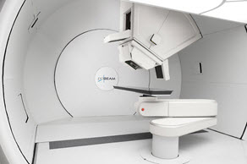
Challenges – Accelerator
Gantries.
  Used to rotate the beam around the patient.
  Significant cost of the accelerator facility.
Variable energy.
  Cyclotrons deliver beams at the final energy.
  Degraders are used to vary the beam energy
  but this produces radiation.
Low energy injection of cyclotrons limits
beam current due to space charge.
Multiple ion species.
  Synchrotrons can deliver multiple
  ion species but these have a larger
  footprint than cyclotrons → more costly.
Varian proton gantry
Proton and carbon synchrotron at MedAustron.

Slide 14
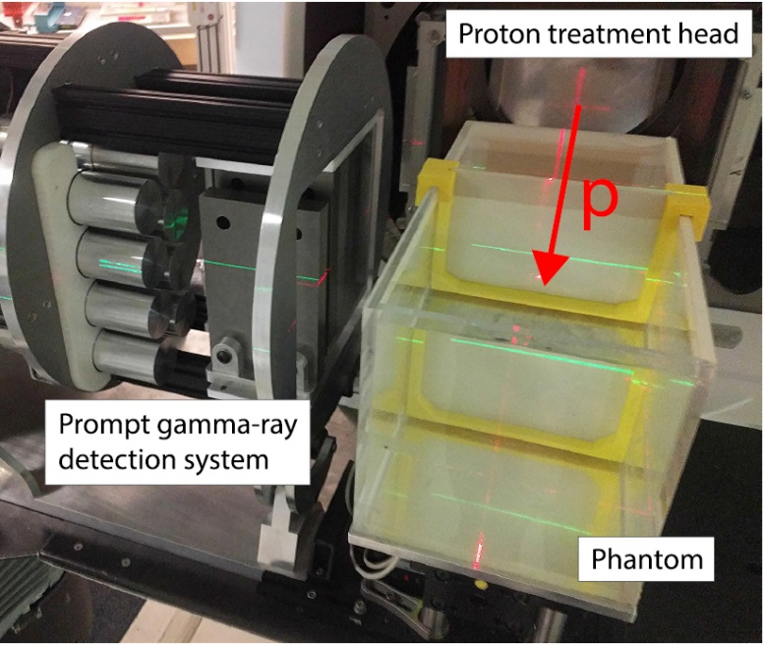
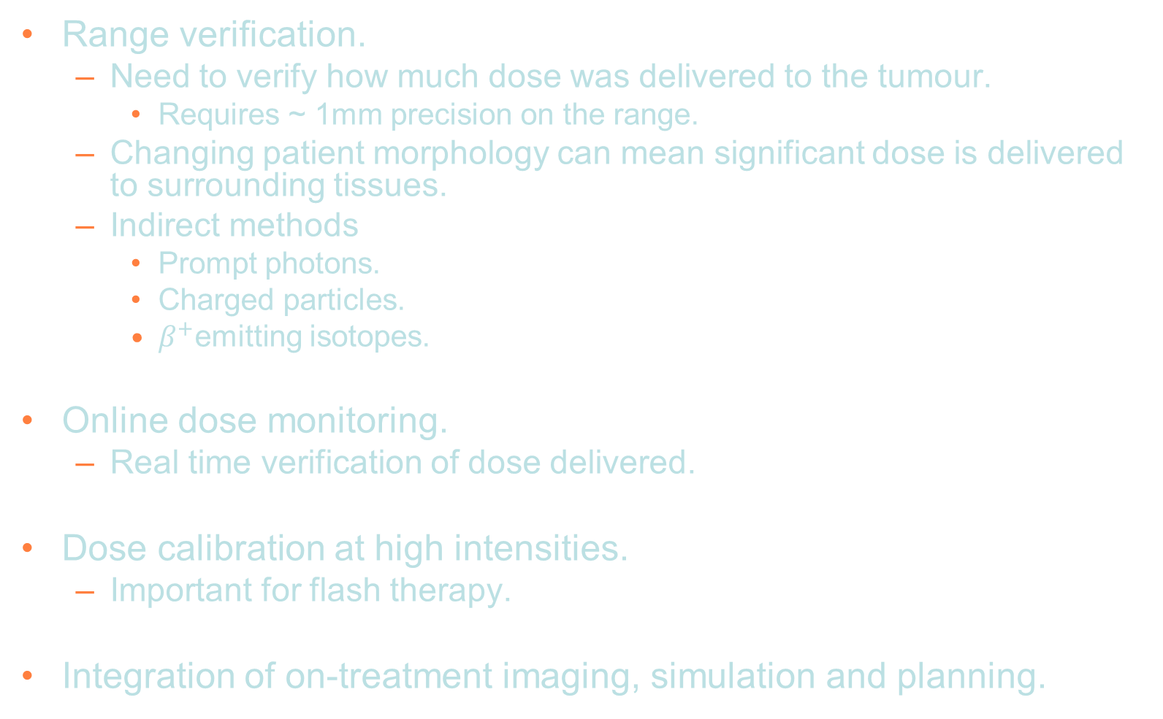
Challenges – Diagnostics and imaging
Range verification.
  Need to verify how much dose was delivered to the tumour.
    Requires ~ 1mm precision on the range.
  Changing patient morphology can mean significant dose is delivered to surrounding tissues.
  Indirect methods
    Prompt photons.
    Charged particles.
    $β^{+}$emitting isotopes.
Online dose monitoring.
  Real time verification of dose delivered.
Dose calibration at high intensities.
  Important for flash therapy.
Integration of on-treatment imaging, simulation and planning.
F. Hueso-González et al., “A full-scale clinical prototype for proton range verification using prompt gamma-ray spectroscopy”, Phys Med Biol. 2018;63(18):185019

Slide 15
The Centre for the Clinical Application of Particles

Slide 16





The CCAP
The CCAP is an interdisciplinary collaboration aiming to
  “develop the technologies, systems, techniques and capabilities necessary to deliver a paradigm shift in the clinical exploitation of particles.”
R&D areas: accelerators; detectors; and image processing.
Facility being proposed: Laser-hybrid Accelerator for Radiobiological Applications (LhARA).

Slide 17
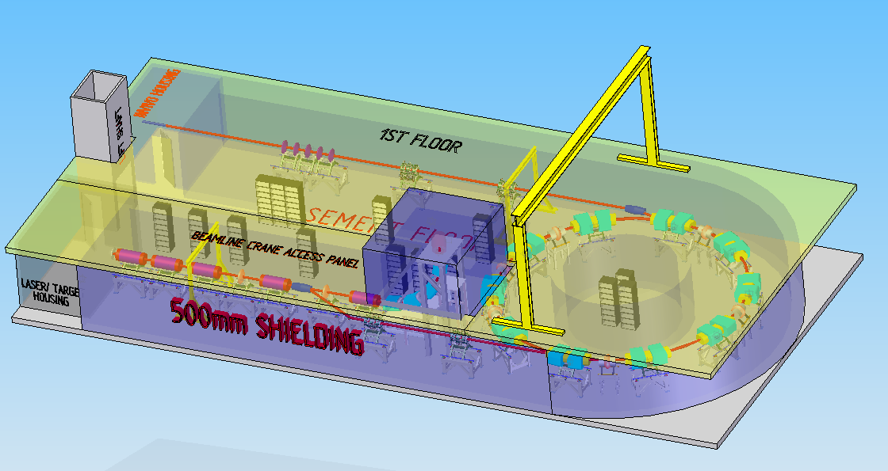
Laser-hybrid Accelerator for Radiobiological Applications (LhARA)
Dedicated facility for radiobiological research
  Systematic studies of RBE.
Unique features
  Large flux of protons and ions in very short bunches gives a
  very large instantaneous dose.
  Injection at 15MeV overcomes space charge limitations.
  Compact capture system.
Implementation in two stages.
  In vitro studies with protons at 15MeV.
  In vivo studies with 127MeV protons and in vitro studies with 33 MeV/u carbon 6+ ions.
Prove novel accelerator technology and novel diagnostics.
Developing conceptual design.
  A number of partners involved.
  Simulations using BDSIM – Geant4 based beam line tool kit.
    Simulate beam line and material interactions (important for simulating dose deposition in the cells).
  General Particle Tracer – accelerator simulation code includes space charge effects.

Slide 18


LhARA Stage 1 beam line
END STATION
Where the cells will be irradiated. The beam will be delivered vertically from below the cell culture plate.
LASER TARGET
Laser used to generate intense beams of different types of ions, e.g. protons and carbon ions.
beam
ENERGY SELECTION
A Gabor lens and a collimator are used to select particle energy.
y
z
2.55 m
45$°$
laser
11.58 m
CAPTURE SECTION
Gabor lenses used for compact focussing to capture the large divergence and energy spread of the laser-driven ion beam.
MATCHING
Two Gabor lenses are used to adjust the beam size and divergence in the end station.
90$°$ VERTICAL BEND
Combined function magnets deliver the beam vertically to the end station.

Slide 19
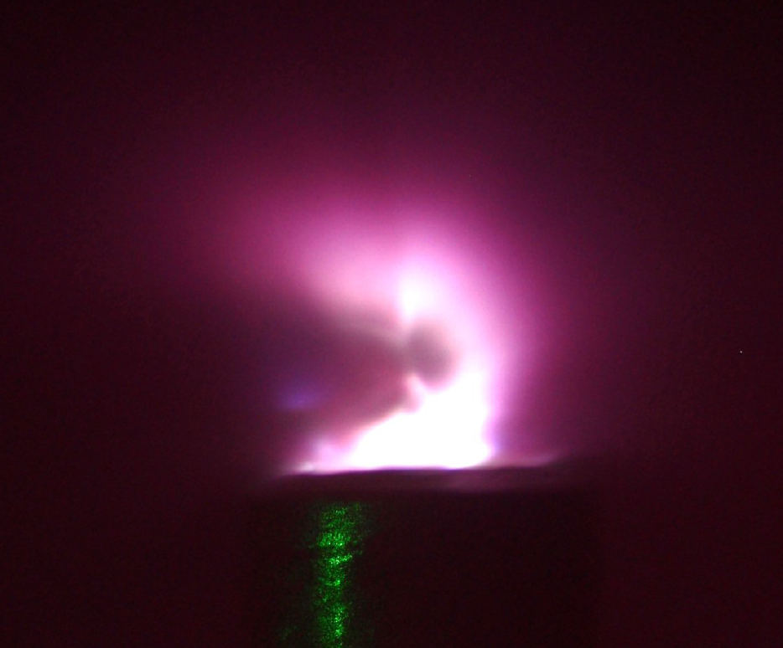

Laser source
Positive ions from hydrocarbon contamination on the target surface
LASER
45$°$
+
+
+
+
+
+
+
+
+
+
-
-
-
-
-
-
-
-
Ion beam
Electron sheath generated by the laser accelerates positive ions from the target
Principle of target normal sheath acceleration (TNSA).
Produces intense beams and multiple species, e.g. proton and carbon ions.
  Overcome space charge limit of conventional sources since beams are produced with energies O(10) MeV.
Issues to consider
  Large energy spread.
  Large divergence.
  Beam stability, especially if laser operated near the limits of its specifications.
A number of other proposals to use laser ion beams for medical applications.
Notes:
At the start we have a laser which is fired at a thin metal target at an angle of 45 deg. This then generates an ion beam from the surface of the target.
Using this method we can produce very intense beams but with a very large angular spread.
Simulations used a beam generated from the same parameters used in the optics design. Beta means small spot size and with this emittance that means you have a beam with a very large divergence.
Need a strong focusing element to prevent the beam being lost.

Slide 20
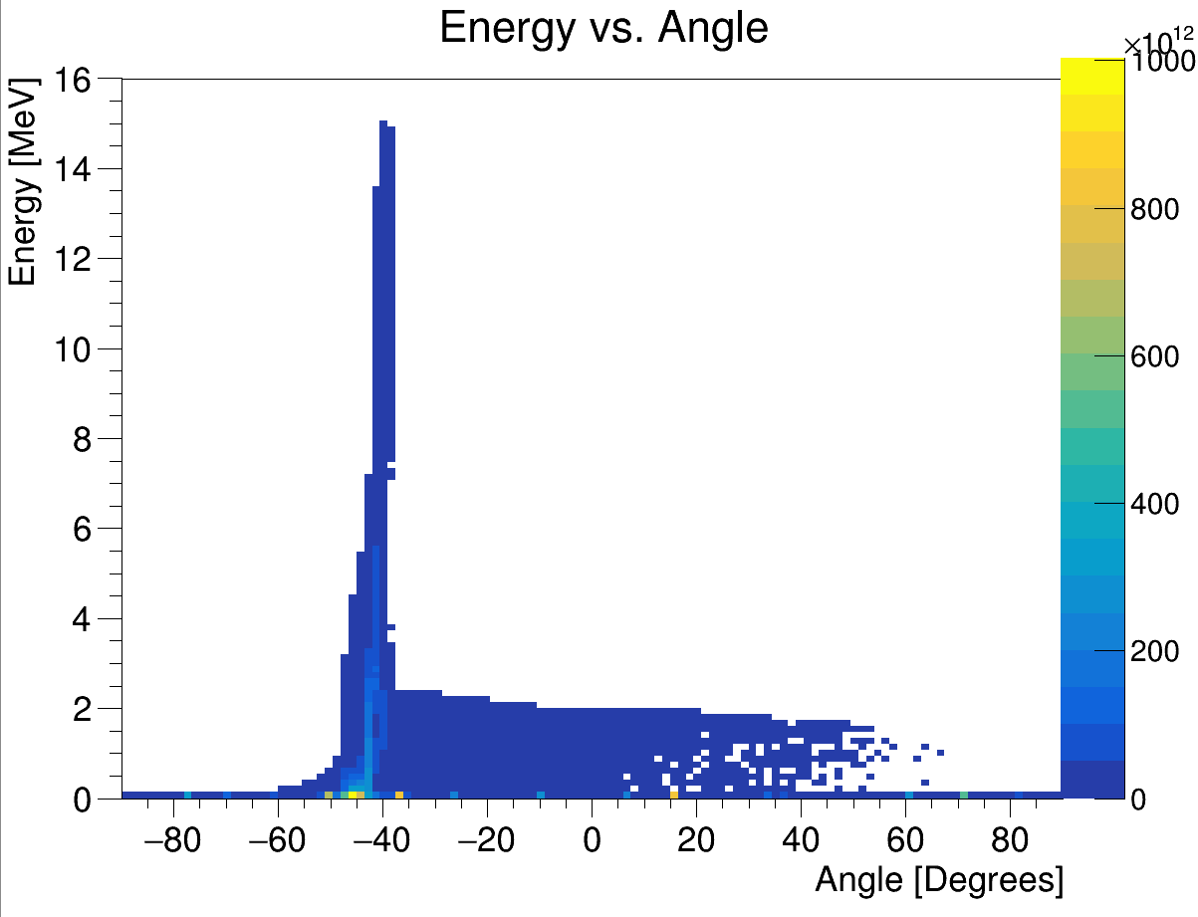
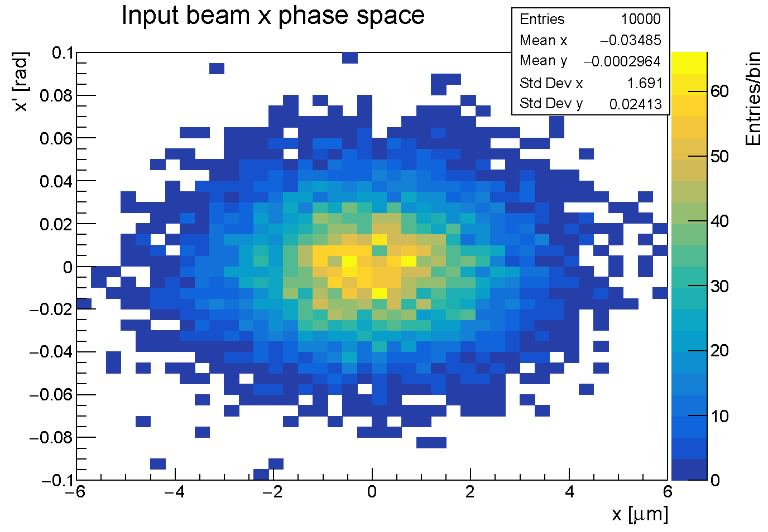
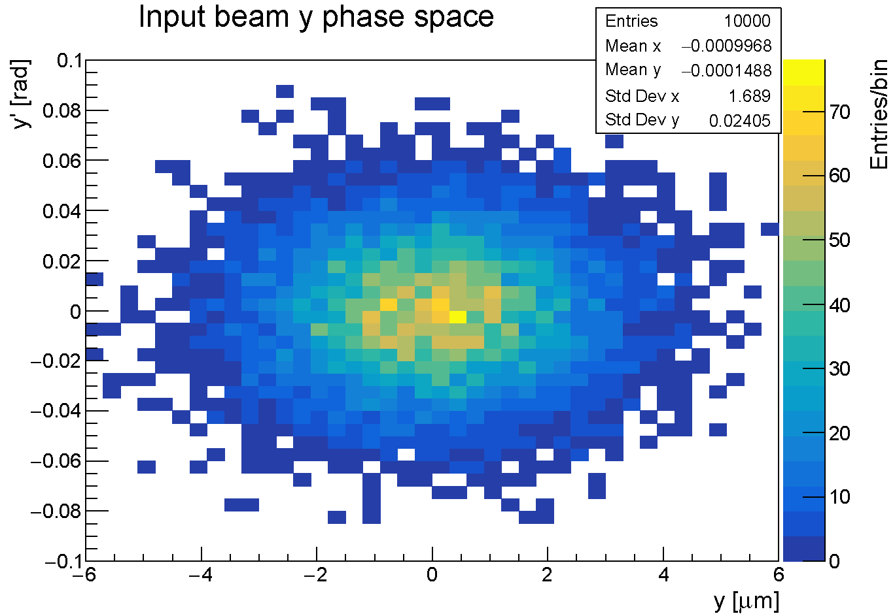
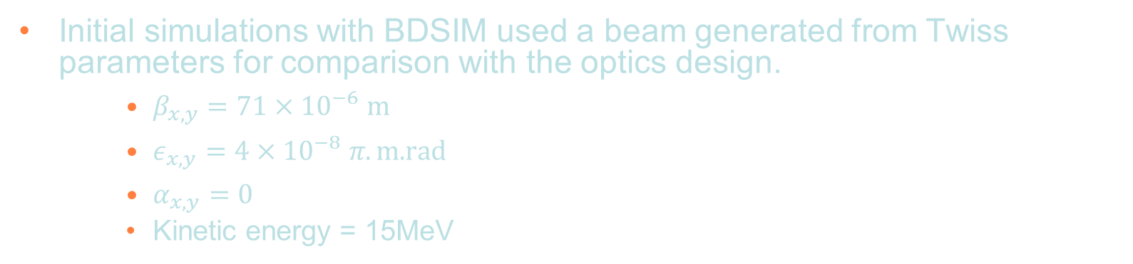
Initial Beam
Energy vs angle with respect to laser beam direction
x and y phase space of the input beam generated by BDSIM.
Laser driven ion beam simulation using EPOCH.
Initial simulations with BDSIM used a beam generated from Twiss parameters for comparison with the optics design.
    $β_{x,y}=71×{10}^{−6} m$
    $ε_{x,y}=4×{10}^{−8} π.\text{m}\text{.}\text{rad}$
    $α_{x,y}=0$
    Kinetic energy = 15MeV
Small beam size and large divergence.
Notes:
At the start we have a laser which is fired at a thin metal target at an angle of 45 deg. This then generates an ion beam from the surface of the target.
Using this method we can produce very intense beams but with a very large angular spread.
Simulations used a beam generated from the same parameters used in the optics design. Beta means small spot size and with this emittance that means you have a beam with a very large divergence.
Need a strong focusing element to prevent the beam being lost.

Slide 21
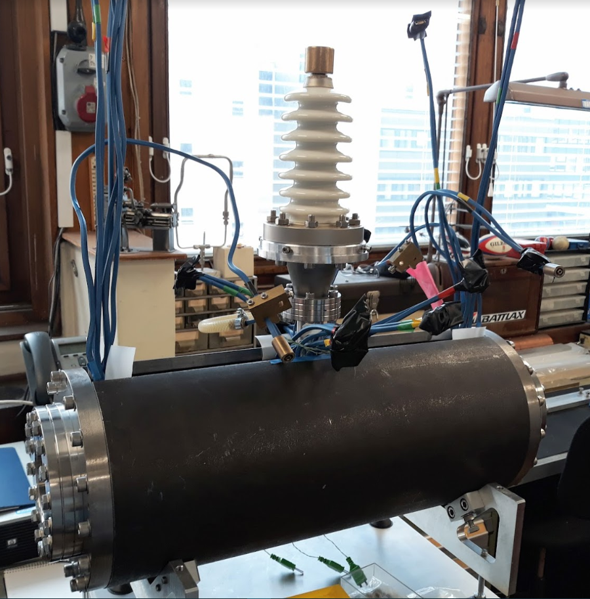
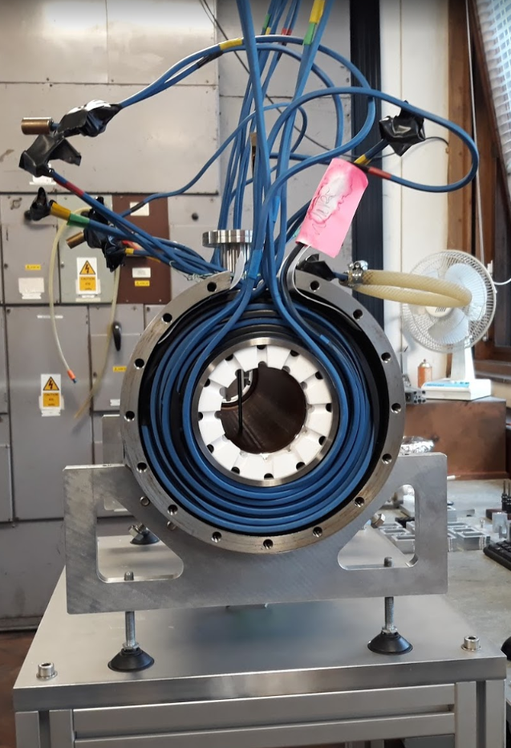
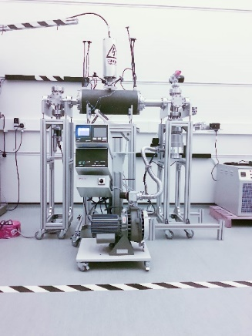
Capture
Solenoid coils
cylindrical
anode
Grounded
end plate
       
       
Grounded
end plate
Ion beam
Electron cloud
       
       
The Gabor lens uses a plasma to generate a strong electro-static focusing field.
Original prototype tested with a 1MeV proton beam at the Surrey Ion Beam Centre.
Gabor lens design being updated and will be tested.
  Vacuum tests.
  Tests with a radioactive source.
  Tests with the laser driven ion beam.
Original Gabor lens prototype was to be tested with the Cerberus laser at Imperial.
Gabor lens development at Imperial College London.
Notes:
What we plan to use to capture these particles is a a Gabor lens. This can provide a very strong focusing field in a short space by utilizing a confined electron plasma.
Schematic of the principle and a prototype at Imperial that we plan to test with a laser-ion beam.
To model in BDSIM
Lines from Jaroslaw’s beam optics code shows Beta_x and Beta_y (a measure of the beam envelope) are on top of each other. The points from BDSIM show the particle tracking simulations are well matched to the optics design.

Slide 22
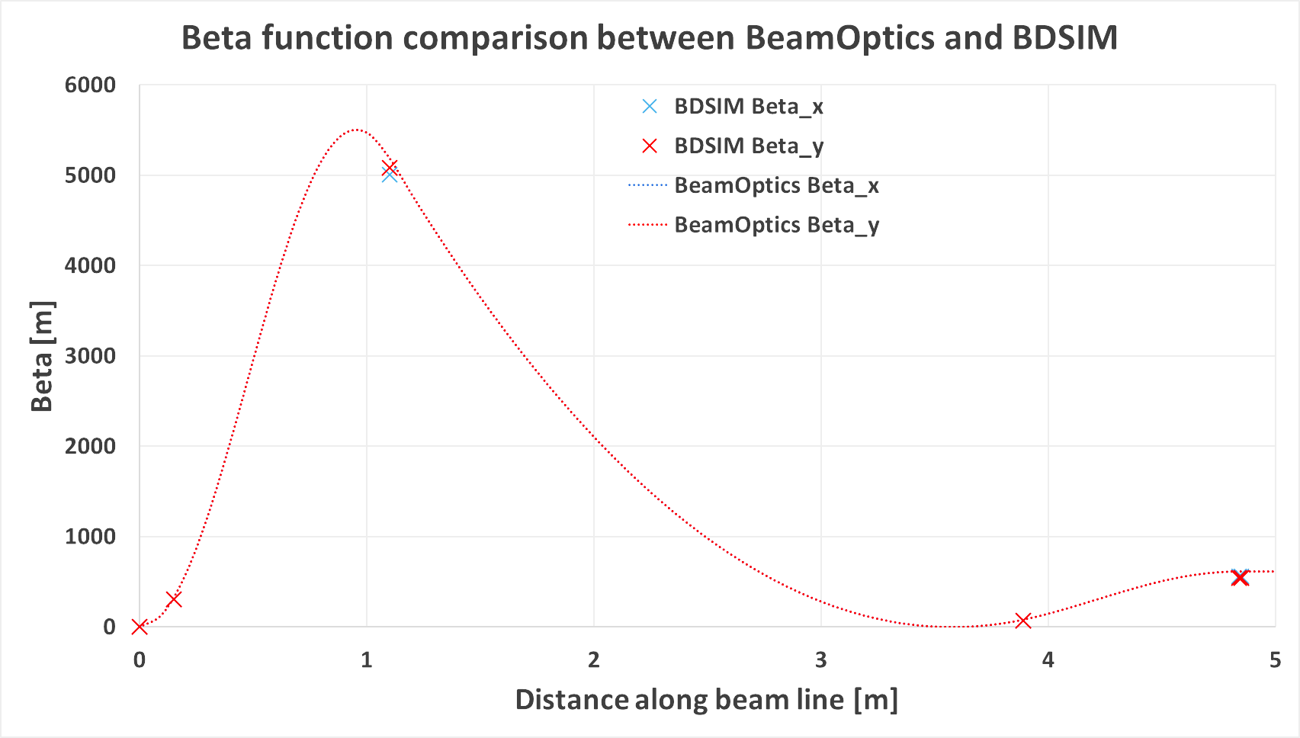
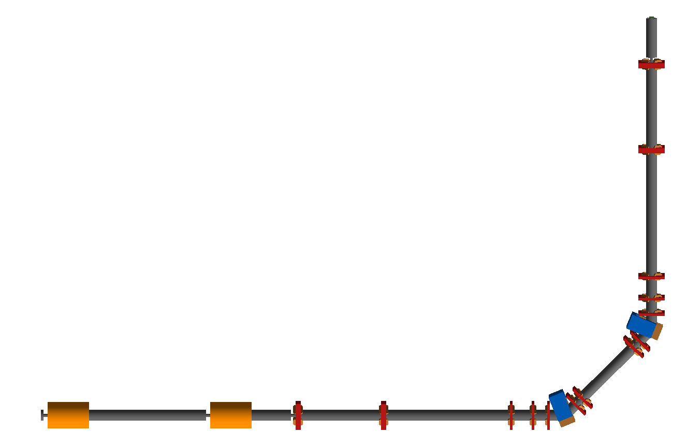
Tracking simulations
BDSIM (Beam Delivery Simulation), based on Geant4, is used to track particles from the laser target through the end station.
  Simulation of beam line elements.
  Tracking through 3D EM fields.
  Matrix propagator.
  Material interactions.
  Easy to extract beam optics parameters and energy deposition from the simulation.
Gabor lenses initially simulated as equivalent focal length solenoids.
  Convenience whilst the design is evolving.
  Will then use an EM simulation of the Gabor lens.

Slide 23
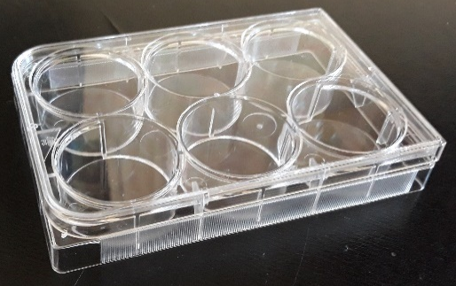
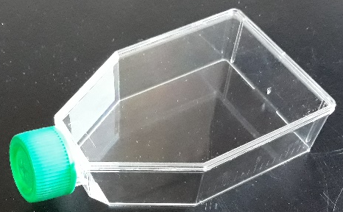
End station simulations
Material budget determines required beam energy.
  More material increases cost of laser.
  Consider cell sample containers.
Energy deposition and dose calculation very important for the design of the end station.
  Want the Bragg peak in the cell layer.
  Ensure efficient delivery of dose to the cells (i.e. minimize the time needed to irradiate a sample).
BDSIM provides energy loss along beam direction.
10 mm
15 mm cell nutrient
solution. G4_WATER
0.03 mm cell layer.
G4_SKIN_ICRP
1.15 mm sample
container base.
G4_POLYSTYRENE
5mm air gap.
G4_AIR
0.25 mm scintillating fibre layer. G4_POLYSTYRENE
0.075 mm vacuum window.
G4_MYLAR
beam
Notes:
The beam then arrives in the end station.
Important to minimize the amount of material in the beam line.
Vertical beam delivery cell sample containers filled with liquid and are open so prefer to be held horizontally.
Composition of the end station.

Slide 24
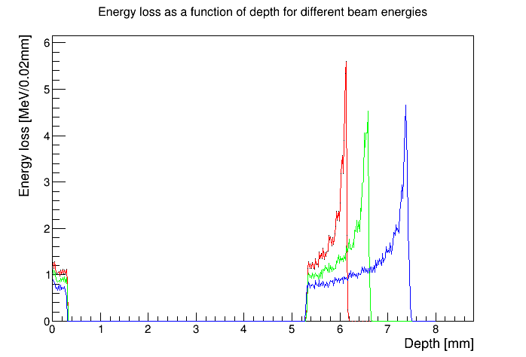
End station simulations
Energy loss in the end station using the beam tracked from after the capture section.
10 MeV
12 MeV
15 MeV
beam
0.075 mm vacuum window
0.25 mm scintillating fibre layer
1.15 mm sample
container base
0.03 mm cell layer
15 mm cell nutrient
solution
5 mm air gap
Notes:
This plot shows the energy loss as a function of depth.
Explain we are at 15MeV and then say why.
Can look at having the cells before the Bragg peak and in the tail of the Bragg peak.

Slide 25
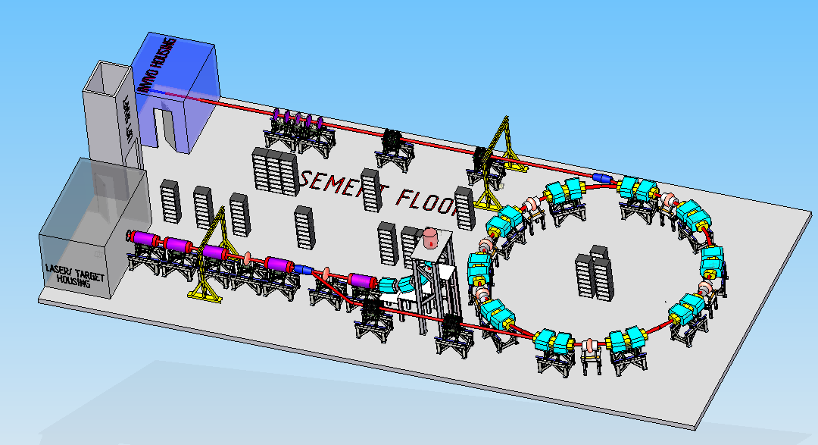
LARA – Stage II
Goal is to irradiate animal models.
  Need post-acceleration to increase energy of the beam driven by the laser.
Current solution is based on a fixed field accelerator.
  Can achieve factor 3 increase in momentum or more.
    15 MeV protons accelerated to 127 MeV.
    3.8 MeV/u carbon 6+ ions accelerated to 33 MeV/u.

Slide 26
Fixed Field Accelerator
Type of accelerator where the bending magnetic fields do not vary in time.
  Rapid acceleration.
Alternating gradient gives strong focussing.
Very large acceptance.
  Useful, e.g. to accelerate muon beams.
FFAG
F
D
D
High energy
Low energy
Beam dynamics (and orbits) are more complicated than the cyclotron.
Advantages over conventional medical cyclotrons.
  Variable energy operation without energy degraders.
  Operation with different ions.
  Multiple extraction ports.

Slide 27
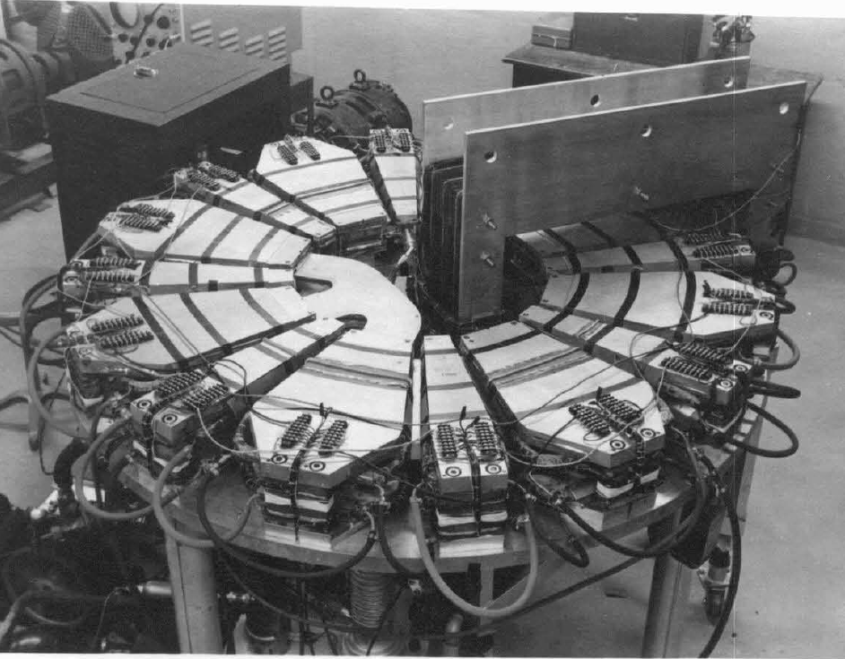
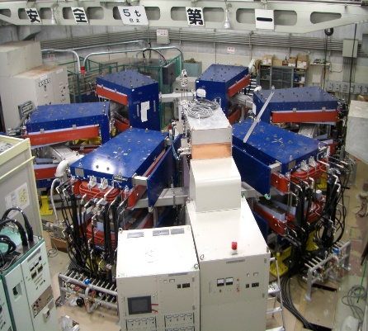
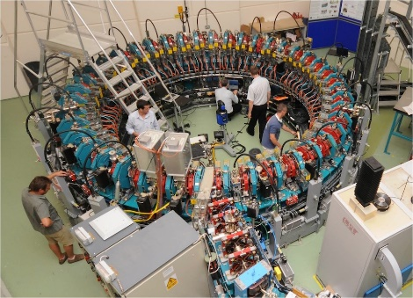
FFA
In the early 1950s, the idea for FFAs was developed independently in Japan by Tihiro Ohkawa, in the United States by Keith Symon, and in Russia by Andrei Kolomensky.
The first prototype was operated in 1956.
  Lawrence W. Jones, Kent M. Terwilliger, A Small Model Fixed Field Alternating Gradient Radial Sector Accelerator, Technical Report MURA-LWJ/KMT-5 (MURA-104), April 3, 1956.
Not much activity until first proton accelerator in 2000.
Number of applications in high-energy physics, accelerator-driven sub-critical reactors (ADSR) and medicine.
The Michigan Mark I FFA 400KeV electron accelerator was the first operational FFA.
Kyoto University FFA for ADSR
PRISM muon beam phase rotation demonstration ring at Osaka.
EMMA at Daresbury
500 keV Proton proof-of-principle FFA at KEK.

Slide 28
LhARA FFA
LhARA Ring Parameters
Number of sectors 10
k 5.19
Spiral angle 47.64°
R_{max} 3.49 m
R_{min} 2.92 m
B_{max} 1.4 T
Max Proton injection energy 15 MeV
Max Proton extraction energy 127.4 MeV
h 1
RF frequency
for acceleration (15-127.4MeV) 2.89 – 6.48 MHz
Bunch intensity ~10⁸ protons
J. Pasternak

Slide 29
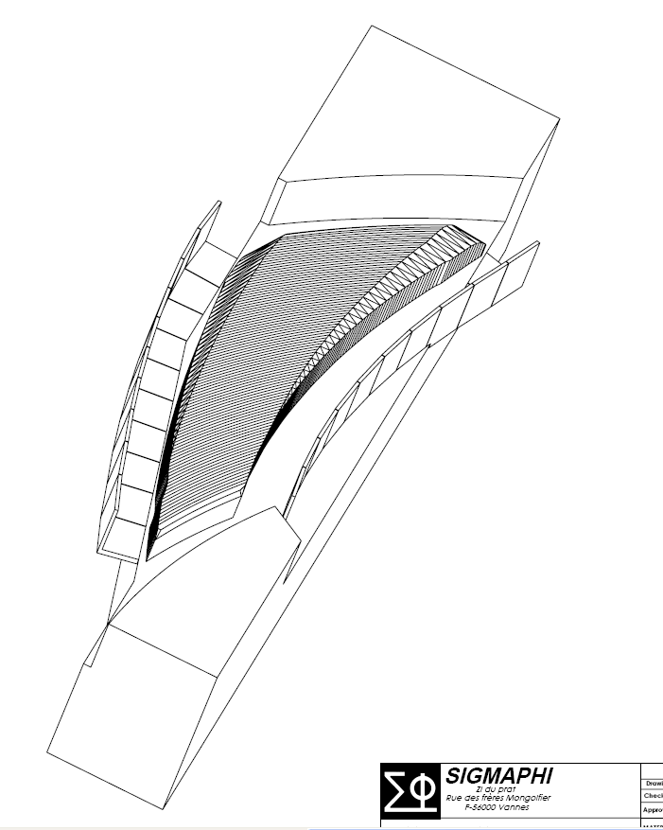
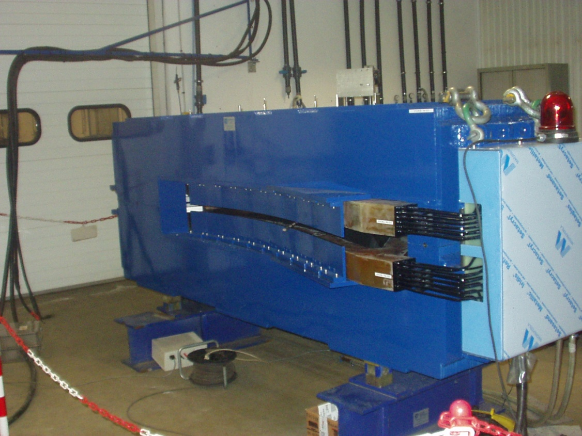
FFA – technical challenges for the magnet
Spiral FFA magnet built by SigmaPhi for the RACCAM project.
Magnet uses a variable chamfer and field clamp to stabilize the tune.
Constructed in 2008.

Slide 30
FFA – technical challenges for the RF
Low frequency and large frequency variation 3-7MHz.
Can use magnetic alloy (MA) cavities, e.g. like those used at J-PARC.
C. Ohmori et al., Phys. Rev. STAB 16, 112002 (2013)

Slide 31
Diagnostics
SciWire

Slide 32

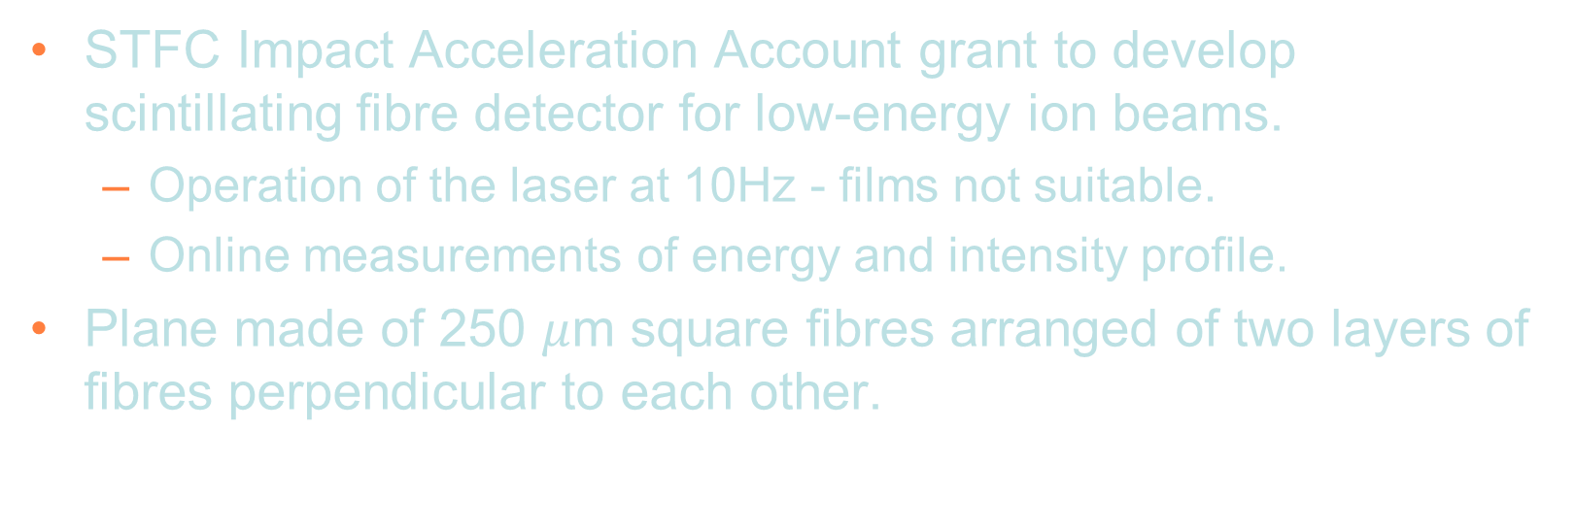
SciWire - Scintillating Fibre Detector
STFC Impact Acceleration Account grant to develop scintillating fibre detector for low-energy ion beams.
  Operation of the laser at 10Hz - films not suitable.
  Online measurements of energy and intensity profile.
Plane made of 250 $μ$m square fibres arranged of two layers of fibres perpendicular to each other.
Detector consists of multiple planes.
Scintillation light from all planes is read out from one side for each orientation.
250$μ$m
5cm
BEAM
5cm

Slide 33
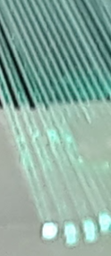
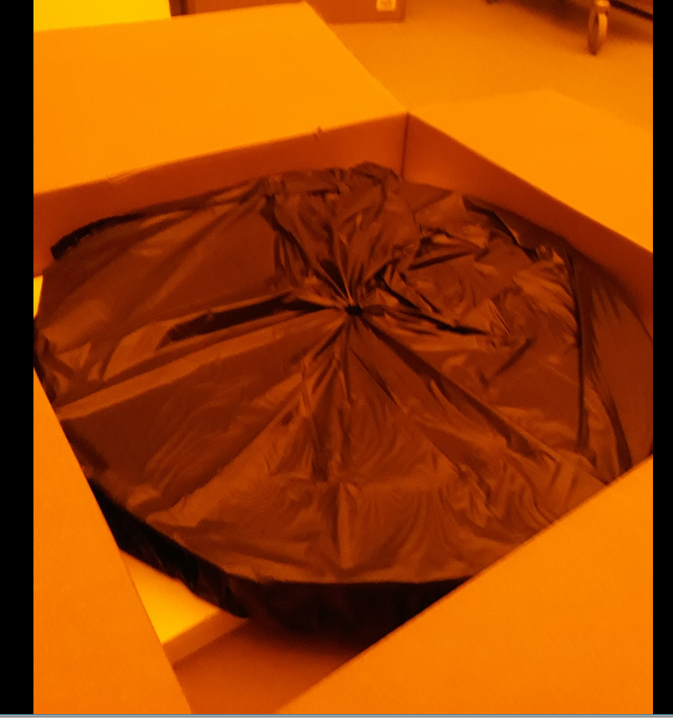
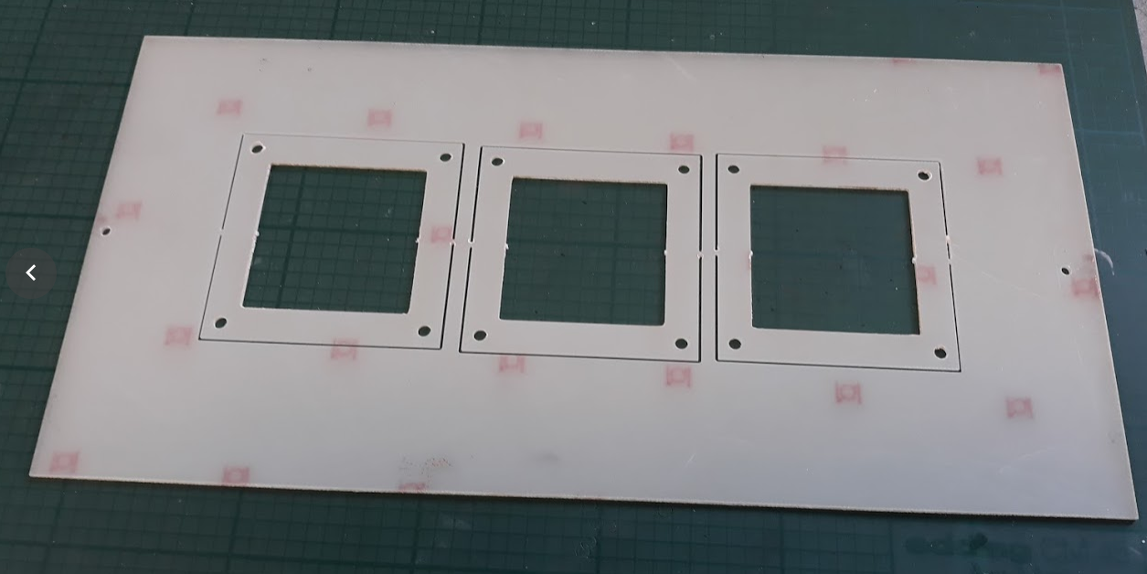
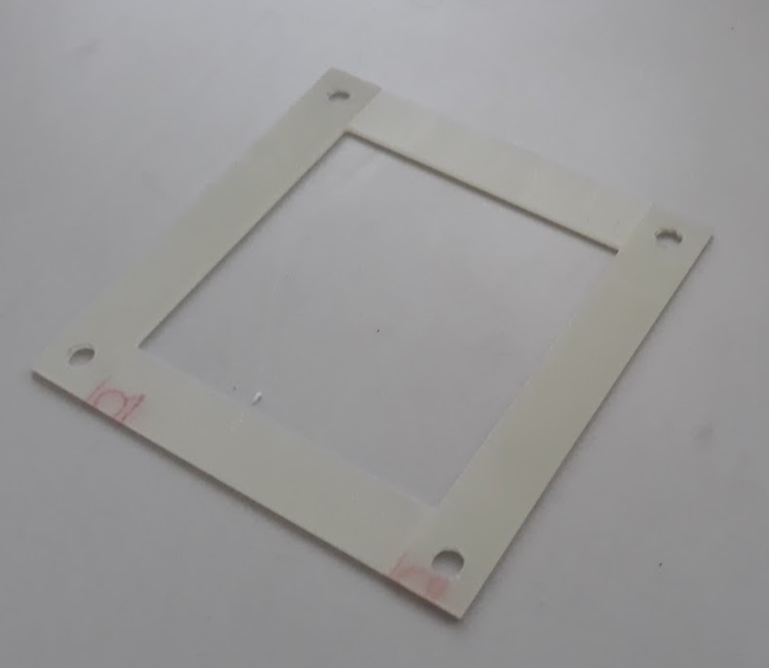
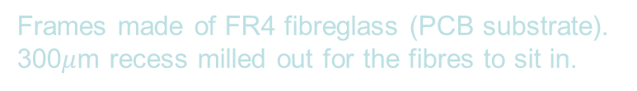
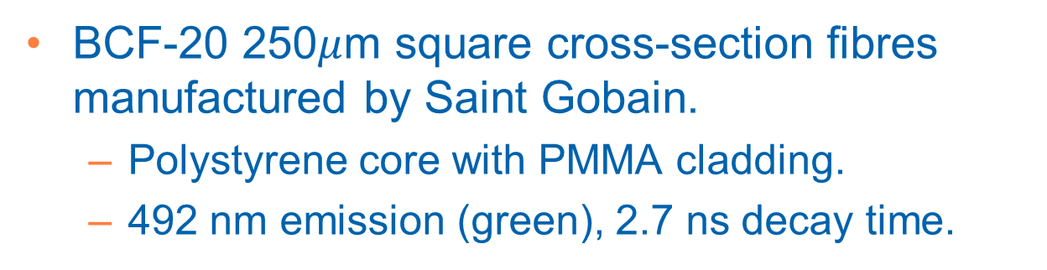
Fibres
BCF-20 250$μ$m square cross-section fibres manufactured by Saint Gobain.
  Polystyrene core with PMMA cladding.
  492 nm emission (green), 2.7 ns decay time.
840m on a cardboard spool 76cm diameter.
Frames made of FR4 fibreglass (PCB substrate).
300$μ$m recess milled out for the fibres to sit in.

Slide 34
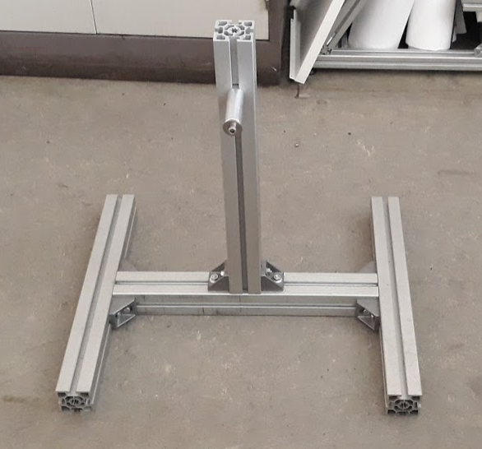
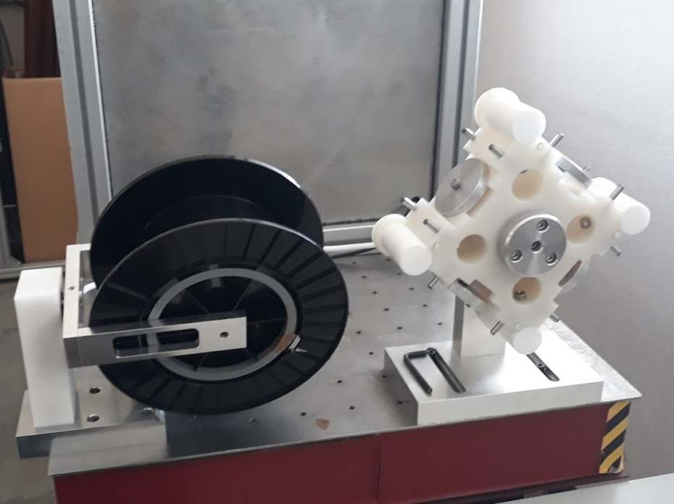
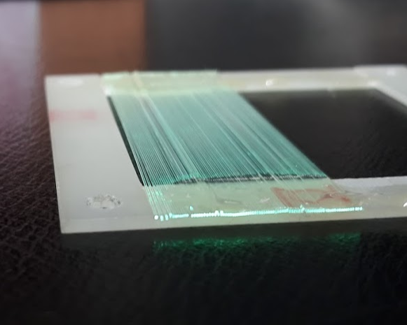
Fibre Winding
Rotating spool to take out any twists.
Jig designed to wind 4 frames at a time.
Tensioning done manually.
Microscope for visual inspection while winding.
Main spool stand, intermediate spool and winding jig.
First attempt test winding.

Slide 35
Detector performance characterisation
Step a Sr⁹⁰ source across face of the detector, positioning the source at the centre of a pair of x and y fibres.
Measure.
  Position resolution.
  Cross-talk.
Possibility of calibrating energy profile measurements.
Sr⁹⁰

Slide 36
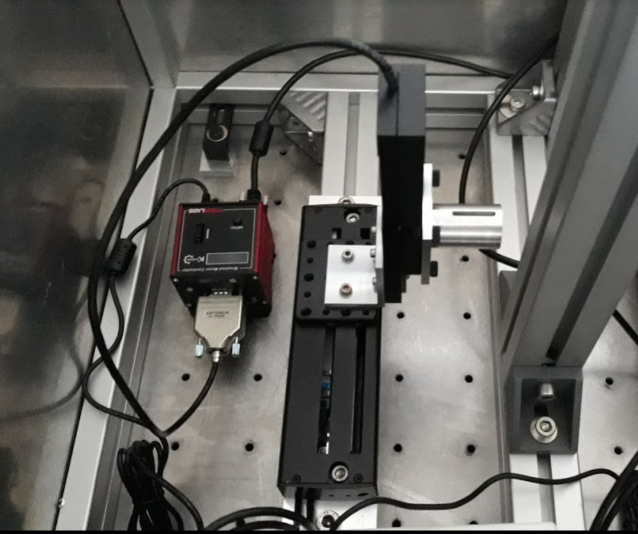
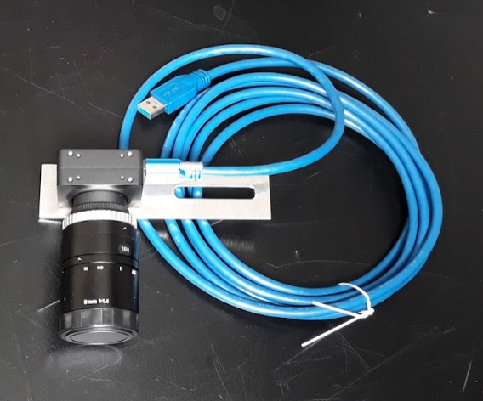
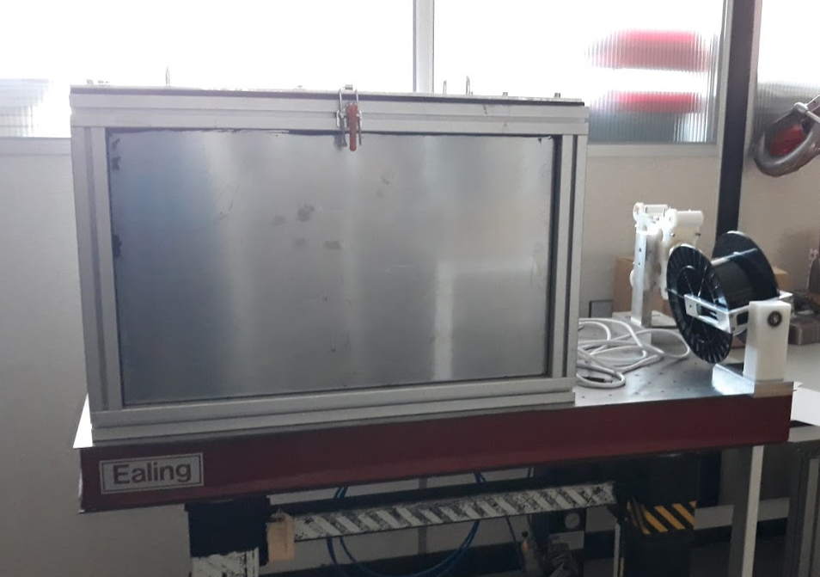

Detector performance characterisation
2 linear drive stages from Thorlabs mounted perpendicular to each other.
2 FLIR Chameleon-3 USB cameras.
1.7MBq Sr-90 source
Controlled using LabVIEW.
Initial tests with the source done.
Potential for further investigations but the project is now concluded.

Slide 37
Diagnostics
SmartPhantom

Slide 38

SmartPhantom
A water phantom is used to simulate the energy absorbed by the body.
  Water filled box or water equivalent plastic.
  Dose calibration.
  Radiobiological studies.
Cell sample irradiation in a water phantom
studies at MedAustron.
  Investigate RBE for protons and carbon ions.
  Look at effect of equivalent dose before and after Bragg peak.
  Previous water phantom studies at MedAustron used separate runs for cell irradiation and dosimetry.
STFC Impact Acceleration Account to develop an instrumented phantom that can measure the dose profile shot-by-shot (up to 10Hz) delivered to the cell sample.
T41023 from PTW

Slide 39




SmartPhantom Concept
250 $μ$m scintillating fibre layer, in a doublet structure, with clear fibre to the CMOS camera read-out.
5 stations located before the sample flask, each made of two fibre doublet layers arranged perpendicular to each other.
Measure energy deposition as a function of position and reconstruct Bragg peak location to measure energy deposited in the cell sample.

Slide 40

SmartPhantom Manufacturing
Tensioning and alignment test using fishing wire.
Alternative fibre support frame design for additional stiffness.
Finalising support frame design then will start manufacturing the prototype detector.
Read-out tests using the Sr-90 source.
Beam time at MedAustron early December!
Frame winding jig. Four frames are wound simultaneously.

Slide 41
Summary and Outlook
Overview of why particle therapy is important and key challenges for improving it.
CCAP has an exciting R&D program to make a significant impact in improving cancer therapy!
  LhARA will be a dedicated facility to improve our understanding of radiobiology.
    Test bed for novel accelerator technology and diagnostics.
Outlook
  Obtained STFC funding to develop conceptual design of LhARA.
  Development of improved Gabor lens design and tests with laser-driven ion beams.
  SmartPhantom testing at MedAustron in December.

Slide 42
Thank you !

