Slide 1


LhARA the Laser-hybrid Accelerator for Radiobiological Applications
for the LhARA collaboration
Serving the Ion Therapy Research Facility with

Slide 2
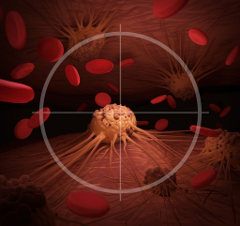
LhARA collaboration’s mission
Create a uniquely-flexible, novel system that will:
Deliver a systematic and definitive radiobiology programme
Prove the feasibility of the laser-hybrid approach
Lay the foundations for transformative ion-beam therapy
Highly automated, patient-specific
Implies triggerable source, online imaging, integrated fast feedback and control

Slide 3
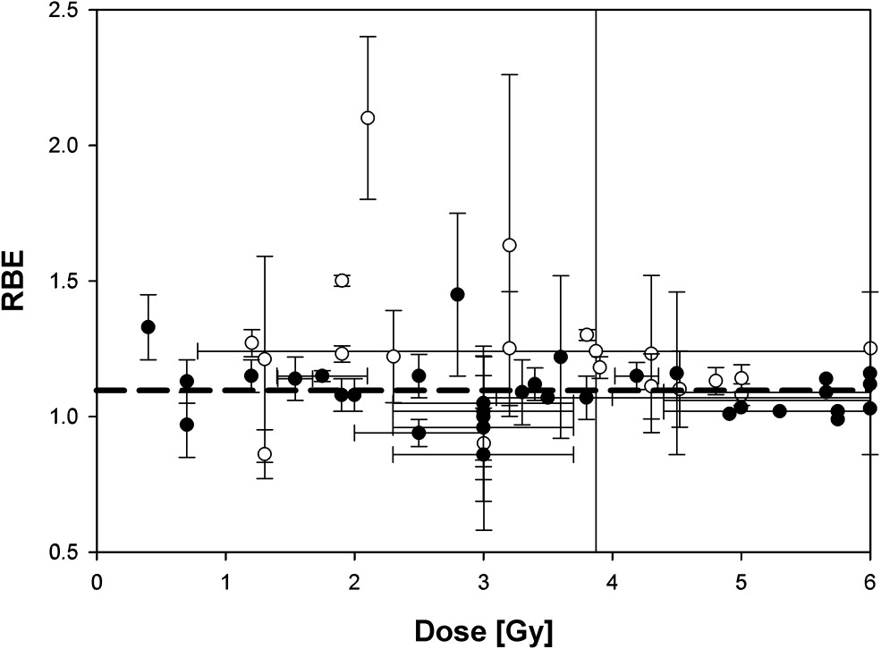
The case for fundamental radiobiology
Relative biological effectiveness:
Defined relative to reference X-ray beam
Known to depend on:
Energy
Ion species
Dose
Dose spatial distribution
Dose rate
Tissue type
Biological endpoint
Yet:
All p-treatment planning uses RBE = 1.1
Effective values are used for C⁶⁺
Maximise the efficacy of PBT now & in future:
Systematic programme needed to develop full understanding of radiobiology
Paganetti, van Luijk (2013)
SemRadOncol

Slide 4
Radiobiology in new regimens
Time
domain
Space
domain
The ideally flexible beam facility can deliver it all!
⇒ substantial opportunity for a step-change in understanding!
Ion
species
Energy
In combination with chemo/immuno Therapies

Slide 5
The case for transformative ion-beam therapy
Cancer: second most common cause of death globally
Radiotherapy indicated in half of all cancer patients
Significant growth in global demand anticipated:
14.1 million new cases in 2012 ⇢ 24.6 million by 2030
8.2 million cancer deaths in 2012 ⇢ 13.0 million by 2030
Scale-up in provision essential:
Projections above based on reported cases (i.e. high-income countries)
Opportunity: save 26.9 million lives in low/middle income countries by 2035
Provision on this scale requires:
Development of new and novel techniques…integrated in a
Cost-effective system to allow a distributed network of RT facilities
Atun, Lancet Oncol. 2015 Sep;16(10):1153-86

Slide 6
The LhARA laser-hybrid approach is disruptive
The LhARA initiative will:
Create the capability to deliver particle-beam therapy in completely new regimens
Flexibility!
Combine a variety of ion species in a single treatment facility, exploiting ultra-high dose rates in novel spatial- and spectral-fractionation schemes
Make "best in class" treatments available to the many
Automated, triggerable system → reduce requirement for large gantry:
Incorporate dose-deposition imaging in fast feedback-and-control system; track movement, deliver dose at optimum tissue alignment

Slide 7
Laser-hybrid Accelerator for Radiobiological Applications
A novel, hybrid, approach:
Laser-driven, high-flux proton/ion source
Overcome instantaneous dose-rate limitation
Capture at >10 MeV
Deliver protons or ions in very short pulses
Bunches as short as 10—40 ns
Triggerable; arbitrary pulse structure
Novel “electron-plasma-lens” capture & focusing
Strong focusing (short focal length) without use of high-field solenoid
Fast, flexible, fixed-field post acceleration
Variable energy
Protons: 15—127 MeV
Ions: 5—34 MeV/u
Front. Phys., 29 September 2020; DOI: 10.3389/fphy.2020.567738

Slide 8
Collaboration and STFC labs now developing “Preliminary Phase” programme
WP1: Project management
Project management
Stakeholder engagement & PPI
WP4: Ion-acoustic dose profiling
WP2: Ion source
LhARA collaboration open to new collaborators:
Fantastic ambitions!
Outstanding opportunities!
WP5: Novel end station development
WP6: Design and integration
WP3: Capture

Slide 9

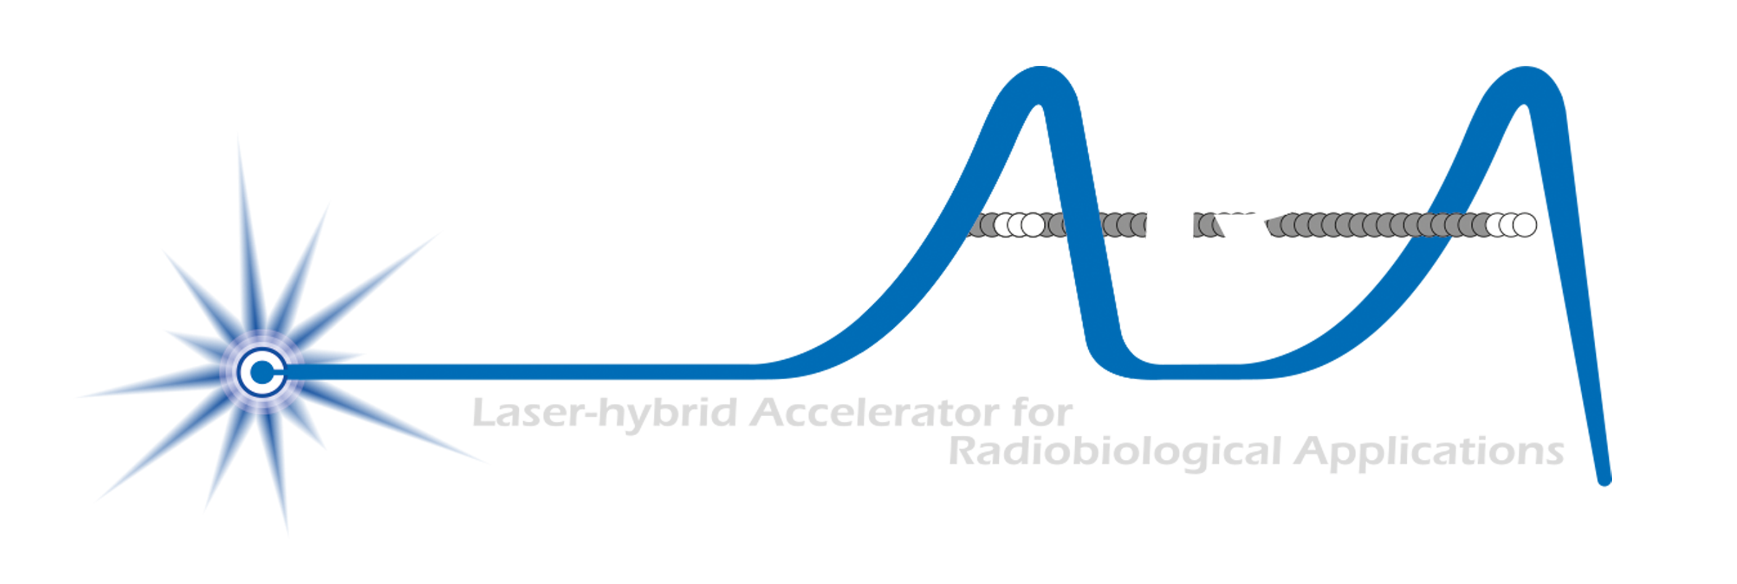

Conclusions
Laser-driven source is a disruptive technology
Has the potential to drive a step-change in clinical capability
Laser-hybrid approach can:
Overcome dose-rate limitations of present proton and ion beam therapy sources
Deliver a uniquely flexible facility:
Range of ion species, energy, dose, dose-rate and time and spatial distribution
Be used in automated, triggerable system → reduce requirement for large gantry
Transformative approach to proton and ion-beam therapy for 2040
By serving the ITRF the LhARA collaboration now seeks to:
Prove the novel laser-hybrid system in operation
Provide facility capable of delivering broad & definitive radiation biology programme
Create the novel capabilities required to transform proton and ion beam therapy

