Slide 1
The Laser-hybrid Accelerator for Radiobiological Applications LhARA
arXiv:2006.00493

Slide 2
Challenges and opportunities
The Laser-hybrid Accelerator for Radiobiological Applications (LhARA)

Slide 3
Radiotherapy; the challenge
Cancer is the second leading cause of death globally (WHO)
Radiotherapy indicated in half of all cancer patients
Growing requirement for radiotherapy:
High-income countries: anticipate significant growth in demand
Low/middle income countries; enormous unmet need:
Opportunity to save ~30 million lives by 2035
Scale-up in provision essential:
Requires:
Development of new and novel techniques … integrated in a
Cost-effective system to allow a distributed network of RT facilities
Atun, Lancet Oncol. 2015 Sep;16(10):1153-86

Slide 4
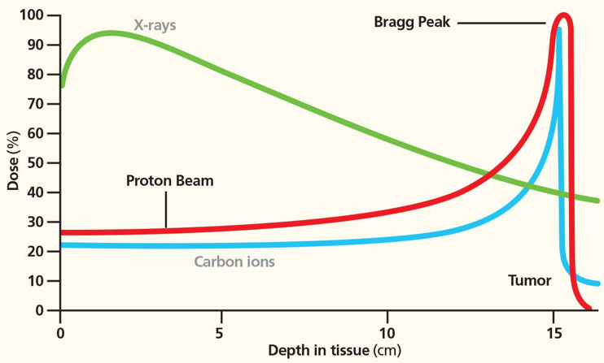
Particle-beam therapy
Proton and ion-beam therapy:
Bulk of dose deposited in Bragg peak
Significant normal-tissue sparing (entry)
Almost no dose beyond the Bragg peak

Slide 5
LhARA … the vision
The execution of the LhARA programme will:
Create the capability to deliver particle-beam therapy in completely new regimens
Flexibility!
Combine a variety of ion species in a single treatment fraction, exploiting ultra-high dose rates in novel spatial- and spectral-fractionation schemes
Make "best in class" treatments available to the many
Automated, triggerable system → reduce requirement for large gantry:
System incorporating dose-deposition imaging in fast feedback-and-control system; track movement, deliver dose at optimum tissue alignment

Slide 6
Radiobiology
The Laser-hybrid Accelerator for Radiobiological Applications (LhARA)

Slide 7
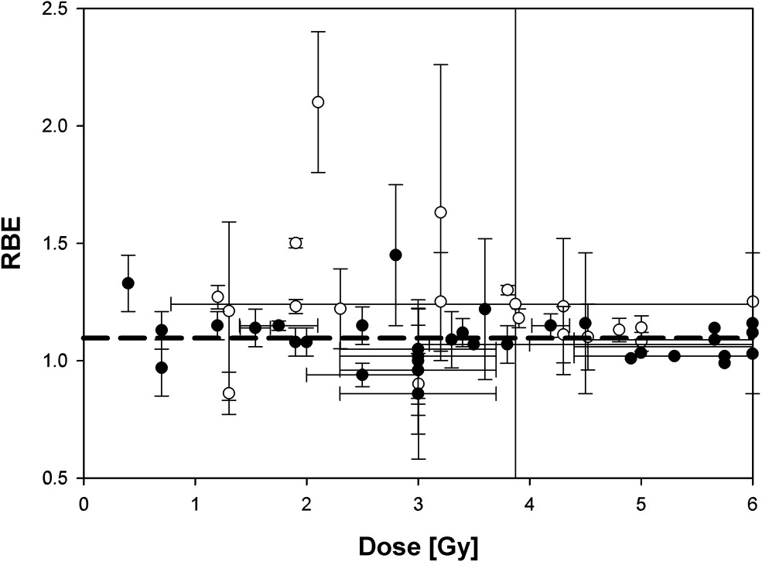
The radiobiology needs to be understood
Relative Biological Effectivness (RBE):
Ratio of dose required to gain same biological response as reference photon beam
Paganetti, van Luijk Sem. Rad. Oncol (2013)
RBE known to depend on:
Energy, ion species
Dose & dose rate
Tissue type
Biological endpoint
Treatment planning:
Based on RBE:
Proton-treatment planning uses RBE = 1.1
Effective values are used for C⁶⁺
Essential: improved, fundamental, understanding of radiobiology

Slide 8
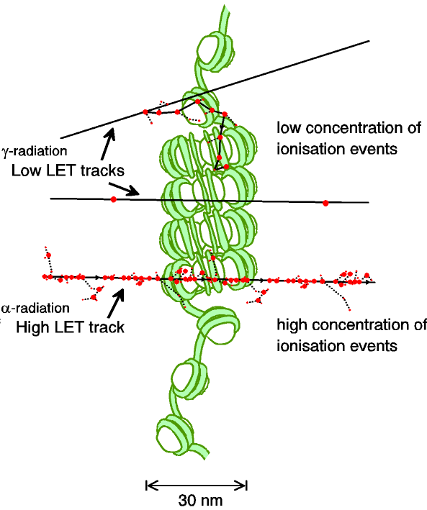
Biological impact ^{from the} physics of ionisation
Low-LET radiation:
Repairable single/double strand breaks
High-LET radiation:
Complex DNA lesions
Multiple DNA pathways
More difficult to repair
Enhances cell death
Programmatic approach:
Dynamic studies of impact of radiation
Interpret with advanced computer models (e.g. G4DNA)
Parsons et al.

Slide 9
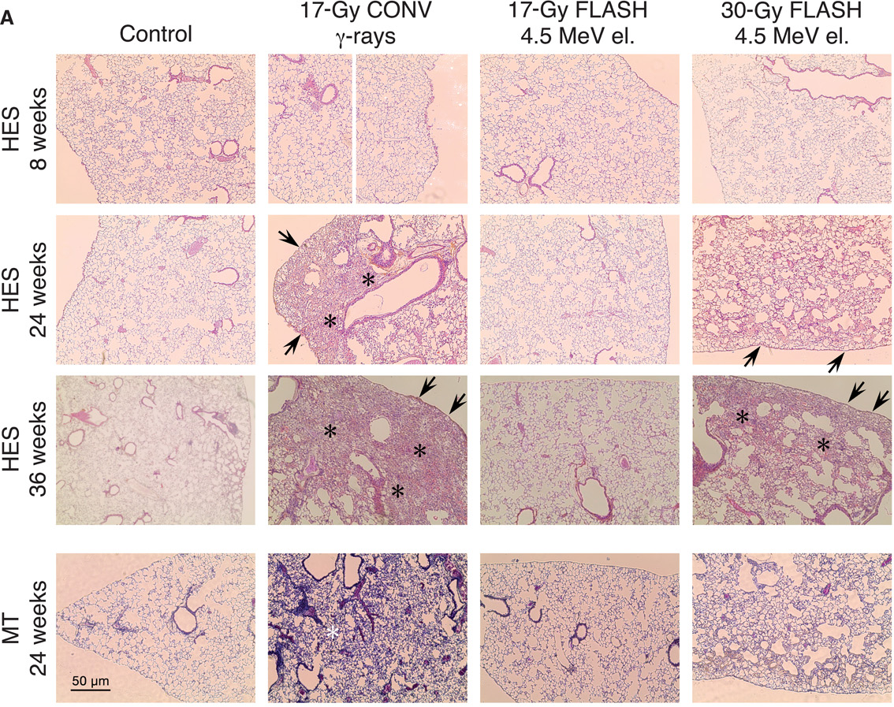
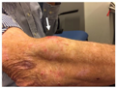
Radiobiology in new regimens
Temporal dependence
Worked example: FLASH
Conventional regime n: ~2 Gy/min
FLASH regime : >40 Gy/s
Evidence of normal-tissue sparing while tumour-kill probability is maintained:
i.e. enhanced therapeutic window
Time line:
Initial reports: 2014 (e.g. Flauvadon et al, STM Jul 2014)
Confirmation in mini-pig & cat: 2018 (Clin. Cancer Research 2018)
First treatment 2019 (Bourhis et al, Rad.Onc. Oct 2019)

Slide 10
Radiobiology in new regimens
Spatial dependence
Worked example: micro beams
Conventional regime : > 1 cm diameter; homogeous
Microbeam regime : < 1 mm diameter; no dose between ‘doselets’
Remarkable increase of normal rat brain resistance.
[Dilmanian et al. 2006, Prezado et al., Rad. Research 2015]
Dose escalation in the tumour possible – larger tumor control prob.

Slide 11
Radiobiology in new regimens

Slide 12
LhARA
The Laser-hybrid Accelerator for Radiobiological Applications (LhARA)

Slide 13
Laser-hybrid Accelerator for Radiobiological Applications
A novel, hybrid, approach:
Laser-driven, high-flux proton/ion source
Overcome instantaneous dose-rate limitation
Capture at >10 MeV
Delivers protons or ions in very short pulses
Bunches as short as 10—40 ns
Triggerable; arbitrary pulse structure
Novel “electron-plasma-lens” capture & focusing
Strong focusing (short focal length) without the use of high-field solenoid
Fast, flexible, fixed-field post acceleration
Variable energy
Protons: 15—127 MeV
Ions: 5—34 MeV/u

Slide 14
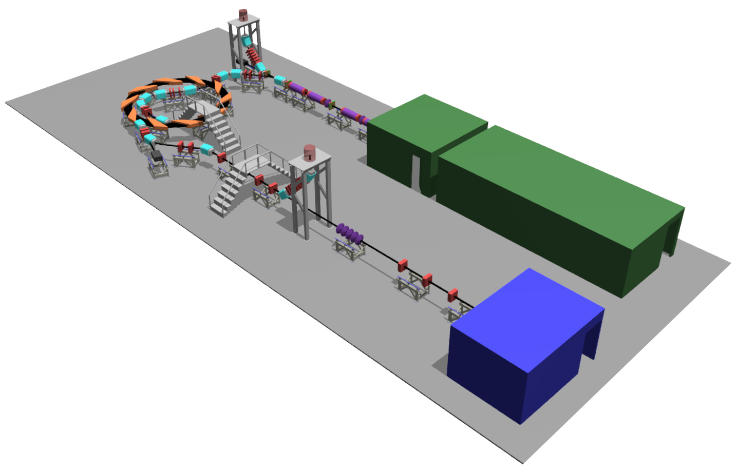
LhARA
arXiv:2006.00493

Slide 15
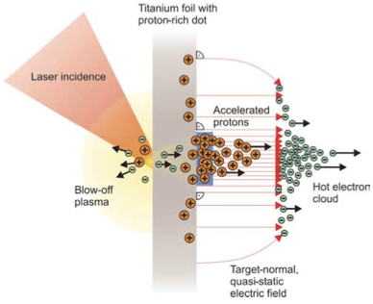
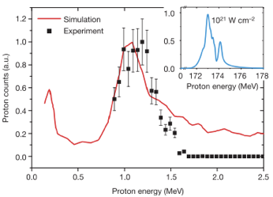
Sheath acceleration
Laser incident on foil target:
Drives electrons from material
Creates enormous electric field
Field accelerates protons/ions
Dependent on nature of target
Active development:
Laser: power and rep. rate
Target material, transport
Schwoerer, H. et al., 2006; Nature, 439(7075).

Slide 16
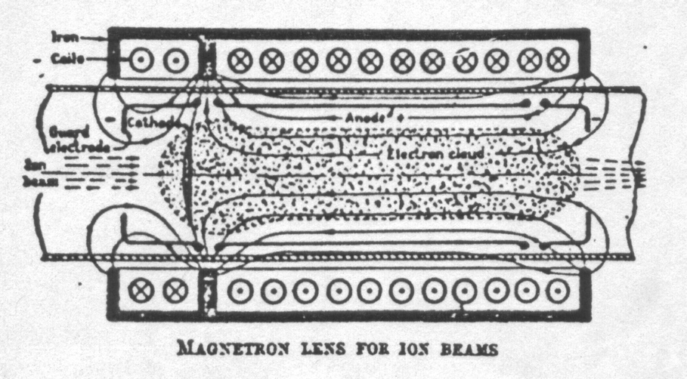
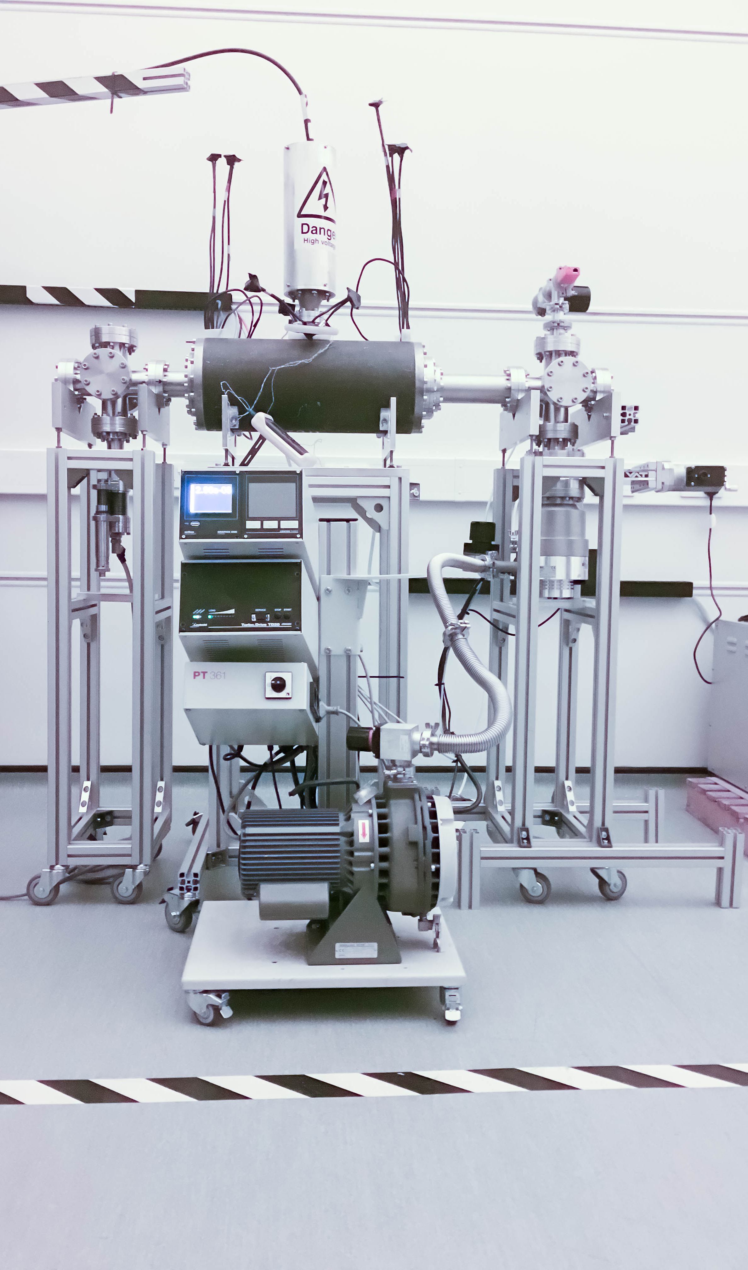
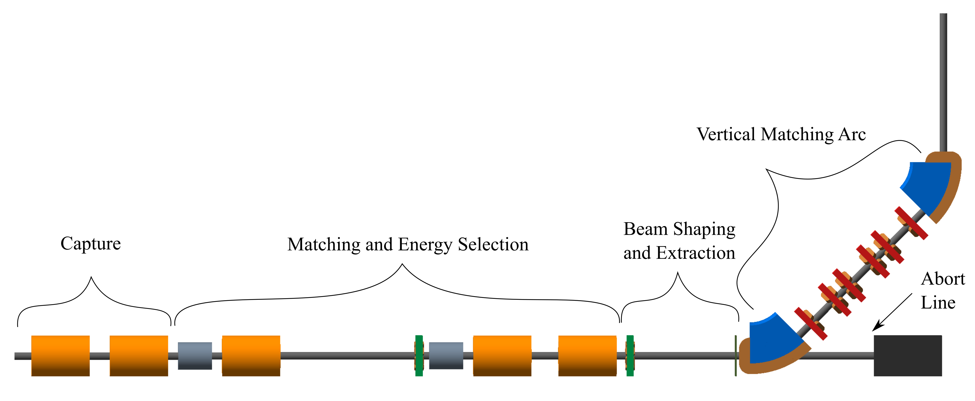
Beam capture/production principle
Posocco, Pozimski
“Electron-plasma” (Gabor) lens:
Strong focusing exploiting electron gas in “Penning/Malmberg” trap
Gabor
1957
arXiv:2006.00493

Slide 17
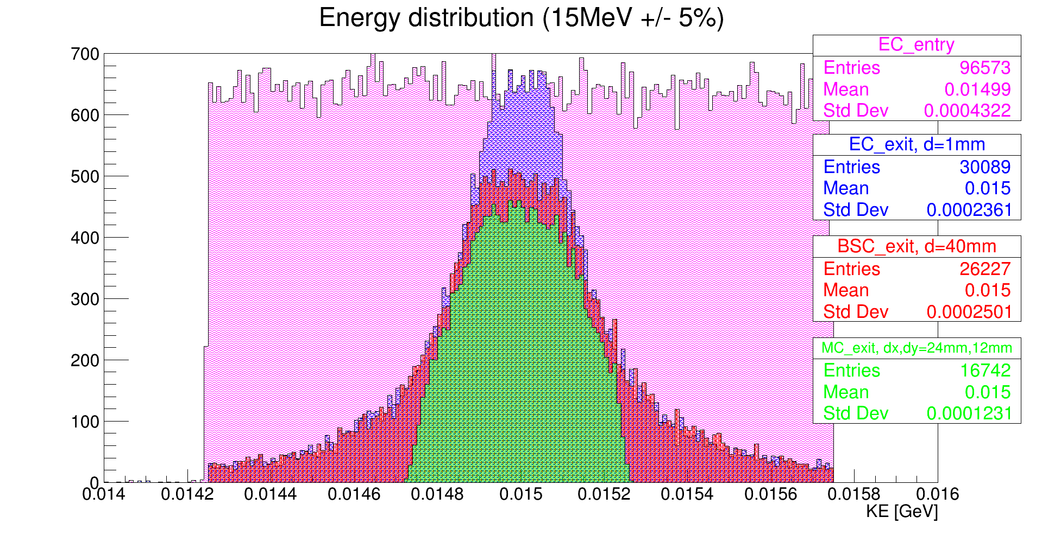
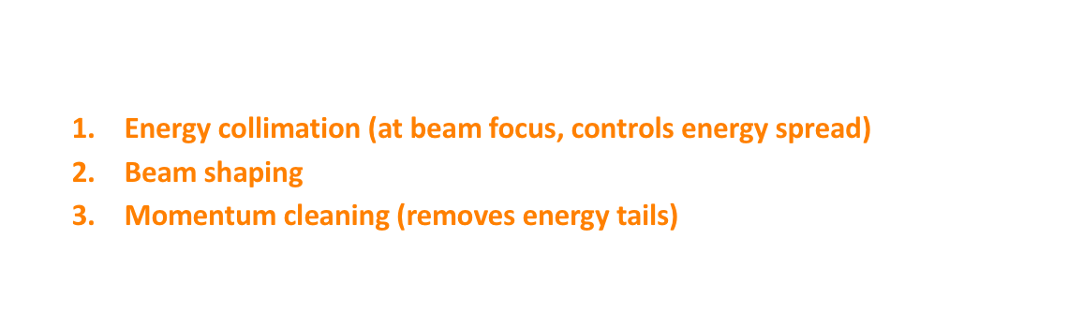

Energy collimation
LhARA Stage 1 beamline
1
3
2
$$±2\%$$
Flat initial energy profile $15 MeV±15\%$
3 collimators
Energy collimation (at beam focus, controls energy spread)
Beam shaping
Momentum cleaning (removes energy tails)

Slide 18
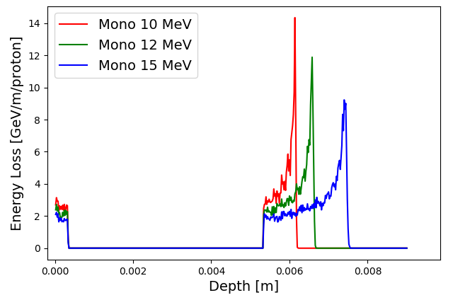
LhARA; stage 1
Pasternak
Dose uniformity at end station
arXiv:2006.00493
arXiv:2006.00493

Slide 19
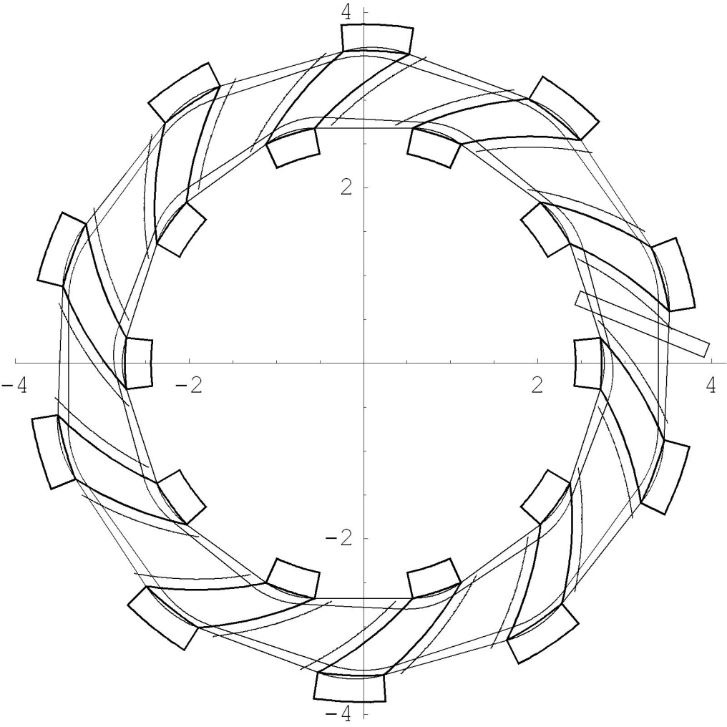
Rapid, flexible acceleration for stage 2
Dimensions in m
Evolution of RACCAM design; prototype magnet demonstrated
Fixed-field alternating-gradient accelerator (FFA):
Invented in 1950s
Kolomensky, Okhawa, Symon
Compact, flexible solution:
Multiple ion species
Variable energy extraction
High repetition rate (rapid acceleration)
Large acceptance
Successfully demonstrated:
Proof of principle at KEK
Machines at KURNS
Non-scaling pop, EMMA, at DL
LhARA FFA
10 cells
2 MA loaded RF cavities
η
β_{v}
β_{h}
arXiv:2006.00493

Slide 20
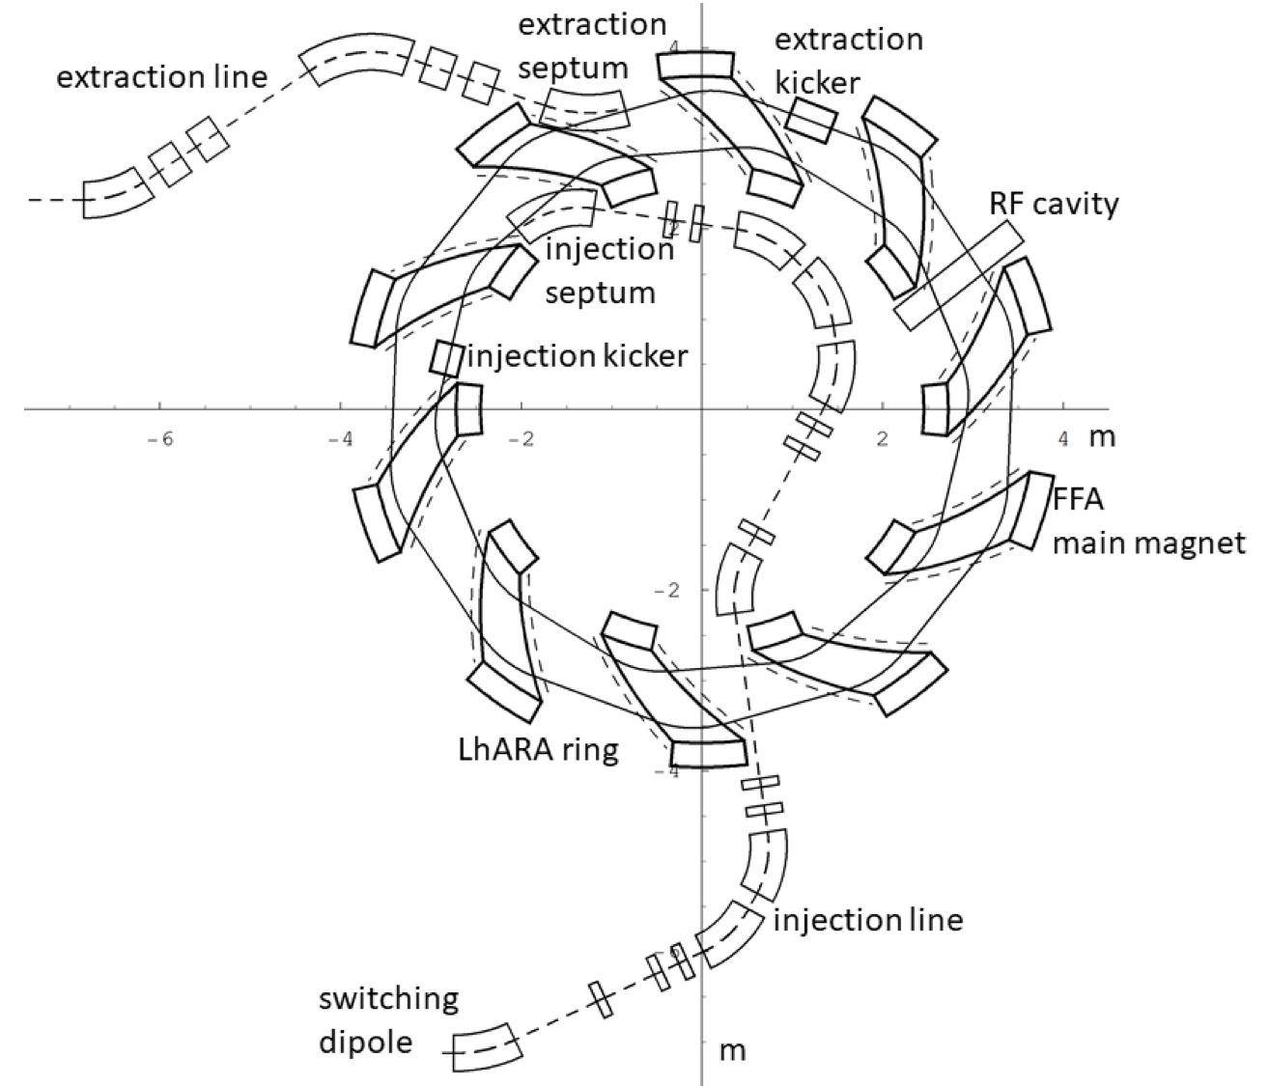
FFA for acceleration in LhARA – Stage 2
Baseline: x3 increase in momentum
15 MeV protons accelerated to 127 MeV
3.8 MeV/u carbon 6+ ions accelerated to 34 MeV/u
arXiv:2006.00493

Slide 21
LhARA performance: doses and dose rates

Slide 22
Conclusions
The Laser-hybrid Accelerator for Radiobiological Applications (LhARA)

Slide 23

Conclusions
LhARA consortium has:
Developed the concept of a laser-hybrid accelerator for biomedical applications
Laser-hybrid approach has potential to:
Overcome dose-rate limitations of present PBT sources
Deliver uniquely flexible facility:
Range of: ion species; energy; dose; dose-rate; time; and spatial distribution
Be used in automated, triggerable system → reduce requirement for large gantry
Disruptive/transformative approach to “distributed PBT for 2050”
The LhARA consortium now seeks the opportunity to:
Prove the novel laser-hybrid systems in operation
Contribute to the study of the biophysics of charged-particle beams
Enhance treatment planning
Create novel capabilities to ‘spin back in’ to science and innovation

Slide 24
Acknowledgements
The LhARA consortium

