Slide 1
The Laser-hybrid Accelerator for Radiobiological Applications LhARA
arXiv:2006.00493

Slide 2
Acknowledgements
The LhARA consortium!
Since completion of pre-CDR (Apr20) the following groups have joined the consortium;
The National Physical Laboratory
Surrey
Birmingham:
School of Physics and Astronomy
University Hospitals Birmingham NHS
Foundation Trust
Birmingham Cyclotron Facility
Positron Imaging Centre at the University of Birmingham
Institut Curie (Paris)
LhARA consortium Nov19

Slide 3
Radiotherapy; the challenge
Cancer: second most common cause of death globally
Radiotherapy indicated in half of all cancer patients
Significant growth in global demand anticipated:
14.1 million new cases in 2012 ⇢ 24.6 million by 2030
8.2 million cancer deaths in 2012 ⇢ 13.0 million by 2030
Scale-up in provision essential:
Projections above based on reported cases (i.e. high-income countries)
Opportunity: save 26.9 million lives in low/middle income countries by 2035
Provision on this scale requires:
Development of new and novel techniques … integrated in a
Cost-effective system to allow a distributed network of RT facilities
Atun, Lancet Oncol. 2015 Sep;16(10):1153-86

Slide 4
Particle-beam therapy
Proton and ion-beam therapy:
Bulk of dose deposited in Bragg peak
Significant normal-tissue sparing (entry)
Almost no dose beyond the Bragg peak

Slide 5
LhARA … the vision
The execution of the LhARA programme will:
Create the capability to deliver particle-beam therapy in completely new regimes
by combining a variety of ion species in a single treatment fraction and exploiting ultra-high dose rates and novel spatial-fractionation schemes.
Make "best in class" treatments available to the many
by demonstrating in operation a system that incorporates dose-deposition imaging in a fast feedback-and-control system thereby reducing the requirement for a large gantry.

Slide 6
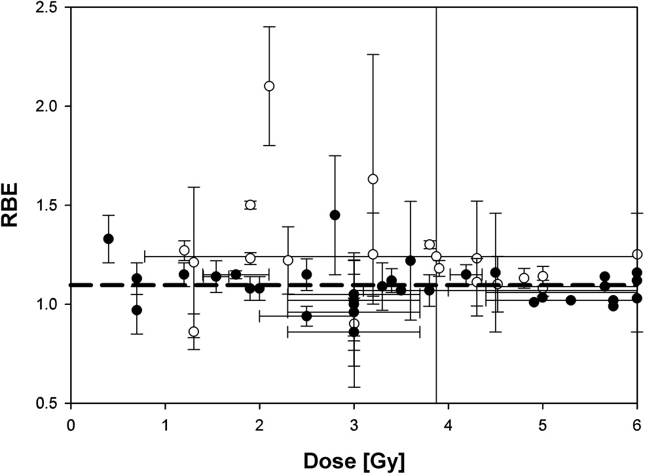
The radiobiology needs to be understood
RBE:
Ratio of dose required to gain same biological response as reference photon beam
Treatment planning:
Based on ‘Relative Biological Effectiveness (RBE)
Proton-treatment planning uses RBE = 1.1
Effective values are used for C⁶⁺
Paganetti, van Luijk Sem. Rad. Oncol (2013)
RBE known to depend on:
Energy, ion species
Dose & dose rate
Tissue type
Biological endpoint
Essential: improved, fundamental, understanding of radiobiology

Slide 7
Radiobiology in new regimens
Time
domain
Space
domain
The ideally flexible beam facility can deliver it all!
⇒ substantial opportunity for a step-change in understanding!
Ion
species
Energy
In combination and with chemo/immuno Therapies

Slide 8
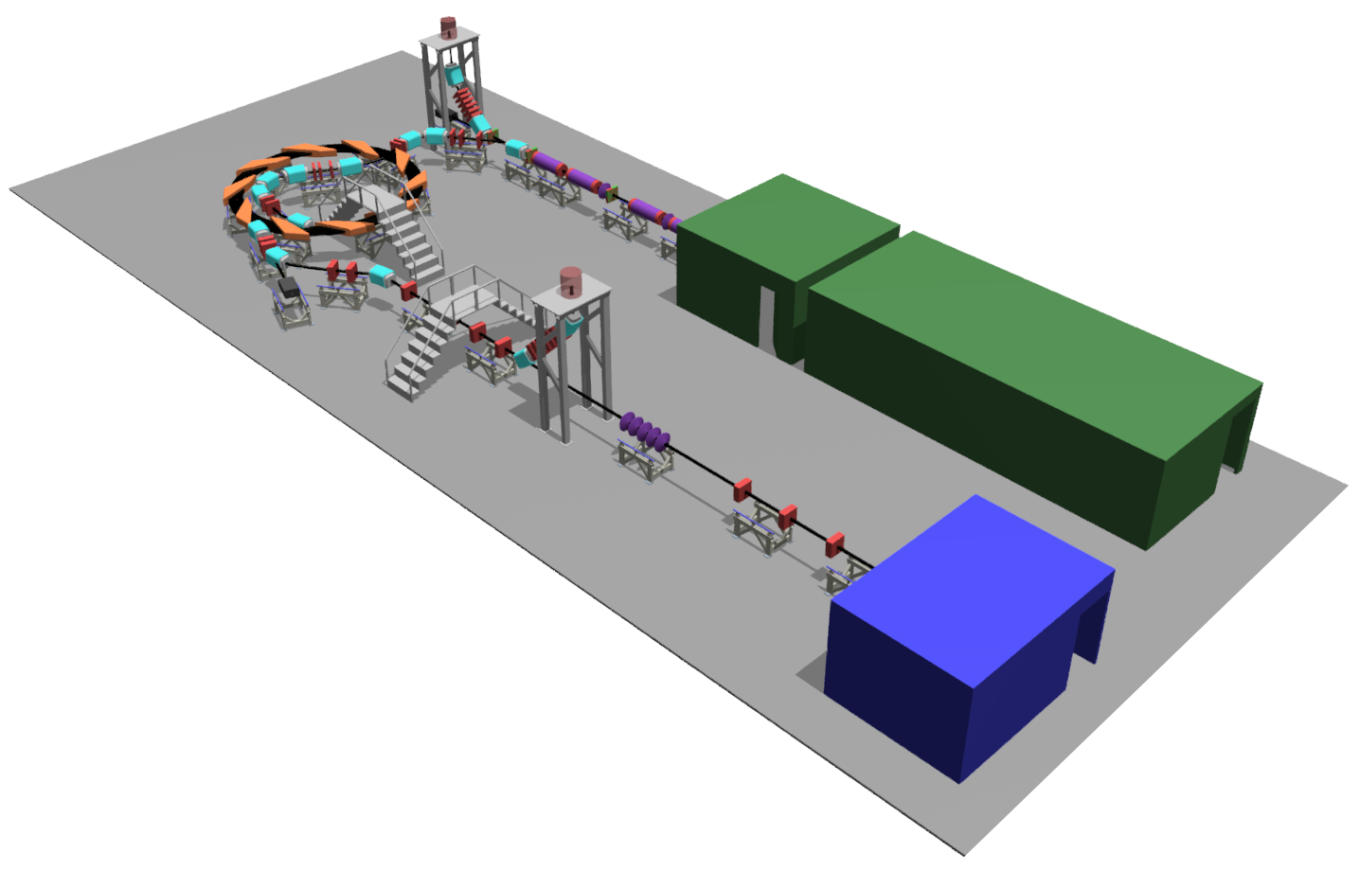

Laser-hybrid Accelerator for Radiobiological Applications
LhARA; a novel, hybrid, approach:
High-flux, laser-driven proton/ion source:
Overcome instantaneous dose-rate limitation
Delivers protons or ions in very short pulses:
Pulse length 10 – 40 ns
Can provide arbitrary pulse structure
Novel plasma-lens capture & focusing
Fast, flexible, fixed-field post acceleration
Protons up to 127 MeV p;
Ions up to ~35 MeV/u
Staged implementation:
Stage 1: In vitro studies with protons at energies up to 15 MeV
Stage 2: In vivo & in vitro studies with protons up to 127 MeV and ions up to 33 MeV/u
→ compact, uniquely flexible facility
arXiv:2006.00493
LhARA consortium

Slide 9
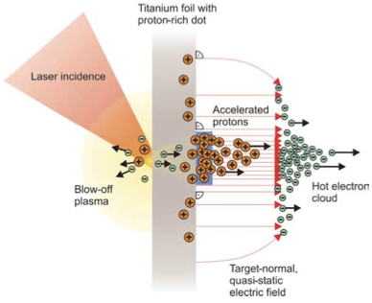
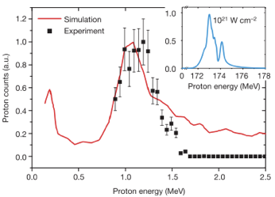
Sheath acceleration
Laser incident on foil target:
Drives electrons from material
Creates enormous electric field
Field accelerates protons/ions
Dependent on nature of target
First observation ~2000
Active development:
Laser: power and rep. rate
Target material, transport
Schwoerer, H. et al., 2006; Nature, 439(7075).

Slide 10
LhARA
arXiv:2006.00493

Slide 11
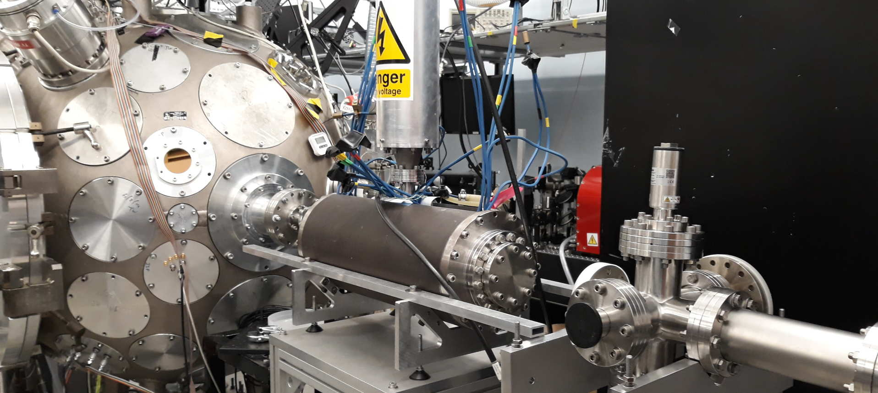
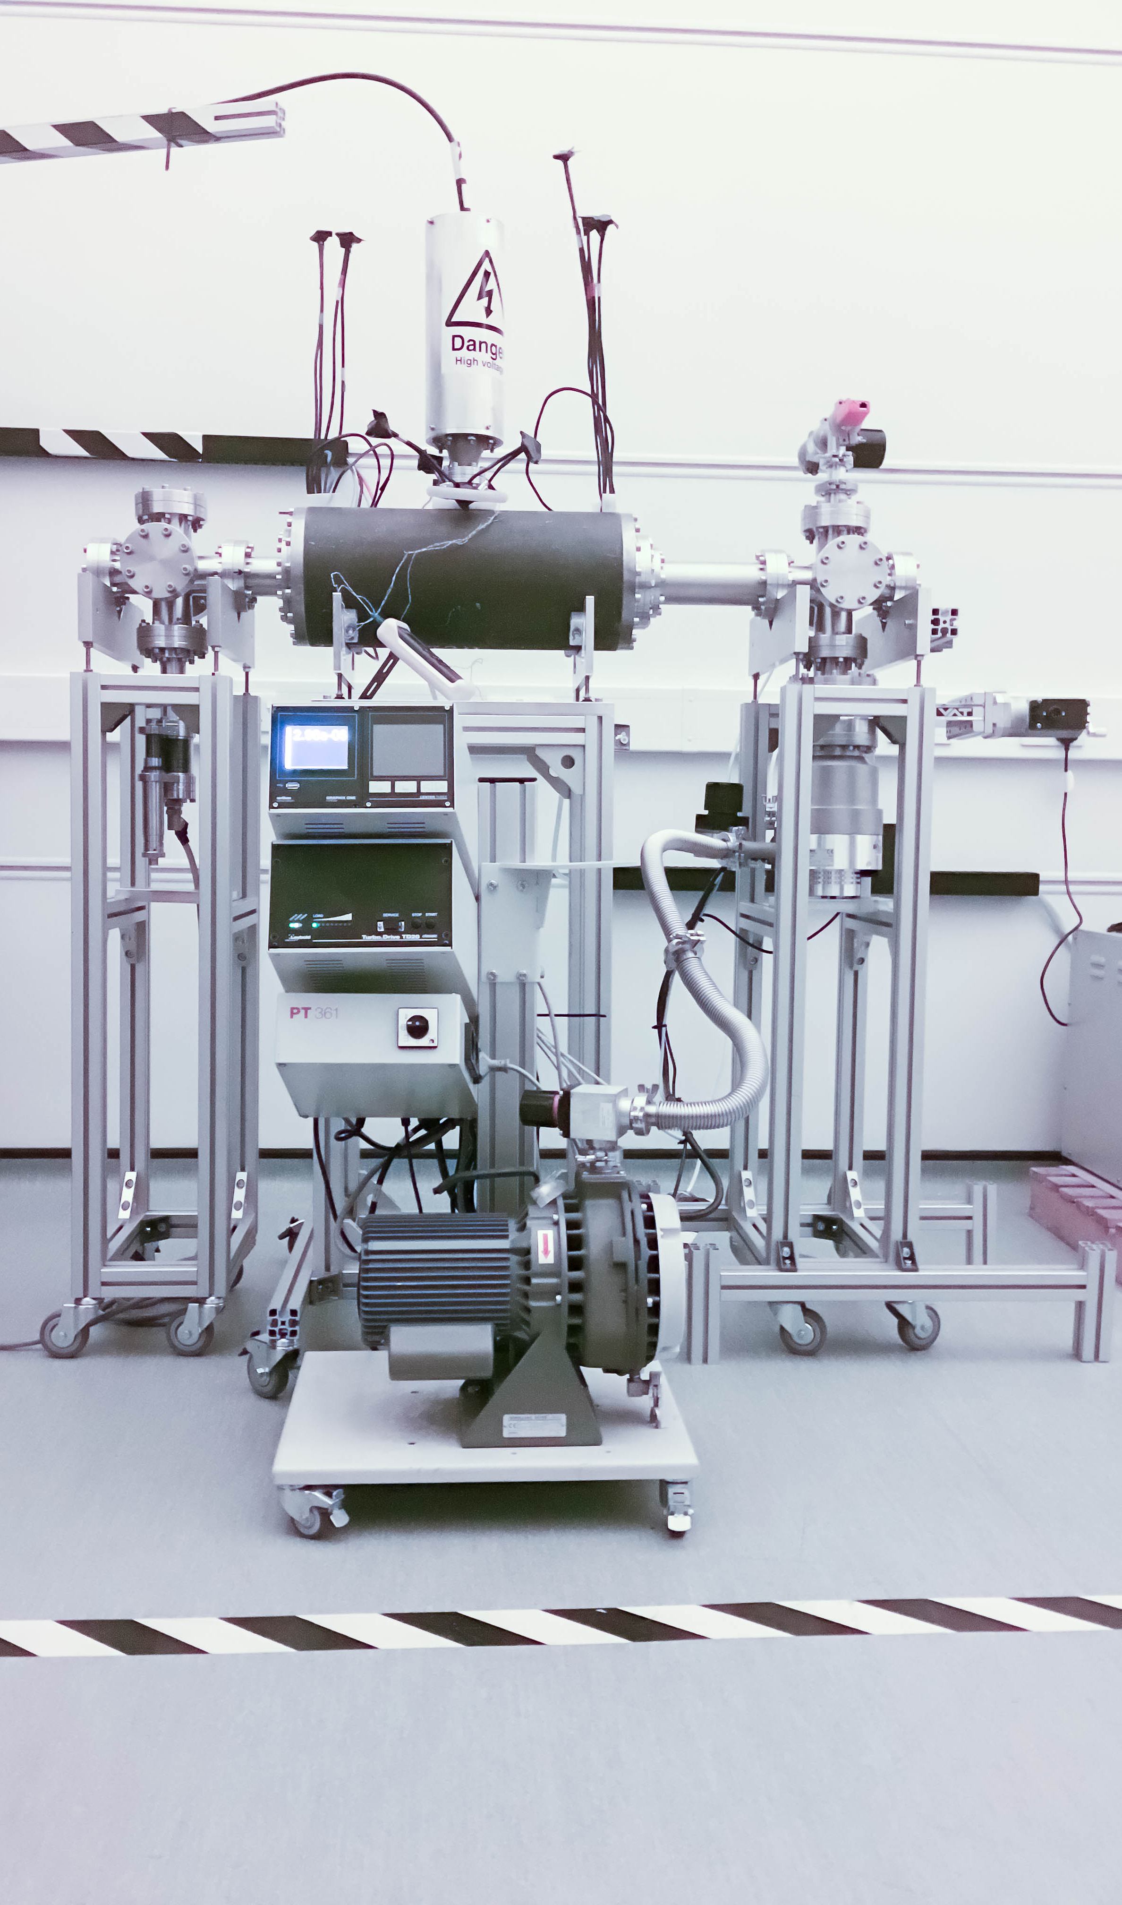
LhARA: ion-source development
Capture
Laser source/capture test
Electron plasma:
Strong focusing of +ve ions
1st prototype:
1 MeV protons Surrey Ion Beam Centre
Aberrations observed
Upgraded prototype:
Under development Imperial
Integration test:
Gabor lens on cerberus Laser at Imperial
Plan:
“Now”: prepare to validate lens with α
Next: test using laser-driven source

Slide 12
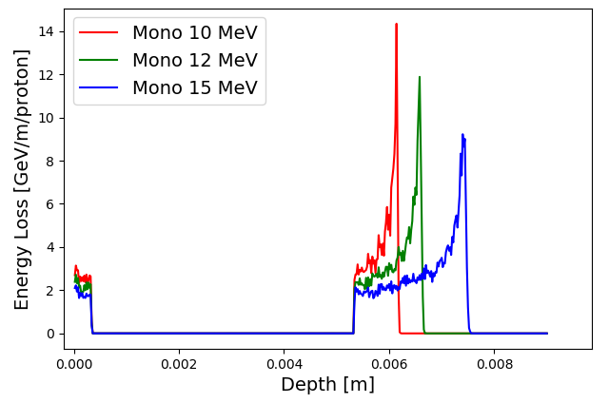
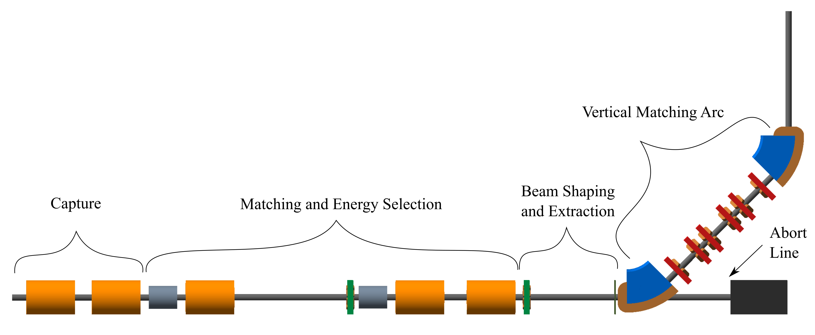
LhARA; stage 1
Pasternak
arXiv:2006.00493

Slide 13
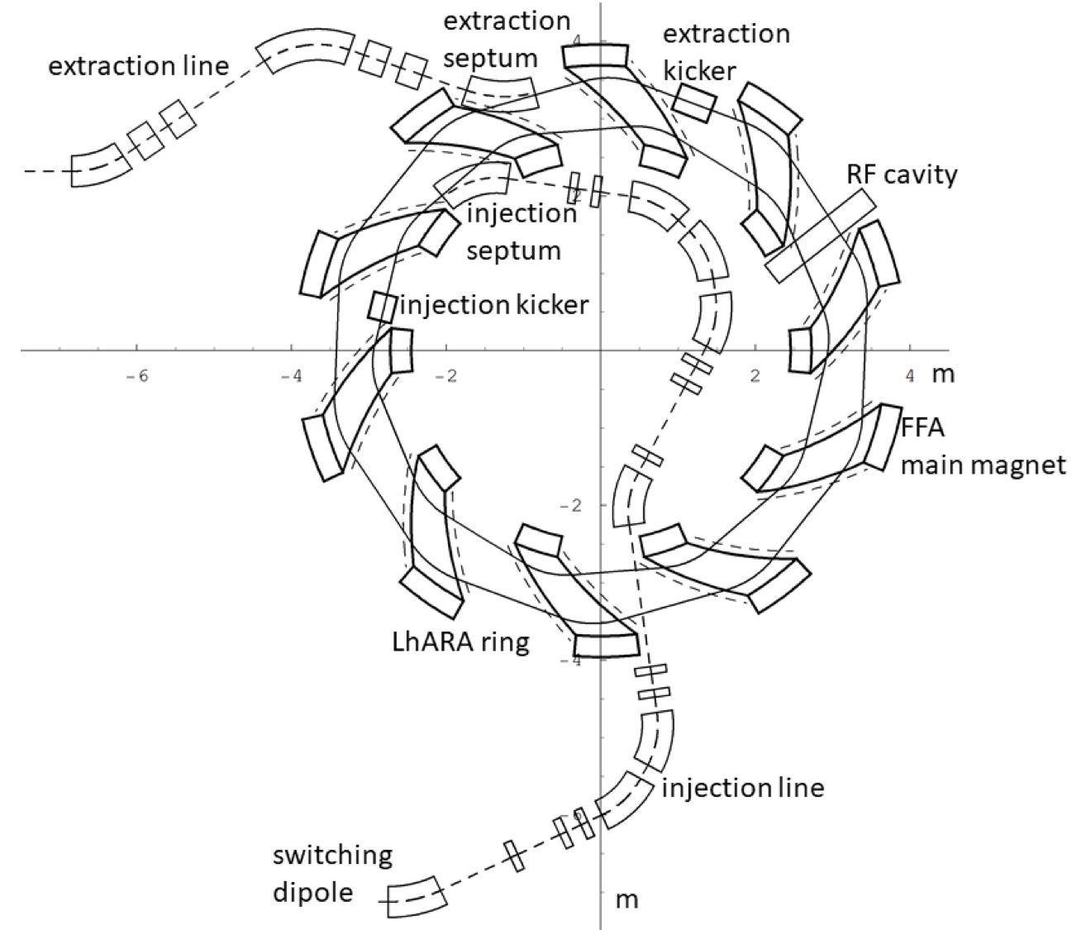
LhARA – Stage 2
In-vitro radiobiology using animal models:
Post-acceleration required
Baseline: fixed field accelerator:
x3 increase in momentum
15 MeV protons accelerated to 127 MeV
3.8 MeV/u carbon 6+ ions accelerated to 33 MeV/u
arXiv:2006.00493

Slide 14
Next steps; 5-year R&D plan
5-year plan presented in pre-CDR designed to:
Address technical risks presented in pre-CDR
Especially source and plasma-lens capture
Instrumentation and diagnostics
Deliver technical designs for the LhARA facility
End stations.
Automation, sample handling, imaging
Simulation, including impact on tissue/tissue response
→ Capability to start Stage 1 in-vitro programme
arXiv:2006.00493

Slide 15
Conclusions
K.Long@imperial.ac.uk
Laser-hybrid approach has potential to:
Overcome dose-rate limitations of present PBT sources;
Deliver uniquely flexible facility:
Range of ion species, energy, dose, dose-rate
Disruptive/transformative approach ‘for 2050’ …
Opportunity:
Develop and prove novel systems in production system;
Deliver research facility dedicated to radiobiology;
Contribute to study of biophysics of charged-particle beams
First and next steps:
Initial concept developed and prototype evaluation underway
Seeking resources to execute R&D programme laid out in ‘pre-CDR’
Wonderful opportunity to build novel techniques to spin back in!

Slide 16
Backup
Laser-hybrid Accelerator for Radiobiological Applications (LhARA)

Slide 17
LhARA status
Modest resources to date have delivered LhARA "pre-CDR":
STFC Opportunities 2019 award; and consortium
Milestone: pre-CDR by April 2020:
Completed.
Review by international panel 25&31 Mar20
Peer-endorsement subsequent to 2019 PPRP review
Publication based on the pre-CDR:
Submitted to Frontiers in Physics Medical Physics and Imaging
Uploaded to the arXiv as arXiv:2006.00493

