Slide 1

Novel accelerators for innovation, science and society

Slide 3


The Standard Model
u
c
t
g
up
charm
top
gluon
Quarks
s
γ
d
b
down
strange
bottom
Force Carriers
photon
ν_{e}
ν
ν
W
μ
τ
Leptons
e-neutrino
μ-neutrino
τ-neutrino
e
μ
τ
W boson
Z
electron
muon
tau
Z boson
Generations of matter
I
II
III
Higgs
Boson
Higgs
Boson

Slide 4
The Higgs as window on new physics
SM within uncertainty
  Motivates Higgs factory to reduce uncertainties
    Statistical and systematic uncertainties

Slide 5
Energy frontier to illuminate limit of SM
Degrassi et al, 10.1007/JHEP08(2012)098
Hernandez, Granada, 2019
Measurement at highest possible energy
  Experimental motivation clear!
    Theorists motivated by ‘meta-stability’ of SM

Slide 6
Neutrinos as window on origin of flavour
PMNS
Related to physics at very high energy scale
  Motivates high-precision neutrino programme
    Large event samples and low systematic uncertainties

Slide 7
Neutron scattering facilities in Europe;
Present status and future perspectives
ESFRI Physical Sciences and Engineering Strategy Working Group
Neutron Landscape Group
STFC, Neutron scattering Materials research for modern life
Strong case for increased neutron capacity

Slide 8
Ambition
Our ambition is to make measurements:
  Of the properties of the Higgs
    With the highest possible precision
  Of the properties of the neutrino
    With the highest possible precision
  Of the properties of matter
    At the highest possible energies
  Study materials, biological systems, and chemical processes
    In as much detail as possible
New accelerators required to drive this programme
  Energy efficiency will be a key requirement

Slide 9

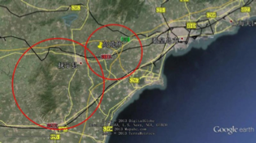
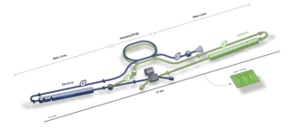
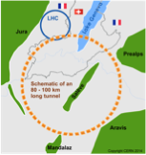
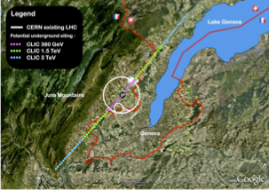

Options for ⎷s x 10
250—350 GeV
for Higgs & e/w
CepC, ILC &/or CLIC
pp @ 100 TeV
⎷s ⇢ 10 TeV
for exploration
FCC-hh

Slide 10
But, timescales are long

Slide 11
Disruptive technology 1: laser-driven acceleration
Shrink footprint using ultra-high gradient acceleration:
  Exploit plasma waves
P. Ratoff, CI/Lancaster
/ particle
Excitation of plasma:
  Photon (laser)
  Particle beam:
    Electron or proton

Slide 12
Disruptive technology 1: AWAKE
SPS proton bunch:
  seeded self-modulation
Accelerated e- beam:
  From 15 MeV – 2 GeV in 10 m
AWAKE, Nature 561 (2018) no.7723, 363-367
AWAKE, 10.1103/PhysRevLett.122.054802
Gschwendtner & Turner, 10.1098/rsta.2018.0418

Slide 13
Disruptive technology 2: muon acceleration
Big advantage over pp:
  Fundamental fermion
Big advantage over e+e-
  No beam/bremsstrahlung

Slide 16
Neutrino Factory: sensitivity & precision
Unique:
  Large, high-energy
  ν_{e} (ν_{e}) flux
    Muon-beam cooling
  Favourable rigidity:
    Optimise E for given L
First described for SPS by:
Koshkarev, Globenko;
ITEP-33-1974

Slide 17
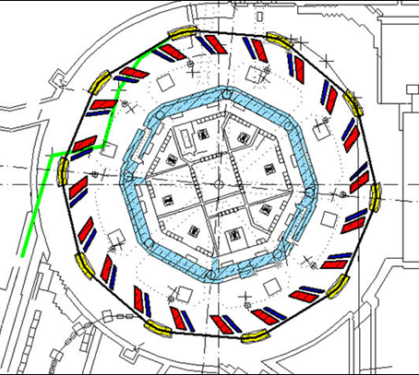
High-power driver for neutron production
High power:
  Required to serve many beamlines
    Maximise scientific return
Key requirements:
  Cost
  Flexibility in operation
  Energy efficient
Example:
  ISIS II:
    Consider Fixed-Field Accelerator (FFA):
      Do not need to ramp magnets:
        Rapid cycling
        Can use s/c technology
    Reduced power consumption
J. Thomason, G. Aymar:
[ISIS II] PROJECT LIFECYCLE PLAN

Slide 18
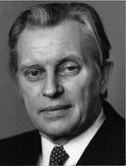
FFA concept
Ohkawa
Kolomensky
Symon
EMMA, Nature Phys., 8, 243-247

Slide 19
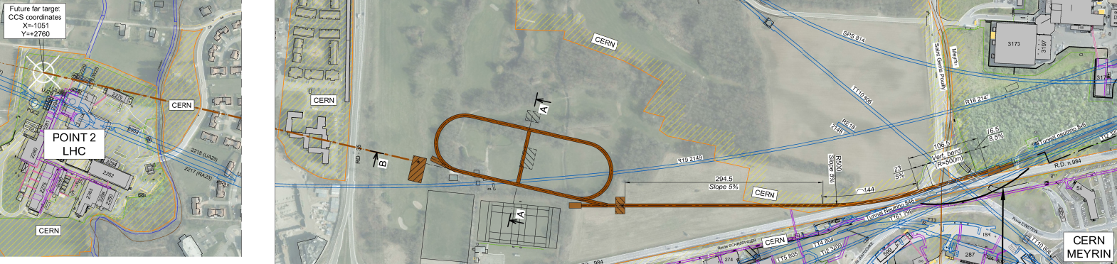
Neutrinos from stored muons
Scientific objectives:
  %-level (ν_{e}N) cross sections
    Double differential
  Sterile neutrino search
    Beyond Fermilab SBN
  Muon-accelerator R&D
    FFA optics; cooling …
Precise neutrino flux:
  Normalisation: < 1%
  Energy (and flavour) precise
π ⇢ μ injection pass:
  “Flash” of muon neutrinos

Slide 20
P. Burrows (Oxford/JAI)
Synergy: realise ambition & contribute to society

Slide 21
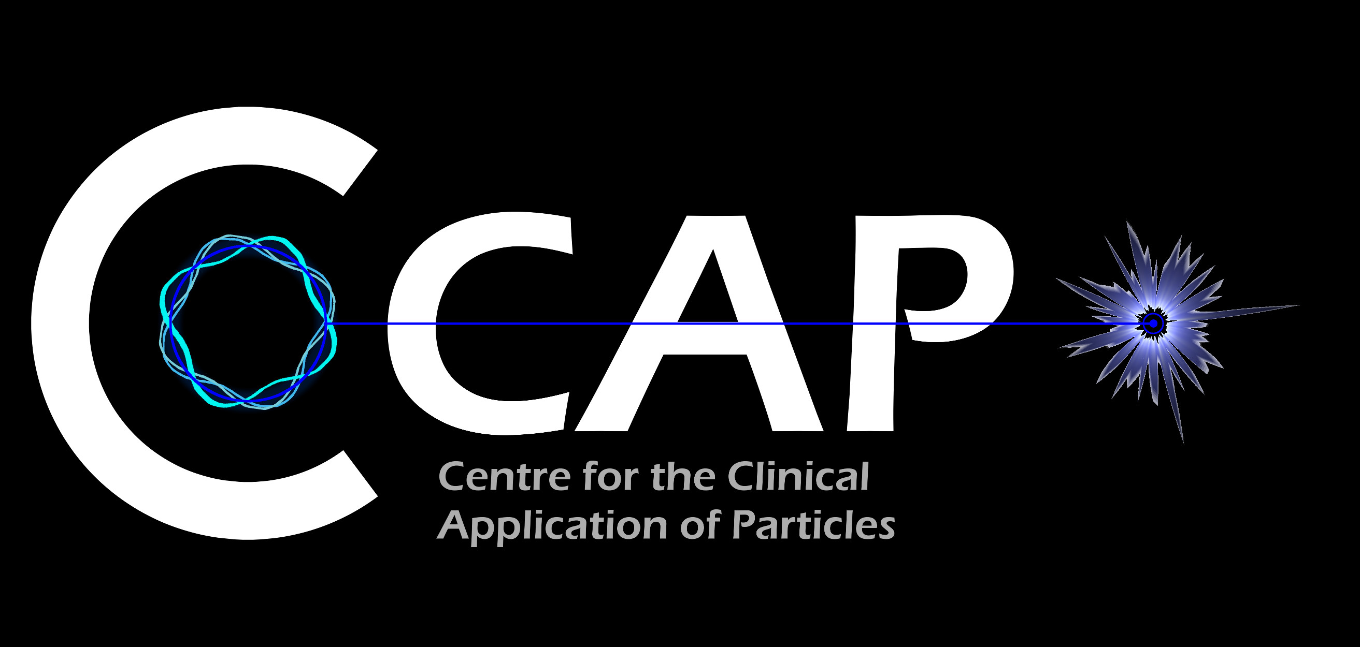
Medical accelerators; the challenge
Radiotherapy, indicated in half of all cancer patients
Significant growth in demand anticipated:
  14.1 x 10⁶ new cases in 2012 ⇢ 24.6 x 10⁶ by 2030
  8.2 x 10⁶ cancer deaths in 2012 ⇢ 13.0 x 10⁶ by 2030
Demographic:
  Projections above based on reported cases (i.e. HIC)
  Opportunity to save 26.9 x 10⁶ lives in LMIC by 2035
Scale-up in provision:
  Requires development of new and novel techniques
Atun, Lancet Oncol. 2015 Sep;16(10):1153-86

Slide 22
Medical accelerators; the opportunity
R&D programme:
  Incremental development of current practice
  System approach: robust, flexible next-generation facilities
  Multi-disciplinary R&D to harness novel techniques
Opportunity: contribute to underpinning science:
  Radiobiology: especially charged particle (p, ion)
  In-situ dose-deposition imaging: especially p, ion
  Integration of on-treatment imaging, simulation, planning

Slide 23
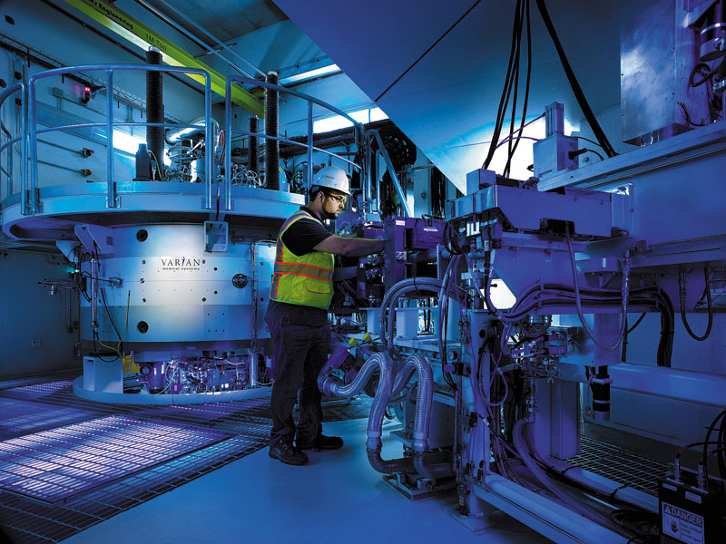
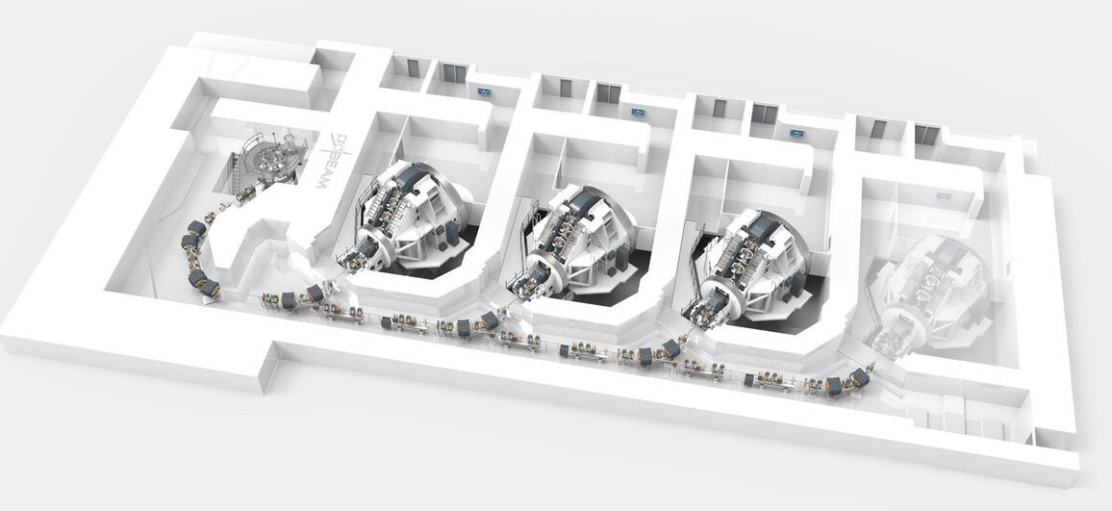
Particle beam therapy
Proton:
  Mostly cyclotron-based
    Issues:
      Energy modulation;
      Shielding
      Source:
        Injector per ion species
        Limit to instantaneous dose rate
Proton & ion (carbon):
  Synchrotron based:
    Issues:
      Energy modulation
      Source:
        Injector per ion species
        Limit to instantaneous dose rate
Christie
MedAustron

Slide 24
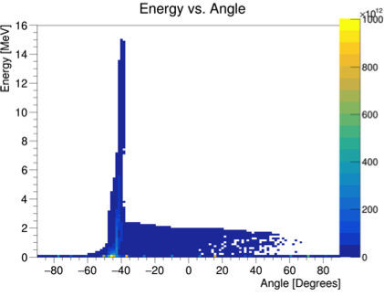
Laser-driven proton/ion source
Advantage:
  Enormous proton/ion flux at 10—15MeV in tint (30 fs) pulse
Issue to be solved:
  Efficient capture, focusing, selectin and manipulation of divergent ion beam

Slide 25
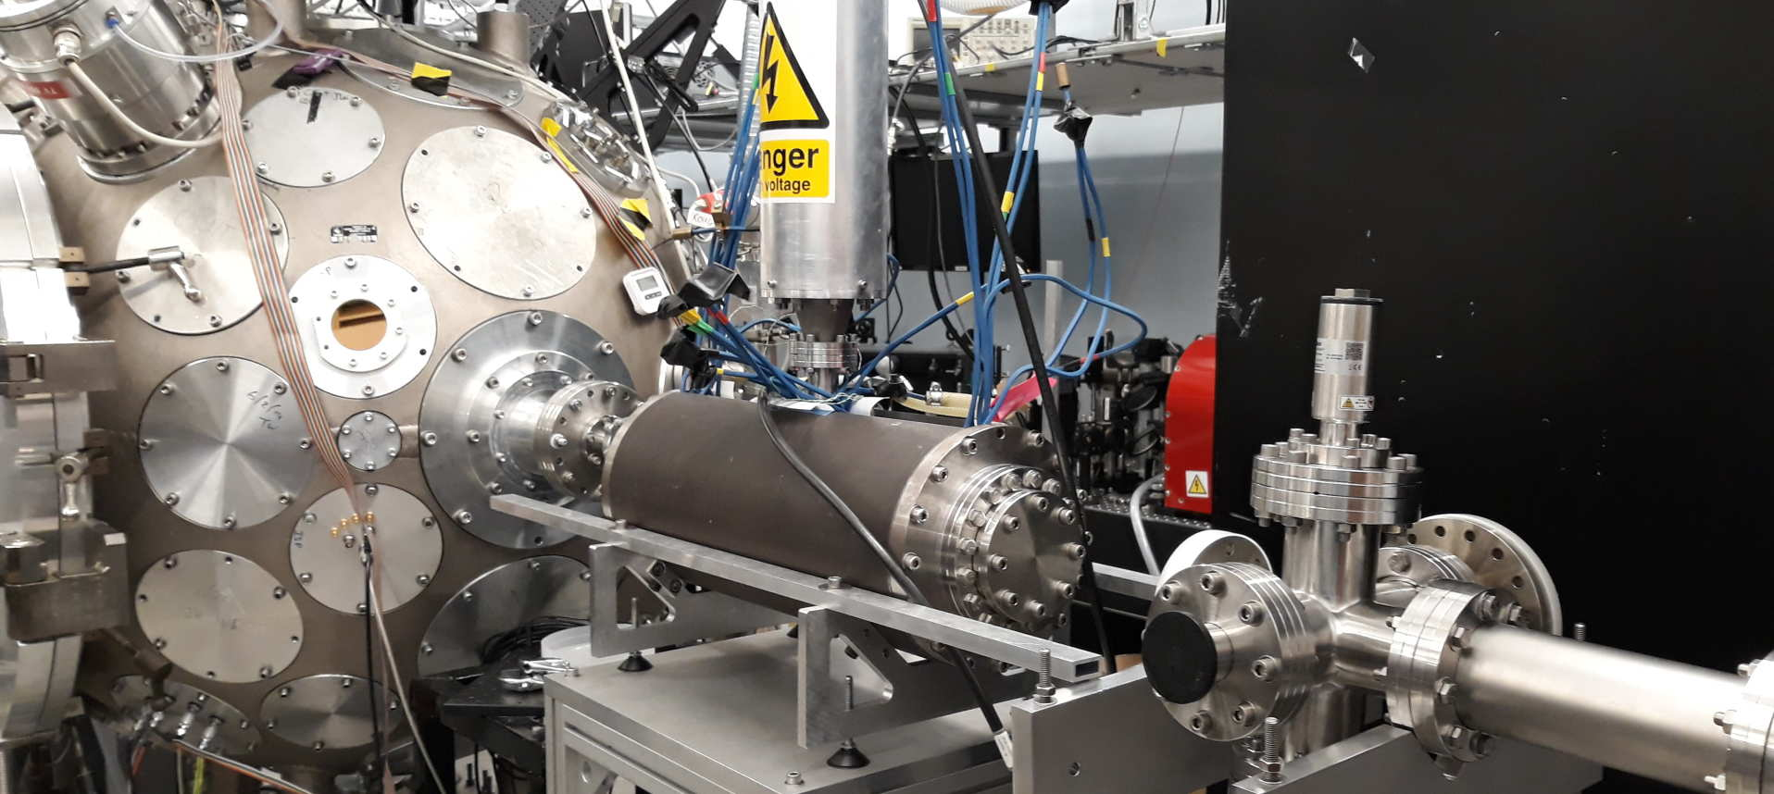
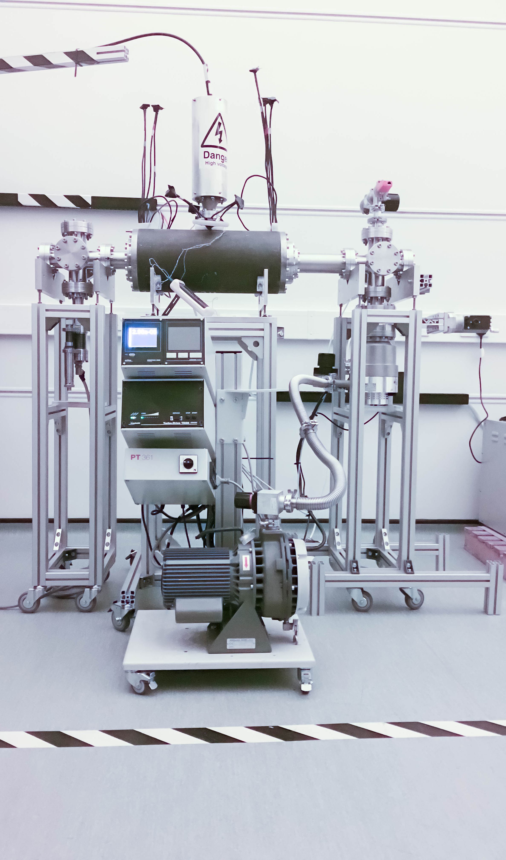
LhARA: ion-source development
Capture
Laser source/capture test
Electron plasma:
  Strong focusing
  of +ve ions
1st prototype:
  1 MeV protons
  Surrey Ion Beam
  Centre
  Aberrations
  observed
Upgraded
prototype:
  Under test, Imperial
Integration test:
  Gabor lens on Serberus Laser at Imperial
Plan:
  “Now”: validate lens with α source
  Summer: test using laser-driven source

Slide 26
Laser-hybrid Accelerator for Radiobiological Applications
LhARA; a novel, hybrid, approach:
  High-flux, laser-driven proton/ion source;
  Novel plasma (Gabor) lens capture & focusing
  Post-acceleration and phase rotation: FFA &/or SC RF
Unique features:
  Very large flux of p or ions in very short pulses:
    Enormous instantaneous dose
  Inject at ~15 MeV into first accelerating structure
    Overcomes space-charge limit of today’s ion sources
  Staged implementation:
    In-vitro studies permitted at 15 MeV:
      Source, capture, transport
    In-vivo studies using post-accelerator (127 MeV p; ~35 MeV/u)
Uniquely flexible radiobiology facility:
  Many ions, proton to carbon, in single facility
  Wide range of energy and dose rate, allows UHDR/FLASH radiotherapy
Technologies can be developed to create uniquely flexible therapy facility

Slide 27
Conclusions
Outstanding case for scientific exploration of:
  The energy frontier at energies 10 times larger than at LHC
  The new physics that determines neutrino properties
  Matter in all its forms through neutron scattering
To do this requires advances in accelerator technology, e.g.:
  Laser-driven acceleration for generate ultra-high-gradients
  Novel FFA accelerator rings to reduce energy consumption
Substantial opportunity!
  Exploit synergy with requirements in clinical and industrial applications:
    E.g. Laser-hybrid Accelerator for Radiobiological Applications
  To develop disruptive technologies to:
    Meet the future needs of particle physics and materials science; and to
    Contribute to the enhancement of healthcare and wealth creation

