Slide 1
Laser hybrid Accelerator for Radiobiological Applications
LhARA

Slide 2
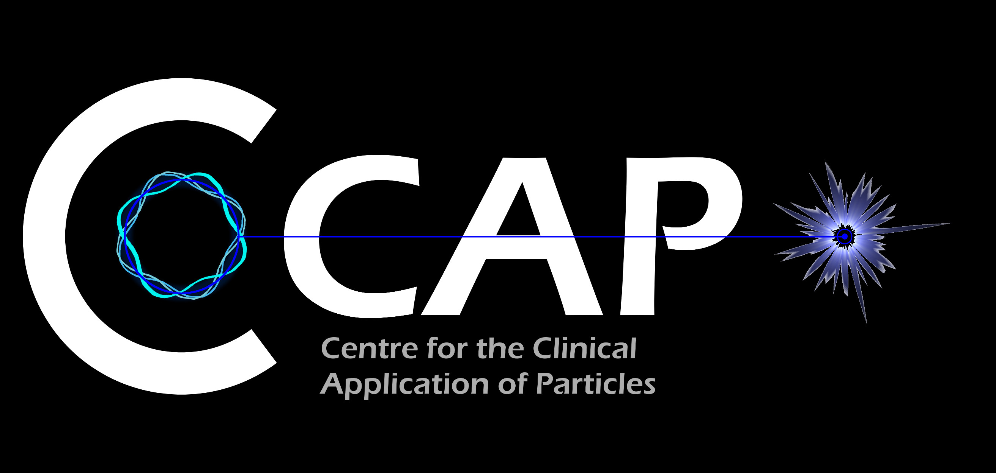
Acknowledgements

Slide 3
Medical accelerators; the challenge
Radiotherapy, indicated in half of all cancer patients
Significant growth in demand anticipated:
14.1 x 10⁶ new cases in 2012 ⇢ 24.6 x 10⁶ by 2030
8.2 x 10⁶ cancer deaths in 2012 ⇢ 13.0 x 10⁶ by 2030
Demographic:
Projections above based on reported cases (i.e. HIC)
Opportunity to save 26.9 x 10⁶ lives in LMIC by 2035
Scale-up in provision:
Requires development of new and novel techniques
Atun, Lancet Oncol. 2015 Sep;16(10):1153-86

Slide 4
Medical accelerators; the opportunity
R&D programme:
Incremental development of current practice
System approach: robust, flexible next-generation facilities
Multi-disciplinary R&D to harness novel techniques
Opportunity: contribute to underpinning science:
Radiobiology: especially charged particle (p, ion)
In-situ dose-deposition imaging: especially p, ion
Integration of on-treatment imaging, simulation, planning

Slide 5
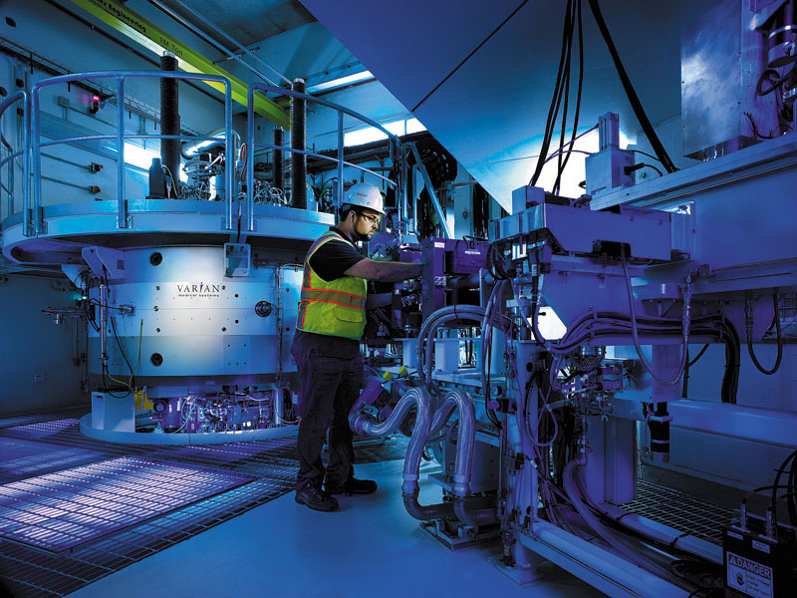
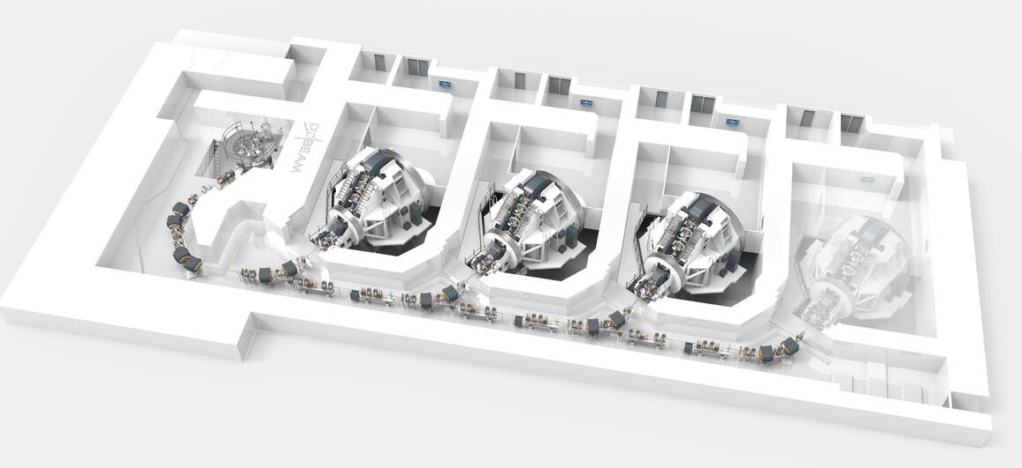
Particle beam therapy
Proton:
Mostly cyclotron-based
Issues:
Energy modulation;
Shielding
Source:
Injector per ion species
Limit to instantaneous dose rate
Proton & ion (carbon):
Synchrotron based:
Issues:
Energy modulation
Source:
Injector per ion species
Limit to instantaneous dose rate
Christie
MedAustron

Slide 6
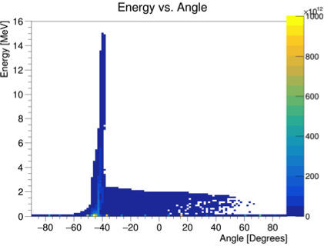
Laser-driven proton/ion source
Advantage:
Enormous proton/ion flux at 10—15MeV in tint (30 fs) pulse
Issue to be solved:
Efficient capture, focusing, selectin and manipulation of divergent ion beam

Slide 7
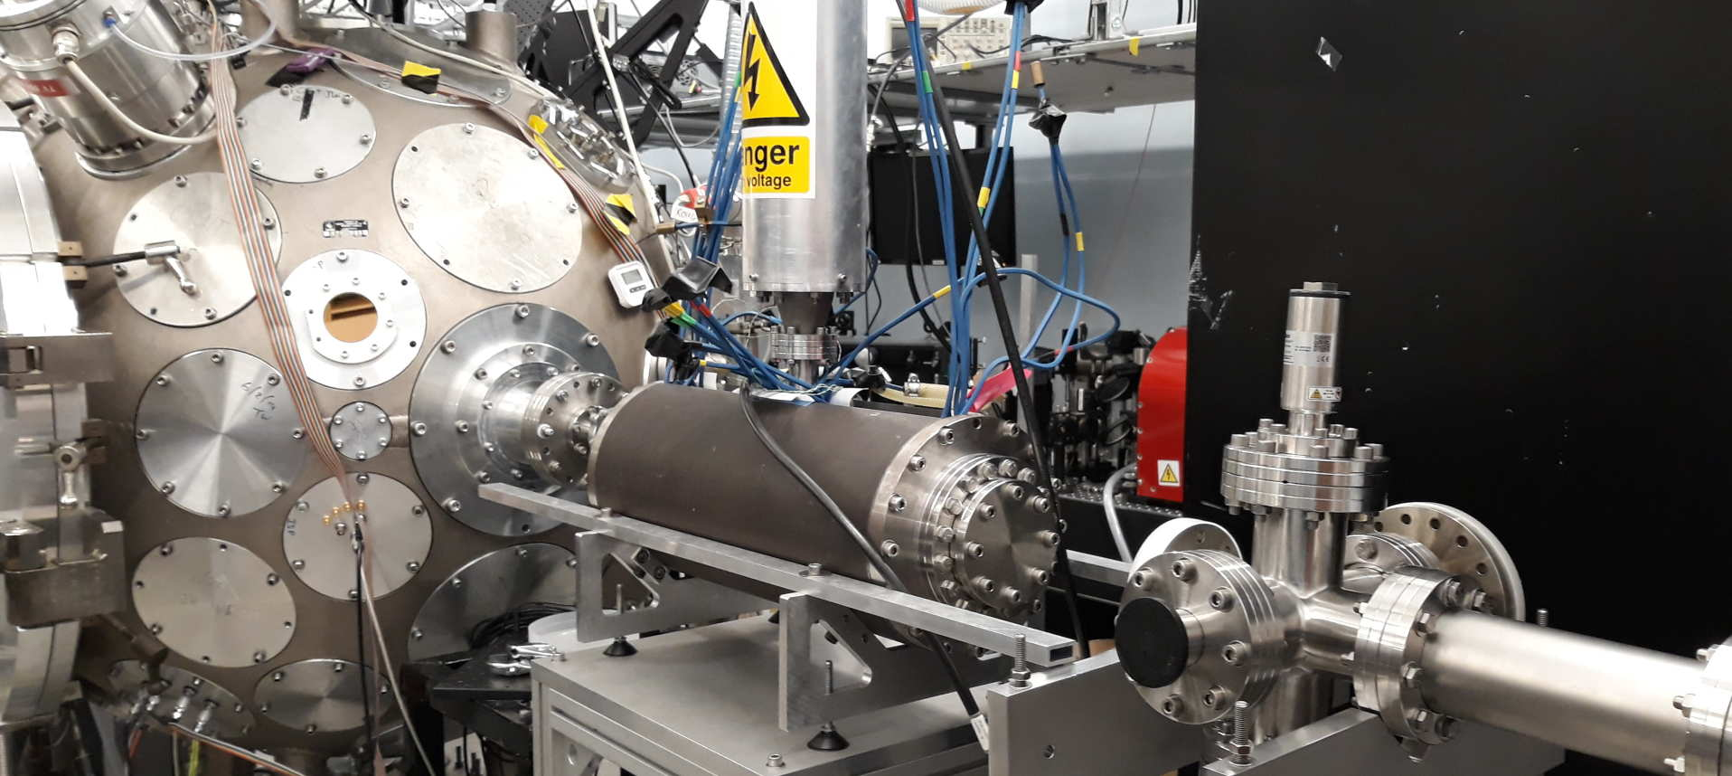
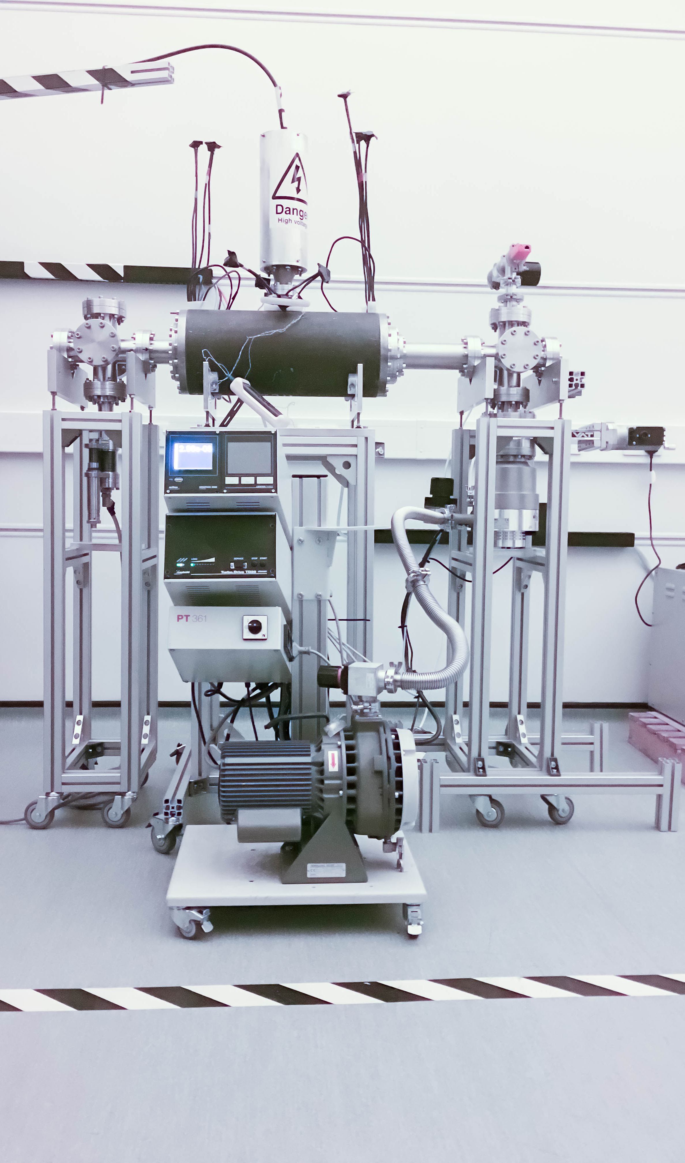
LhARA: ion-source development
Capture
Laser source/capture test
Electron plasma:
Strong focusing of +ve ions
1st prototype:
1 MeV protons Surrey Ion Beam Centre
Aberrations observed
Upgraded prototype:
Under test, Imperial
Integration test:
Gabor lens on Serberus Laser at Imperial
Plan:
“Now”: validate lens with α source
Summer: test using laser-driven source

Slide 8
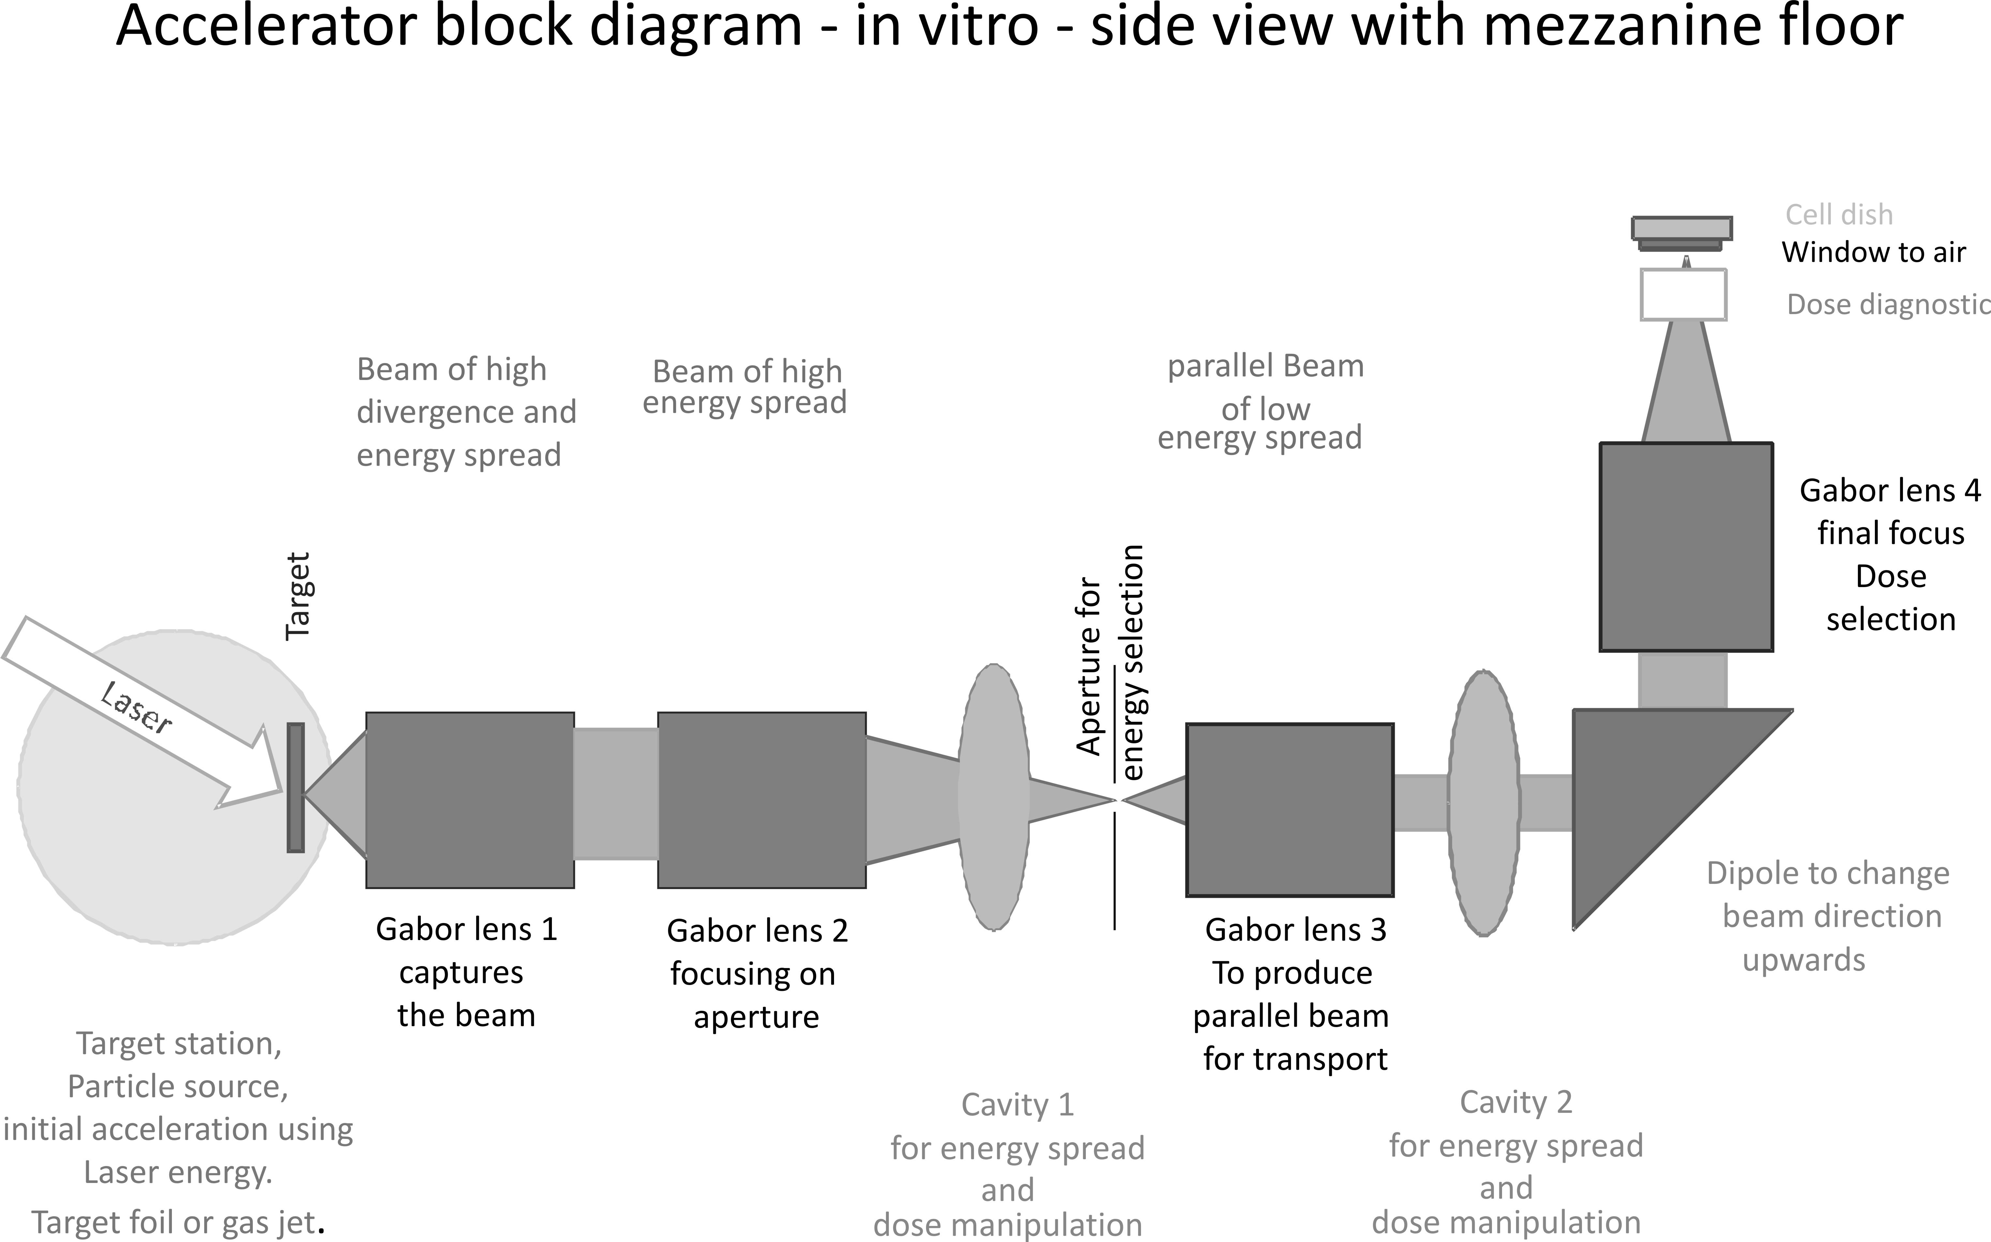
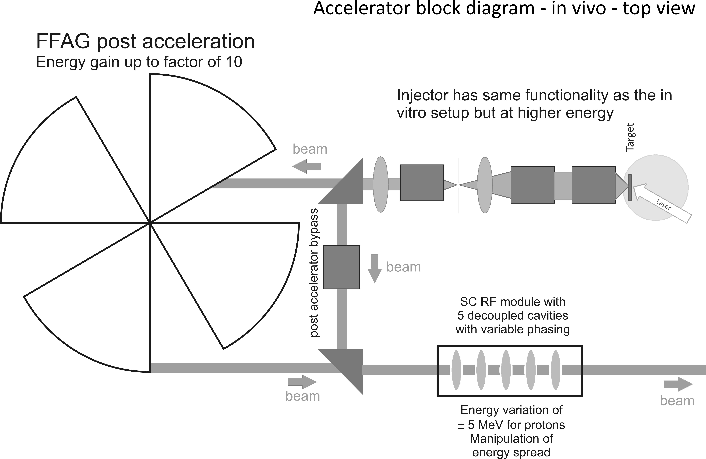
Laser-hybrid Accelerator for Radiobiological Applications
LhARA; a novel, hybrid, approach:
High-flux, laser-driven proton/ion source;
Novel plasma (Gabor) lens capture & focusing
Post-acceleration and phase rotation: FFA &/or SC RF
Unique features:
Very large flux of p or ions in very short pulses:
Enormous instantaneous dose
Inject at ~15 MeV into first accelerating structure
Overcomes space-charge limit of today’s ion sources
Staged implementation:
In-vitro studies permitted at 15 MeV:
Source, capture, transport
In-vivo studies using post-accelerator (127 MeV p; ~35 MeV/u)
Uniquely flexible radiobiology facility:
Many ions, proton to carbon, in single facility
Wide range of energy and dose rate, allows UHDR/FLASH radiotherapy
Technologies can be developed to create uniquely flexible therapy facility
Original concept: Pozimski

Slide 9
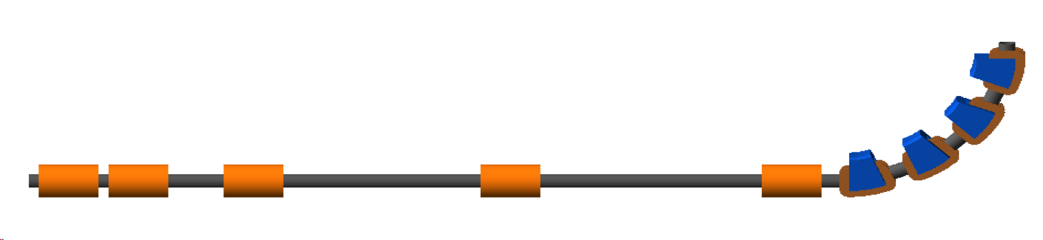
LhARA; stage 1
Pasternak
Vertical arc
Laser
Capture @ 10—15 MeV
Energy selection
Phase-space matching
11.6 m

Slide 10
Conclusions
Laser-hybrid approach has potential to:
Overcome dose-rate limitations of present PBT sources;
Deliver uniquely flexible facility:
Range of ion species, energy, dose, dose-rate
Disruptive/transformative approach ‘for 2050’ …
Opportunity:
Develop and prove novel systems in production system;
Deliver research facility dedicated to radiobiology;
Contribute to study of biophysics of charged-particle beams
First and next steps:
Initial concept developed and prototype evaluation underway
Working towards CDR for LhARA
GSI/FAIR, this workshop, wonderful opportunity to seek synergies!

