Slide 1

LARA: a Laser-based Beam Line for Clinical Applications
JAI Fest
Ajit Kurup
7th December 2018
Notes:
Good afternoon. It’s my pleasure to talk to you about the work we have been doing at the Centre for Clinical Application of Particles on the design of a new radiobiological facility.

Slide 2





Introduction
The ‘Centre for the Clinical Application of Particles’ (the CCAP) is an interdisciplinary collaboration of personnel from:
The Imperial Department of Physics, the Imperial Faculty of Medicine, the Imperial Academic Health Science Centre, the Imperial CRUK Cancer Centre, the Institute of Cancer Research, the John Adams Institute and the Oxford Institute for Radiation Oncology
The CCAP’s mandate is to:
“Develop the technologies, systems, techniques and capabilities necessary to deliver a paradigm shift in the clinical exploitation of particles.”
The Centre’s programme will:
Develop novel, compact, laser-driven accelerator systems for clinical applications;
Deliver the capability to assess the biological and therapeutic efficacy of different ion species; and
Develop improved diagnostic, dose-measurement, imaging, treatment-planning, data-processing, and machine-learning techniques.
Focus of this talk is on the conceptual design of Laser Accelerator for Radiobiological Applications (LARA).
Initial stage will deliver in vitro studies of radiobiological effects.
Second stage will allow in vivo studies.
Notes:
The CCAP brings together clinicians and scientists from a variety of disciplines with the grand goal of developing technologies that will deliver a paradigm shift in the clinical exploitation of particles. A major focus of this is on improving accelerator, detector and data processing technologies for the use of protons and ions in radiotherapy.
In this talk I will focus on LARA which will be a facility to study radiobiological effects by irradiate cells with protons and light ions beams. The first stage will look at in vitro cell irradiation and in the future an upgrade of the beam energy will allow in vivo studies.

Slide 3
Laser Accelerator for Radiobiological Applications – LARA
Laser Accelerator for Radiobiological Applications (LARA) is a facility proposed by the CCAP that will study radiobiological effects using a laser-driven ion beam.
Intense beams.
Protons and light ions, e.g. carbon.
Conceptual design of LARA requires simulation of accelerator components and being able to study dose deposition in the cells and surrounding material in the end-station.
Develop the conceptual design using BDSIM.
Particle tracking simulations to compare with the optics design.
Study energy loss in the end station and verify required beam parameters.
Notes:
LARA will use a laser driven ion beam. Benefits very intense pulse and multiple ions species.
Requires simulation of the accelerator beam line and energy loss in the end station where the end stations design can easily feedback to the accelerator design.
For these reasons we decided to use BDSIM and I will present our initial results on the particle tracking sim …

Slide 4
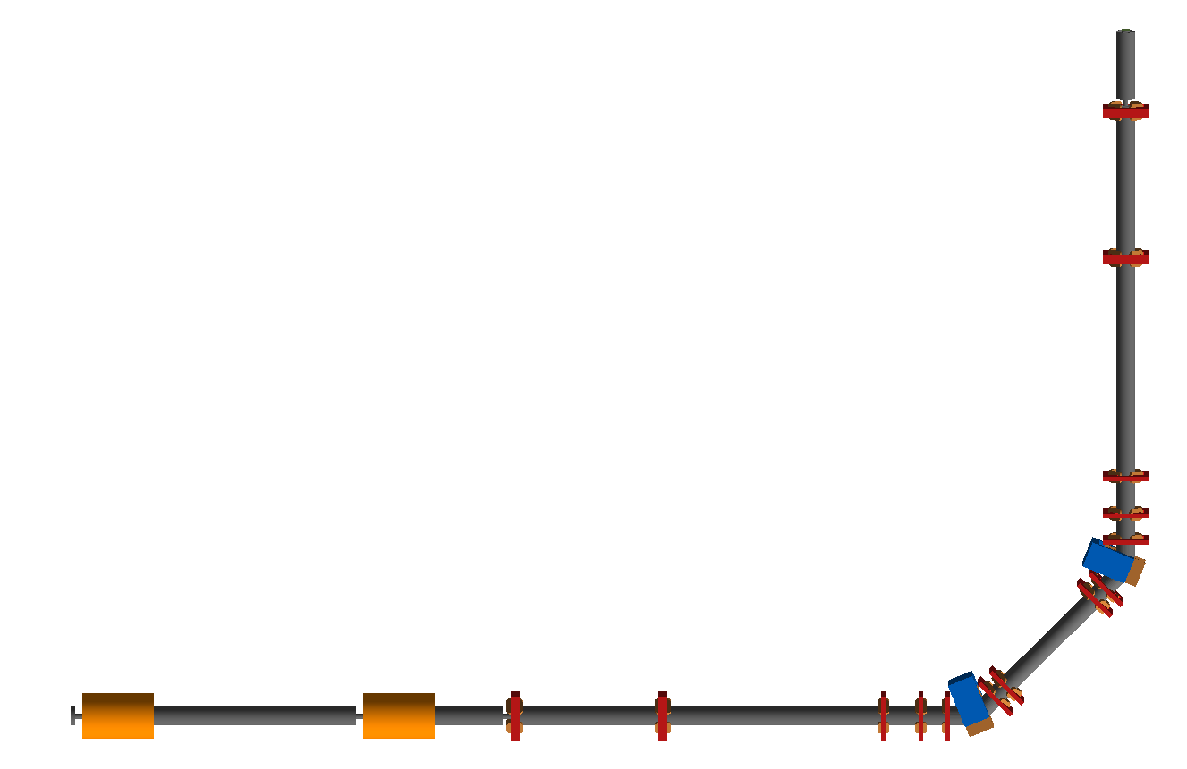



LARA
END STATION
Where the cells will be irradiated. The beam will be delivered vertically from below the cell sample container.
Q14
y
DOWNSTREAM MATCHING
Quadrupole focussing channel to match the beam to the end station
z
Q13
9.21m
LASER TARGET
Laser used to generate intense ions beams and beams of different types of ions, e.g. protons and carbon ions.
ENERGY AND ION SELECTION
Dipole bending and collimator system to select particles based on momentum.
CAPTURE SECTION
Gabor lenses used for compact focussing to capture the large divergence and energy spread of the laser driven ion beam.
Q12
D2
45$°$
Q11
UPSTREAM MATCHING
Quadrupole focussing channel to match the beam from the Gabor lenses to the dipole.
Q10
D1
45$°$
Q9
Q8
45$°$
laser
Q7
Q4
Q5
Q6
GL1
GL2
Q1
Q2
Q3
14.05m
Total beam line length: 22m
Notes:
This is a snapshot of the LARA beam line implemented in BDSIM. Right at the beginning you have the laser which defines the input beam. BDSIM simulation starts with the capture section. Transport …
Want to irradiate the cells from below so will have the beam line going vertically up.

Slide 5
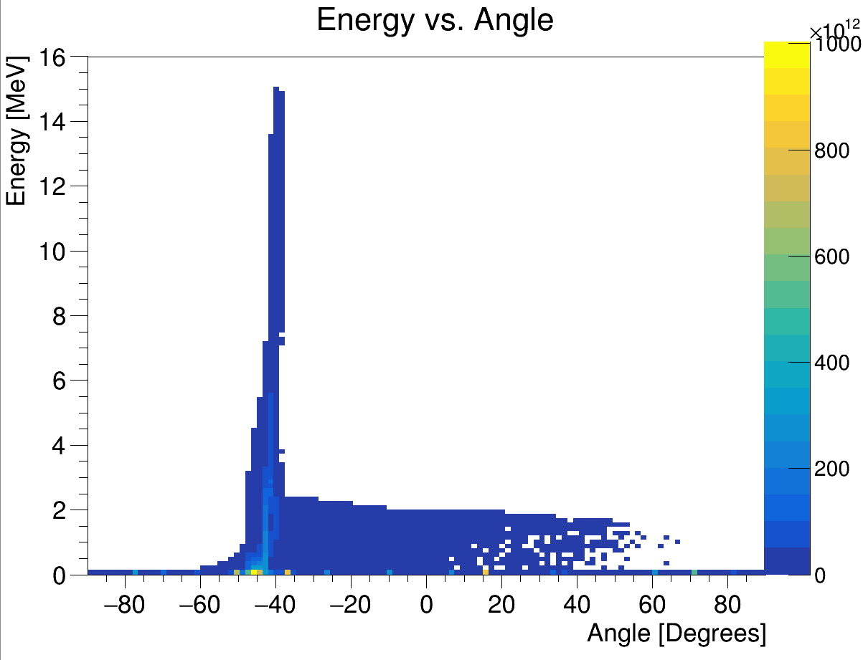
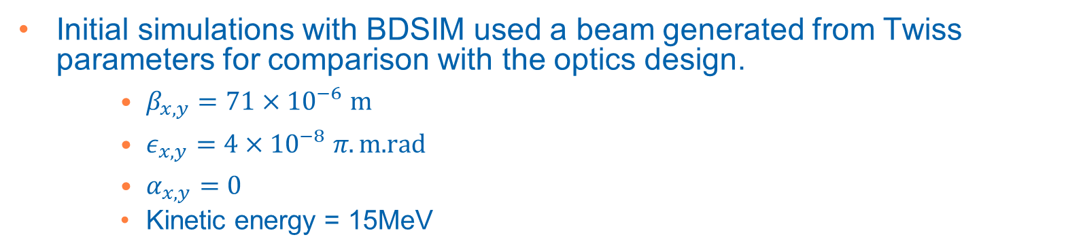
Initial Beam
Energy vs angle with respect to laser beam direction
Positive ions from hydrocarbon contamination on the target surface
LASER
+
+
+
+
+
+
+
+
+
+
-
-
-
-
-
-
-
-
Ion beam
Electron sheath generated by the laser accelerates positive ions from the target
Produces intense beams and multiple species, e.g. proton and carbon ions.
Laser driven ion beam simulation using EPOCH.
Initial simulations with BDSIM used a beam generated from Twiss parameters for comparison with the optics design.
$β_{x,y}=71×{10}^{−6} m$
$ε_{x,y}=4×{10}^{−8} π.\text{m}\text{.}\text{rad}$
$α_{x,y}=0$
Kinetic energy = 15MeV
Small beam size and large divergence.
Notes:
At the start we have a laser which is fired at a thin metal target at an angle of 45 deg. This then generates an ion beam from the surface of the target.
Using this method we can produce very intense beams but with a very large angular spread.
Simulations used a beam generated from the same parameters used in the optics design. Beta means small spot size and with this emittance that means you have a beam with a very large divergence.
Need a strong focusing element to prevent the beam being lost.

Slide 6
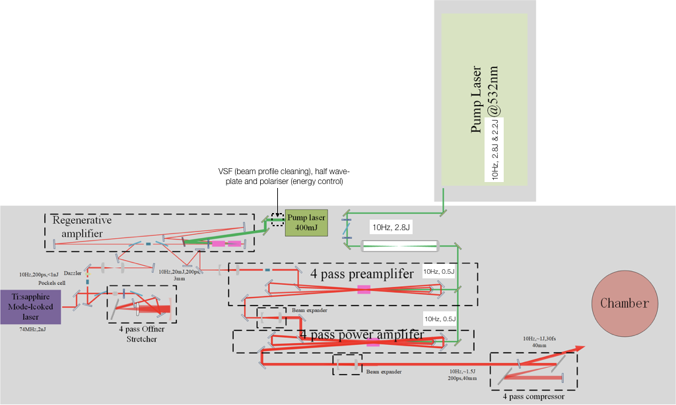
Laser at Imperial
Current operating parameters
100mJ, 38fs and 10Hz.
Aim to reach
1J, 30fs and 10Hz.
Schematic diagram of the laser.

Slide 7
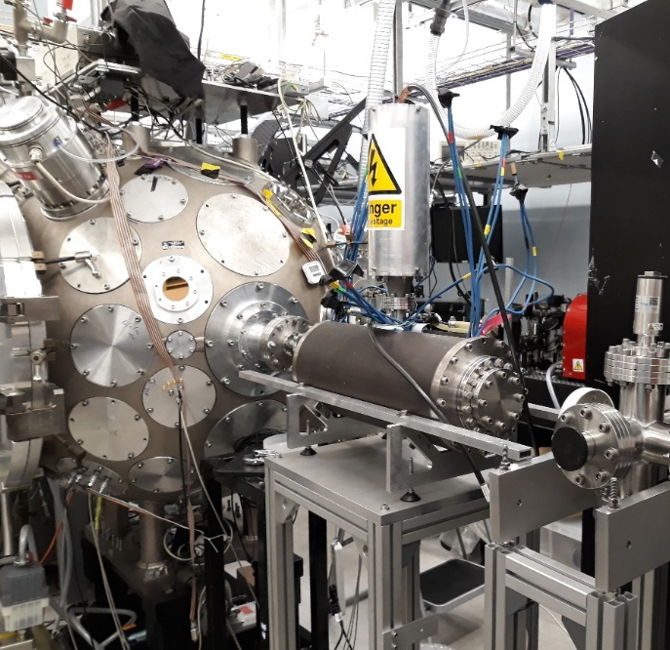
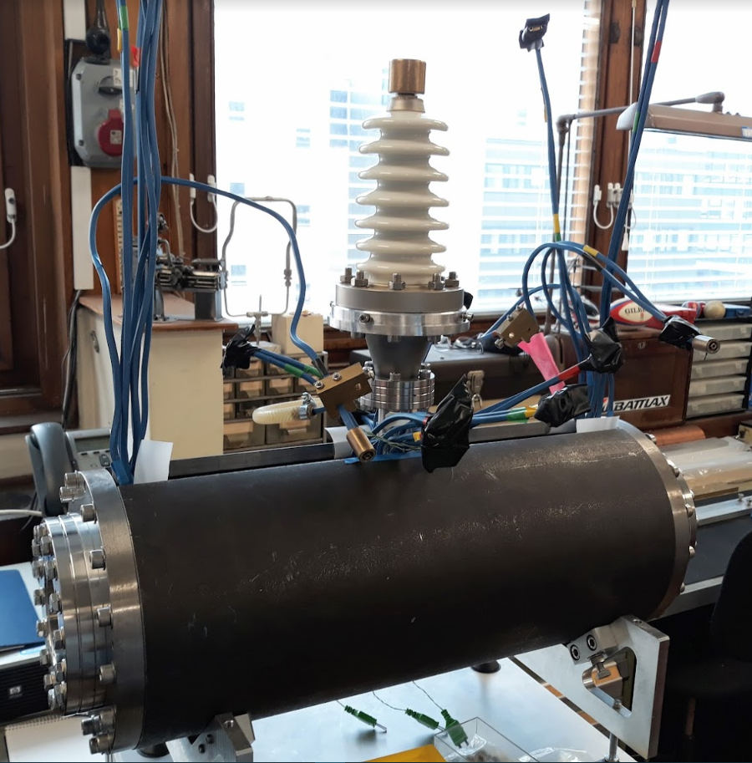
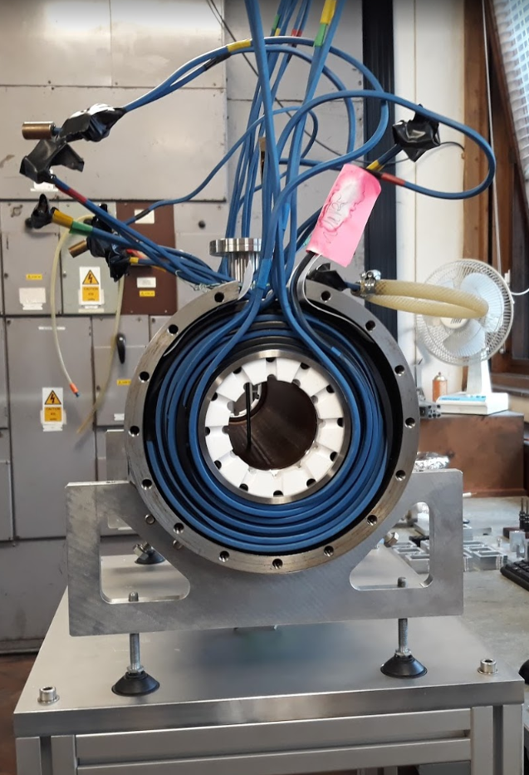
Capture
Solenoid coils
cylindrical
anode
laser target vessel
Grounded
end plate
       
       
Grounded
end plate
Ion beam
Electron cloud
       
       
Gabor lens
The Gabor lens uses a plasma to generate a strong electro-static focusing field.
Original prototype tested with a 1MeV proton beam at the Surrey Ion Beam Centre.
Upgraded Gabor lens has been recently assembled and will be tested at Imperial.
Vacuum tests.
Tests with a radioactive source.
Tests with the laser driven ion beam.
Original Gabor lens prototype was to be tested with the Cerberus laser at Imperial.
Upgraded Gabor lens being assembled 3/12/18
Notes:
What we plan to use to capture these particles is a a Gabor lens. This can provide a very strong focusing field in a short space by utilizing a confined electron plasma.
Schematic of the principle and a prototype at Imperial that we plan to test with a laser-ion beam.
To model in BDSIM
Lines from Jaroslaw’s beam optics code shows Beta_x and Beta_y (a measure of the beam envelope) are on top of each other. The points from BDSIM show the particle tracking simulations are well matched to the optics design.

Slide 8
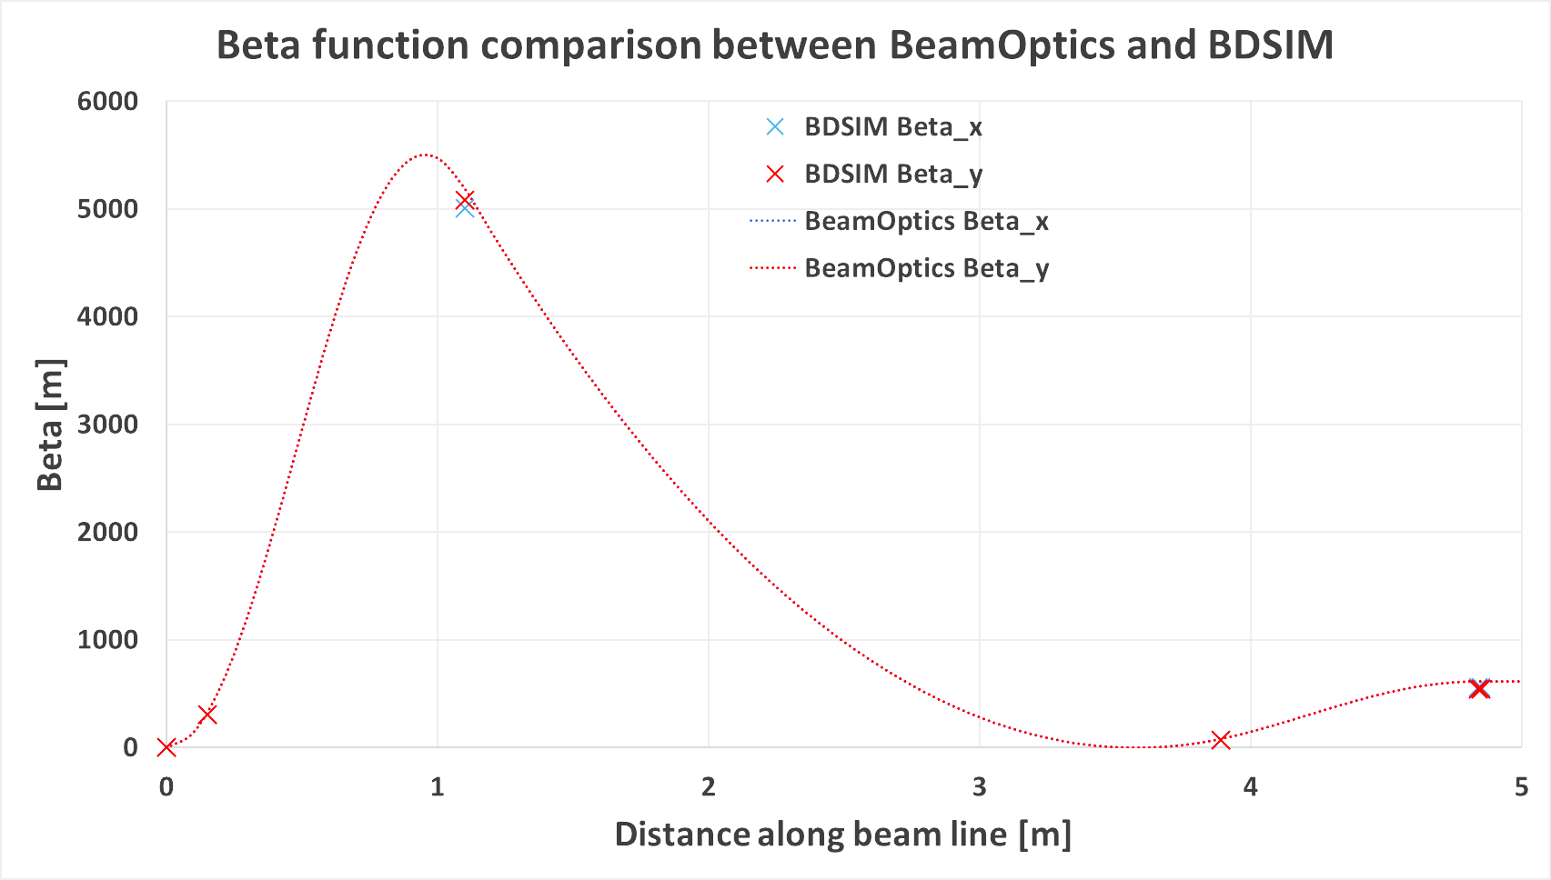
Capture
 | Equivalent Solenoid
Gabor lens 1 | 1.4T
Gabor lens 2 | 1.1T
Included in the BDSIM simulation as a solenoid of equivalent focusing strength.
Can use electro-static field map from a plasma simulation.
BDSIM developers may provide a Gabor lens element in the future.
Notes:
What we plan to use to capture these particles is a a Gabor lens. This can provide a very strong focusing field in a short space by utilizing a confined electron plasma.
Schematic of the principle and a prototype at Imperial that we plan to test with a laser-ion beam.
To model in BDSIM
Lines from Jaroslaw’s beam optics code shows Beta_x and Beta_y (a measure of the beam envelope) are on top of each other. The points from BDSIM show the particle tracking simulations are well matched to the optics design.

Slide 9
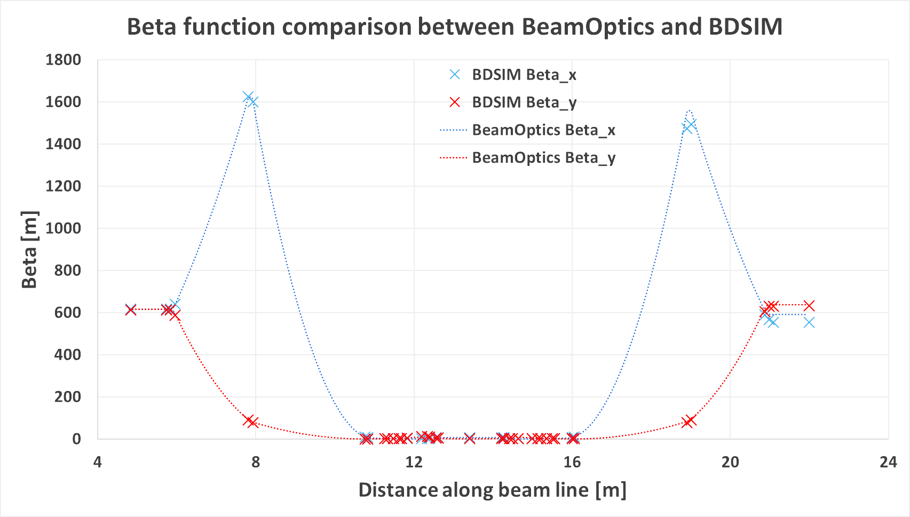
Beam Transport
Dipole bends and collimators for energy selection and vertical delivery of the beam to the end station.
Option for ion species selection using a Wien filter.
Particle tracking simulations with BDSIM based on optics design.
Notes:
The beam is then transported down beam line that contains dipoles and collimators for .. and vertical …
Here are the results of particle tracking

Slide 10
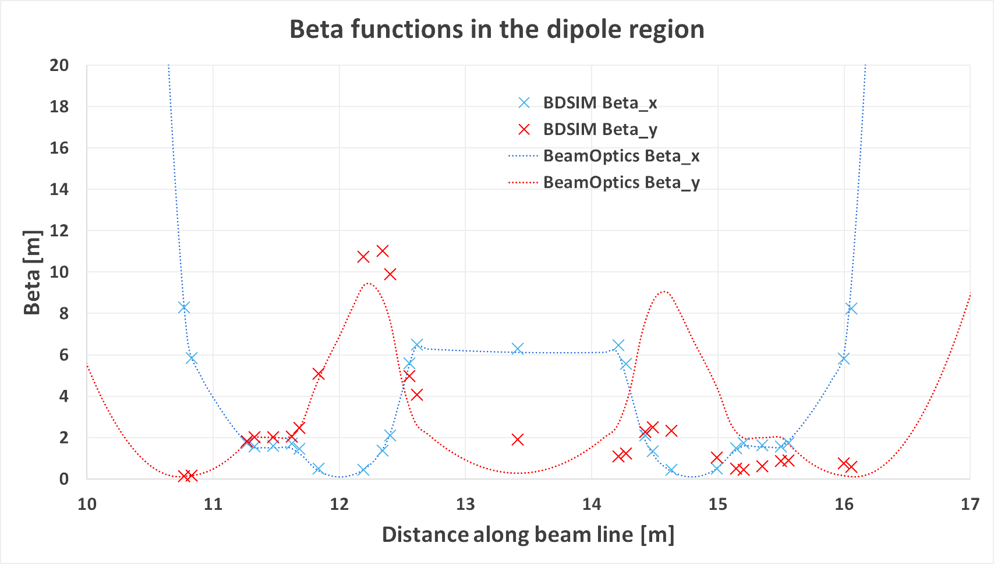
Transport
Optics in the bending region. Differences in Beta_y may be due to different treatments of edge focussing.

Slide 11
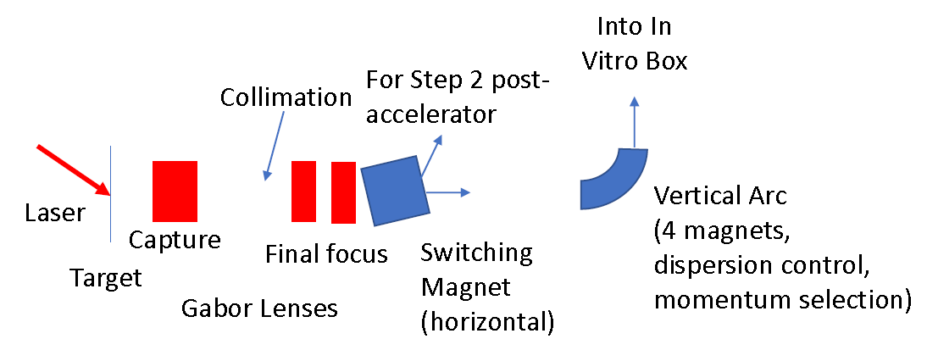
Alternative Beam line
More compact design in progress.
Capture and beam transport based on Gabor lenses.
Energy selection based on collimation.
Momentum selection in the arc.
Option to use normal conducting solenoids.
5m

Slide 12
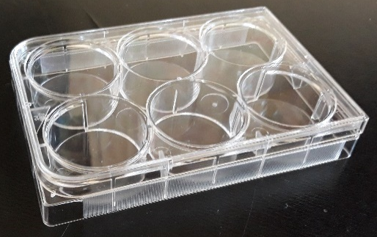
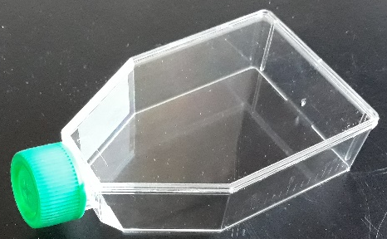
End Station
Material budget determines required beam energy.
More material increases cost of laser.
Consider cell sample containers.
Energy deposition and dose calculation very important for the design of the end station.
Want the Bragg peak in the cell layer.
Ensure efficient delivery of dose to the cells (i.e. minimize the time needed to irradiate a sample).
BDSIM provides energy loss along beam direction.
10 mm
15 mm cell nutrient
solution. G4_WATER
0.03 mm cell layer.
G4_SKIN_ICRP
1.15 mm sample
container base.
G4_POLYSTYRENE
5mm air gap.
G4_AIR
0.25 mm scintillating fibre layer. G4_POLYSTYRENE
0.075 mm vacuum window.
G4_MYLAR
beam
Notes:
The beam then arrives in the end station.
Important to minimize the amount of material in the beam line.
Vertical beam delivery cell sample containers filled with liquid and are open so prefer to be held horizontally.
Composition of the end station.

Slide 13
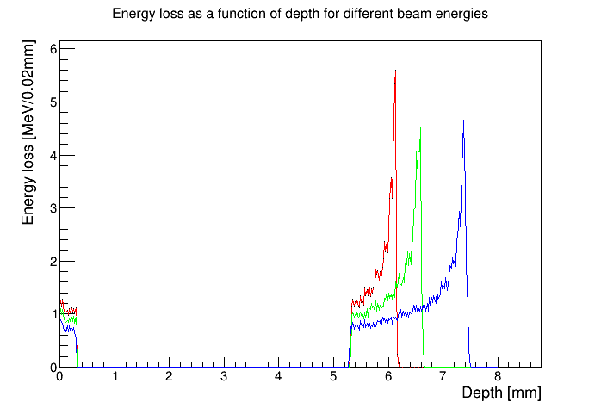
End Station
Energy loss in the end station using the beam tracked from after the capture section.
10 MeV
12 MeV
15 MeV
beam
0.075 mm vacuum window
0.25 mm scintillating fibre layer
5mm air gap
1.15 mm sample
container base
0.03 mm cell layer
15 mm cell nutrient
solution
Notes:
This plot shows the energy loss as a function of depth.
Explain we are at 15MeV and then say why.
Can look at having the cells before the Bragg peak and in the tail of the Bragg peak.

Slide 14
LARA – Stage II
Goal is to irradiate animal models.
Need post-acceleration to increase energy of the beam driven by the laser.
Current solution is based on an FFA.
Can achieve factor 3 increase in momentum or more.
For 15 MeV input can get 127MeV.
Would like to accelerate protons, helium, C⁶⁺ and other ions.
Development follows R&D for ISIS-II at RAL.
In vivo
end station

Slide 15
Summary and Future Plans
Initial design of the CCAP radiobiology facility has been simulated using BDSIM.
Particle tracking simulations compare well with the optics design.
Details of the materials in the end station has been simulated to verify the required beam energy and thus the requirements on the laser system.
Future plans.
Completion of the conceptual design report for LARA.
Study effect of beam variability using the beam from the laser simulation.
Collimation, beam dumps and shielding of the end station.
Gabor lens testing.
Investigate alternative beam line for energy and particle selection.
Design post-accelerator for LARA stage II.
Notes:
To summarise …

Slide 16
Acknowledgements
Imperial College London
Geoff Barber, Victoria Blackmore, Oliver Ettlinger, Chris Hunt, Hin Tung Lau, Ken Long, Jaroslaw Pasternak and Juergen Pozimski.
University of Birmingham summer students
Laura Murgatroyd and Rebecca Taylor.
Medical University of Vienna
Sylvia Gruber
Thanks to BDSIM developers Laurie Nevay and William Shields.
Notes:
Finally, I’d like to thank everyone who contributed to this work.

