Slide 1
BioPhysicsX
The future of convergent science

Slide 2
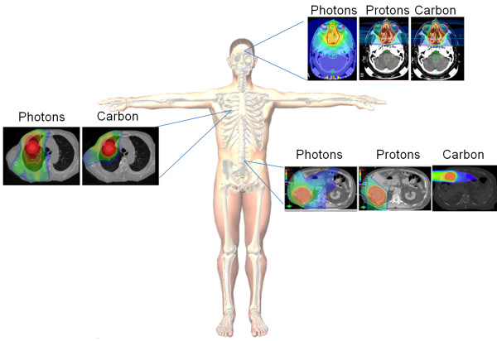
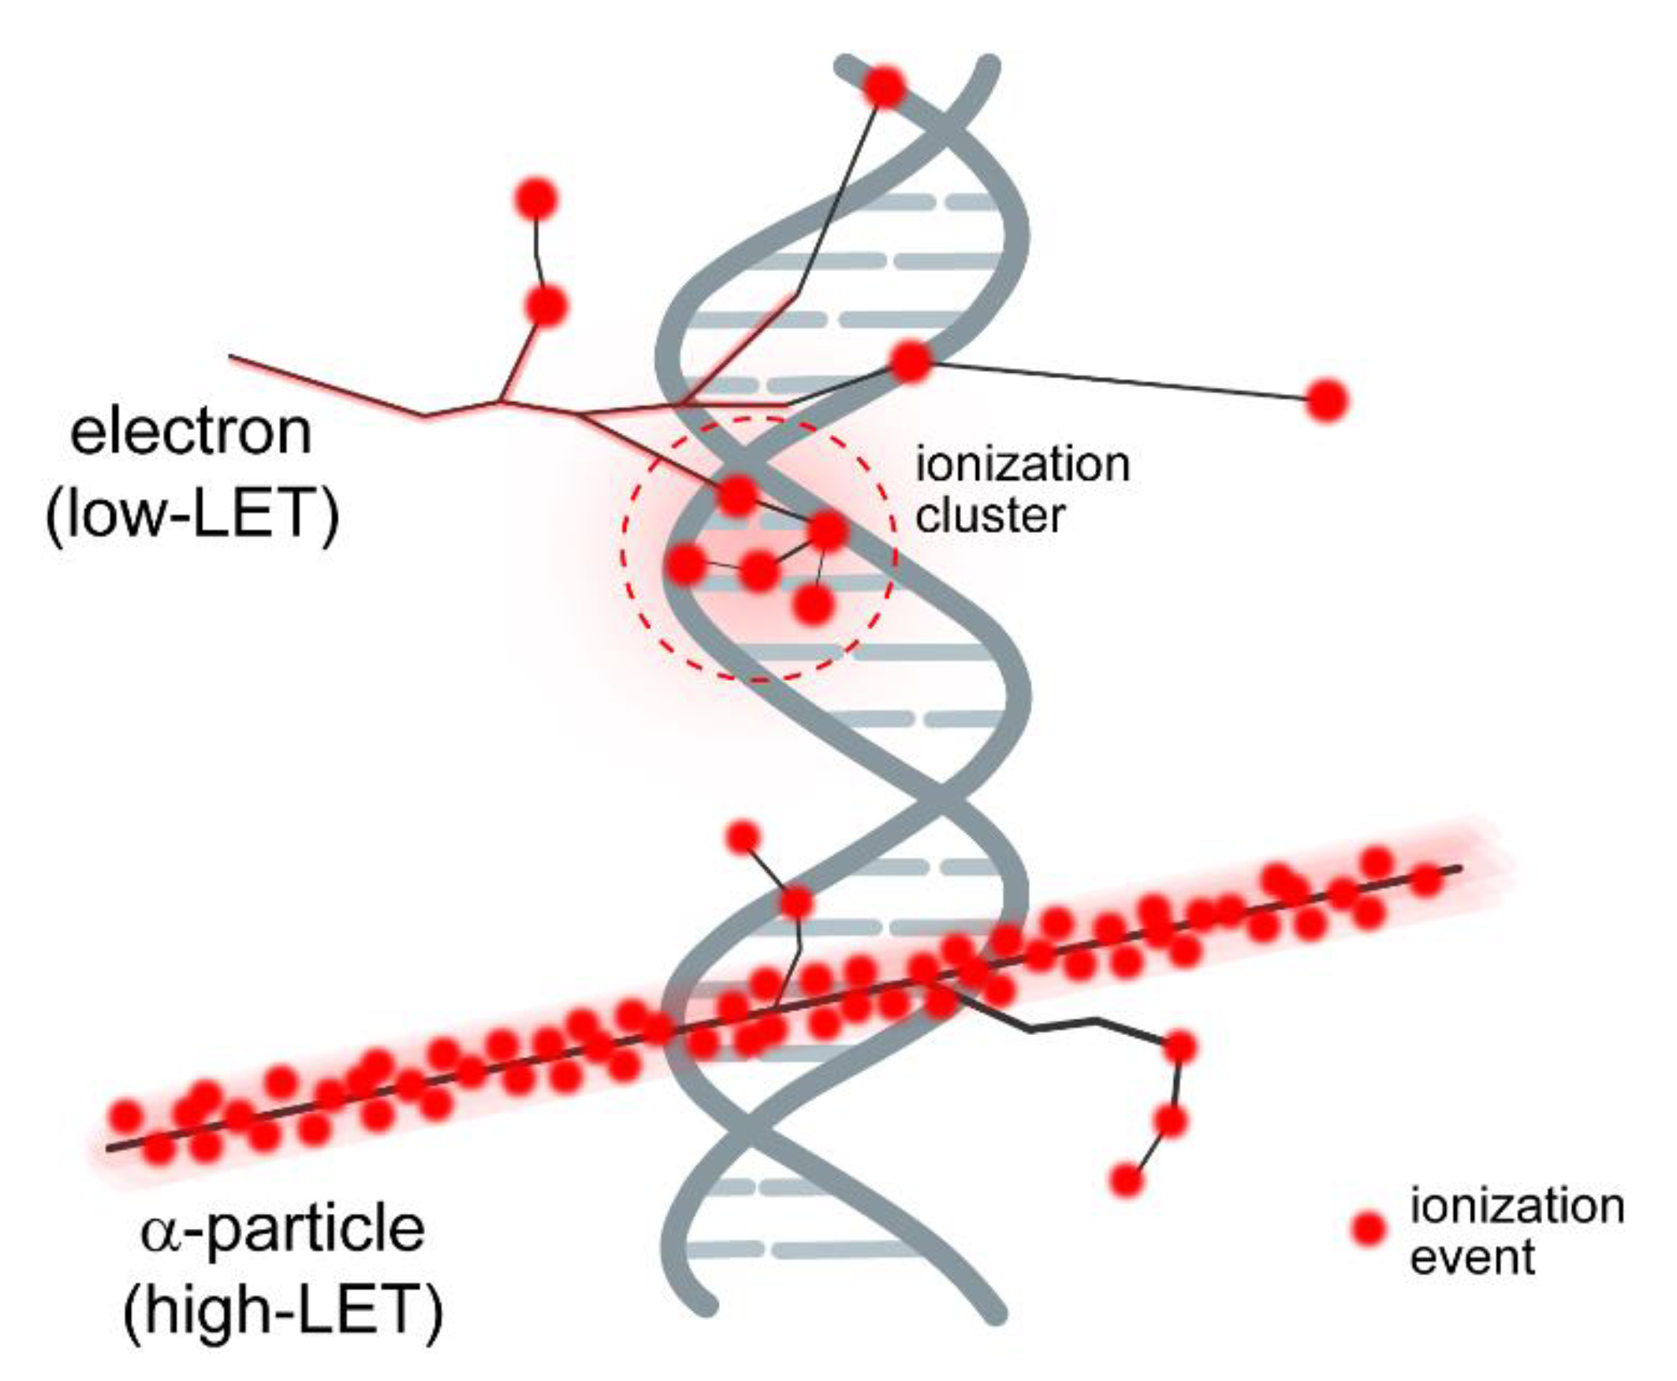
Beyond protons - a radical step change in radiotherapy science
Flexibility:
Energy, speed, ion type, time structure, spatial fractionation
Strong rationale for clinical benefit of proton and ion therapies, but evidence is limited
Superior Dose Distribution of Carbon Ions Compared to Protons and Photons
Carbon Ions Induce More Lethal Damage Per Unit Dose than Photons or Protons
For most tumors, carbon ion therapy results in improved tumour control and decreased toxicity in comparison to photons or protons.
In some intermediate- and high-risk cancers, the clinical data suggests a survival advantage for carbon ion.

Slide 3
Why BioPhysicsX
To develop better clinical systems and improved treatment outcomes for patients
To understand how DNA in living cells reacts to different beams and cancer treatment regimes
To develop skills and expertise
To attract and retain world-class researchers
To work with industry and entrepreneurs

Slide 4
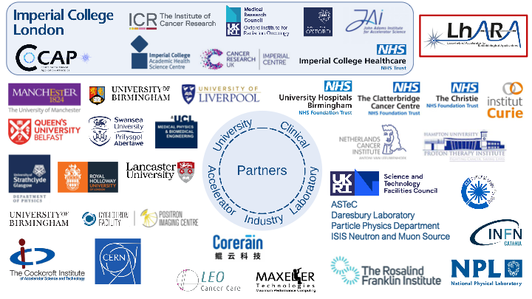
What is BioPhysicsX
A multidisciplinary institute – physics, radiobiology and clinical disciplines
Will be based at Imperial College’s White City campus
A partnership between Imperial College, Institute of Cancer Research and Oxford University
A collaboration of national and international institutes, expertise and entrepreneurs

Slide 5
Trusted experts and leaders in each discipline – excellence everywhere
Environment for ground-breaking research: physics, engineering, laser, biological clinical
Co-located fostering a co-operative setting and removing silos
Application driven, coordinated approach and jointly developed science programme
Industry partners
skills development and training
Novel research
Photo
???
Photo
LhARA end station consultation??
BioPhysicsX
Creating innovation

Slide 6
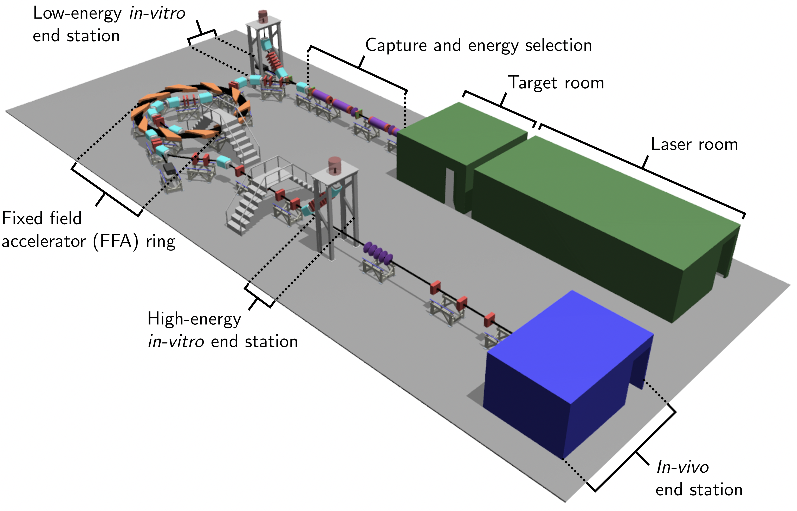
BioPhysicsX and LhARA
The Laser-hybrid Accelerator for Radiobiological Applications (LhARA) is at the heart of BioPhysicsX
The accelerator facility will deliver ion species at ultra-high dose rate in different spatial- temporal and spectral fractionation schemes
2-year funding for preliminary study is underway

Slide 7
BioPhysicsX: current research
Physics:
Energy-efficient accelerator using fixed field alternating gradient technique
Laser/plasma science:
Large flux of protons/ions in nano-second pulses with interactive feedback
Electron-plasma lens to capture and focus the beam
Combined, source and capture system evade today’s limitations on instantaneous dose rate
Computing:
High performance/throughput computing simulation of:
Source and capture, accelerator systems
Time-evolution of impact of ionizing radiation on tissue
Radiobiology:
Measurement of (e.g.):
Relative biological effectiveness of different ion species
Impact on tumour kill and normal-tissue sparing of various beam configurations (e.g. FLASH, MBRT)
Impact in the clinical treatment:
With industrial partner working towards co-creation of automatic patient positioning system
Notes:
Ion acoustic system WP in LhARA led by Jeff Bamber

Slide 8
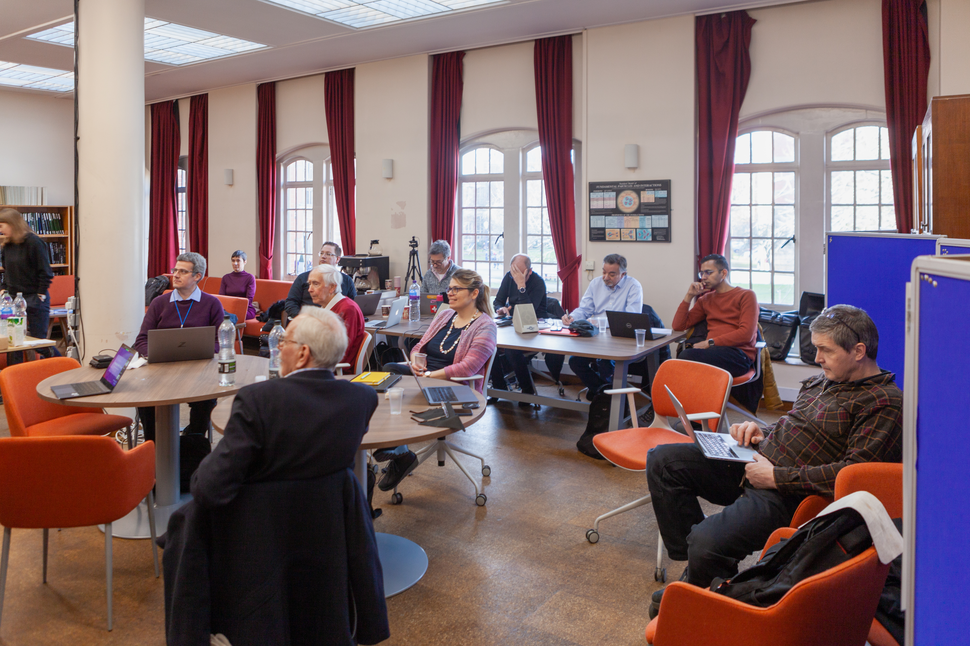
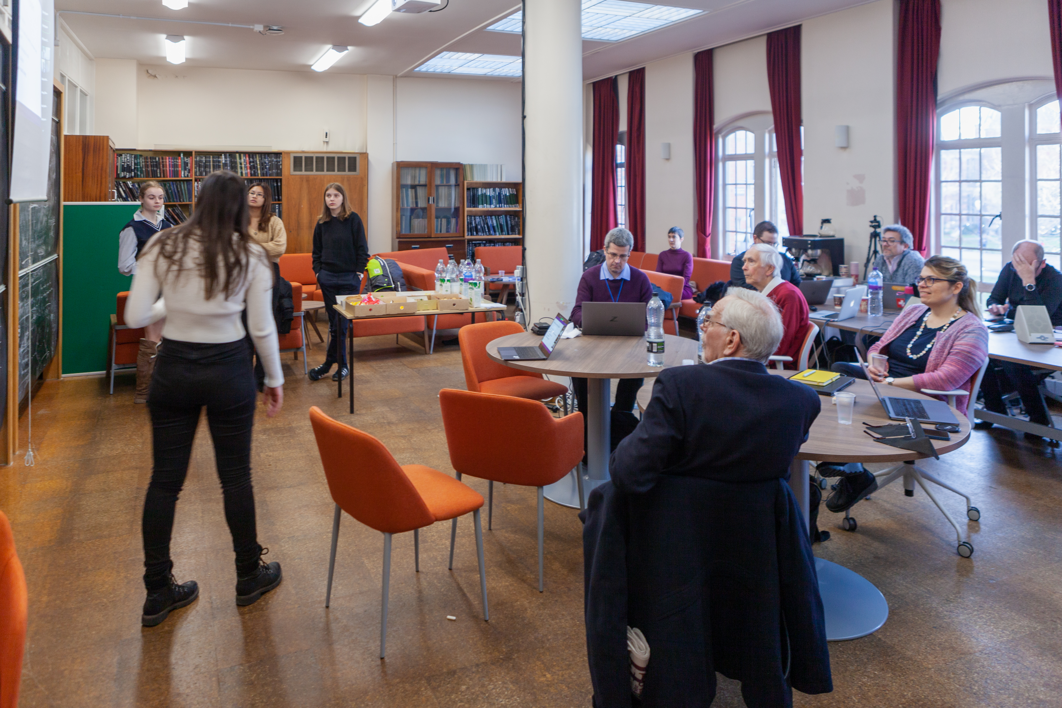
Maria (f/g), Josie, Vania, and Anthea presenting the ion acoustic work.

Slide 9
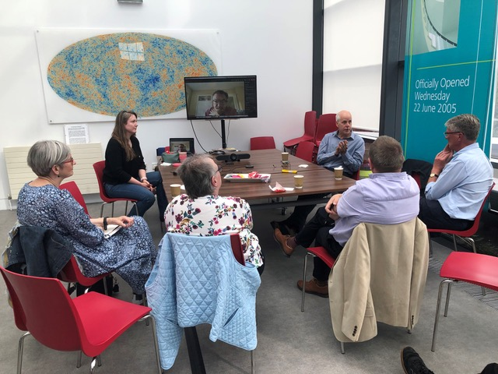

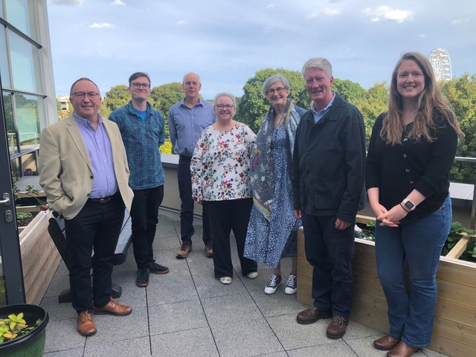
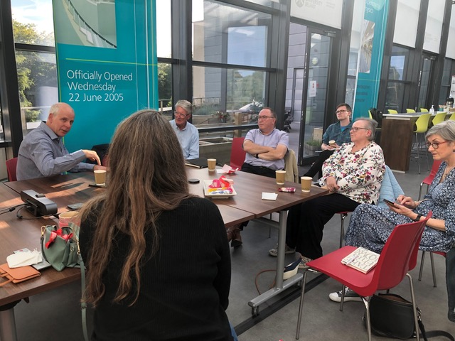
Northern Irland Cancer Research
Consumer Forum Members

