Slide 1

LhARA the Laser-hybrid Accelerator for Radiobiological Applications

Slide 2
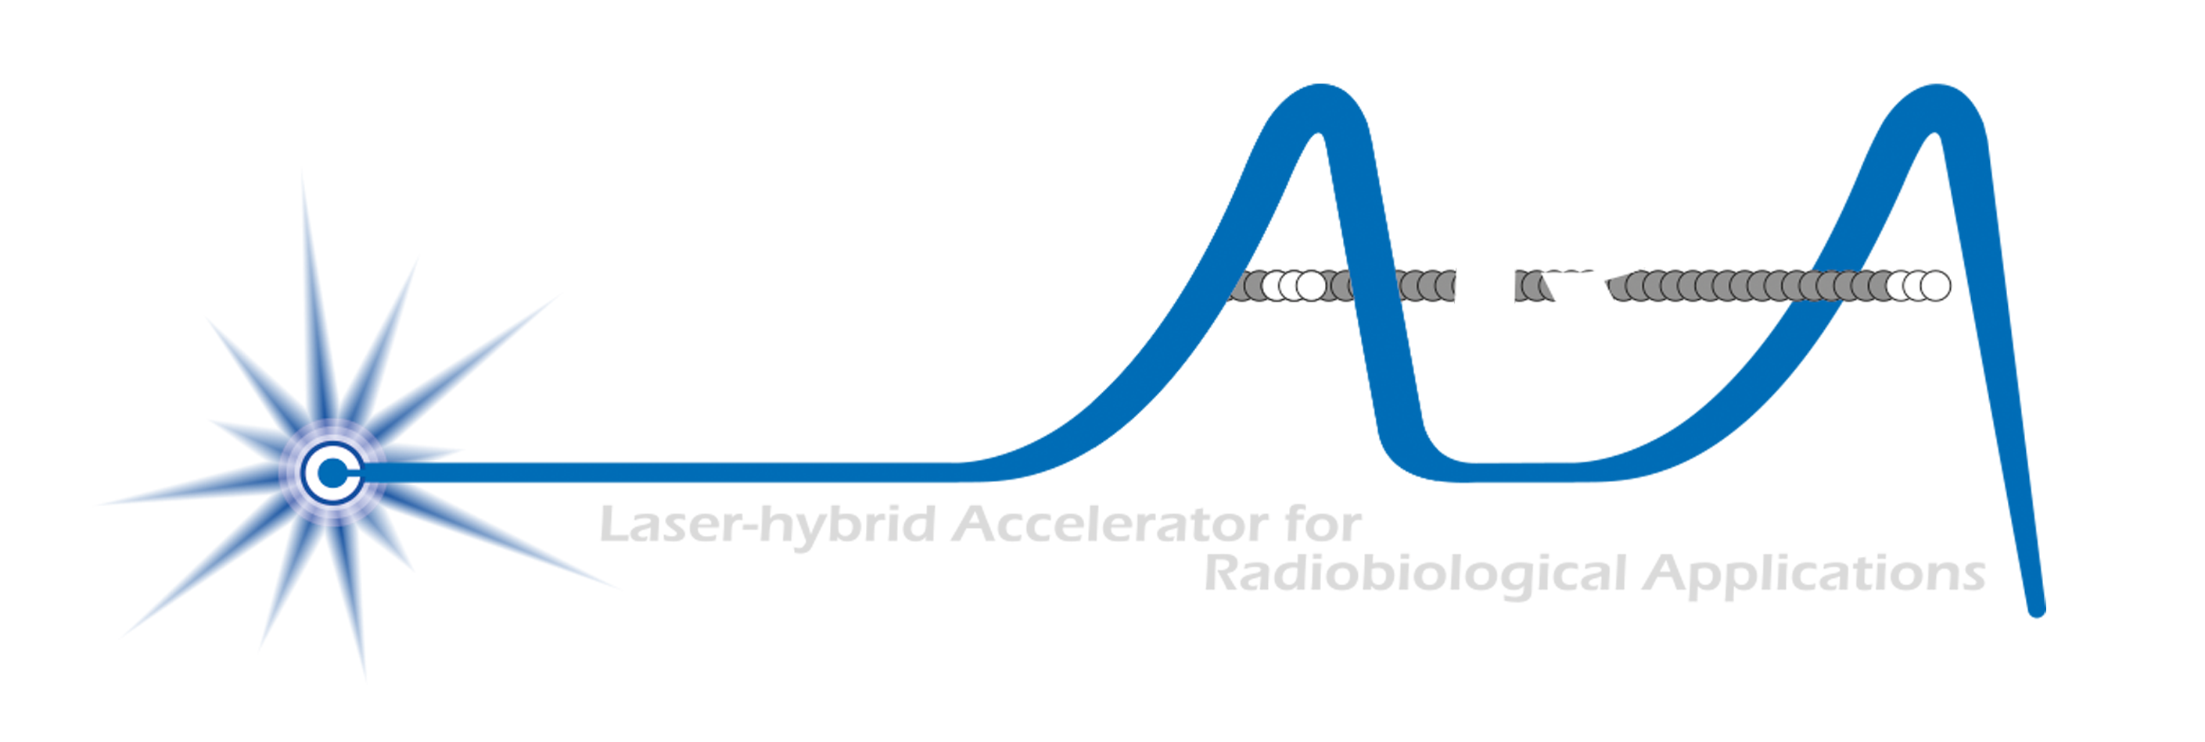



Our ambition is to:
Deliver a systematic and definitive radiation biology programme
Prove the feasibility of laser-driven hybrid acceleration
Lay the technological foundations for the transformation of PBT
automated, patient-specific proton and ion beam therapy

Slide 3
Radiotherapy; the challenge
Cancer: second most common cause of death globally
Radiotherapy indicated in half of all cancer patients
Significant growth in global demand anticipated:
14.1 million new cases in 2012 ⇢ 24.6 million by 2030
8.2 million cancer deaths in 2012 ⇢ 13.0 million by 2030
Scale-up in provision essential:
Projections above based on reported cases (i.e. high-income countries)
Opportunity: save 26.9 million lives in low/middle income countries by 2035
Provision on this scale requires:
Development of new and novel techniques … integrated in a
Cost-effective system to allow a distributed network of RT facilities
Atun, Lancet Oncol. 2015 Sep;16(10):1153-86

Slide 4
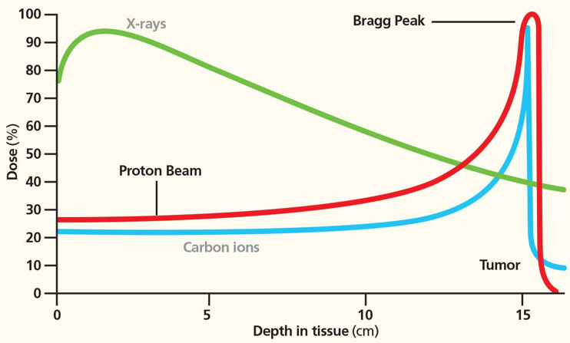
Particle-beam therapy
Proton and ion-beam therapy:
Bulk of dose deposited in Bragg peak
Significant normal-tissue sparing (entry)
Almost no dose beyond the Bragg peak

Slide 5
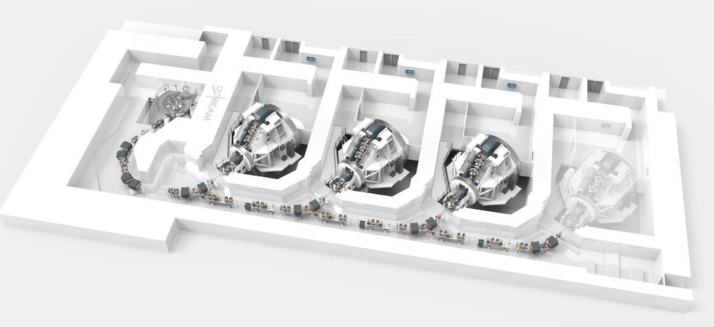
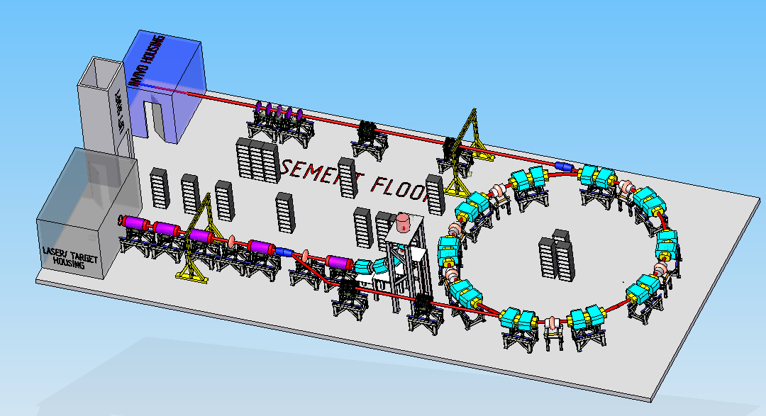
Particle beam therapy today
Cyclotron based:
Limitations:
Energy modulation
Instantaneous dose rate
Synchrotron based:
Limitiations:
Complexity
Instantaneous dose rate
⇒ reduce footprint, cost and complexity
‘PBT for the many’!
Christie Hospital Manchester
⇒ increase flexibility
optimize treatments
MedAustron Austria

Slide 6
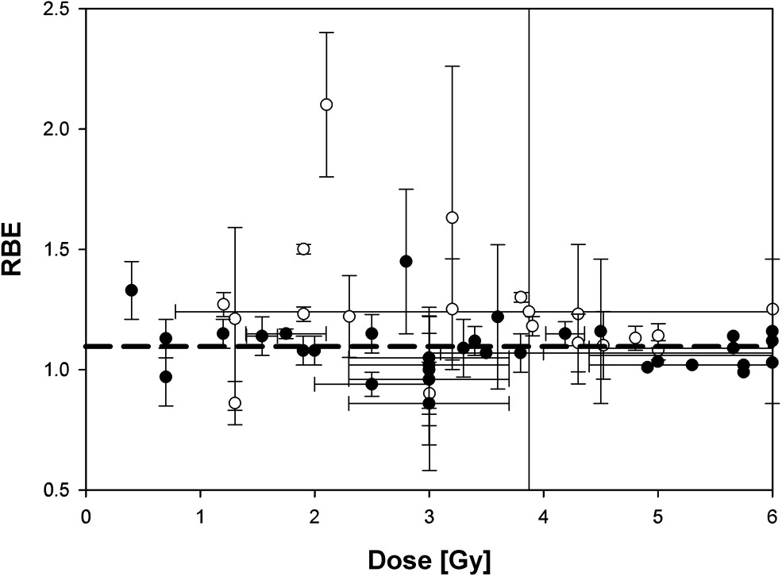
The case for fundamental radiobiology
Relative biological effectiveness:
Defined relative to reference X-ray beam
Known to depend on:
Energy, ion species
Dose & dose rate
Tissue type
Biological endpoint
Yet:
p-treatment planning uses 1.1
Effective values are used for C⁶⁺
Maximise the efficacy of PBT now & in the future:
Require systematic programme to develop full understanding of radiobiology
Paganetti, van Luijk (2013)
SemRadOncol

Slide 7
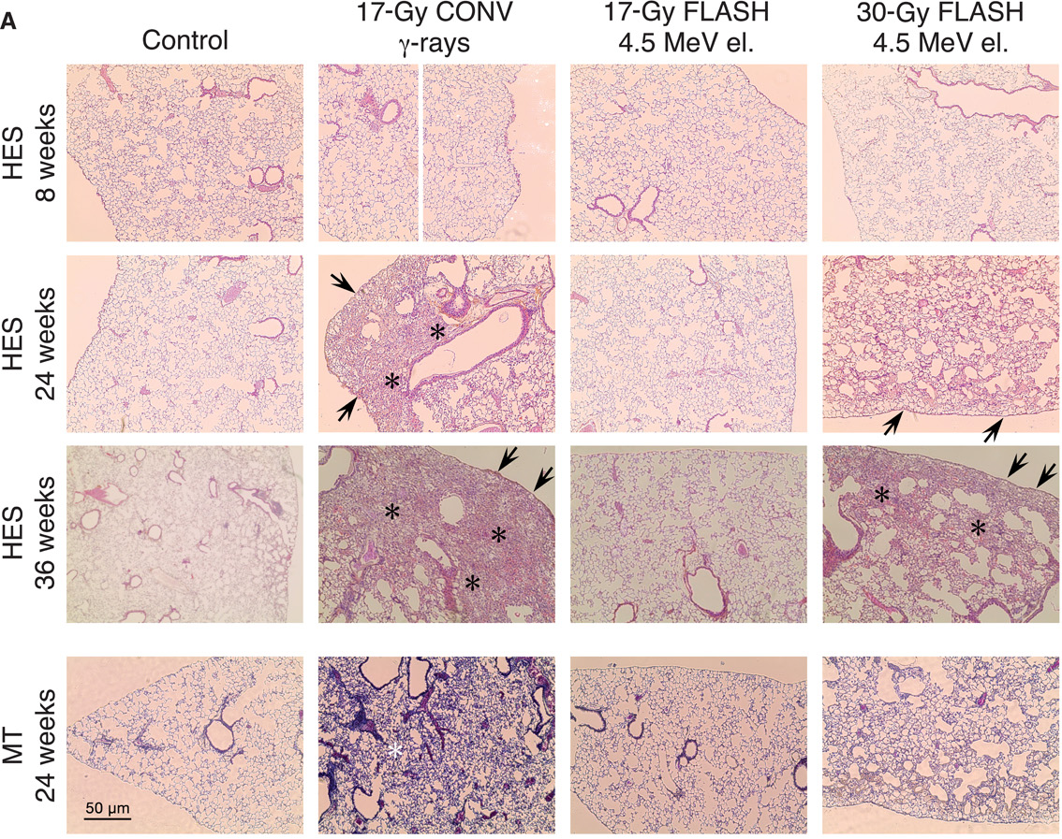
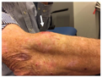
Radiobiology in new regimens
Worked example: FLASH
Conventional regime : ~2 Gy/min
FLASH regime : >40 Gy/s
Evidence of normal-tissue sparing while tumour-kill probability is maintained:
i.e. enhanced therapeutic window
Time line:
Initial reports: 2014 (e.g. Flauvadon et al, STM Jul 2014)
Confirmation in mini-pig & cat: 2018 (Clin. Cancer Research 2018)
First treatment 2019 (Bourhis et al, Rad.Onc. Oct 2019)

Slide 8
Radiobiology in new regimens
Worked example: micro beams
Conventional regime : > 1 cm diameter; homogeous
Microbeam regime : < 1 mm diameter; no dose between ‘doselets’
Remarkable increase of normal rat brain resistance.
[E.g. Dilmanian et al. 2006, Prezado et al., Rad. Research 2015]
Dose escalation in the tumour possible – larger tumor control prob.
Prezado et al

Slide 9
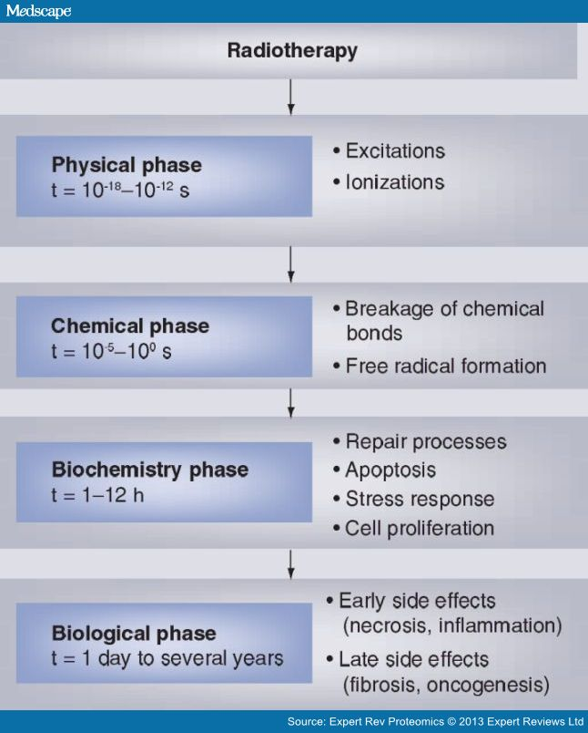
Radiobiology in new regimens
Time
domain
Space
domain
The ideally flexible beam facility can deliver it all!
⇒ substantial opportunity for a step-change in understanding!
Ion
species
Energy
Multidisciplinary approach essential
In combination and with chemo/immuno Therapies

Slide 11
LhARA initiative organogram

Slide 12
Laser-hybrid Accelerator for Radiobiological Applications
A novel, hybrid, approach:
Laser-driven, high-flux proton/ion source
Overcome instantaneous dose-rate limitation
Capture at >10 MeV
Delivers protons or ions in very short pulses
Bunches as short as 10—40 ns
Triggerable; arbitrary pulse structure
Novel “electron-plasma-lens” capture & focusing
Strong focusing (short focal length) without the use of high-field solenoid
Fast, flexible, fixed-field post acceleration
Variable energy
Protons: 15—127 MeV
Ions: 5—34 MeV/u
Front. Phys., 29 September 2020; DOI: 10.3389/fphy.2020.567738

Slide 13
LhARA to serve ITRF Preliminary Activity
Preliminary Activity: £2M over 2 years
project start October 2022

Slide 14
N. Bliss (DL)
N. Bliss et al
Front. Phys., 29 September 2020; DOI: 10.3389/fphy.2020.567738
Draft
⇒ compact, uniquely flexible facility

Slide 15

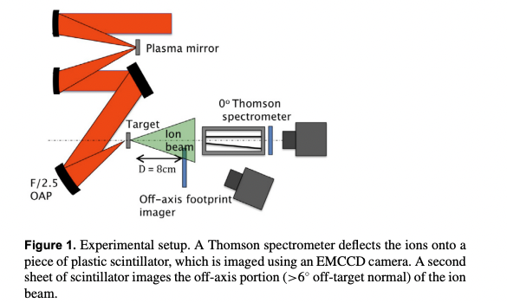
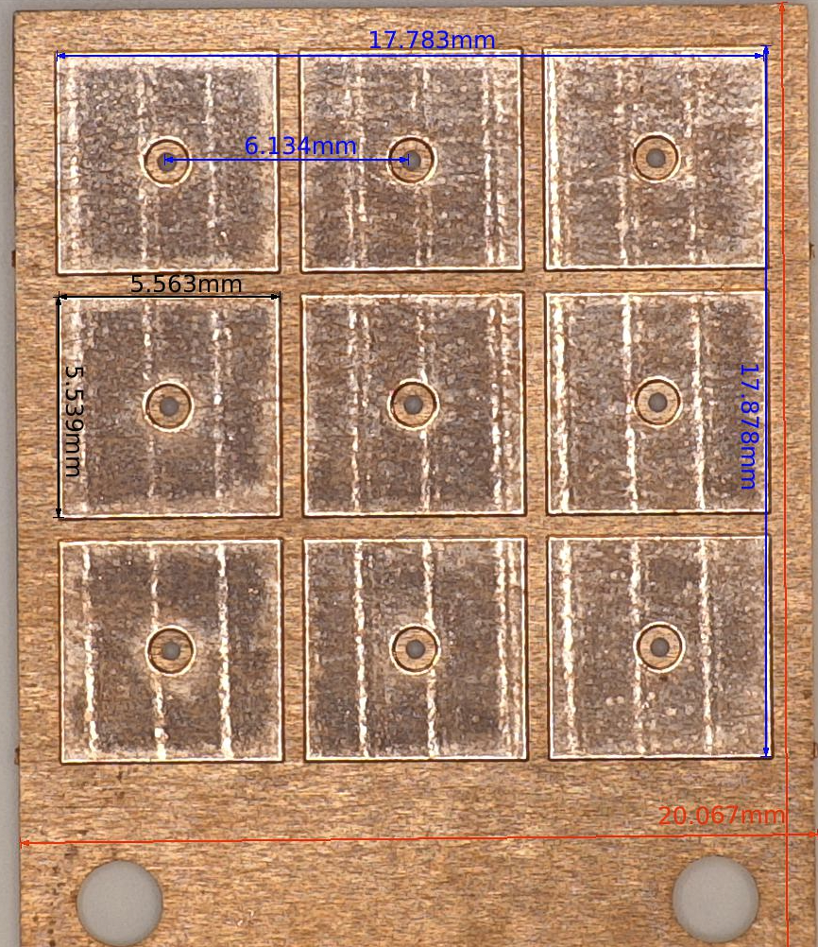
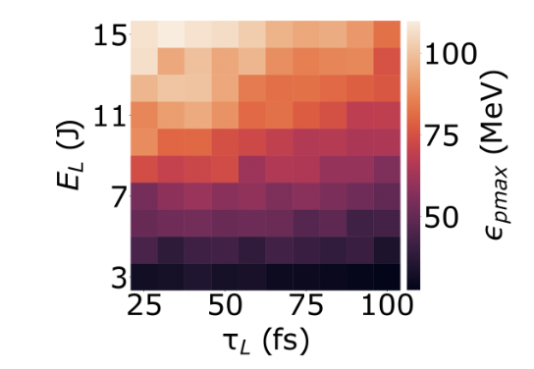
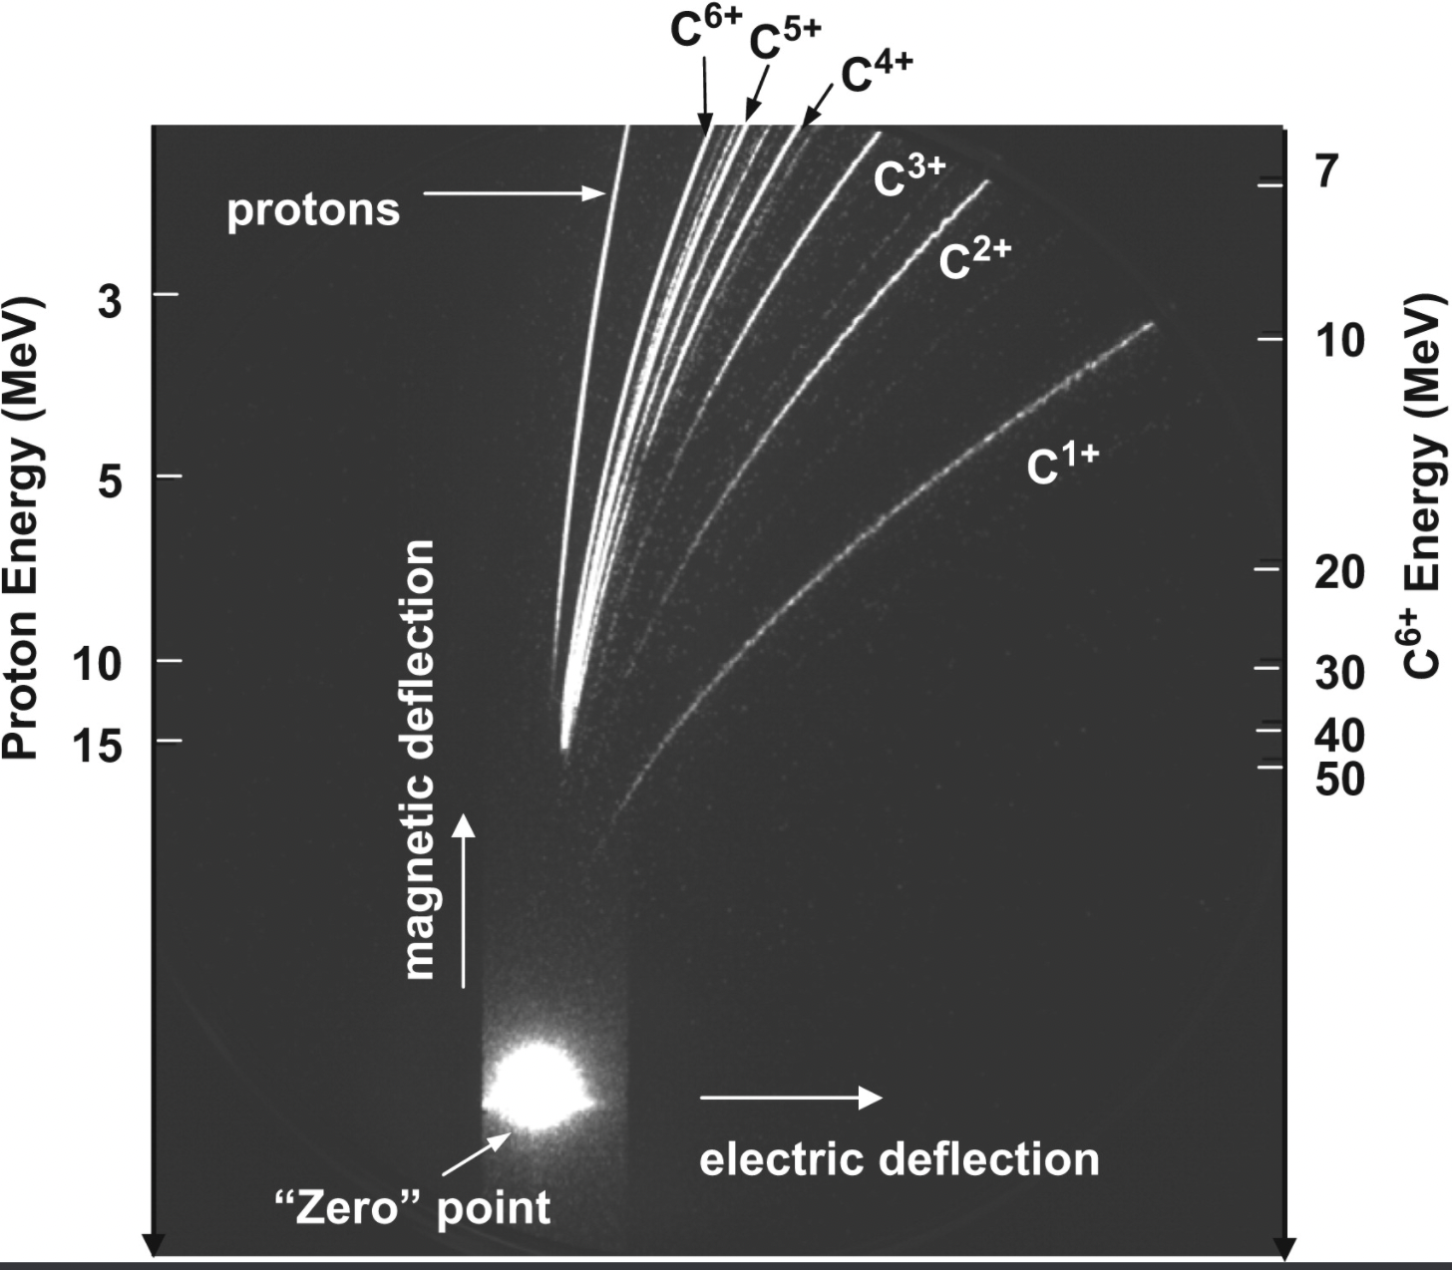
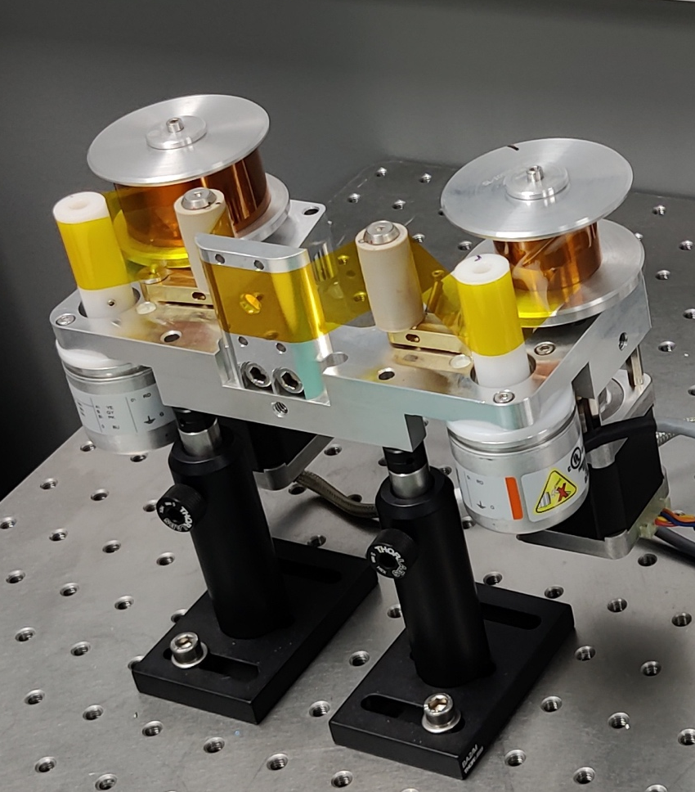
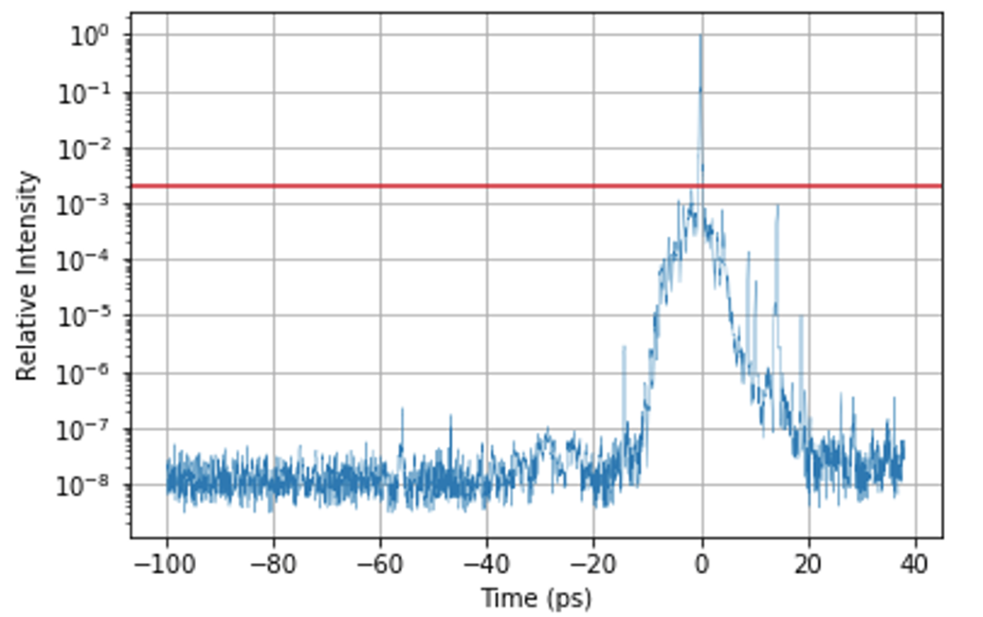
2-year Programme: Characterising Source and Benchmarking Simulations
Established Diagnostics…
Established Targetry…moving toward Hz-level targetry
….to build a systematic parameter space map of the source performance
Energy, Flux, Divergence across multiple ion species
Typical 9-target array
J.S Green et al., NJP. 12 (2010) 085012
..but also need to consider some other experimental contributions like temporal contrast
R. Prasad et al., Nucl. Instrum. Methods. 623.2 (2010): 712-715.
Tape targetry system (online in SCAPA 2022)
E. Boella, N. Dover, R. Gray et al

Slide 16
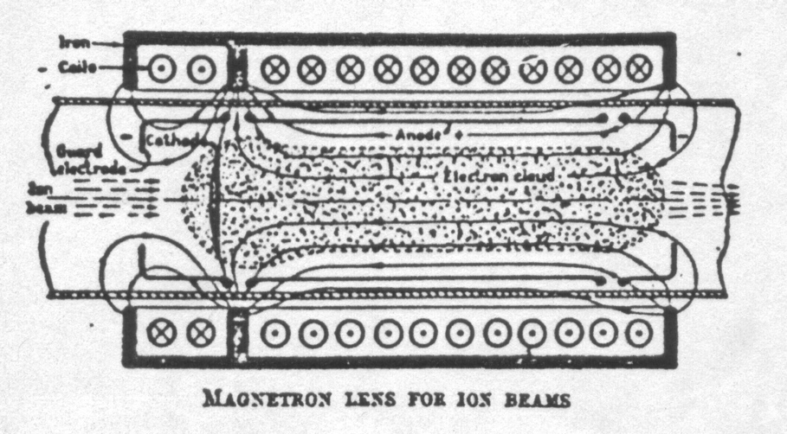
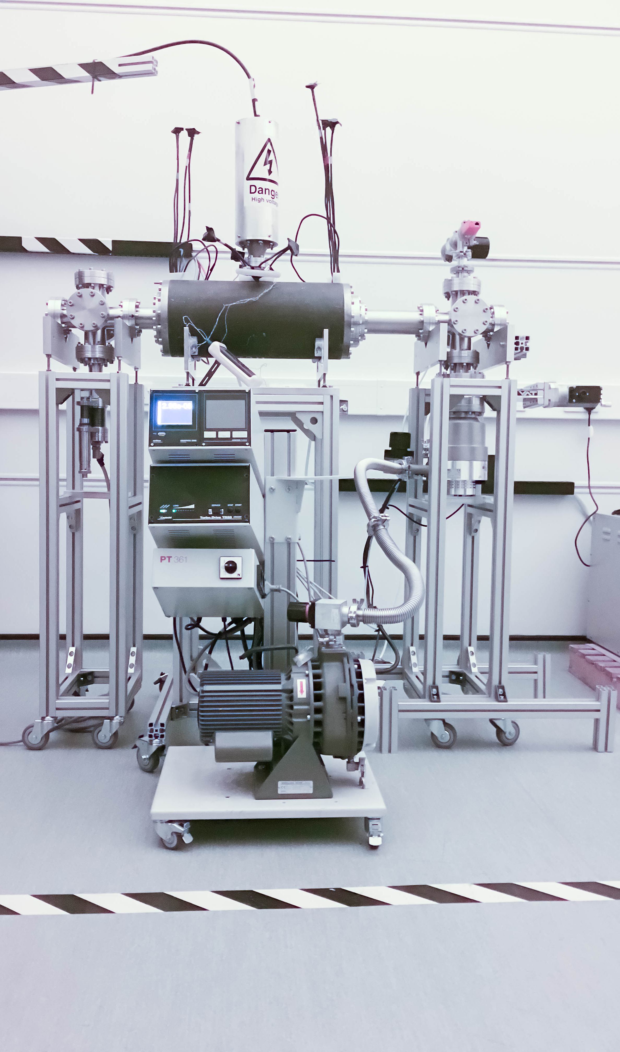

LhARA Capture
“Electron-plasma” (Gabor) lens:
Strong focusing exploiting electron gas in “Penning/Malmberg” trap
Gabor
1957
Front. Phys., 29 September 2020; DOI: 10.3389/fphy.2020.567738

Slide 17
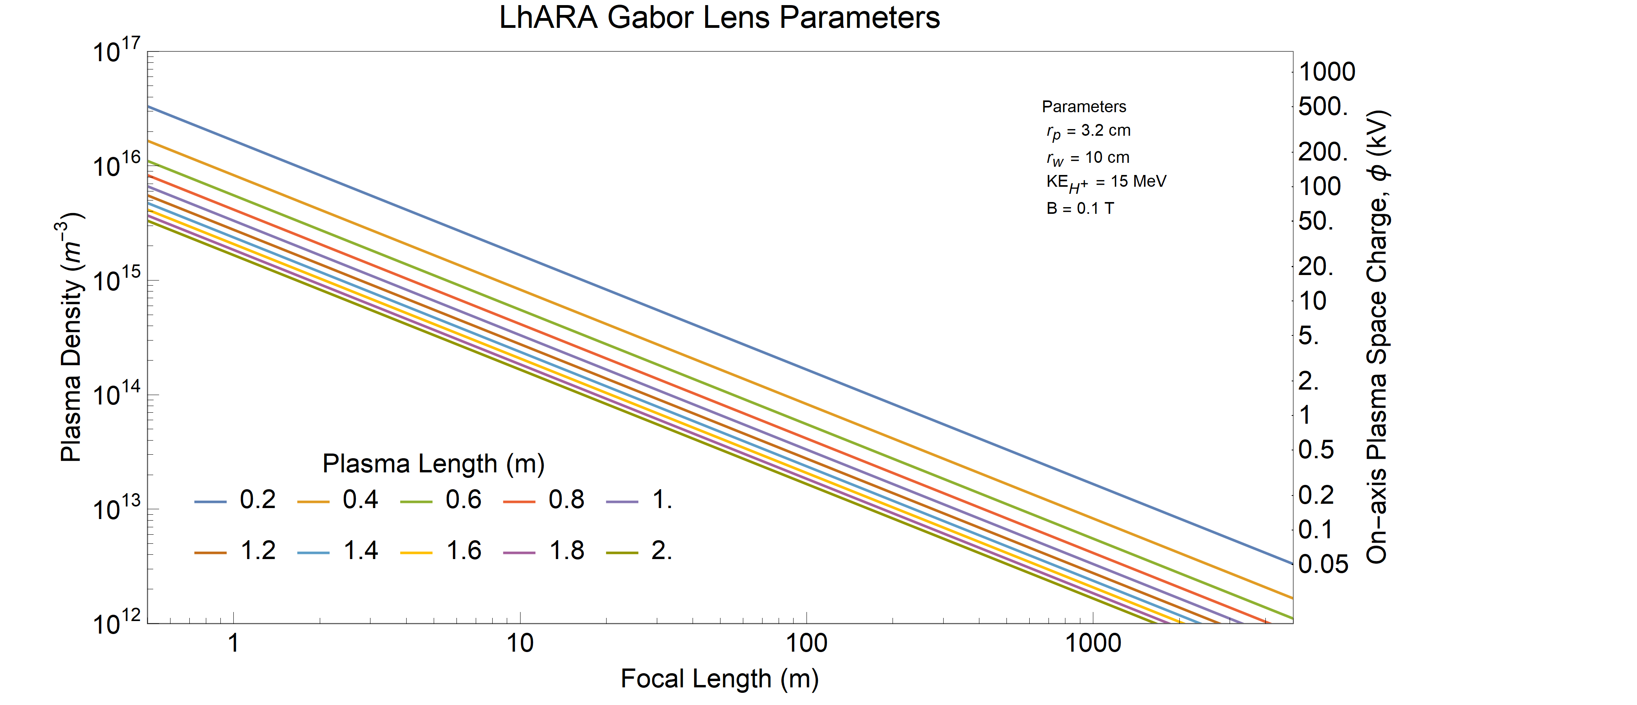
Year 5 milestone
Subsequent 3-year Programme: develop plasma parameters required for LhARA
Current
Year 2
Year 5
Final
C. Baker, W. Bertsche et al
Notes:
End of 5th year milestone is to have studied plasma that have focal lengths of a few metres, comparable to many of the lens elements.
Know which 1-2 parameters need to be improved by x2 to reach final ~1m focal length lens. This is opposed to the decades improvement of many parameters needed to reach here.

Slide 18
N. Bliss, for LhARA WP6;
ITRF 6-month progress review, 21Mar23

Slide 19
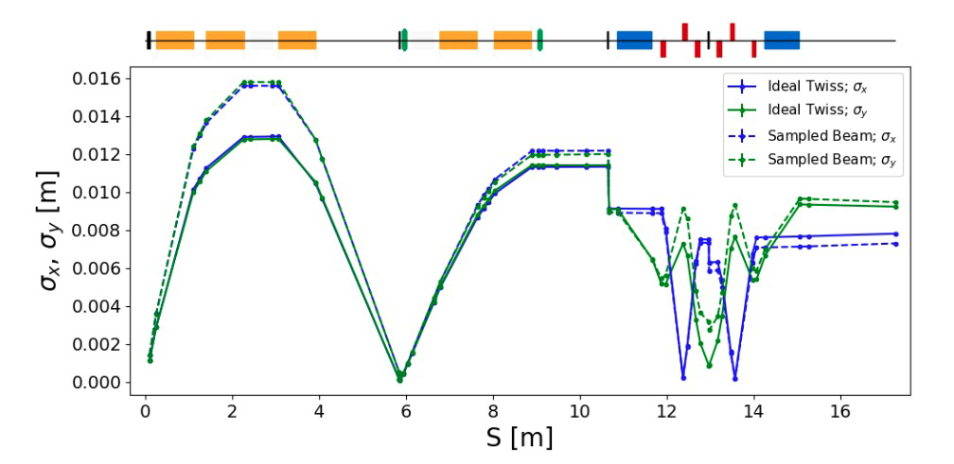
Beam envelopes Stage 1
J. Pasternak, W. Shields et al
HT Lau, IPAC 2021, WEPAB139
Propagation of “semi-realistic” source distribution:
Generated using SMILEI
Optimisation studies on going

Slide 20
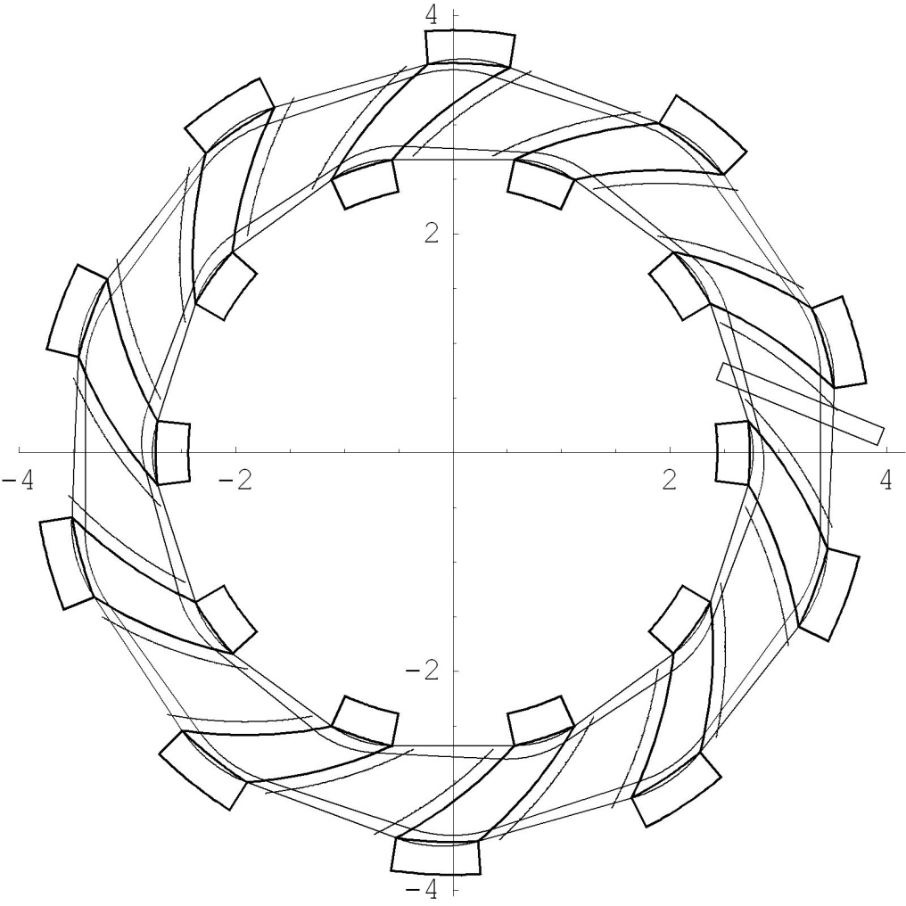
Rapid, flexible acceleration for stage 2
J. Pasternak, W. Shields et al
Dimensions in m
Fixed-field alternating-gradient accelerator (FFA):
Compact, flexible solution:
Multiple ion species
Variable energy extraction
High repetition rate (rapid acceleration)
Large acceptance
Successfully demonstrated:
Proof of principle at KEK
Machines at KURNS
Non-scaling PofP EMMA (DL)
LhARA FFA
10 cells
2 MA loaded RF cavities
η
β_{v}
β_{h}

Slide 21
Opportunity; through IRC deliver our vision to:
Deliver a systematic and definitive radiation biology programme
Prove the feasibility of laser-driven hybrid acceleration
Lay the technological foundations for the transformation of PBT
automated, patient-specific proton and ion beam therapy

